Slide 1
California House Price Prediction
Authors: Ashritha Eswaran, Ishita Malhotra, Jie Sing Yoo

Slide 2
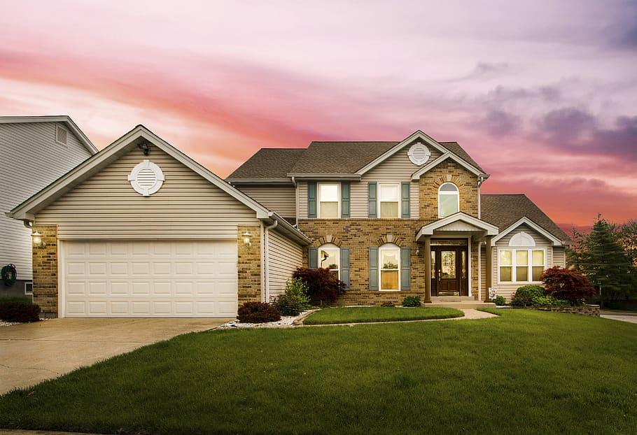
Agenda
Problem Statement
Data Overview
Data Processing & Curation
EDA
Models
Prediction Models
Key Takeaways

Slide 3



Problem Statement
Given skyrocketing house values in California, how can we provide meaningful recommendations to people looking for housing in California?
Predict house values using various regression models
Feature Selection
Hyperparameter Tuning

Slide 4
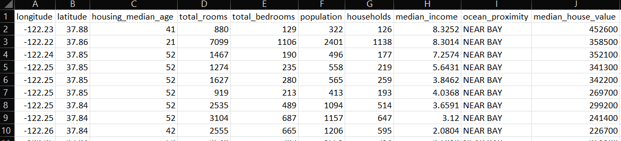
Data Overview
Target Variable
This column contains null values!
Categorical Variable: 5 groups

Slide 5

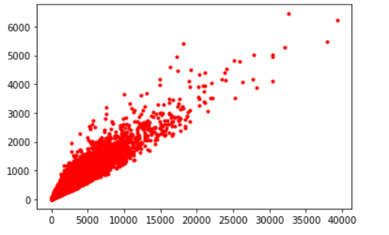
Data Processing & Curation
Our data processing involved looking at different data types, the missing values in total_bedrooms, and data distribution.
Utilized label encoding for our ocean_proximity categorical variable
Scaled our data using StandardScaler()
Missing Values Handling
Linear Relationship between Rooms (x-axis) and Total_Bedrooms (y-axis)

Slide 6

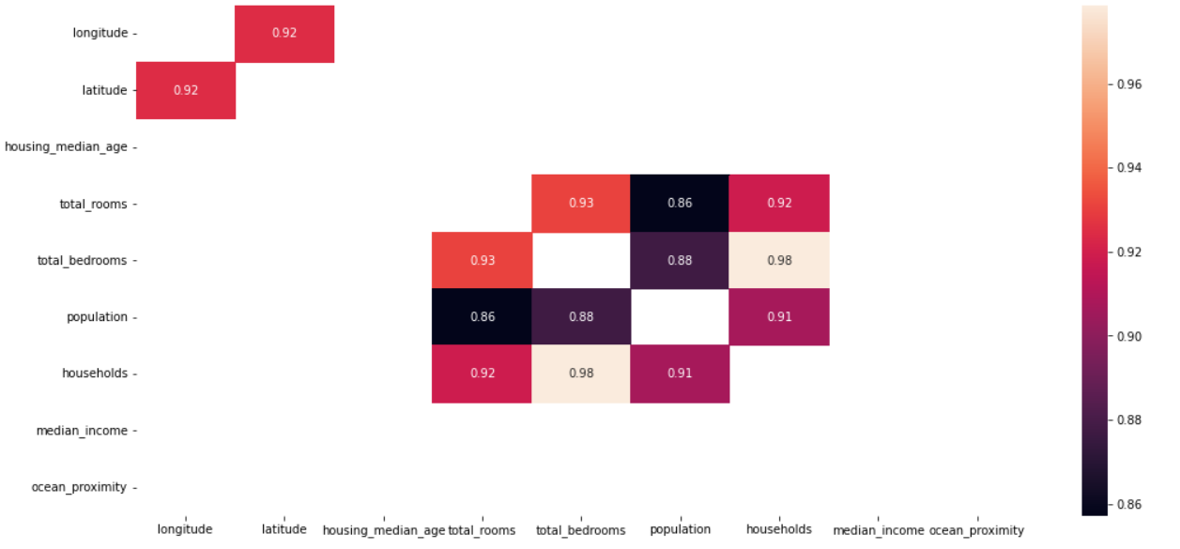
Exploratory Data Analysis
Our EDA involved understanding the data and how features were correlated with each other and the target variable. It also involved doing necessary transformations of existing variables to make new features.

Slide 7
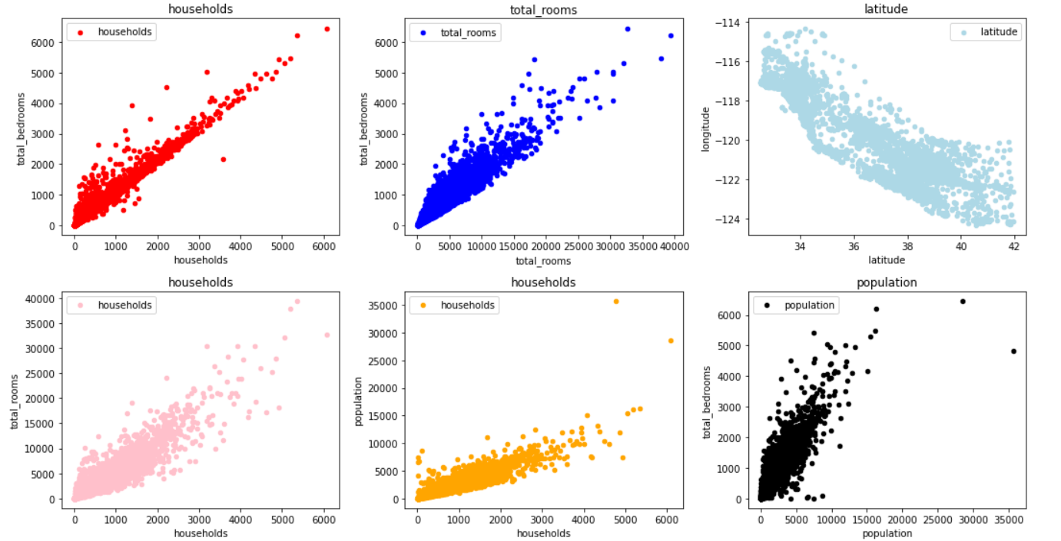
EDA Results + New Features
New Features: Rooms_per_household, People_per_family, Bedroom_per_house

Slide 8

ML Framework
Target variable (Median House Value) is a large number
Divided values by 1000 to get more reasonable RMSEs
Scaled data before applying models
70-30 Train Test Split
Models Tuned
Linear Regression
Decision Tree Regressor
Random Forest Regressor
XGBoost Regressor
Hyperparameter Tuning
RandomizedSearchCV
Cross Validation

Slide 9
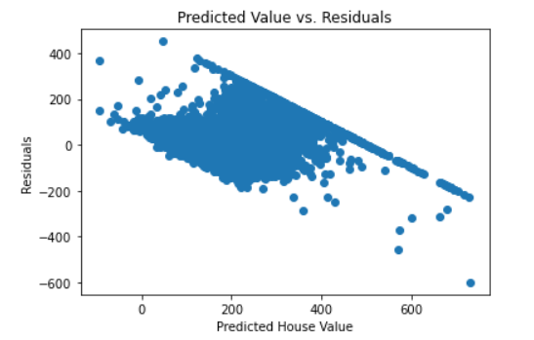
Linear Regression
R² Score: 0.5973
Root Mean Squared Error: 73.2715

Slide 10
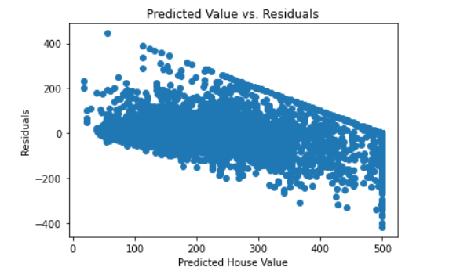
Decision Tree Regressor
R² Score: 0.6634
Root Mean Squared Error: 66.9916

Slide 11
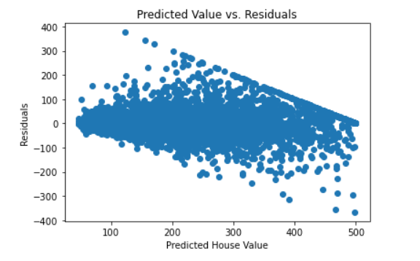
Random Forest Regressor
R² Score: 0.8147
Root Mean Squared Error: 49.6992

Slide 12
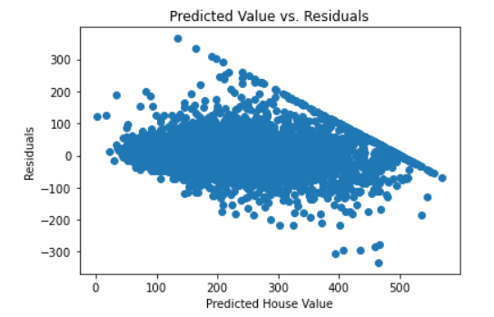
XGBoost Regressor
R² Score: 0.8334
Root Mean Squared Error: 47.1268
Notes:
Ashritha
Note: These are models without tuning

Slide 13
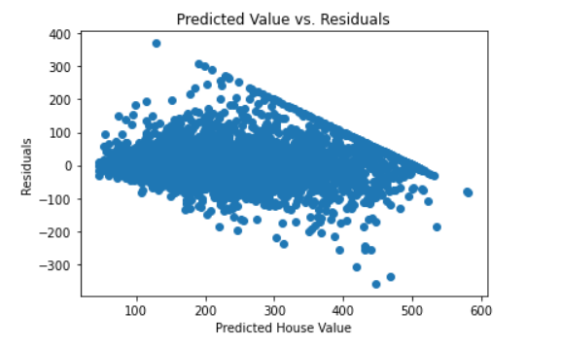
Best Model: Tuning with XGB
R² Score: 0.8409
Root Mean Squared Error: 46.0555

Slide 14
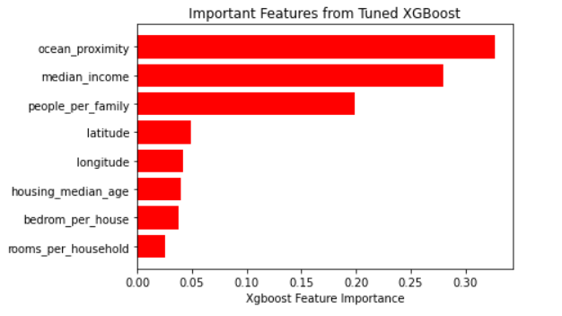
Most Important Features

Slide 15
Summary of Models
Model | Tuned? | R² | RMSE
Linear Regression | No | 0.5973 | 73.2715
Decision Tree | No | 0.6634 | 66.9916
Random Forest | No | 0.8147 | 49.6992
XGBoost | No | 0.8334 | 47.1268
Random Forest | Yes | 0.8292 | 47.7170
XGBoost | Yes | 0.8409 | 46.0555

Slide 16


Key Takeaways
Using Rooms_per_household, People_per_family, Bedroom_per_house, we can predict median house value in 1000s with an accuracy of ~84%!
Using these predictions, we can advise buyers whether or not listed California house prices are reasonable and aid them in their real estate process.
For example, if a house has 4 bedrooms and the household wants 2 rooms, we can predict the median house value from these features
Then, we can compare our predicted median house value with the real estate listing!

Slide 17
Thank You!
Any Questions?

