Slide 1
Algo Section: Kruskal’s Algorithm
Course: CS 2511

Slide 2
Welcome!
Jie
Research Assistant
CS Master Student
Explore PhD path

Slide 3
Algorithm Mind
How about the idea?
When you need use it?
Implementation
Section 1: A Brief Introduction for implementation approach
Section 2: Refine Work
Section 3: Trouble Shoot
Section 4: Design and Re-Design

Slide 4
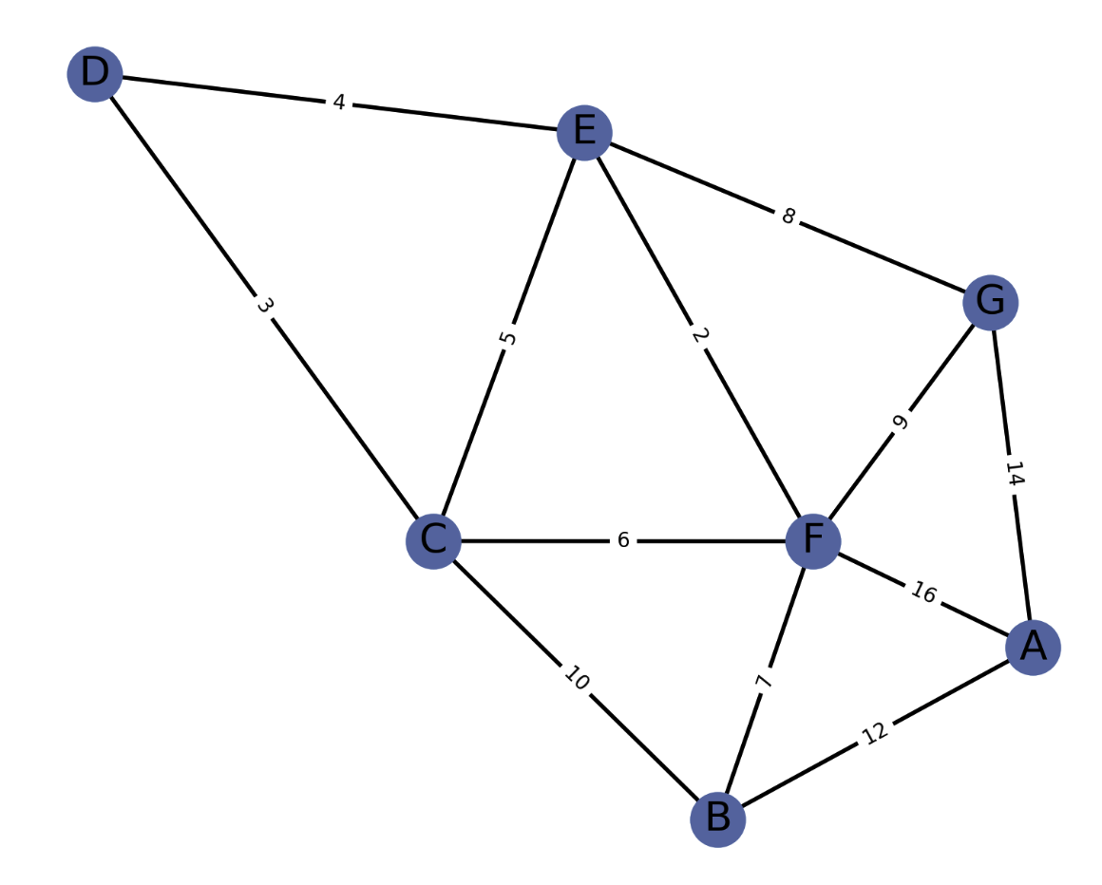
What is Kruskal Algorithm?
Numbers: Weight
V: how many?
E: how many?
Represent: How to represent this graph?
Our problem
The minimum spanning tree problem, which means we want to find a subset of the edges that connects all the vertices together, without any cycles and with the minimum possible total edge weight.
Notes:
There are entire teams at most organizations devoted to mining their company’s logged data, user generated content, and otherwise collected information.
In fact, at Etsy, there’s a team called “Knowledge Base”. But, really, many engineers need a bit of data mining in all the disciplines related to leveraging a company’s or population’s data.
Why did something happen?
Credit Fraud: Suspicious activity?
What can we use this for?

Slide 5
An Example: City Road Planning
Notes:
How many of you have Amazon Prime?
Ever wonder how they are able to achieve 2 day shipping?
Prioritize - first, middle, and last mile
Last mile → supply chain optimization
Not just where they should be, but sizes, and colors, and how many
First mile → getting you to checkout
However, AI-powered technology and deep learning power one of Amazon’s most critical elements of its business — delivery, which is fully dependent on a fluid warehouse operation.
https://www.npr.org/2018/11/21/660168325/optimized-prime-how-ai-and-anticipation-power-amazons-1-hour-deliveries
But a lot of it is thanks to data mining. Computers analyze reams of data, making decisions and performing tasks that typically require human intelligence. Data is key to Amazon's retail forecasting on steroids and its push to shave off minutes and seconds in the rush to prepare, pack and deliver.
"It goes beyond just being able to forecast we need a hundred blouses," Freshwater says. "We need to be able to determine how many do we expect our customers to buy across the sizes, and the colors. And then ... where do we actually put the product so that our customers can get it when they click 'buy.' " That's a key element to how Amazon speeds up deliveries: The team predicts exactly where those blouses should be stocked so that they are as close as possible to the people who will buy them.
This process is even more essential now that the race is on for same-day and even same-hour delivery. Few other retailers have ventured into these speeds, because they're very expensive. And few rely quite so much on AI to control costs while expanding.
Walmart, Target and many others now offer two-day deliveries even without membership fees.
Indeed, AI is woven through every part of an Amazon purchase, from the website to the warehouses to the actual delivery to your doorstep. In corporate lingo, Amazon calls that the "first mile," "middle mile" and "last mile."

Slide 6
An Example: City Road Planning
Imagine a city planning department is tasked with developing a new road system to connect various neighborhoods or points of interest (POIs) such as hospitals, schools, fire stations, and police stations. The goal is to ensure that each POI is accessible from any other POI, but due to budget constraints, the city wants to minimize the total length of the roads constructed.
The planning department can model this problem as a weighted graph where each POI is a vertex and each potential road is an edge connecting two vertices. The cost of constructing a road between any two points is associated with the weight of the edge.
By applying Kruskal's algorithm to this graph, the city planners can determine the most cost-effective set of roads that connects all POIs without creating any cycles, which would represent unnecessary redundancy in the road network. The result would be a network of roads with the minimum total length, thereby using the city's budget efficiently while achieving full connectivity between the POIs.
This minimum spanning tree represents the optimal solution to the city's problem, ensuring that each POI is reachable from any other POI via the new roads, with the least amount of construction and cost. This kind of planning can be critical in emergency situations where quick access between these points is necessary.
Notes:
How many of you have Amazon Prime?
Ever wonder how they are able to achieve 2 day shipping?
Prioritize - first, middle, and last mile
Last mile → supply chain optimization
Not just where they should be, but sizes, and colors, and how many
First mile → getting you to checkout
However, AI-powered technology and deep learning power one of Amazon’s most critical elements of its business — delivery, which is fully dependent on a fluid warehouse operation.
https://www.npr.org/2018/11/21/660168325/optimized-prime-how-ai-and-anticipation-power-amazons-1-hour-deliveries
But a lot of it is thanks to data mining. Computers analyze reams of data, making decisions and performing tasks that typically require human intelligence. Data is key to Amazon's retail forecasting on steroids and its push to shave off minutes and seconds in the rush to prepare, pack and deliver.
"It goes beyond just being able to forecast we need a hundred blouses," Freshwater says. "We need to be able to determine how many do we expect our customers to buy across the sizes, and the colors. And then ... where do we actually put the product so that our customers can get it when they click 'buy.' " That's a key element to how Amazon speeds up deliveries: The team predicts exactly where those blouses should be stocked so that they are as close as possible to the people who will buy them.
This process is even more essential now that the race is on for same-day and even same-hour delivery. Few other retailers have ventured into these speeds, because they're very expensive. And few rely quite so much on AI to control costs while expanding.
Walmart, Target and many others now offer two-day deliveries even without membership fees.
Indeed, AI is woven through every part of an Amazon purchase, from the website to the warehouses to the actual delivery to your doorstep. In corporate lingo, Amazon calls that the "first mile," "middle mile" and "last mile."

Slide 7
Implementation 1: Dry Run (follow your mind with draft codes)
Step 1: Sort the Edges
Start by sorting all the edges of the graph in non-decreasing order of their weight.
Hint: use any sort algorithm, write by your own.
Step 2: Initialize Forest
Create a forest F where each vertex in the graph is a separate tree. In the beginning, the forest has as many trees as there are vertices.
Hint: as many trees as as vertices.
Notes:
Cancer classification with gene expression data
Protein structure prediction
Clinical data mining.
Patient procedures and administration.
Doctor and nurse notes analysis.
Drug Discovery and Interactions
Postmarketing Drug Safety Surveillance
Even many Universities explicitly tailor their courses towards these domains (of bio-engineering). (I’d know since I was considered for teaching at San Jose State, and much of their curricula has a bent toward bio-engineering data mining.)
Abridge.com - https://www.youtube.com/watch?v=FZI5n7ZUrtc
Data mining https://www.ncbi.nlm.nih.gov/pmc/articles/PMC8356896/

Slide 8
Implementation 1: Dry Run (follow your mind with draft codes)
https://en.wikipedia.org/wiki/Kruskal%27s_algorithm
https://www.youtube.com/watch?v=71UQH7Pr9kU
https://visualgo.net/en/mst

Slide 9
Implementation 1: Dry Run (follow your mind with draft codes)
Step 3: Edge Selection
Pick the smallest edge from the sorted edge list that has not yet been checked. Check if it forms a cycle with the spanning tree formed so far. You can check for cycles with union-find data structures.
Notes:
Cancer classification with gene expression data
Protein structure prediction
Clinical data mining.
Patient procedures and administration.
Doctor and nurse notes analysis.
Drug Discovery and Interactions
Postmarketing Drug Safety Surveillance
Even many Universities explicitly tailor their courses towards these domains (of bio-engineering). (I’d know since I was considered for teaching at San Jose State, and much of their curricula has a bent toward bio-engineering data mining.)
Abridge.com - https://www.youtube.com/watch?v=FZI5n7ZUrtc
Data mining https://www.ncbi.nlm.nih.gov/pmc/articles/PMC8356896/

Slide 10
Implementation 1: Dry Run (follow your mind with draft codes)
Step 4: Check for Cycles
If adding the edge does not cause a cycle, add the edge to the forest F, combining two trees into a single tree.
Step 5: Discard If not Cycles
Adding the edge creates a cycle, discard the edge and move on to the next smallest edge.
Notes:
Cancer classification with gene expression data
Protein structure prediction
Clinical data mining.
Patient procedures and administration.
Doctor and nurse notes analysis.
Drug Discovery and Interactions
Postmarketing Drug Safety Surveillance
Even many Universities explicitly tailor their courses towards these domains (of bio-engineering). (I’d know since I was considered for teaching at San Jose State, and much of their curricula has a bent toward bio-engineering data mining.)
Abridge.com - https://www.youtube.com/watch?v=FZI5n7ZUrtc
Data mining https://www.ncbi.nlm.nih.gov/pmc/articles/PMC8356896/

Slide 11
Implementation 1: Dry Run (follow your mind with draft codes)
Step 6: Repeat
Repeat steps 3 to 5 until all vertices are contained in a single connected tree or you have V-1 edges in your forest F, where V is the number of vertices in the graph.
Notes:
Cancer classification with gene expression data
Protein structure prediction
Clinical data mining.
Patient procedures and administration.
Doctor and nurse notes analysis.
Drug Discovery and Interactions
Postmarketing Drug Safety Surveillance
Even many Universities explicitly tailor their courses towards these domains (of bio-engineering). (I’d know since I was considered for teaching at San Jose State, and much of their curricula has a bent toward bio-engineering data mining.)
Abridge.com - https://www.youtube.com/watch?v=FZI5n7ZUrtc
Data mining https://www.ncbi.nlm.nih.gov/pmc/articles/PMC8356896/

Slide 12
Implementation 1: Dry Run (follow your mind with draft codes)
Step 7: Completion
The algorithm stops when every vertex has been included in the spanning tree, which is now a minimum spanning tree (MST) for the graph.
Notes:
Cancer classification with gene expression data
Protein structure prediction
Clinical data mining.
Patient procedures and administration.
Doctor and nurse notes analysis.
Drug Discovery and Interactions
Postmarketing Drug Safety Surveillance
Even many Universities explicitly tailor their courses towards these domains (of bio-engineering). (I’d know since I was considered for teaching at San Jose State, and much of their curricula has a bent toward bio-engineering data mining.)
Abridge.com - https://www.youtube.com/watch?v=FZI5n7ZUrtc
Data mining https://www.ncbi.nlm.nih.gov/pmc/articles/PMC8356896/

Slide 13
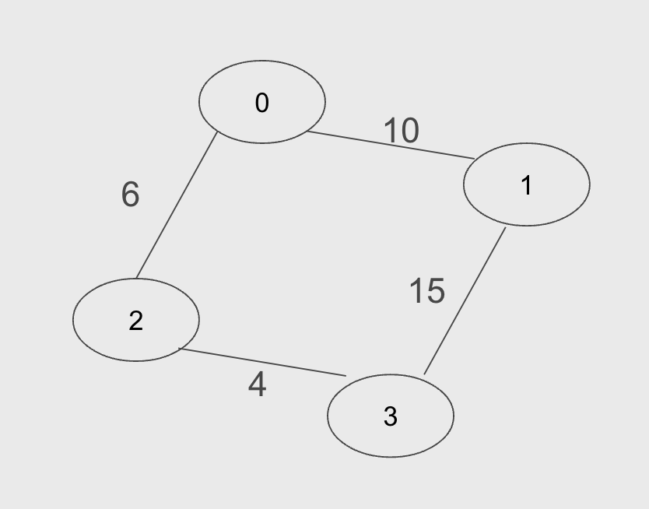
Represent this graph(union-find):
Notes:
Cancer classification with gene expression data
Protein structure prediction
Clinical data mining.
Patient procedures and administration.
Doctor and nurse notes analysis.
Drug Discovery and Interactions
Postmarketing Drug Safety Surveillance
Even many Universities explicitly tailor their courses towards these domains (of bio-engineering). (I’d know since I was considered for teaching at San Jose State, and much of their curricula has a bent toward bio-engineering data mining.)
Abridge.com - https://www.youtube.com/watch?v=FZI5n7ZUrtc
Data mining https://www.ncbi.nlm.nih.gov/pmc/articles/PMC8356896/

Slide 14
Implementation 3: Trouble Shoot
https://github.com/JieUpup/Kruskal-s-AlgorithmUnionFind.git
Function?
Resource?
Type?
Exception?
Type?
Logic?
…
Notes:
Cancer classification with gene expression data
Protein structure prediction
Clinical data mining.
Patient procedures and administration.
Doctor and nurse notes analysis.
Drug Discovery and Interactions
Postmarketing Drug Safety Surveillance
Even many Universities explicitly tailor their courses towards these domains (of bio-engineering). (I’d know since I was considered for teaching at San Jose State, and much of their curricula has a bent toward bio-engineering data mining.)
Abridge.com - https://www.youtube.com/watch?v=FZI5n7ZUrtc
Data mining https://www.ncbi.nlm.nih.gov/pmc/articles/PMC8356896/

Slide 15
Implementation 4: Refine Again
Well-Structure
Documentation
Test(Conner cases)
Dry run by adjust the sample
Write unit-test
Code Style
…
Notes:
Cancer classification with gene expression data
Protein structure prediction
Clinical data mining.
Patient procedures and administration.
Doctor and nurse notes analysis.
Drug Discovery and Interactions
Postmarketing Drug Safety Surveillance
Even many Universities explicitly tailor their courses towards these domains (of bio-engineering). (I’d know since I was considered for teaching at San Jose State, and much of their curricula has a bent toward bio-engineering data mining.)
Abridge.com - https://www.youtube.com/watch?v=FZI5n7ZUrtc
Data mining https://www.ncbi.nlm.nih.gov/pmc/articles/PMC8356896/

Slide 16
….and that’s just use code to show how to solve the problem!
Draft Ideas: Write down your idea
Write step by step approach: sub-problems
Write the sub-step code: use code to explain
Ready for do the refinement and optimization: depth and width.
Notes:
https://ischool.syr.edu/data-mining-in-obamas-2012-victory/
Moneyball

Slide 17
Lab Assignment
Please do the pair programming( 3-4 students per group) to implement the Kruskal’s Algorithm(try Union-Find approach first, use matrix or list either one).
Submission Requirements:
All class source code files, including JUnit test files, should be submitted to a GitHub repository or Canvas by one group( 3-4 people per group).
A README file documenting your approach and any assumptions.
A PDF file containing a graph representation (in matrix or list form) that was used for testing.
Deadline:

Slide 18
Lab Assignment
Link or print( my laptop)

Slide 19
In your life?
Trade off: Time Complexity, Space Complexity
What is Kruskal’s Algorithm
Define your algorithm

Slide 20
Reflection
Did you finish your code?
Reflect on whether you have completed your coding task or if there are still portions that need to be written or finalized.
Did you rewrite your code?
Consider if you had to go back and rewrite any part of your code for clarity, efficiency, or functionality improvements.
Did you re-design your code?
Think about whether the initial design of your code had to be changed. This could include changing the structure of the code, optimizing algorithms, or modifying how different parts of the code interact with each other.

Slide 21
Reflection
Did you write J-Unit Tests for your code?
Reflect on whether you have written tests for your code using the JUnit testing framework to validate the code's functionality and ensure it works as expected.
Did you do further optimize for your current code?
Consider if there were any additional optimizations you made to improve performance, such as reducing complexity, minimizing memory usage, or speeding up execution time.

Slide 22
Reflection
Did you do the pair programming with peers?
Think about whether you engaged in pair programming, where two programmers work together at one workstation, with one writing code while the other reviews each line of code as it is typed in.
Did you make some basic mistakes?
Reflect on any simple errors you might have made in the process of coding, such as syntax errors, logical errors, or incorrect use of data structures, and how you addressed them.

