Slide 1

Calculation for Neutron Reflectometry
A Data Visualization approach combine with multiple tools and parratt_algorithm
Jie Zhang
Feb 2024

Slide 2

ABOUT THE OPEN SOURCE FITTING
01
FIVE DAYS DATA EXPLORATION
02
CONTENTS
NR CALCULATION
03
FITTING COMPARISON
04
TWO POSSIBLE APPROACH
05
Data visualization
Pre-processing
Parratt Algorithm
Neutron Reflectivity using Matrix Formalism
Open Source::
Refl1d, BornAgain, Refnx, Motofit
3D generation based the parameters and dataset(images)
Machine Learning based on Matrix Formalism.

Slide 3
About the open source fitting
Tools:
BornAgain
Refl1D
Motofit
Refnx

Slide 4
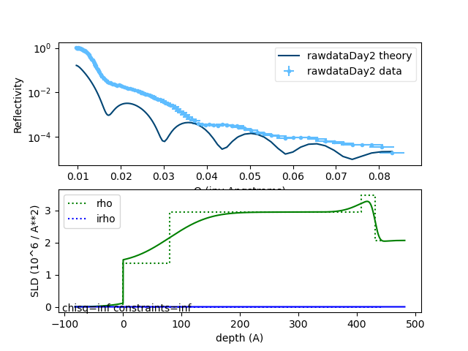
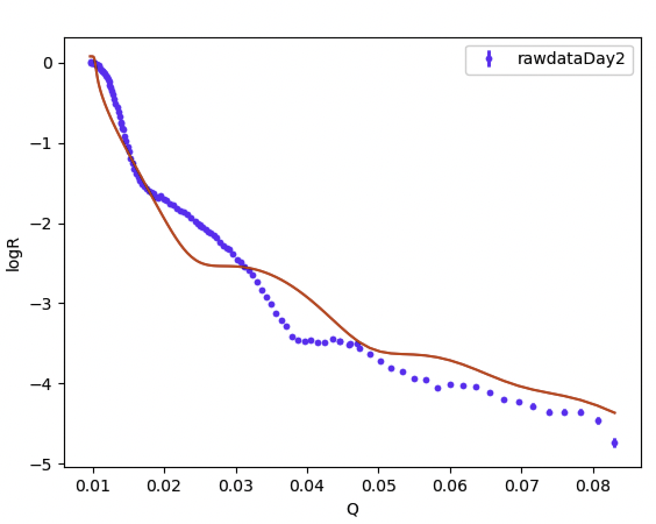
Fitting day 2 dataset with refl1d and refnx
refl1d
refnx

Slide 5
Five days specular data exploration
Data exploration:
Q_data.describe()
R_data.describe()
data.hist
# Scatter plot to visualize the relationship between Q_data and R_data
# Calculate the likelihood for Q and R
# Calculate the PCA for Q and R

Slide 6
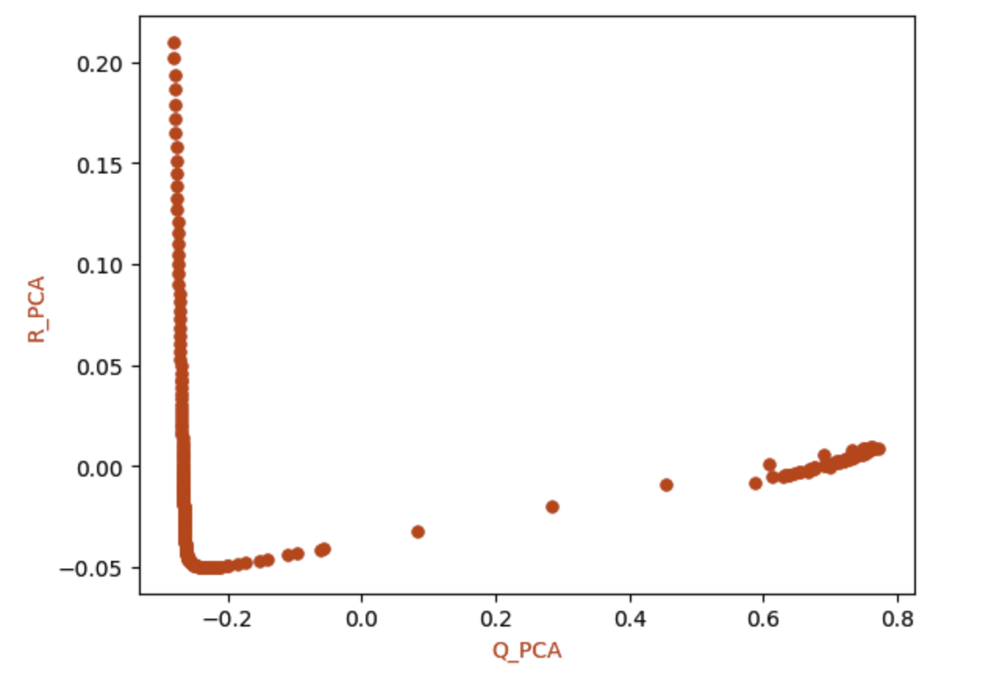
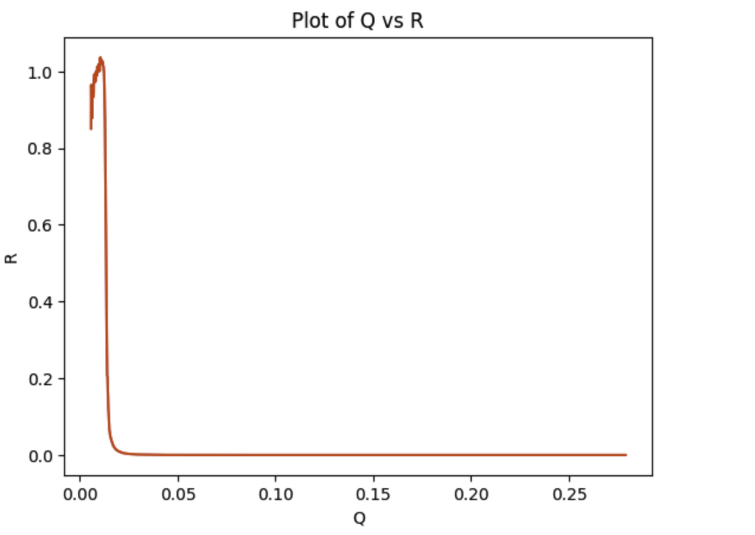
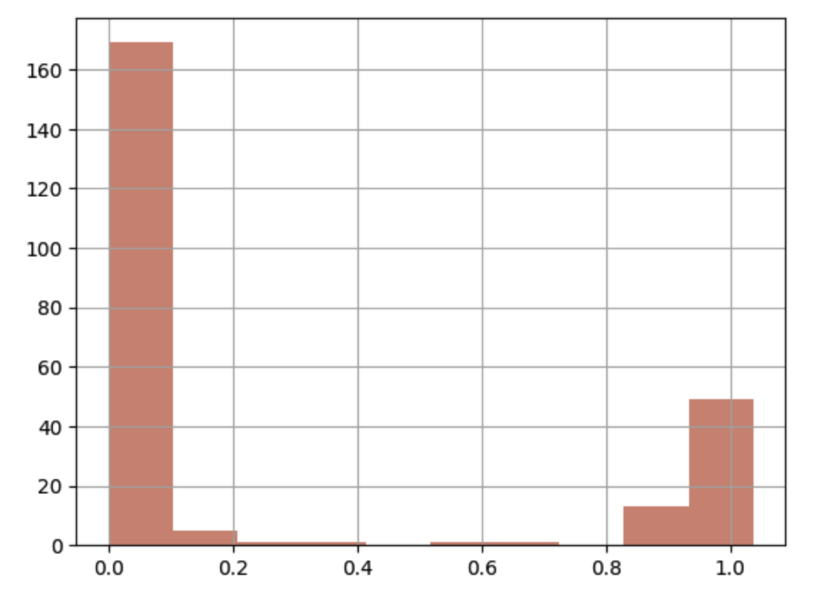
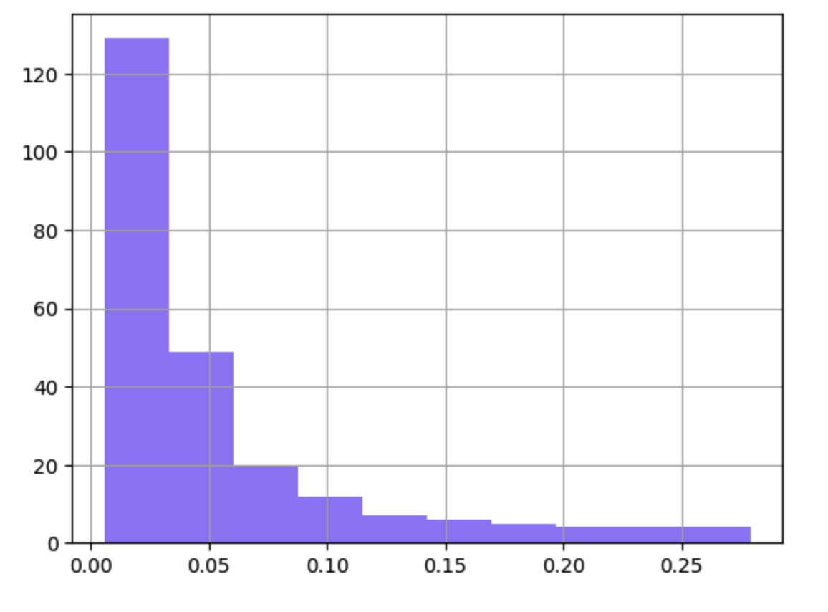
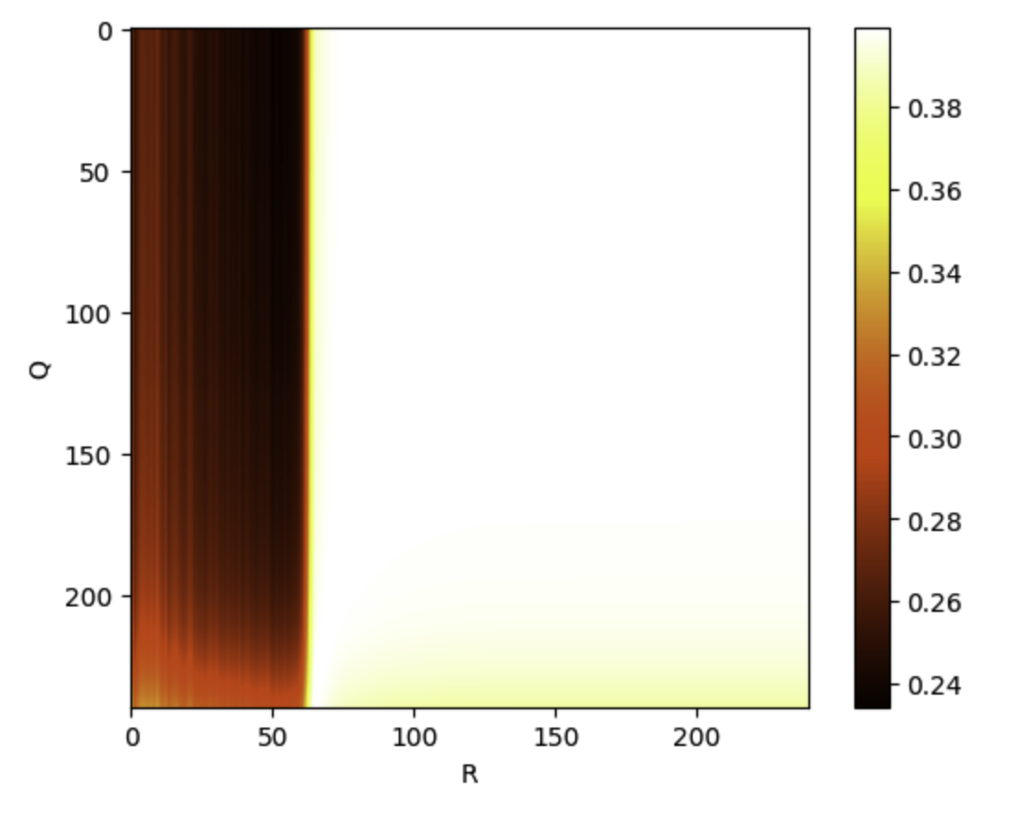

Slide 7
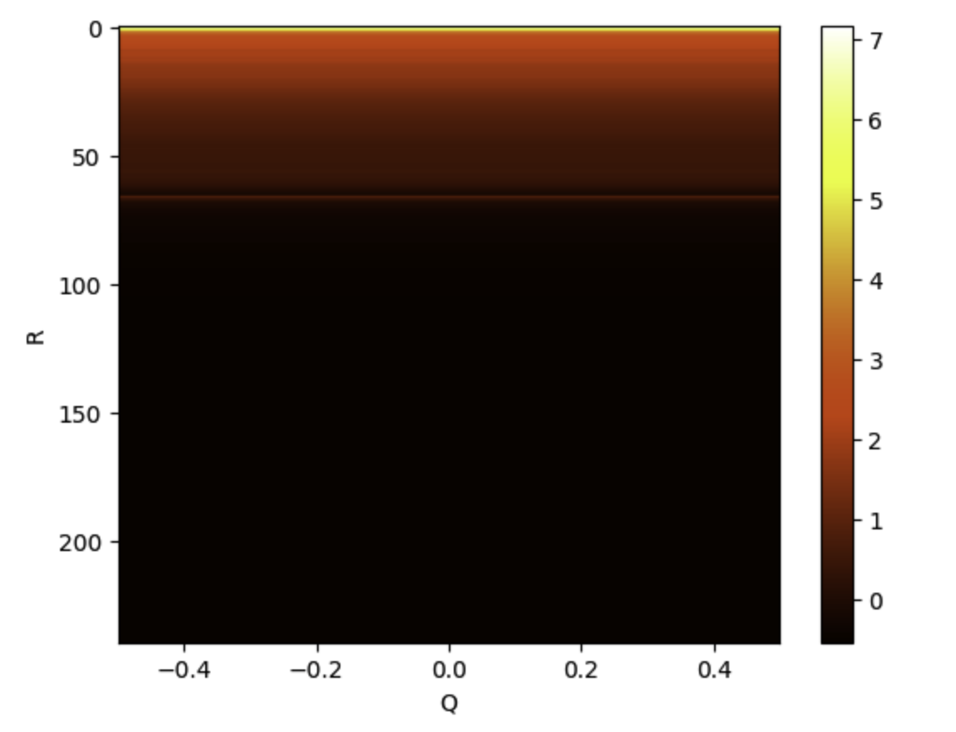
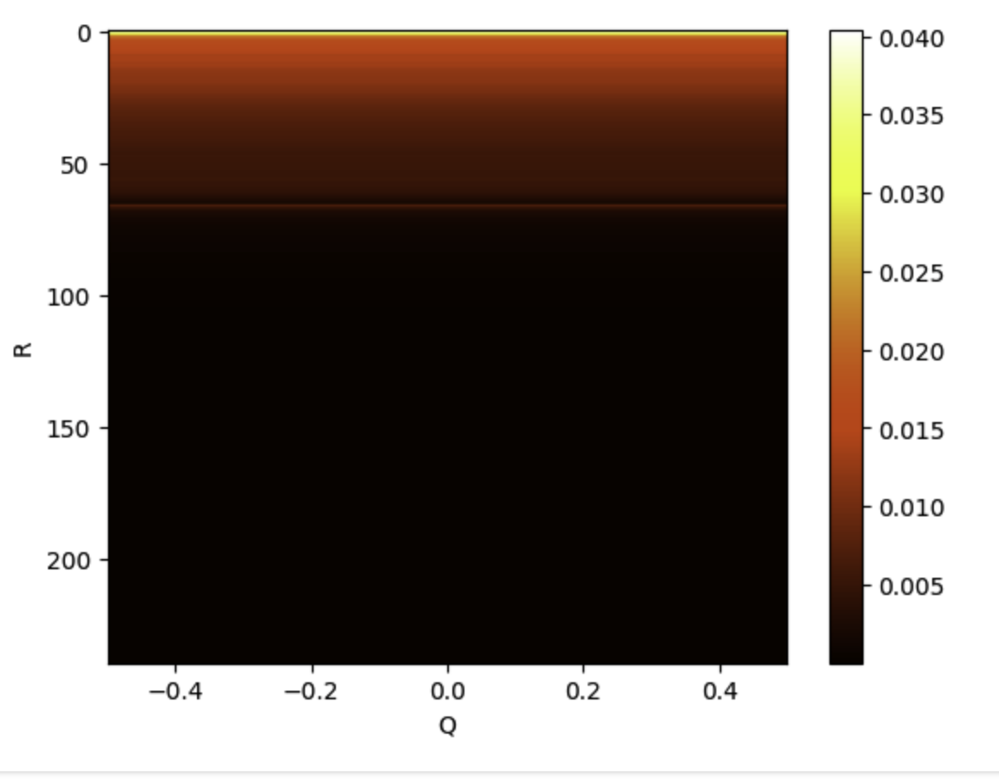
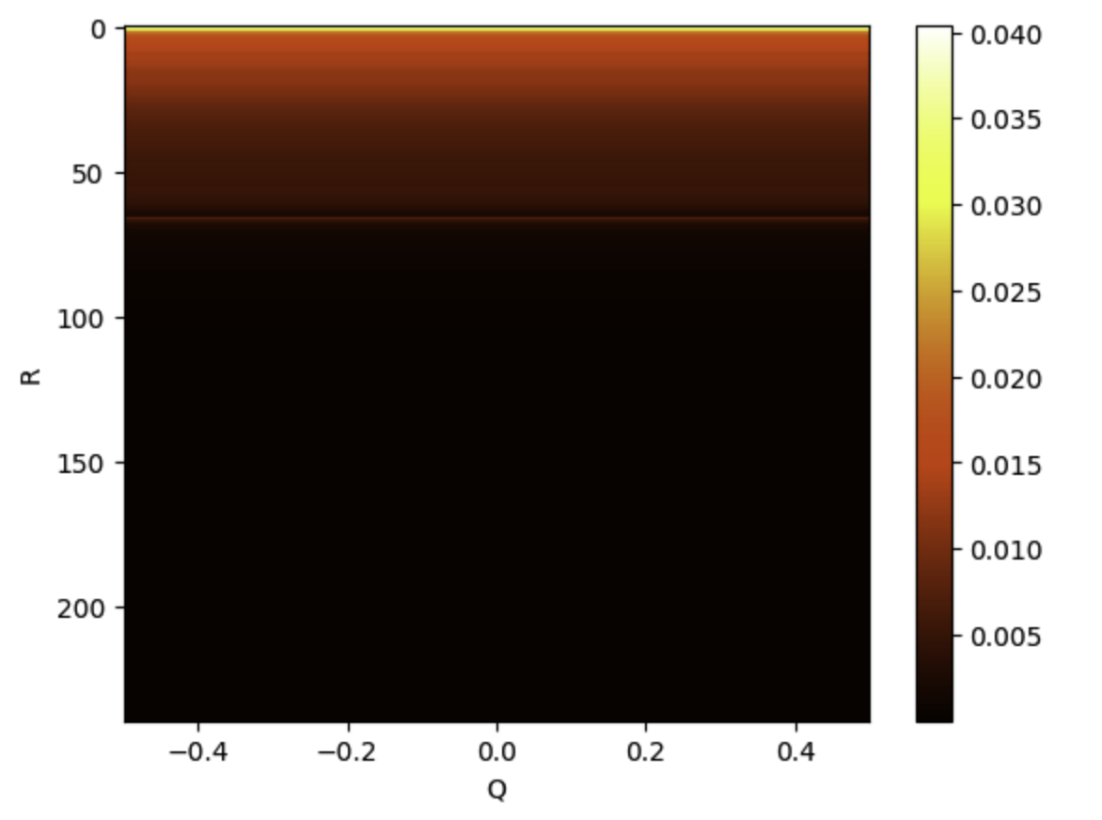
Heatmap for Q and R
Normalization vs real value

Slide 8
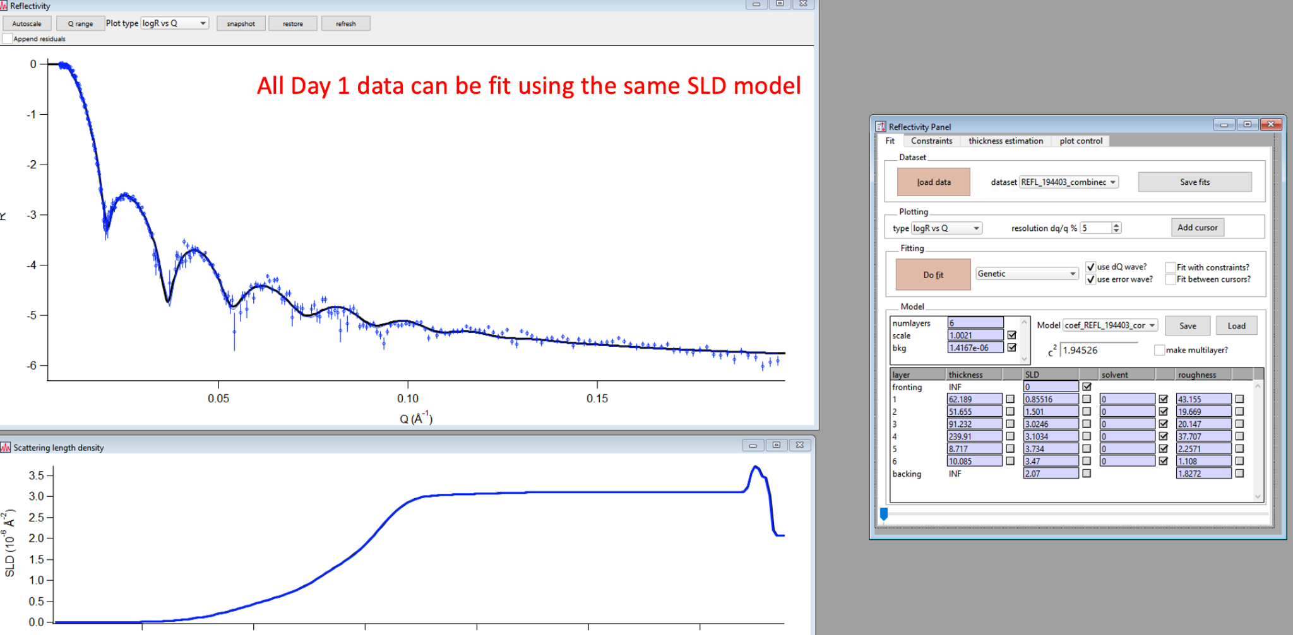
194430

Slide 9
Parameters after fitting- use day1 as the demo
layers_number = 6
layers = [
{"thickness": 62.189, "SLD": 0.85516, "solvent": 0, "roughness": 43.155},
{"thickness": 51.655, "SLD": 1.501, "solvent": 0, "roughness": 19.669},
{"thickness": 91.232, "SLD": 3.0246, "solvent": 0, "roughness": 20.147},
{"thickness": 239.91, "SLD": 3.1034, "solvent": 0, "roughness": 37.707},
{"thickness": 8.717, "SLD": 3.734, "solvent":0, "roughness": 2.2571},
{"thickness": 10.085, "SLD": 3.47, "solvent": 0, "roughness": 1.108}
]

Slide 10
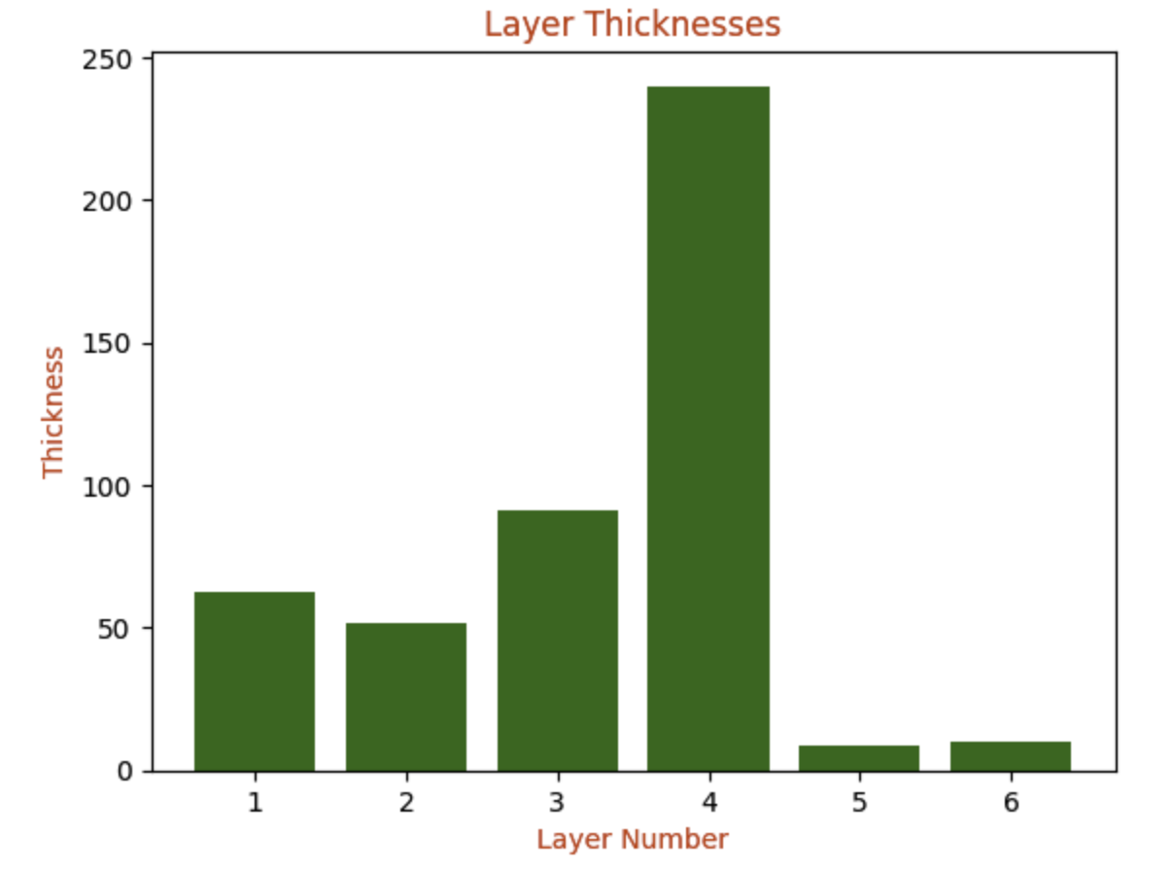
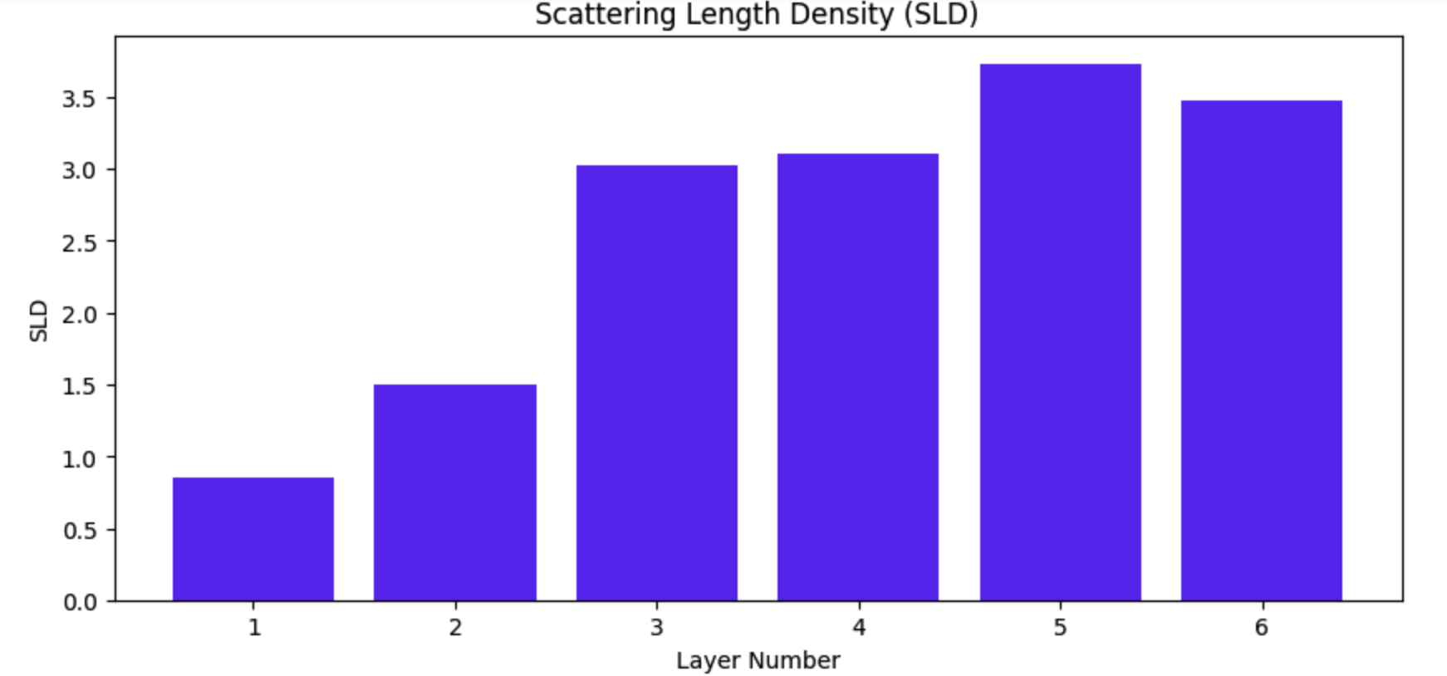
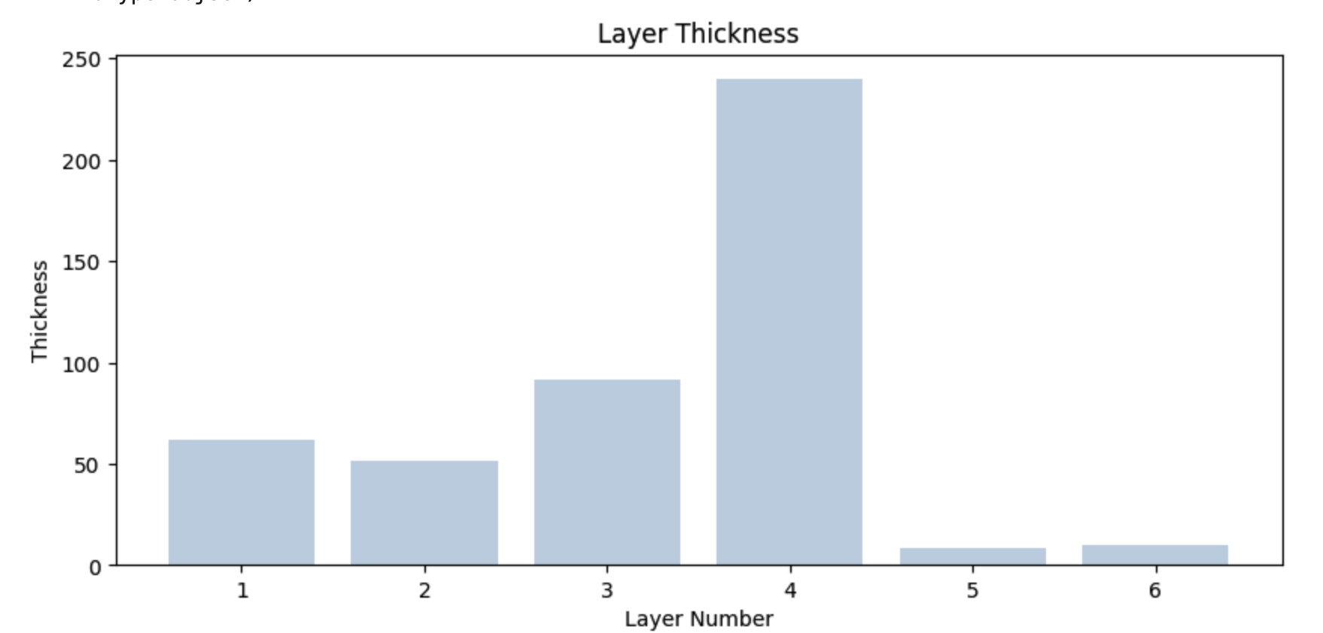
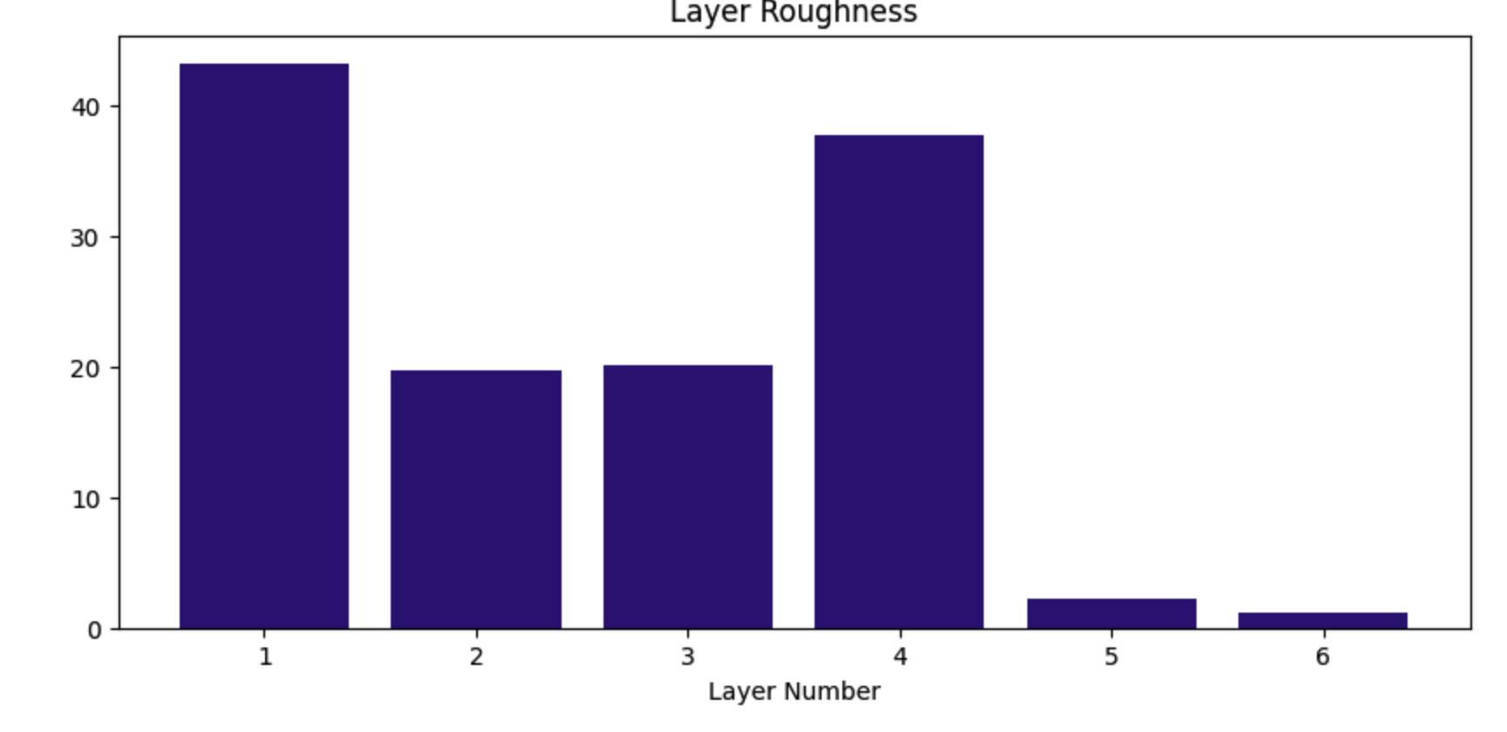
Use five days fitting parameters

Slide 11
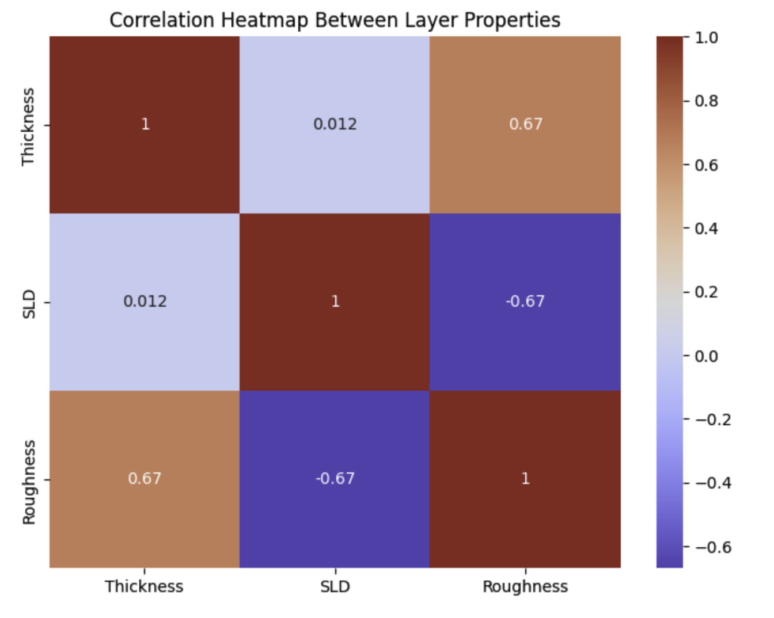
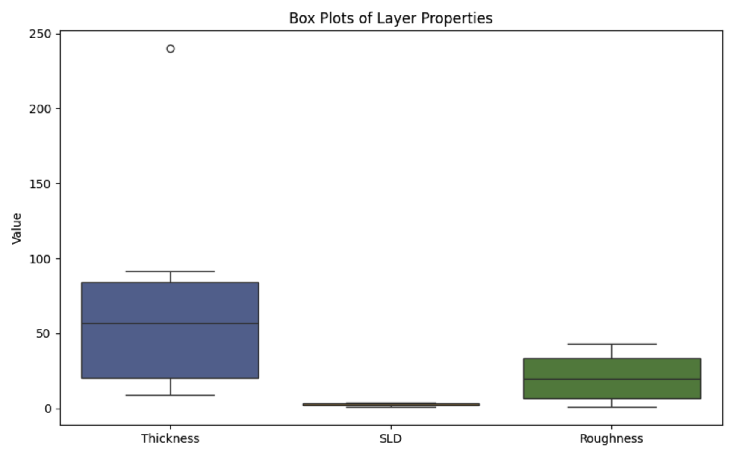
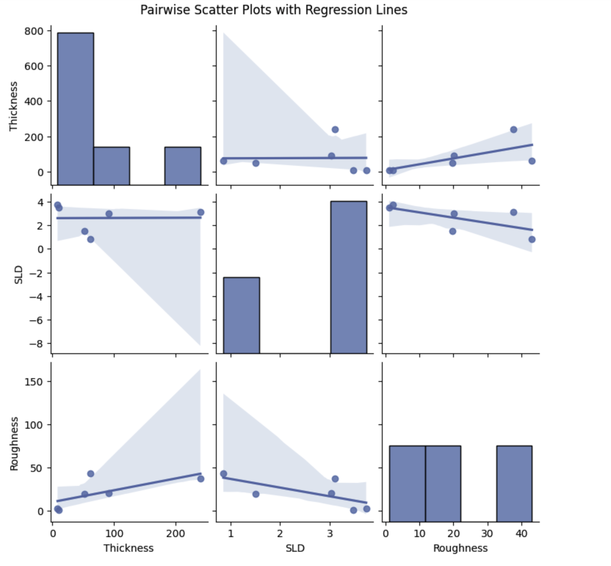

Slide 13
Neutron Reflectivity calculation
Use refl1d and refnx
Diff:
refnx
Utilizes an object-oriented approach where layers and structures are defined as Python objects. Construction of models by stacking different Layer objects to build a Structure.
refl1d:
focus on providing more built-in models for specific types of interfaces and layers, including fractal and rough interfaces.

Slide 14
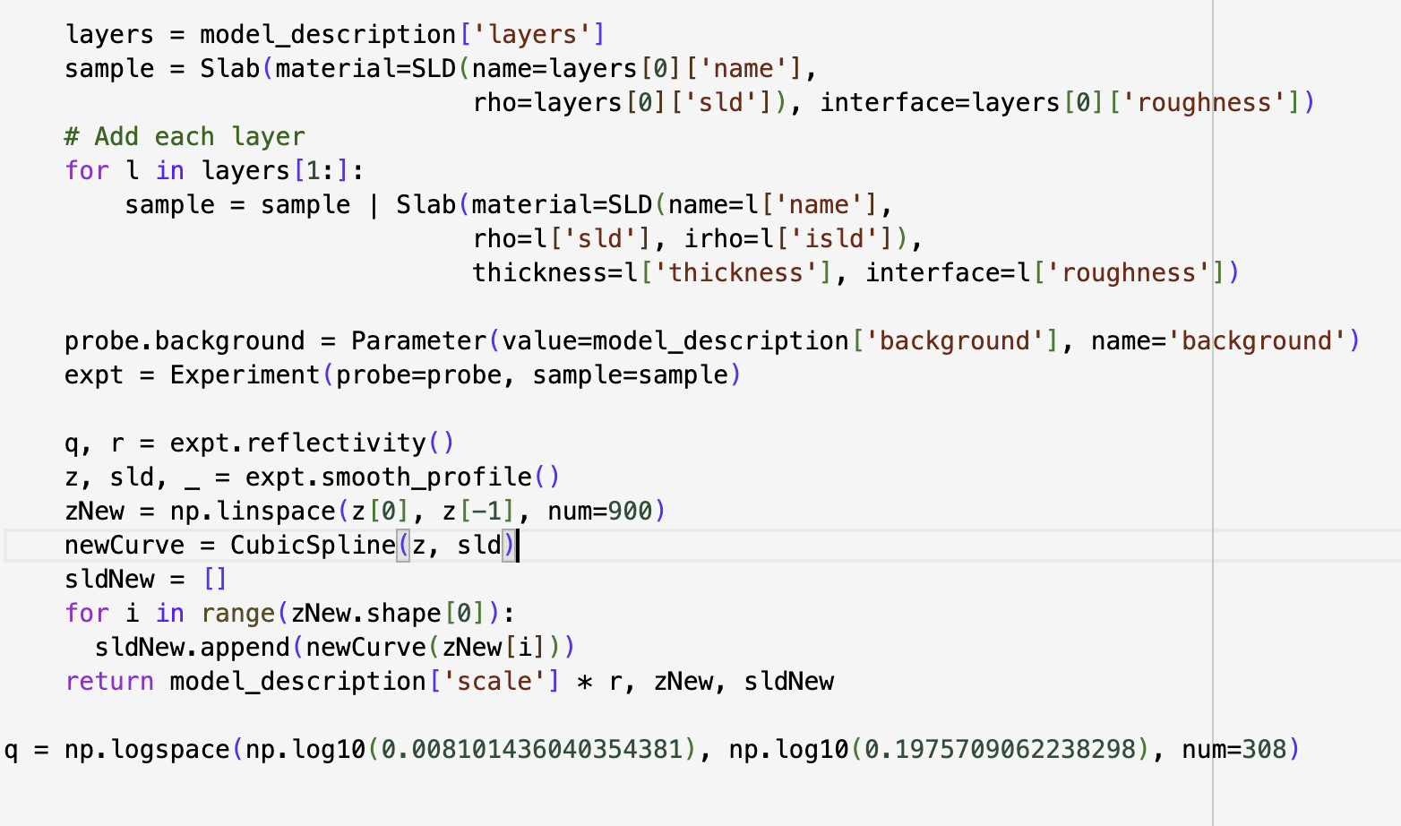

Slide 15
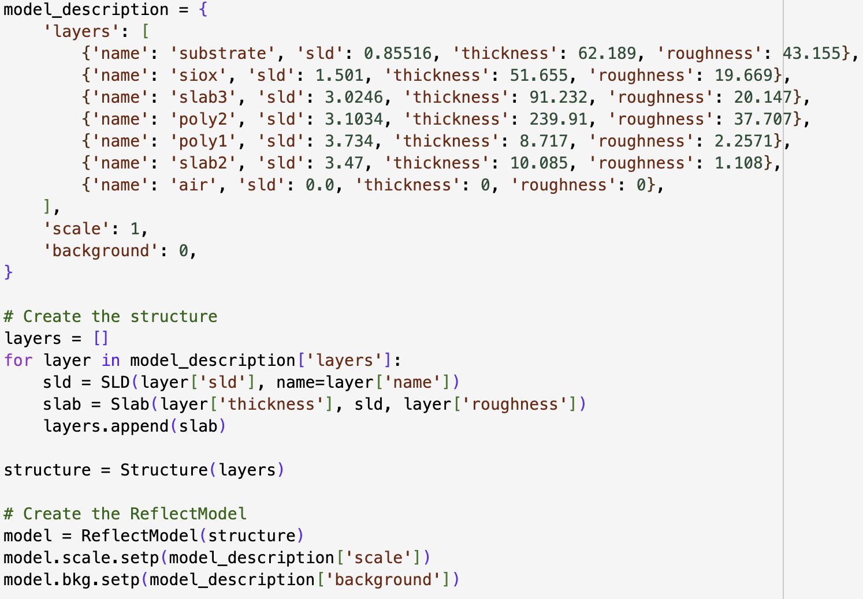

Slide 16
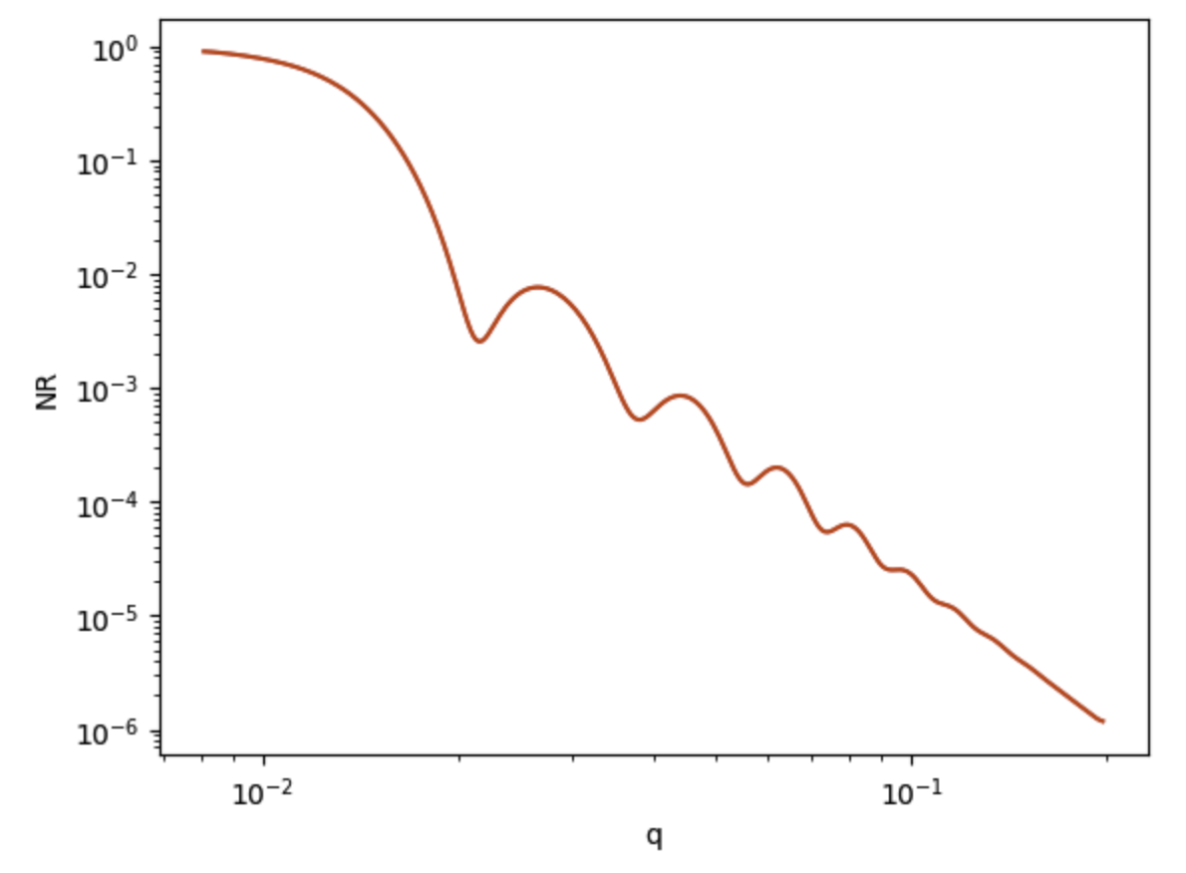
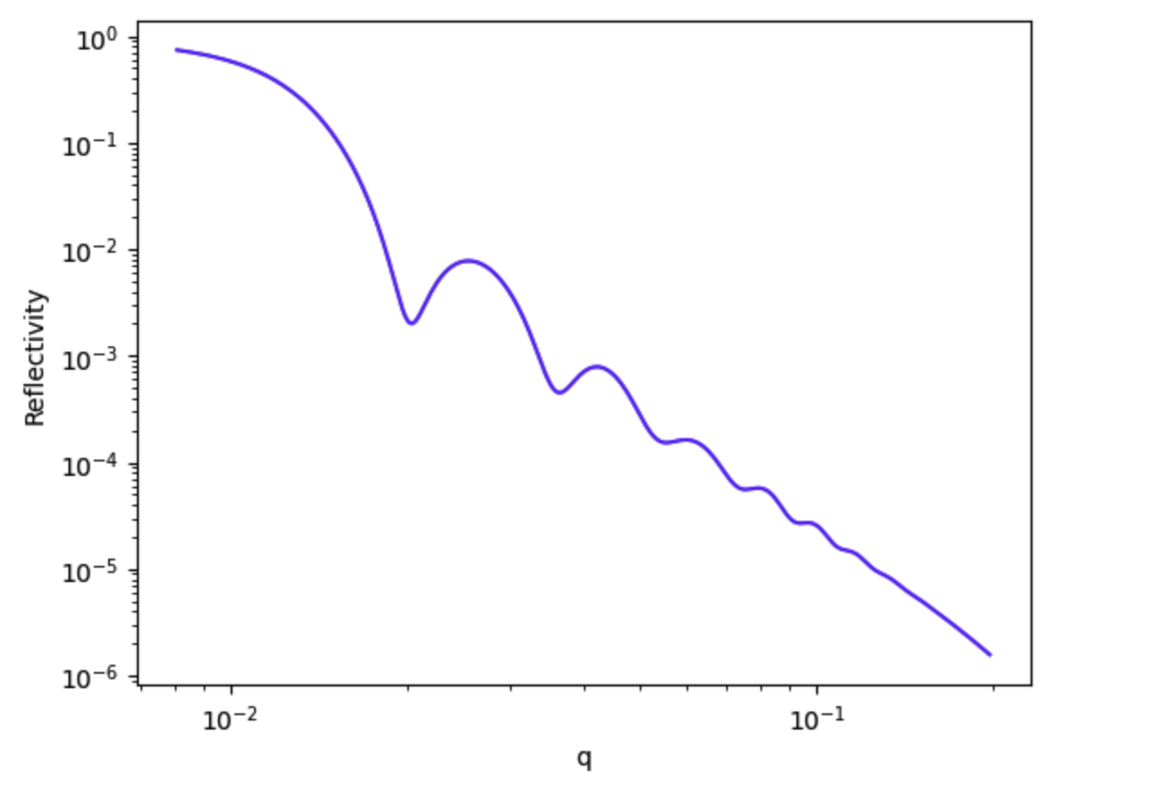
Which one is better?
refl1d
refnx

Slide 17
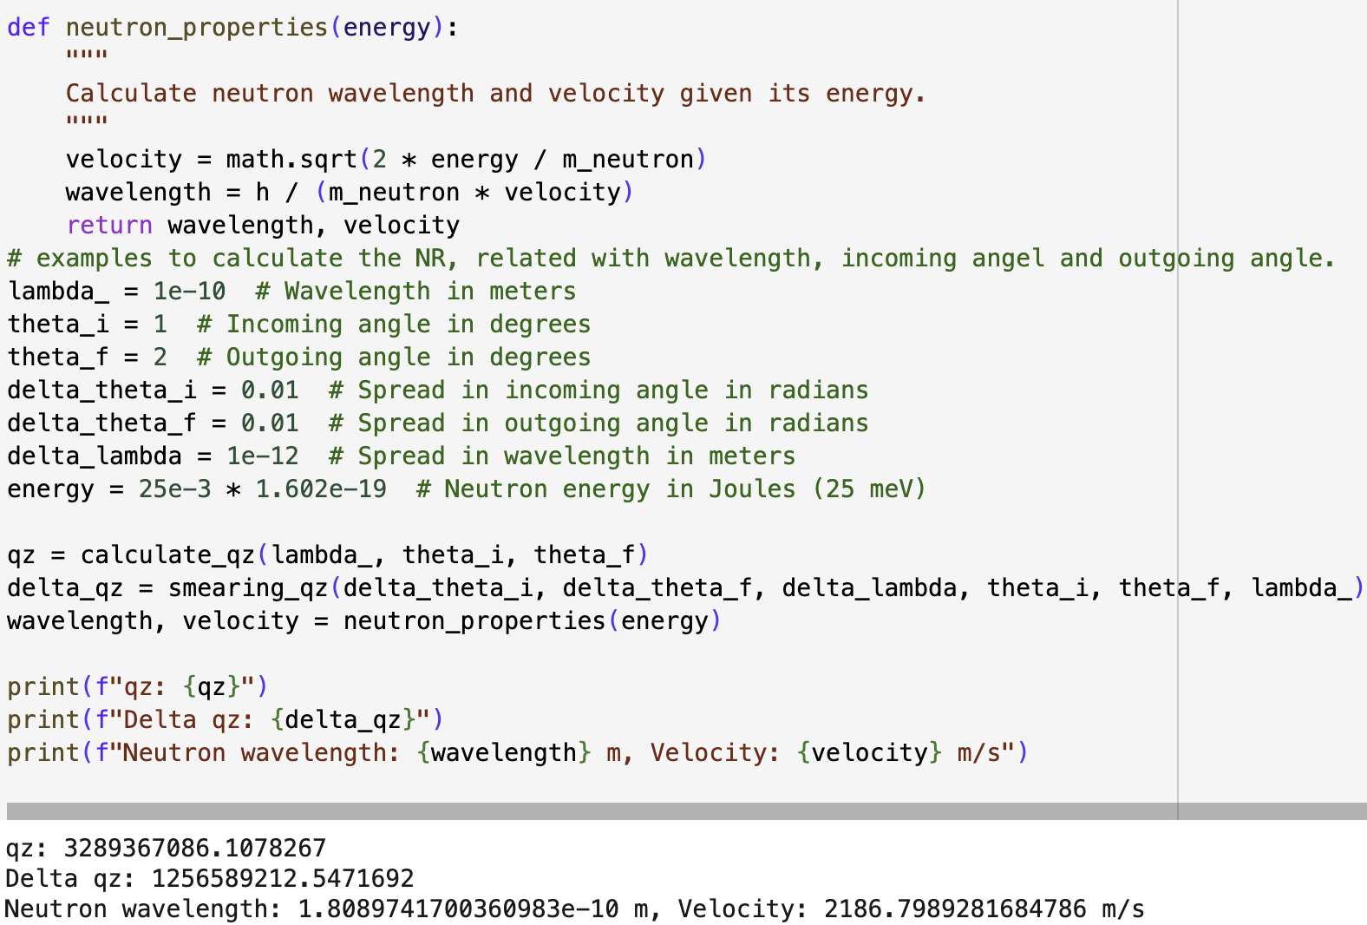

Slide 18
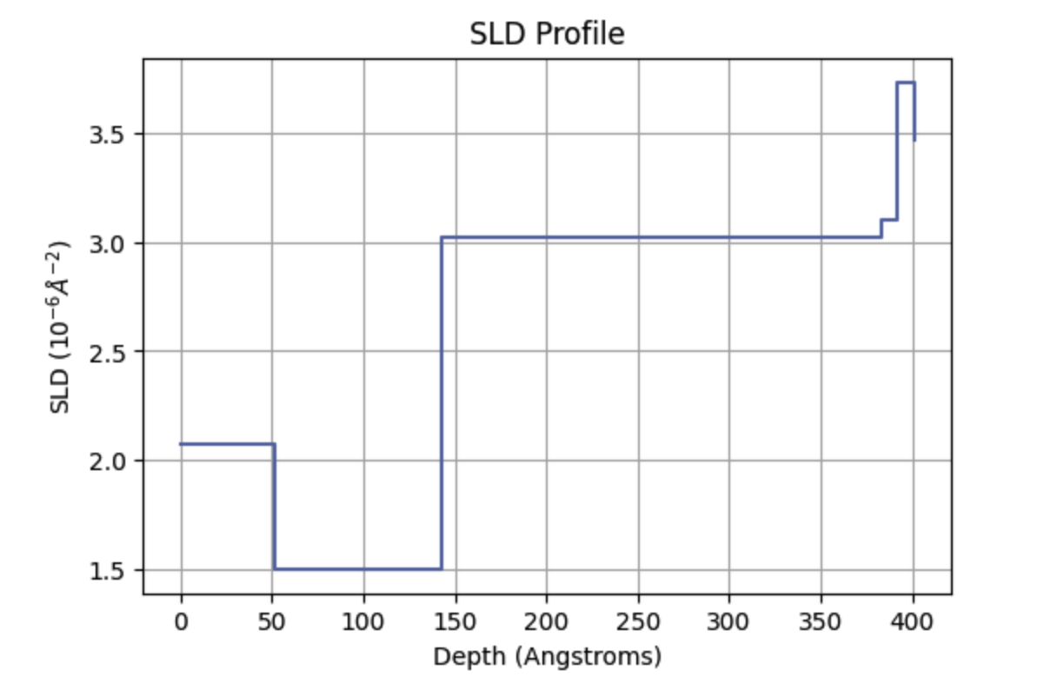

Slide 19
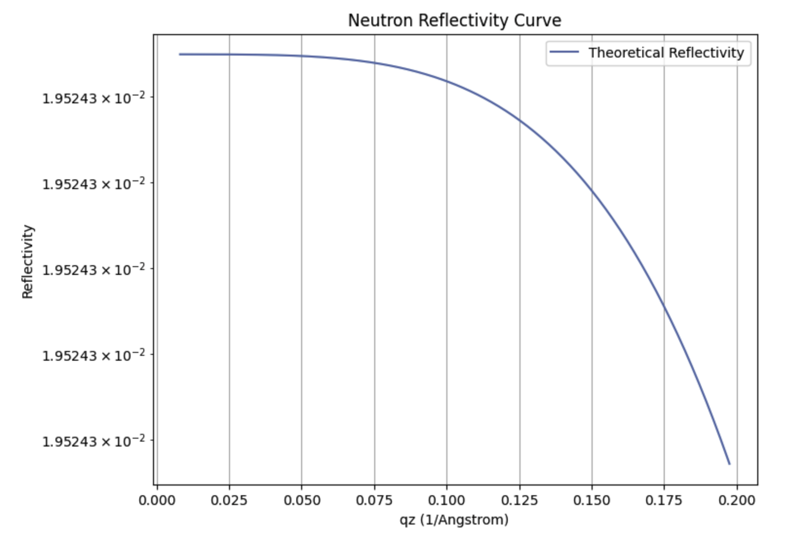
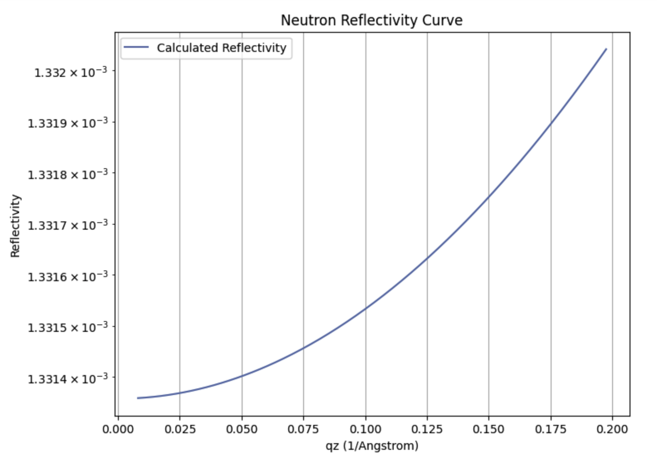
Calculate neutron reflectivity using an enhanced Parratt recursive formalism
Parratt algorithm

Slide 20
Two possible approaches in further research
3D generation for underlayer structure(more data, 2d or images)
Use traditional matix based to do the machine learning(CNN, RNN, LLM)approach the prediction for underlayer structure.

Slide 21
THANKS
Github: https://github.com/JieUpup/day1-Neutron-reflectometry
Does anyone have any questions?
Follow the project updates
m.fuentes-cabrera@northeastern.edu

