Slide 1
STUDY REPORT
8.15-8.19

Slide 2
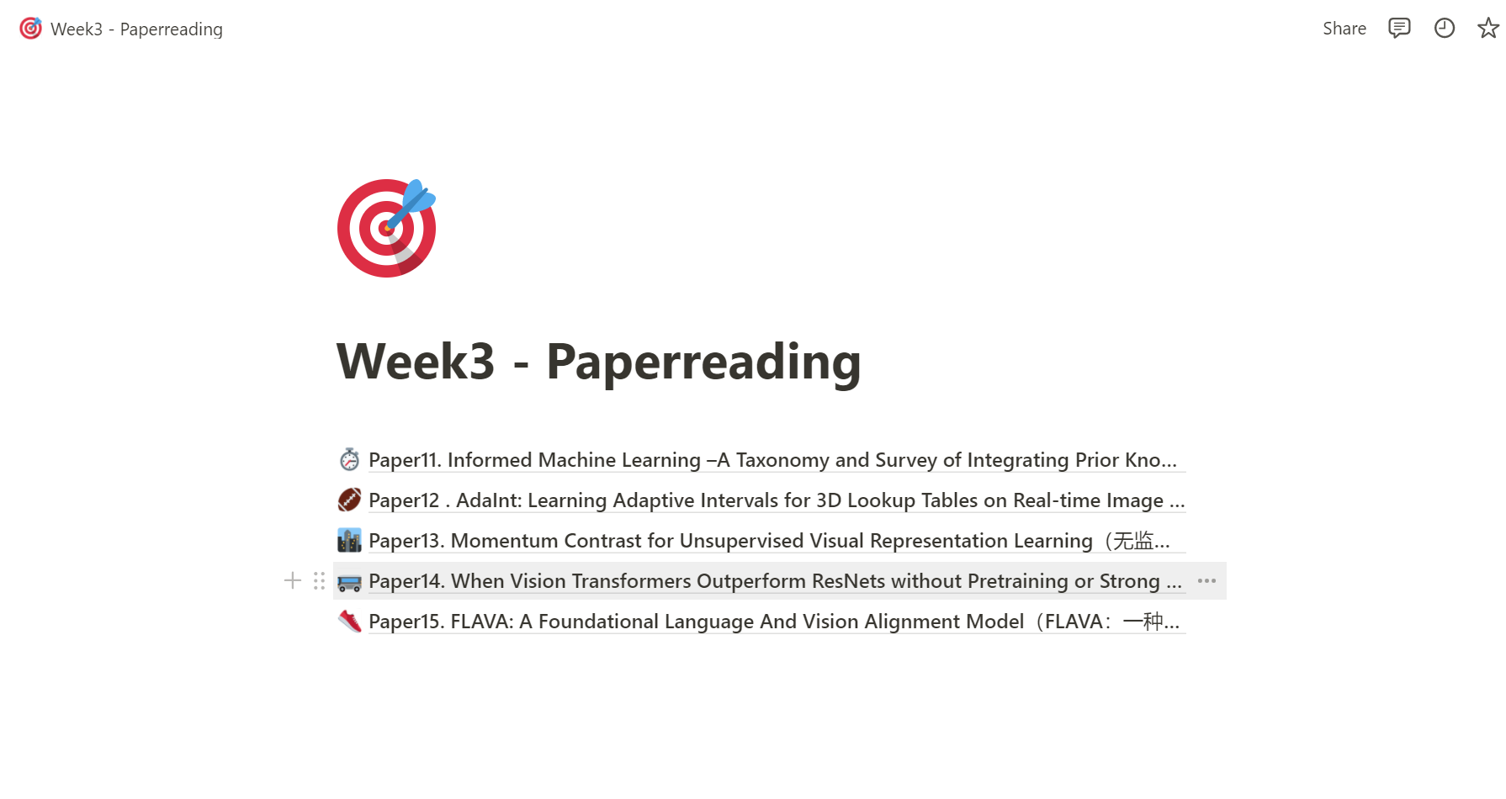
Paper Reading
Mostly about computer vision and some algorithm model analysis papers
Notes URL
https://www.notion.so/Week3-Paperreading-512fb5956a404e0ea159c090ce447591

Slide 3
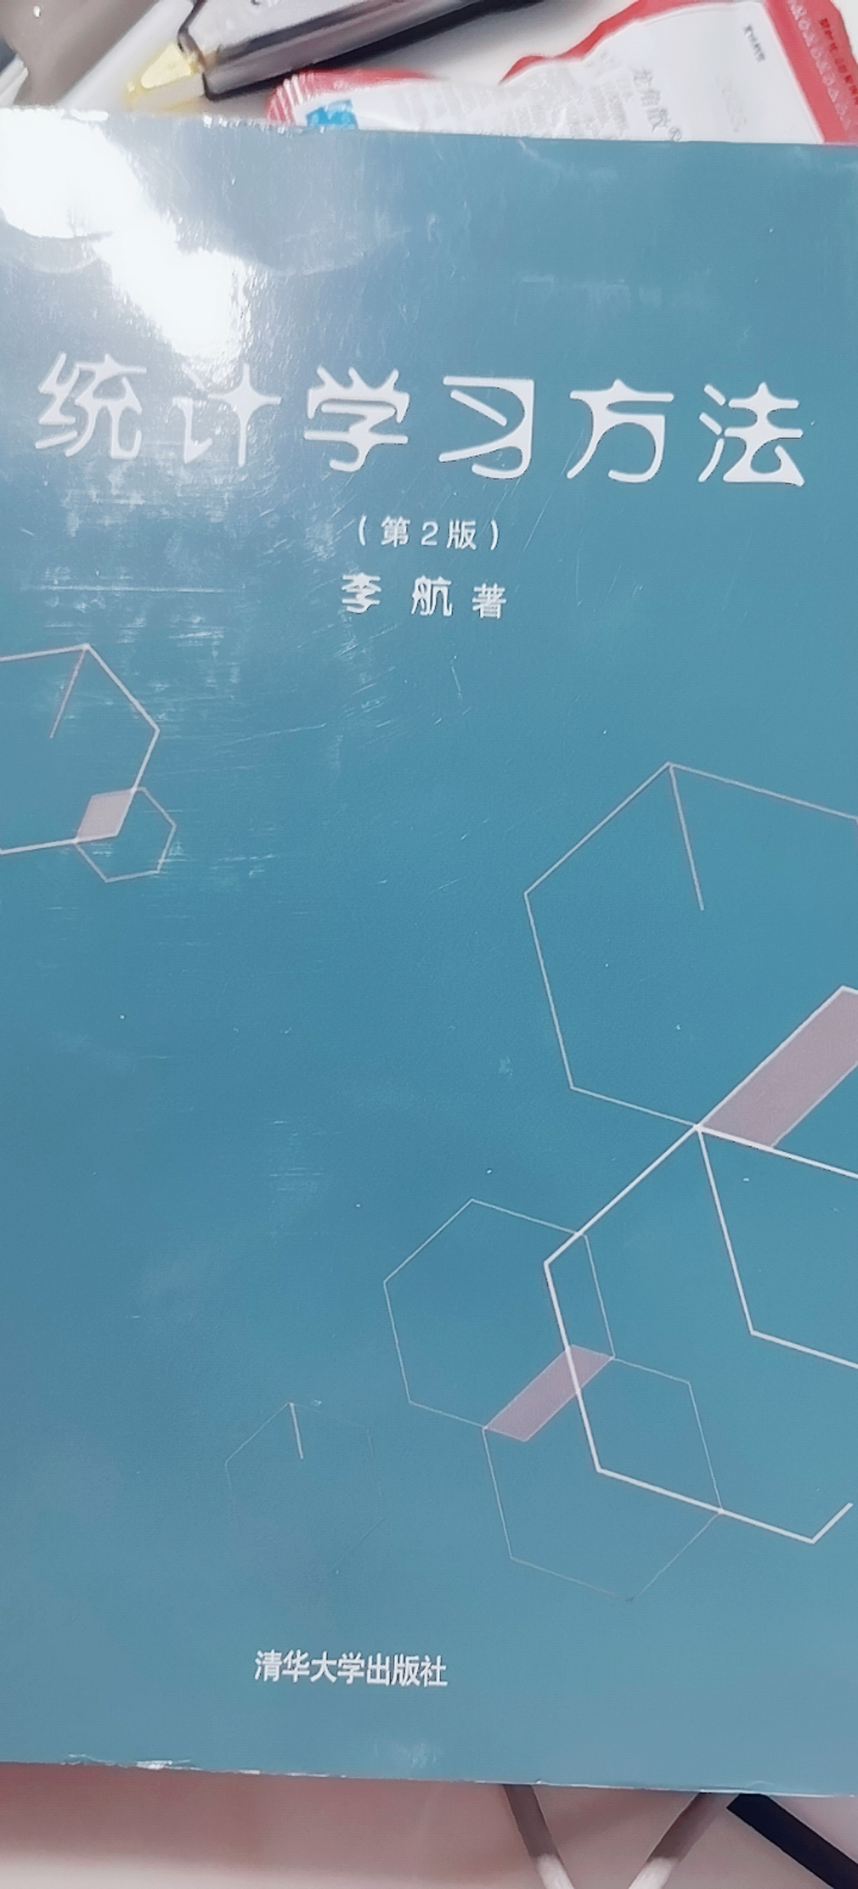
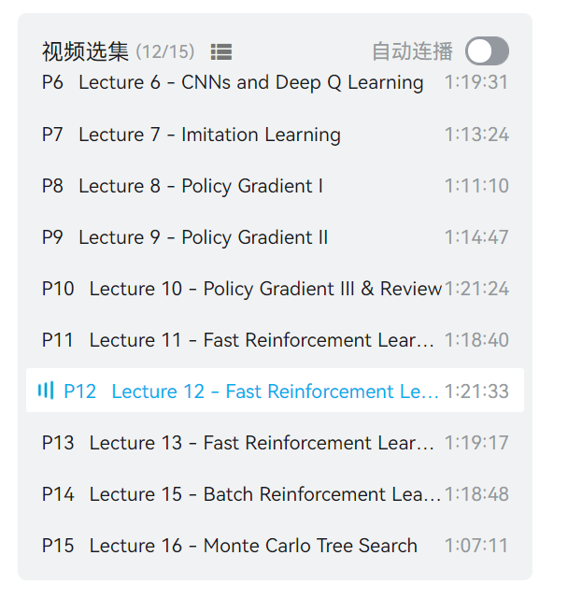
Basic Knowledge Studying
《统计学习方法》6-8 chapter finished
《Reinforcement learning》12/15 finished （notes on github）

