Slide 1



Paper sharing:Pix2seq series
Speaker :Ying Jie

Slide 2

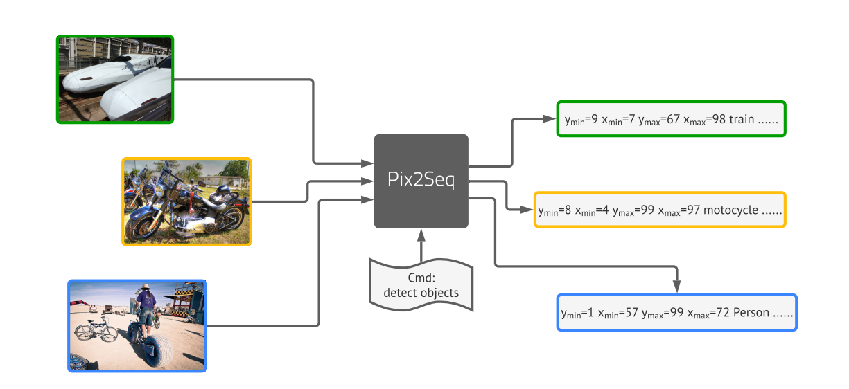
Introduction：PIX2SEQ: A LANGUAGE MODELING FRAMEWORK
FOR OBJECT DETECTION
1. Source: ICLR 2022
2. Author:
Ting Chen -- Research Scientist, Google Brain
Saurabh saxena - Google
Lala Li - Google
Geoffrey e. Hinton, Emeritus Professor
3. Evaluation of a doctoral student: Different attributes are constructed into sequences, and the model design is subversive

Slide 3
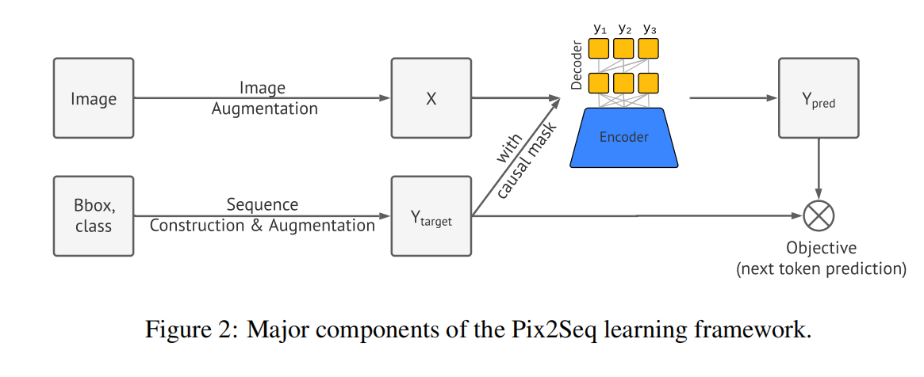
Realization means of Pix2seq
boxes &labels
[ymin, xmin, ymax, xmax, c]
• Image Augmentation: As is common in training computer vision models, we use image augmentations to enrich a fixed set of training examples
• Sequence construction & augmentation: As object annotations for an image are usually represented as a set of bounding boxes and class labels, we convert them into a sequence of discrete tokens.
• Architecture: We use an encoder-decoder model, where the encoder perceives pixel inputs, and the decoder generates the target sequence
• Objective/loss function: The model is trained to maximize the log likelihood of tokens conditioned on the image and the preceding tokens

Slide 4
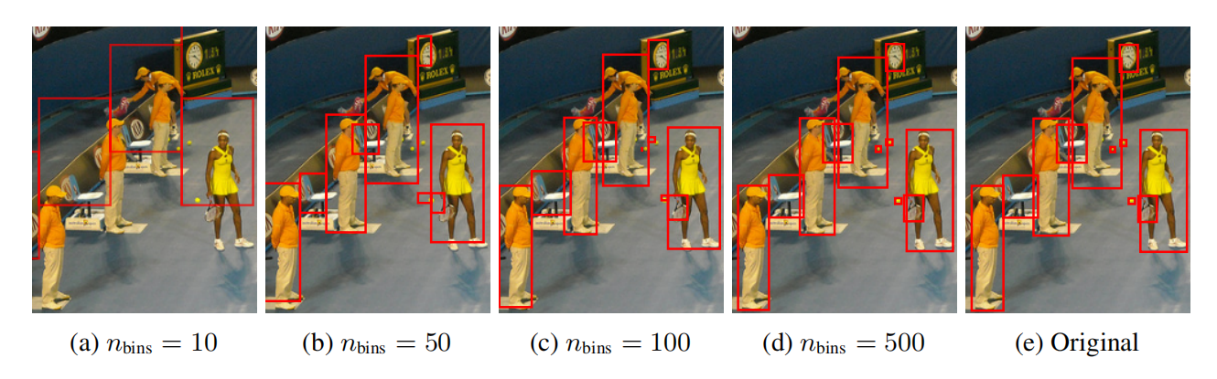
Applying the proposed discritization of bounding box on an image of 480 × 640. Only a quarter of the image is shown for better clarity. With a small number of bins, such as 500 bins (∼1 pixel/bin), it achieves high precision even for small objects.

Slide 5
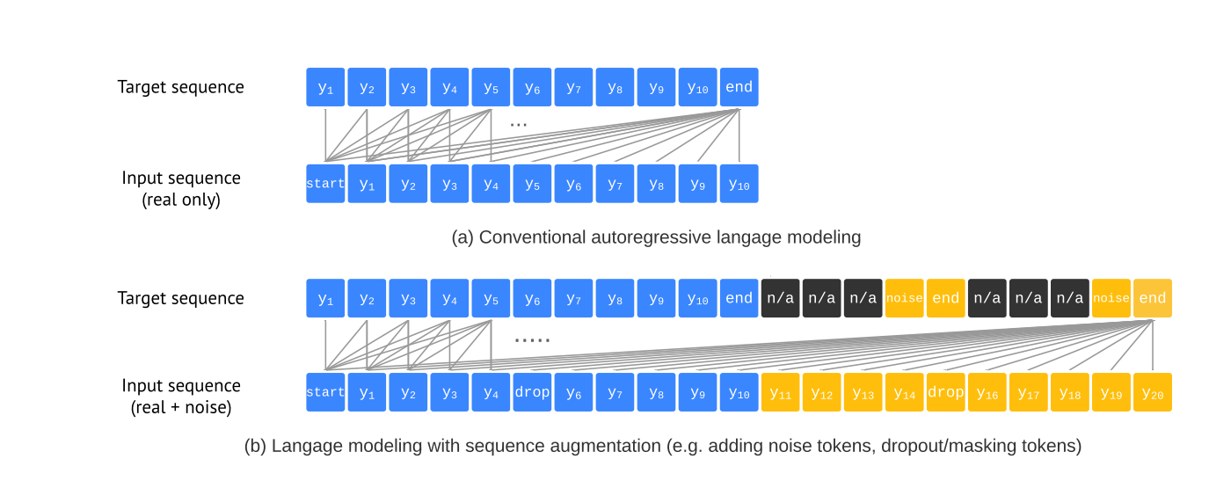
Illustration of language modeling with / without sequence augmentation. With sequence augmentation, input tokens are constructed to include both real objects (blue) and synthetic noise objects (orange). We also randomly dropout the class input tokens.
For the noise objects, the model is trained to identify them as the “noise” class, and we set the loss weight of “n/a” tokens to zero since we do not want the model to mimic them.

Slide 6
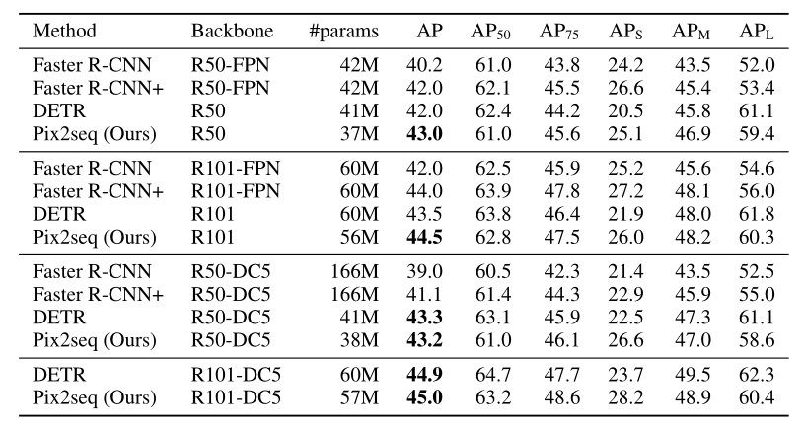
Comparison of average precision, over multiple thresholds and object sizes, on COCO
validation set. Each section compares different methods of the similar ResNet “backbone”. Our
models achieve competitive results to both Faster R-CNN and DETR baselines.

