Slide 1


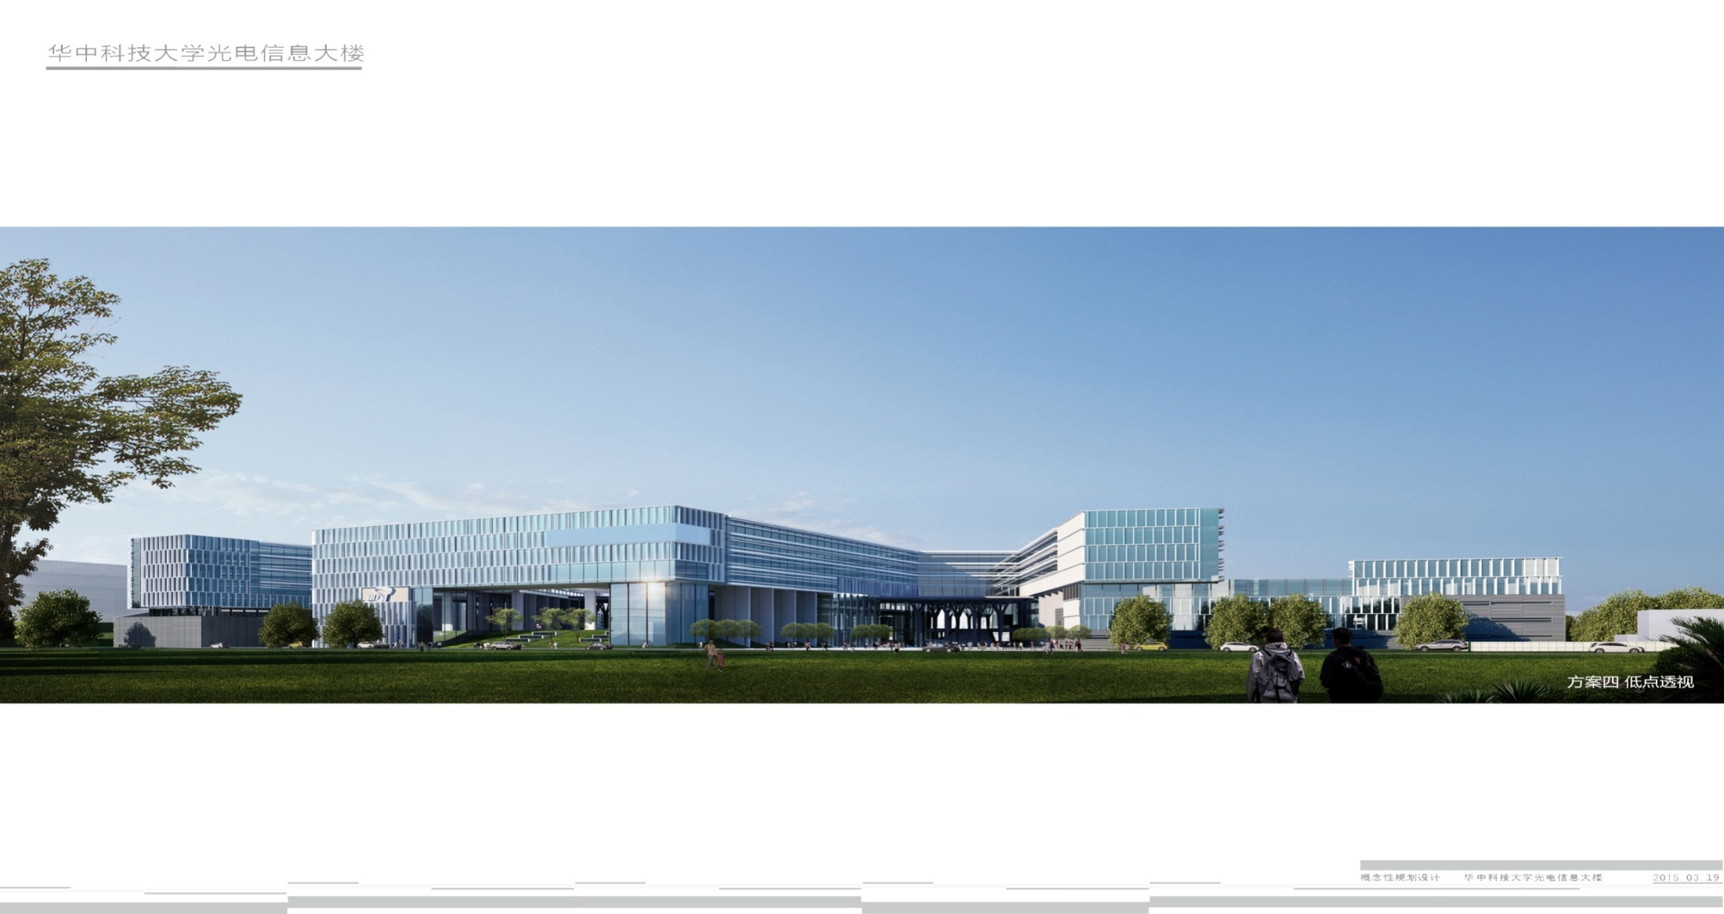
Paper sharing:Pix2seq series
Speaker :Ying Jie

Slide 2

Introduction

