Slide 1
ManufacturingCompanyProductManagement Scenario 1 XYZ MANUFACTURING CUSTOMER ORDER AND PRODUCT APPLICATION

Slide 2
ManufacturingCompanyProductManagement
Overall Description:
The XYZ Manufacturing company needs a database for customer order and products.

Slide 3
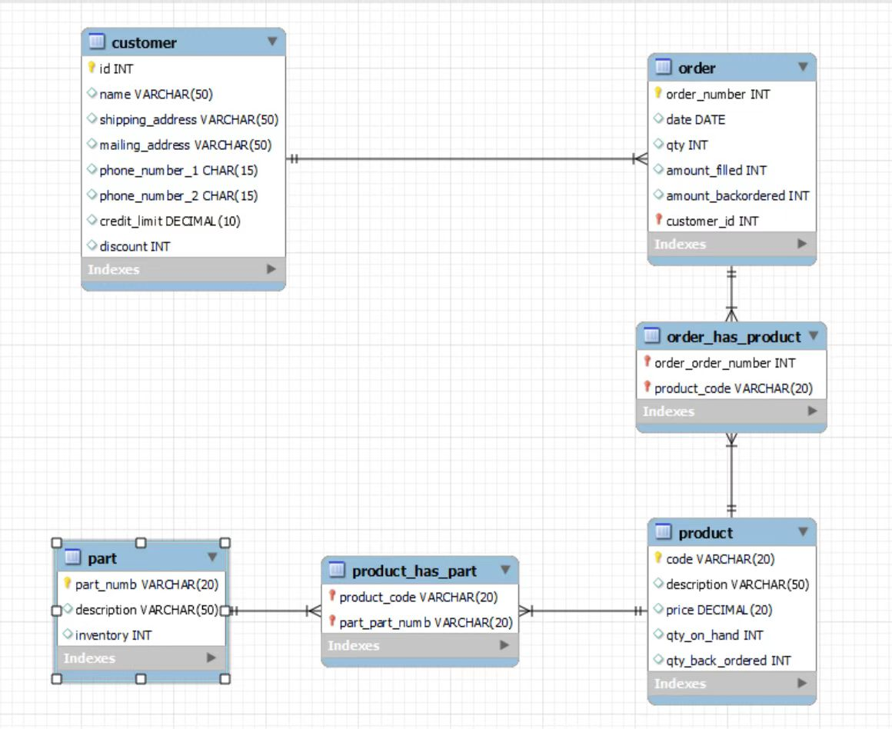
Physical diagram

Slide 4
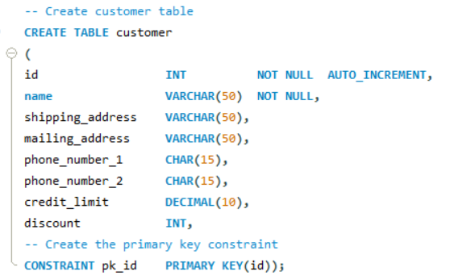
DDL - customers

Slide 5
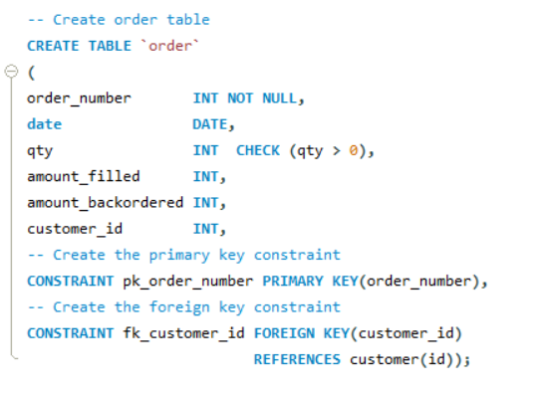
DDL - order

Slide 6
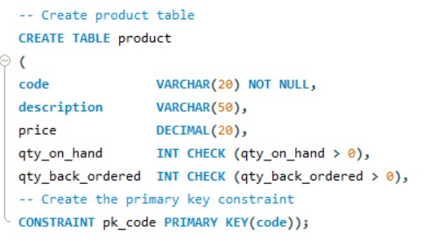
DDL -product

Slide 7
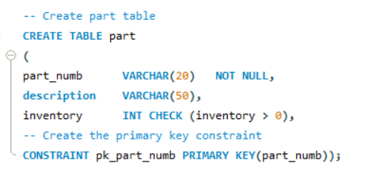
DDL -part

Slide 8
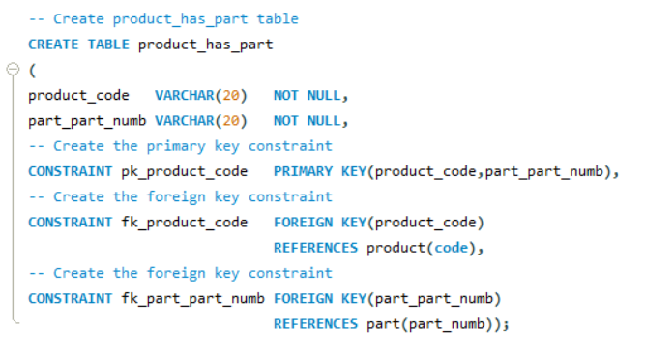
DDL –product_has_part

Slide 9
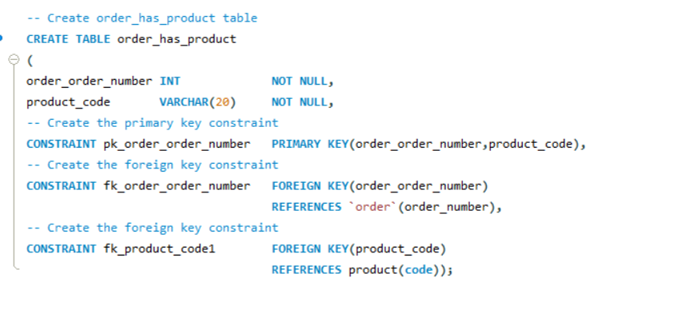
DDL –order_has_product

Slide 10
Customers table-One sample of inserts
DDL - customers
INSERT INTO customer (name,shipping_address,mailing_address,phone_number_1,phone_number_2,credit_limit,discount) VALUES
("Jack Rhodes","7830 Quam St.","4724 Sed Road","1-338-117-3475","(321) 604-2310",4,9);

Slide 11
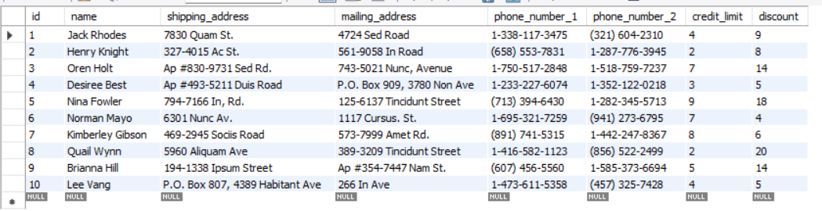
Test Data - customers

Slide 12
Order table-One sample of inserts
DDL - order
INSERT INTO `order` (order_number,date,qty,amount_filled,amount_backordered,customer_id)VALUES
("16381930","2022-10-16",23,5,18,1);

Slide 13
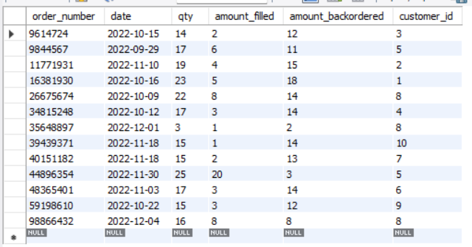
Test Data - order

Slide 14
Product table-One sample of inserts
INSERT INTO product (code,description,price,qty_on_hand,qty_back_ordered)VALUES
("GBV73JSG8CU","Nam interdum enim",370,9,18);

Slide 15
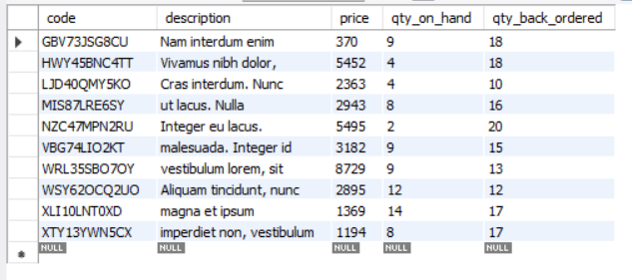
Test Data - product

Slide 16
Part table-One sample of inserts
INSERT INTO part (part_numb,description,inventory)VALUES
("DIZ11QFC1HP","vestibulum, neque sed",12);

Slide 17
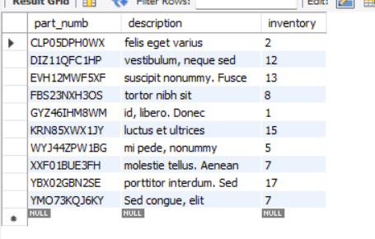
Test Data -part

Slide 18
Product_has_part table-One sample of inserts
INSERT INTO product_has_part (product_code,part_part_numb)
VALUES ("GBV73JSG8CU","DIZ11QFC1HP");

Slide 19
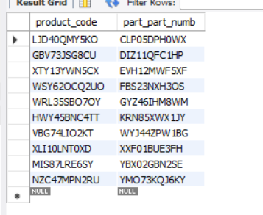
Test Data - Product_has_part

Slide 20
Order_has_product table-One sample of inserts
INSERT INTO order_has_product(order_order_number, product_code)VALUES
("16381930","GBV73JSG8CU");

Slide 21
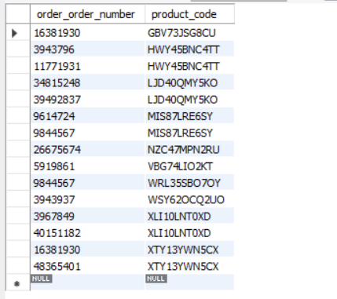
Test Data - Order_has_product

Slide 22
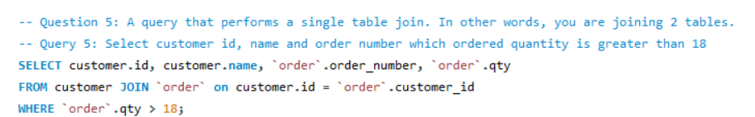
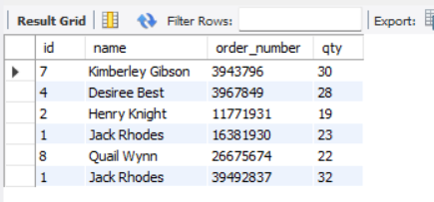
Queries
Single join:
Query 5: Select customer id, name and order number which ordered quantity is greater than 18
SELECT customer.id, customer.name, `order`.order_number, `order`.qty
FROM customer
JOIN `order`
ON customer.id = `order`.customer_id WHERE `order`.qty > 18;

Slide 23
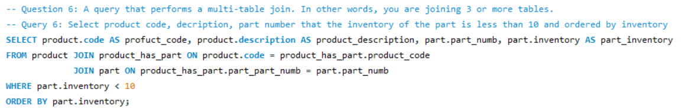
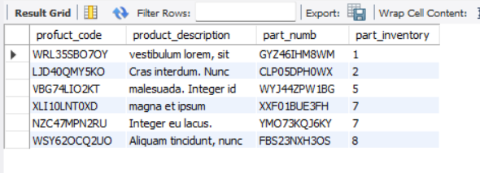
Queries
Multiple joins:
Query 6: Select product code, decription, part number that the inventory of the part is less than 10 and ordered by inventory
SELECT product.code AS profuct_code, product.description AS product_description, part.part_numb, part.inventory AS part_inventory
FROM product
JOIN product_has_part
ON product.code = product_has_part.product_code
JOIN part
ON product_has_part.part_part_numb = part.part_numbWHERE part.inventory < 10
ORDER BY part.inventory;

Slide 24

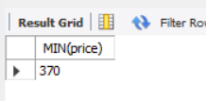
Queries
Performing aggregate:
Query 7: Select the minimum price in product table
SELECT MIN(price) FROM product;

Slide 25
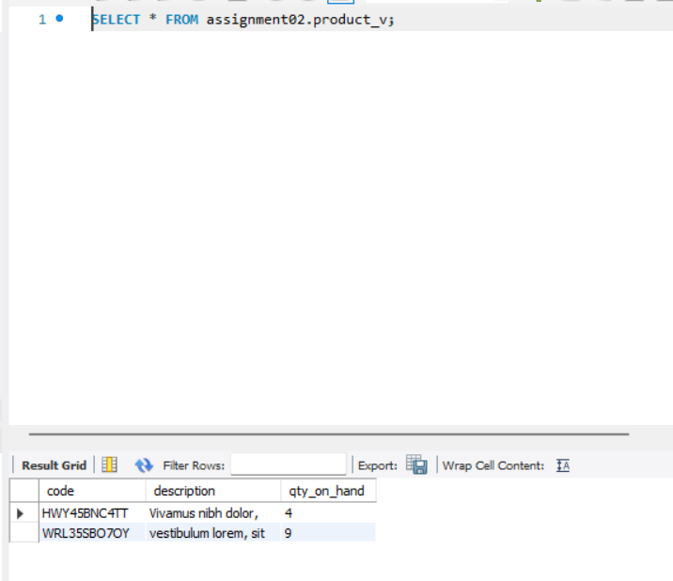
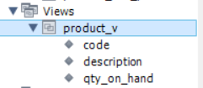
Queries
Dynamic View :
Question 1: Create dynamic view which name is product_V. In the view, contains product code, -- description and quantity on hand which has condition that price equal 5452 or 8729.
DROP VIEW IF EXISTS product_V;
CREATE VIEW product_V AS
SELECT code, description, qty_on_hand
FROM product
WHERE price = 5452 OR price = 8729;

Slide 26
Thank you!

