Slide 1

Parallel Computing in Bioconductor
Jiefei Wang
08/02/2023

Slide 2
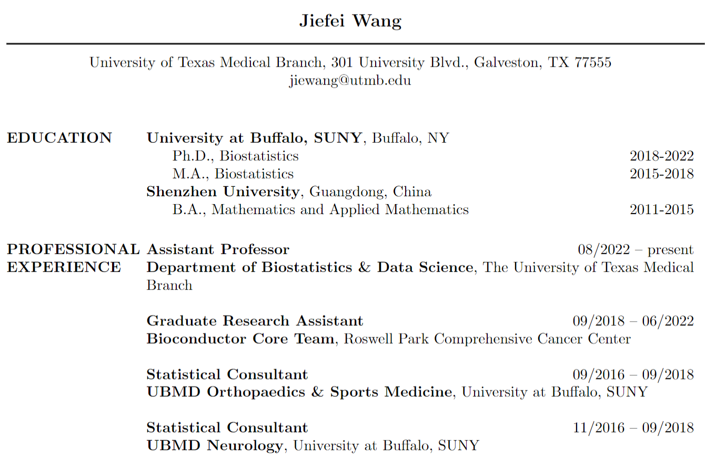

About me

Slide 3

Workshop Organization
This is a practice-driven workshop
You are expected to do some coding
We will focus on the core concept of parallel computing

Slide 4
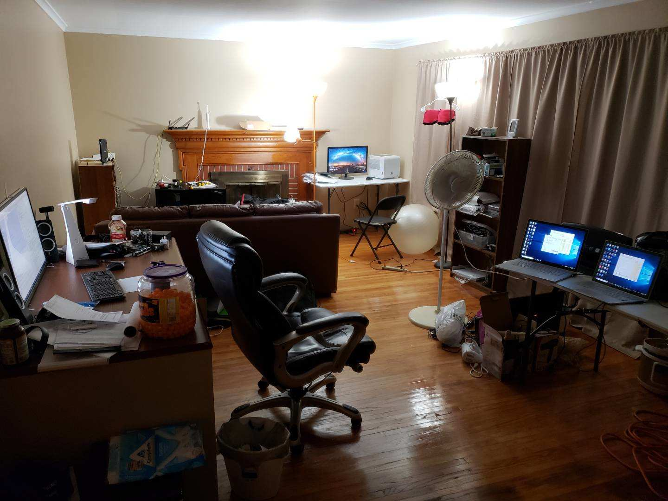
Start of the Story
A mini cluster with two desktop and two laptops
The cluster had 16 cores and 32 workers in total
The process of starting workers were incredibly cumbersome at that time
"Okay," I said, "let me make high-performance computing simpler."
Photo taken on July 10, 2018 at Buffalo

Slide 5
My Packages
Photo taken on July 10, 2018 at Buffalo

Slide 6
What is Parallel Computing?
How many steps does it take to put a giraffe into the refrigerator?
Open the door
Put the giraffe in the refrigerator
Close the door
How many steps does it take to put an elephant into the refrigerator?
Open the door
Take the giraffe out
Put the elephant in the refrigerator
Close the door
Photo taken on July 10, 2018 at Buffalo

Slide 7
What is Parallel Computing?
How many steps does it take to do parallel computing?
Start a master process
Start worker processes
Split a job into smaller tasks
Send tasks to workers
Receive and combine results from workers
Photo taken on July 10, 2018 at Buffalo

Slide 8
Jargon
Cluster: A set of workers working together to perform computational tasks in parallel
Master: The main R process that starts the parallel computing
AKA: Server
Worker: The R process that performs the actual computation in a cluster
AKA: Slave
We use the words 'master' and 'worker' in this workshop. The word 'server' will refer to the literal server.

Slide 9
Cluster Structure
R worker
R worker
R master
R worker
R worker
A simple parallel computing structure
Photo taken on July 10, 2018 at Buffalo

Slide 10
Job Splitting Diagram
R worker
Job
Task 1
Task 2
Task 3
R worker
Split
Task 4
Feed
Task 5
Task 6
R worker
Task 7
Task 8
R worker
A simple job splitting method
Photo taken on July 10, 2018 at Buffalo

Slide 11
Beginner Example

Slide 12
R worker
R worker
R master
R worker
R worker
Parallel Computing via Direct Connection

Slide 13
R worker
R worker
R master
Redis Server
R worker
R worker
Parallel Computing via an Indirect Connection

Slide 14
R worker
Job
Task 1
Task 2
Task 3
R worker
Split
Task 4
Feed
Task 5
Task 6
R worker
Task 7
Task 8
R worker
Parallel Computing via an Indirect Connection

Slide 15
SnowParam
Single Computer
R worker
R worker
R master
Local Network
R worker
R worker
Parallel Computing via Direct Connection

Slide 16
R worker
Job
lapply(1:8, square)
Task 1
lapply(1:2, square)
Task 2
lapply(3:4, square)
R worker
Split
Feed
Task 3
lapply(5:6, square)
R worker
Task 4
lapply(7:8, square)
R worker

Slide 17
SnowParam
Computer 2
Computer 1
Computer 2
IP address
R worker
R worker
R master
Computer 3
R worker
Computer 3
IP address
R worker
Parallel Computing via Direct Connection

Slide 18
RedisParam
Single Computer
R worker
R worker
R master
Redis Server
R worker
R worker

Slide 19
Jiefei’s computer
Cloud Server
Donator 1
R worker
R worker
R master
Redis Server
Donator 2
R worker
R worker

Slide 20
Start
Number of computers in cluster
Single computer
Multiple computer
OS type
Windows
Linux
SnowParam
MulticoreParam
RedisParam

