Slide 1
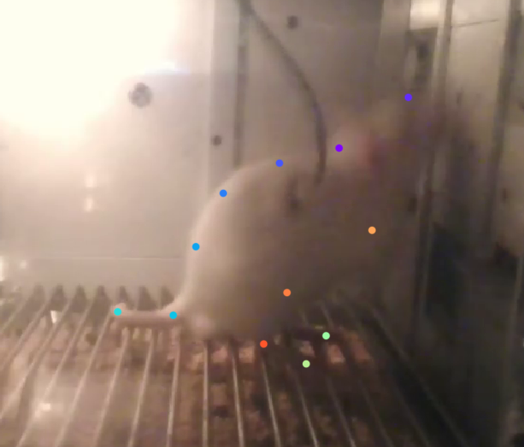
Right hip is not accurate

Slide 2
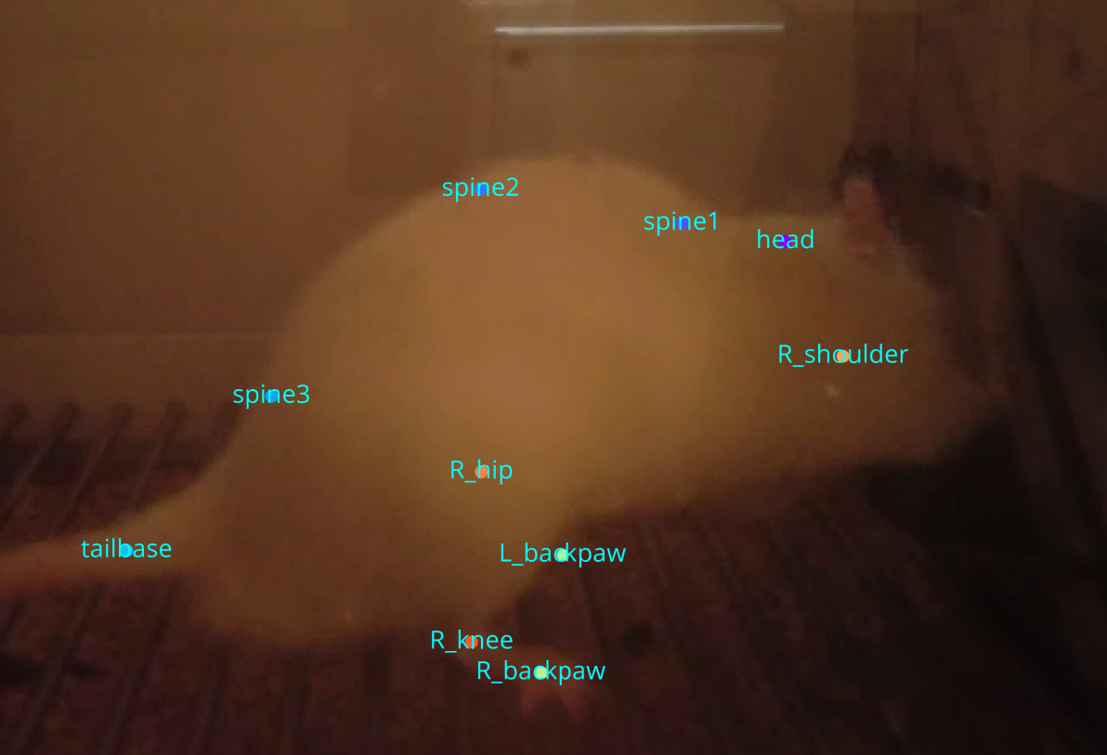
Right shoulder does not contain any learnable features, so we remove them

