Slide 1

#Bellabeat
Intro
Analysis
Summary
Apply
How Can a Wellness Technology Company Play It Smart?
Presented By: Lai Jien Weng
Last Updated: May 31, 2024

Slide 2
Table Of Contents
Intro
Analysis
Summary
Apply
Purpose Statement (What are we talking about?)
Tell Your Story
Conclusion

Slide 3
Executive Summary
Key Findings
Impact
Analysis of FitBit’s data reveals insights into consumer usage patterns, particularly regarding sleep behavior.
Potential growth opportunities identified in expanding product lines
Increase Bellabeat’s sales and market presence, positioning the company for global expansion.

Slide 4
What are we talking about?

Slide 5
Overview
Intro
Analysis
Summary
Apply
Background
Mission
Bellabeat is a high-tech manufacturing company specializing in wellness products for women.
Known for its innovative smart devices, Bellabeat aims to empower women to lead healthier lives.
“To create beautiful, innovative products that inspire women to be healthier and more mindful.”

Slide 6
Objectives
Intro
Analysis
Summary
Apply
Increase sales through targeted marketing strategies.
Explore growth opportunities in new markets and product lines.
Leverage data insights to inform product development and enhance consumer engagement.

Slide 7
Before going into analysis…
Intro
Analysis
Summary
Apply
You need to know that:
Data Source: FitBit Fitness Tracker Data (CC0: Public Domain, dataset available on Kaggle)
Content: Daily activity, steps, heart rate, and sleep monitoring data from 30 Fitbit users.
Data Collection Period: March 12, 2016 - May 12, 2016

Slide 8
Tell Your Story

Slide 9
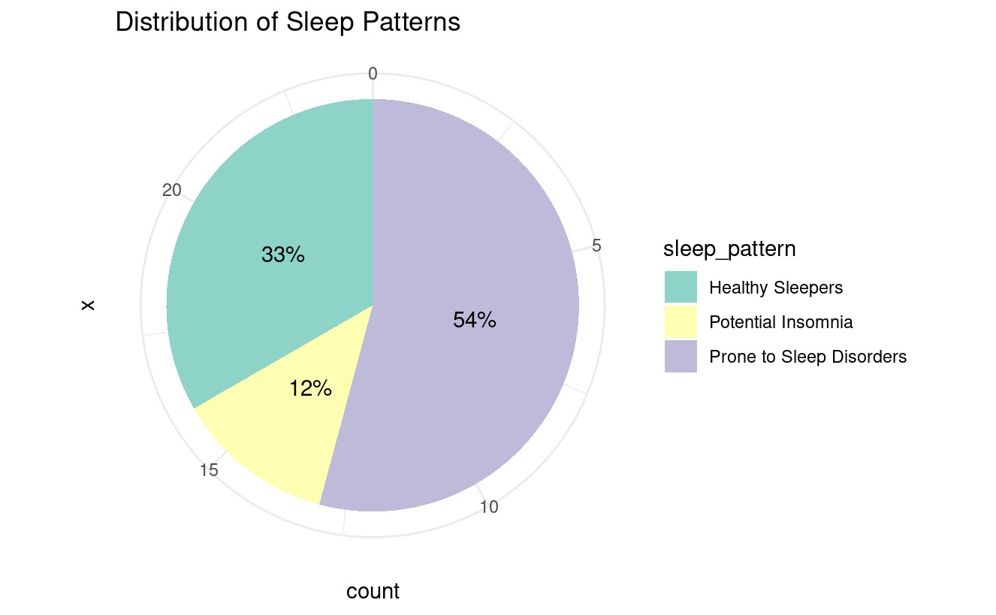
Sleep Patterns
Intro
Analysis
Summary
Apply
Majority users are prone to sleep disorders.
This indicates a significant market for sleep improvement solutions.

Slide 10
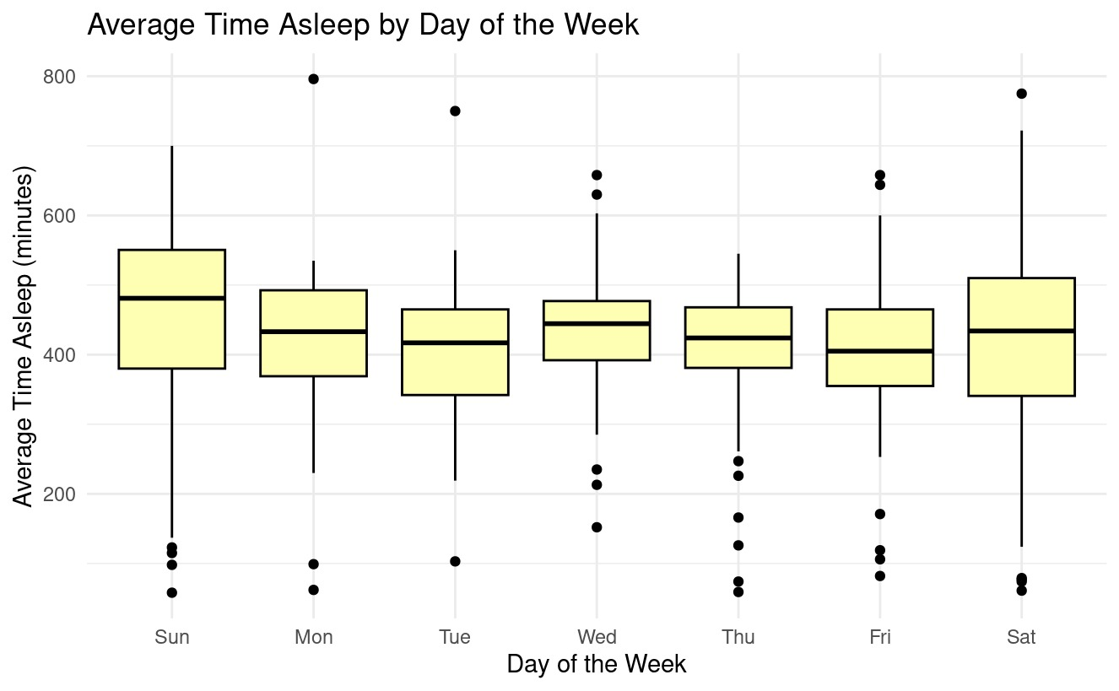
Time Asleep
Intro
Analysis
Summary
Apply
Sleep duration is relatively high with greater variability on weekend (Saturday & Sunday)
This indicates inconsistency of sleep duration, lead to low sleeping quality.

Slide 11
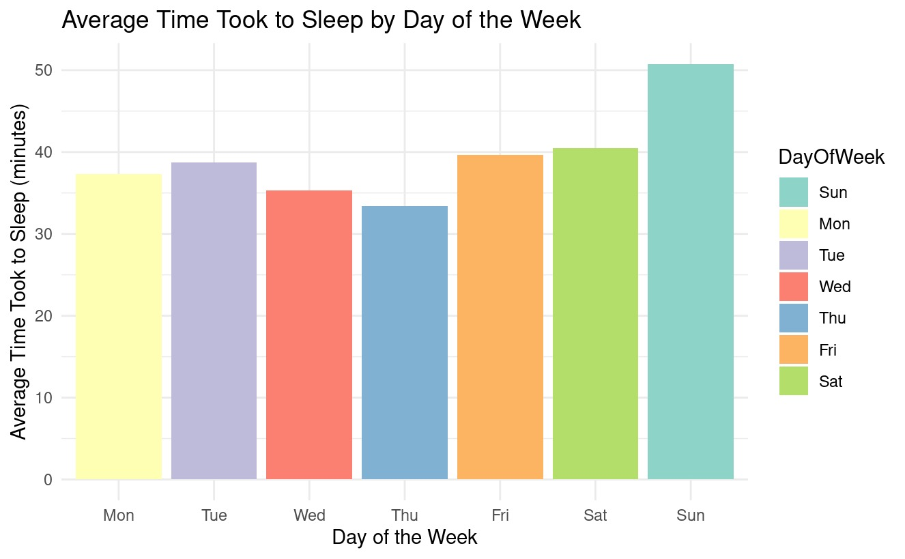
Time Took to Sleep
Intro
Analysis
Summary
Apply
Sunday has the highest average time to fall asleep, the rest are relatively consistent.
This indicates possible anxiety about the upcoming week.

Slide 12
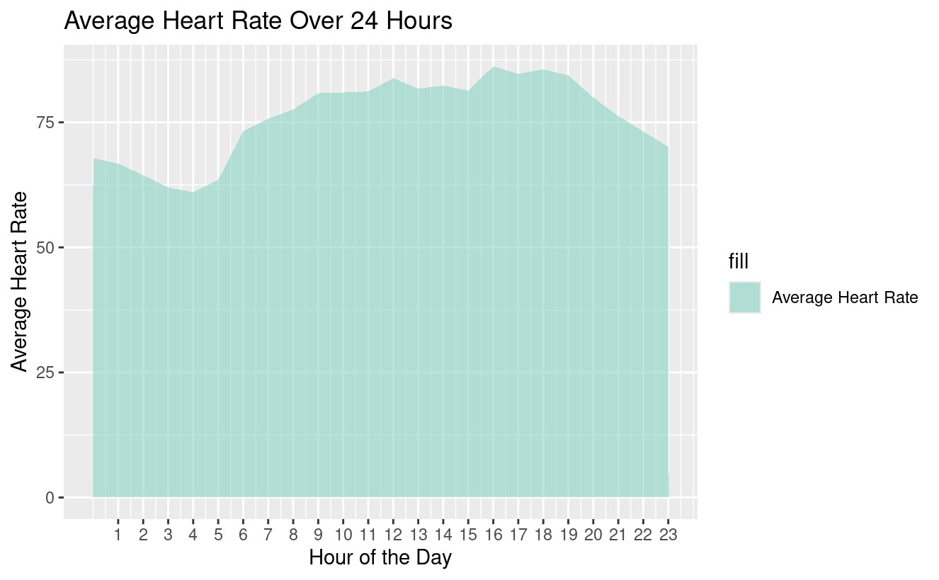
Heart rate
Intro
Analysis
Summary
Apply
Midnight:
Average heart rate is low, indicating restful sleep and high parasympathetic activity.
3:30pm - 7:00pm:
Average heart rate is high due to physical activities or exercise.

Slide 13
Conclusion

Slide 14
Key Findings
Intro
Analysis
Summary
Apply
Sleep Patterns
Time Asleep:
Significant market for sleep improvement solutions.
Inconsistent sleep duration suggests lower sleep quality.
Time Took to Sleep
Heart Rate
Possible anxiety on Sunday night about the upcoming week.
Heart rate dips during midnight rest and rises in the afternoon during physical activity.

Slide 15
Actionable Insights
Intro
Analysis
Summary
Apply
Sleep Patterns
Time Asleep:
Tailor recommendations based on sleep classification.
Offer personalized consultation for each user group.
Introduce aromatic devices for insomnia.
Promote sleep education content.
Time Took to Sleep
Heart Rate
Introduce guided meditation features.
Alert users of abnormal heart rates.
Promote consistent physical activity

Slide 16
#Thanks!
Do you have any questions? reallyhat@gmail.com
https://jienweng.github.io

