Slide 1
QLoRA Fine-Tuning of Qwen3-4B on a Curated Chinese Tourism Q&A Corpus from Undergraduate Contributors
LI Xinjie
Notes:
4-bit Qwen3-4B with LoRA adapters on curated Chinese tourism Q&A, achieving better performance

Slide 2

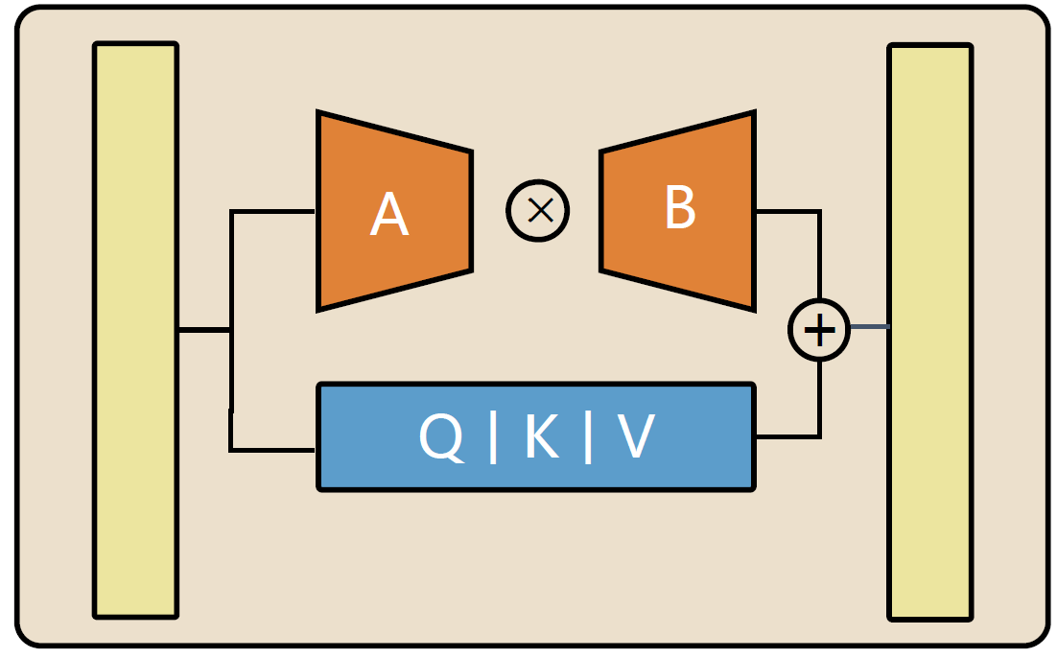

From Curated Multi-Style Q&A to a Chinese Tour Assistant:
Curated Dataset
Supervised Finetuning
Curated tourism Q&A from 136 undergraduate students (117 for train, 19 for validation)
Chinese Tour Assistant
Data augmentation to 1170 Q&A
Spoken expression
Validation by experts
Formal expression
Concision expression

Slide 3



Human-in-the-Loop Evaluation: Gold-Standard Creation and LLM Review
Validation by another human expert
Chinese Tour Assistant
5 unseen prompt created by one expert
Comparison with “Gold Standard” expert answer
Create “Gold Standard” Answers
Validation by LLM
Stage 1
Stage 2

Slide 4
Evaluation scoring system (Wei, 2024):
Category | Score | Explanation
Consistency | 0 | The answer is entirely irrelevant to the question.
 | 1 | The answer is somewhat relevant to the question.
 | 2 | The answer is relevant to the question.
 | 3 | The answer is highly relevant to the question.
Readability | 0 | The answer is extremely difficult to understand or has poor grammar and structure.
 | 1 | The answer is somewhat difficult to understand or has grammatical errors.
 | 2 | The answer is clear, with only a few grammatical errors or room for improvement.
 | 3 | The answer is very clear, well structured, has no grammatical errors and is easy to understand.
Availability | 0 | There are serious problems or errors in the answer and the answer is not very usable.
 | 1 | There are some errors in the answer, some of which need to be verified by searching for the answer.
 | 2 | The answer is error-free, with only a few confusing elements.
 | 3 | The answer is error-free and instructive, providing a better experience for travellers.
Human experts and LLM are given this table for evaluation

Slide 5
Supervised Finetuning
rank = 16
Alpha = 32
learning rate = 5e-4
Warm up = 0.05
Epoch = 2
rank = 16
Alpha = 32
learning rate = 5e-4
Warm up = 0.1
Epoch = 2
rank = 16
Alpha = 32
learning rate = 1e-4
Warm up = 0.1
Epoch = 2
rank = 16
Alpha = 32
learning rate = 5e-4
Warm up = 0.05
Best val loss: 2.55, overfitted
Best val loss: 2.42
overfitted
Best val loss: 1.90
Plateau of loss
rank = 32
Alpha = 64
learning rate = 8e-5
Warm up = 0.1
Epoch = 6
rank = 32
Alpha = 64
learning rate = 1e-4
Warm up = 0.1
Epoch = 6
rank = 32
Alpha = 64
learning rate = 1e-4
Warm up = 0.1
Epoch = 4
Best val loss: 0.81
No signs of overfit
Best val loss: 1.40
overfit
Best val loss: 1.74
No sign of overfit

Slide 6
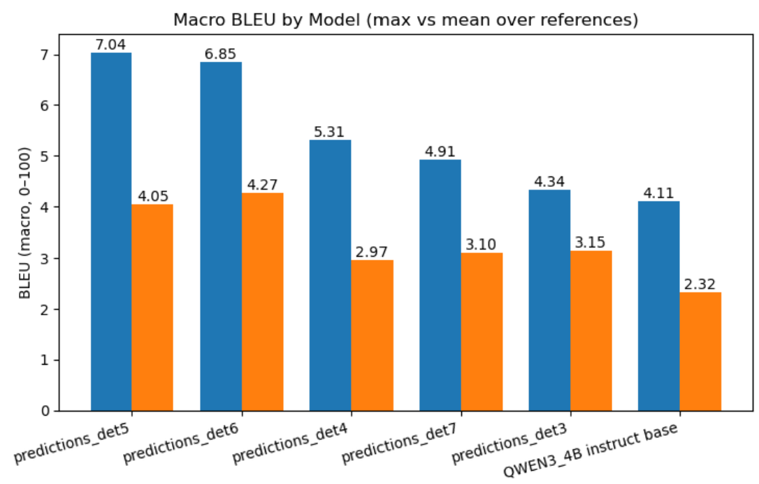
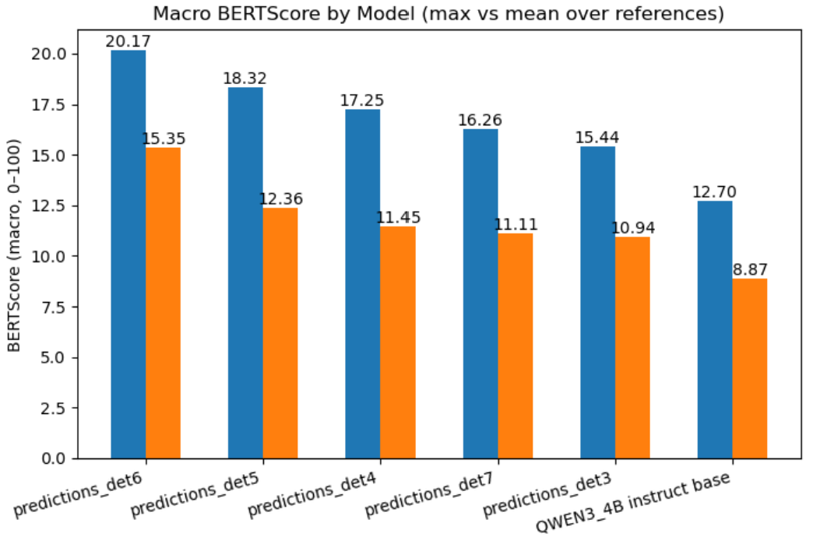

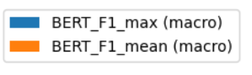
Test against benchmarks (deterministic)
Notes:
predictions_det5 and predictions_det6 top the BLEU chart, indicating the highest n-gram overlap with references under deterministic decoding.
The base QWEN3_4B instruct remains lowest,
predictions_det6 leads on BERT_F1_max, followed by det5 and det4.
Rankings are broadly consistent with BLEU, suggesting gains are semantic, not only surface-level.

Slide 7
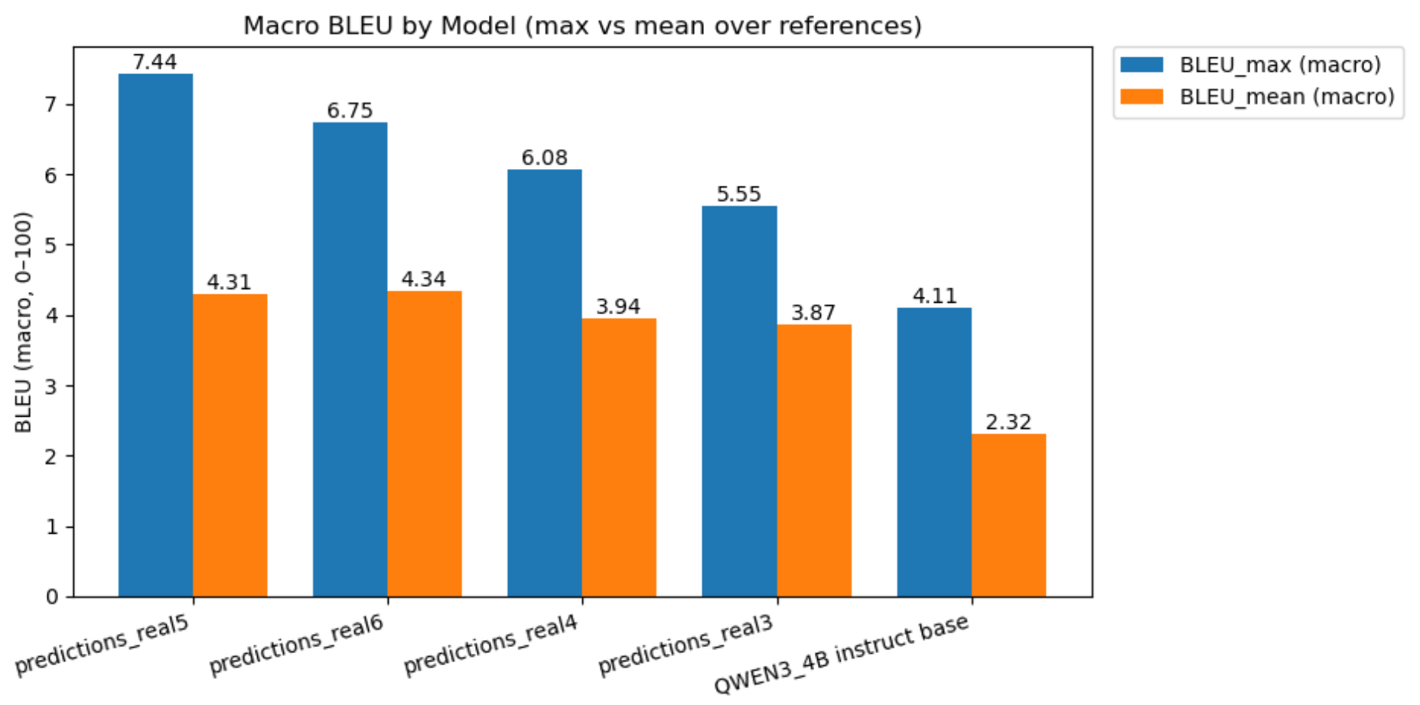
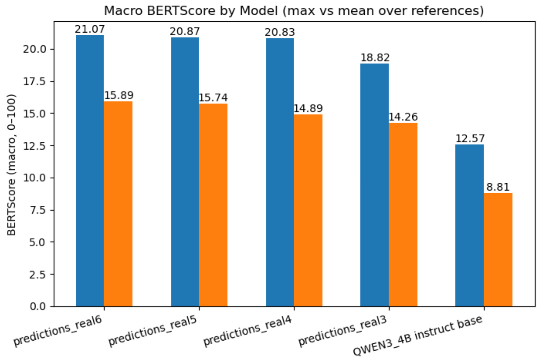
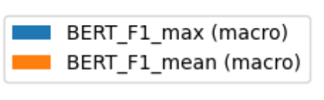
Test against benchmarks (with temperature=0.5)
Notes:
On the left, we see the BLEU scores, which measure n-gram overlap between model outputs and the expert reference answers. Models predictions_real5 and predictions_real6 achieve the highest BLEU scores, indicating that their word-level phrasing is most similar to human references. The base Qwen-3 4B model lags behind, which suggests its responses diverge more lexically even when semantically correct.
On the right, we have BERTScore, which captures semantic similarity at the embedding level — effectively judging whether the model conveys the same meaning, even with different wording. Again, predictions_real6, real5, and real4 perform best, maintaining both lexical and semantic alignment with human-authored answers. The consistent ranking between BLEU and BERTScore indicates that the improvements are genuine semantic gains, not just surface-level imitation.

Slide 8
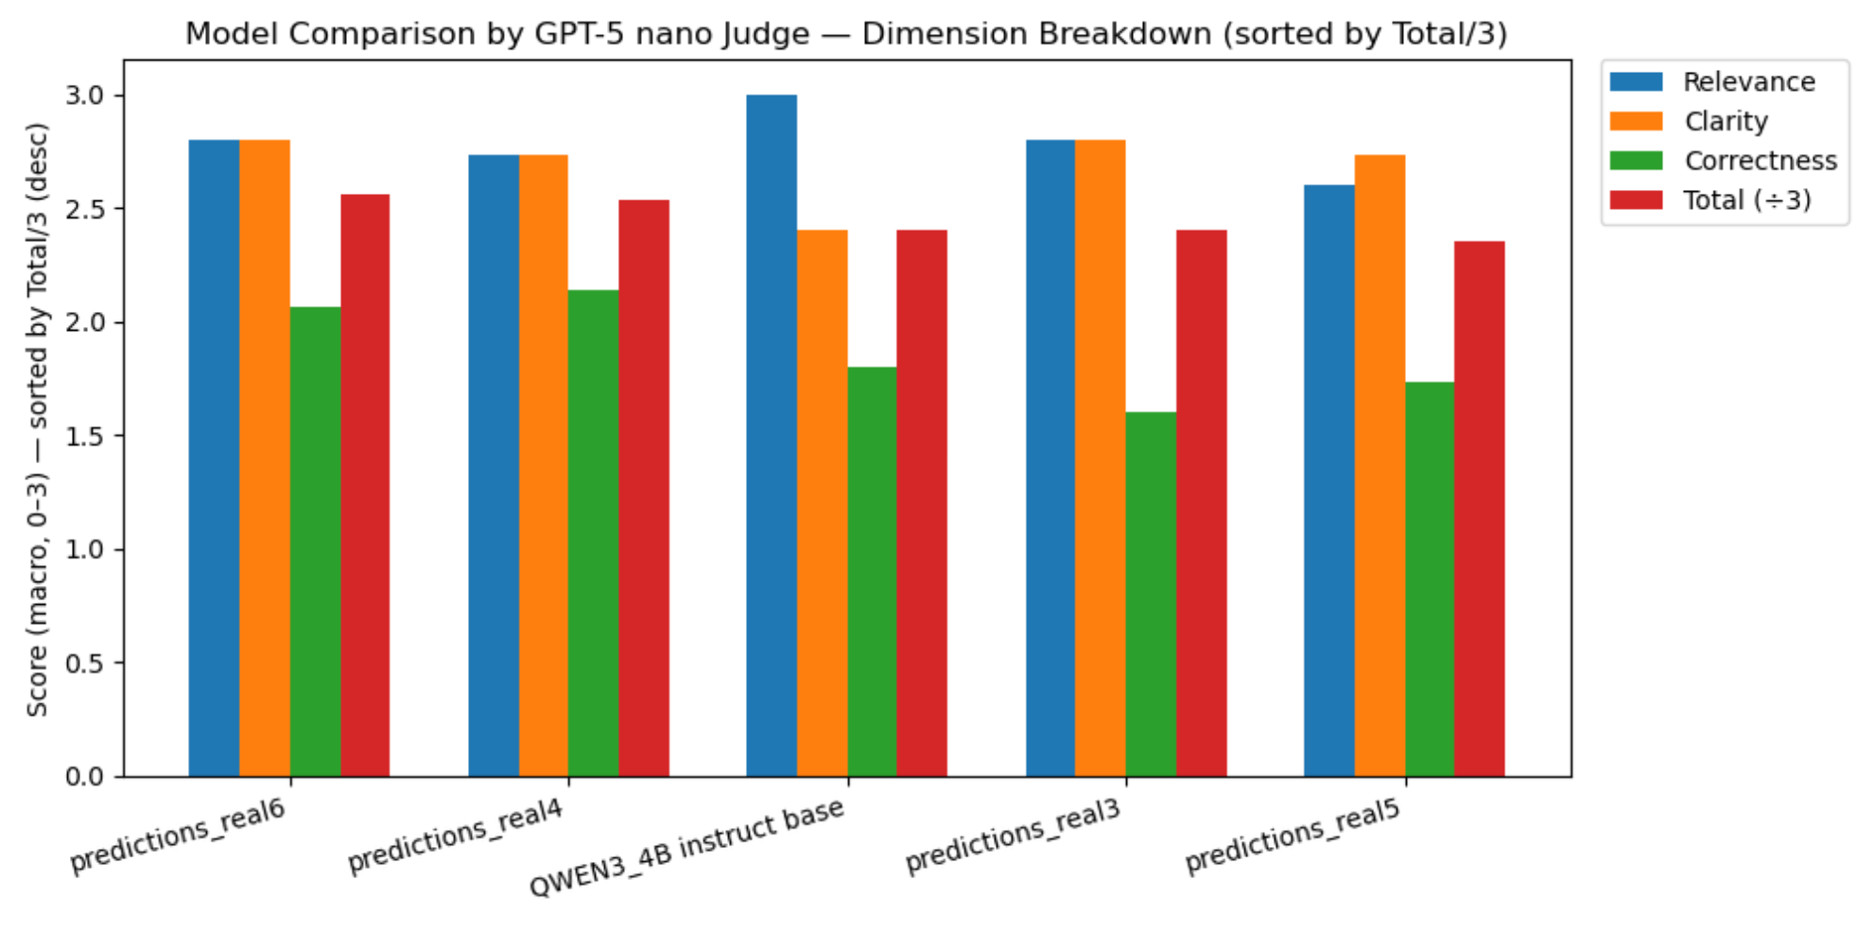
LLM as judge
Notes:
models such as predictions_real6 and predictions_real4 perform best overall, achieving higher clarity and relevance scores. The base Qwen-3 4B model, before fine-tuning, lags slightly behind, indicating that our fine-tuning improved overall answer quality, especially in correctness and clarity

Slide 9
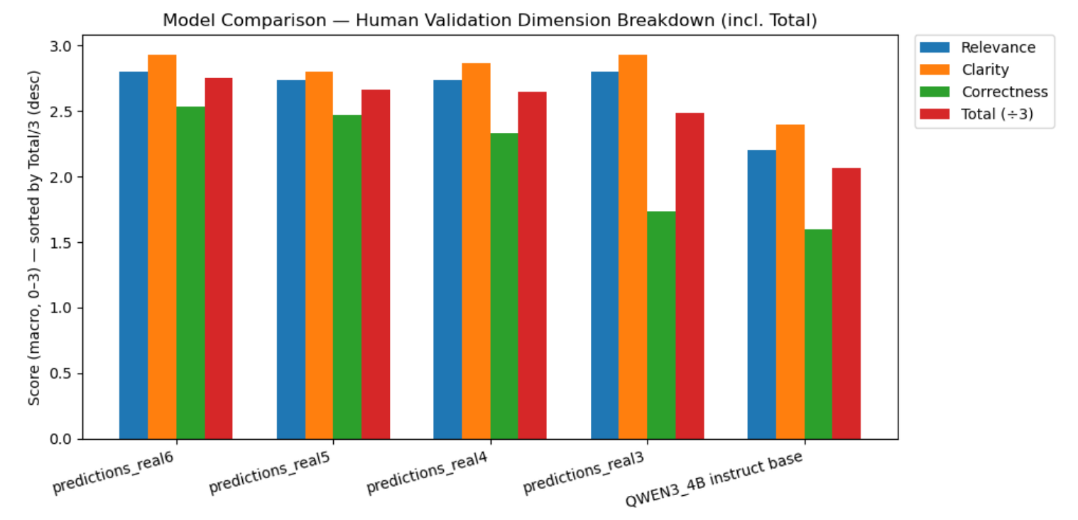
Human as judge
Notes:
the Qwen3-4B base model received lower scores across all dimensions, reaffirming that fine-tuning significantly improved the model’s ability to generate relevant, readable, and accurate responses

Slide 10
Disagreement between metrics
Small validation loss but poor performance in test:
Selection bias for validation set due to small base corpus
Out of Distribution generation of some tasks in test set
Incomplete answer in training data
Small disagreement between human validator and LLM
Although the general trend is similar, human validator are more conservative in relevance ranking and provided a more dispersed feedback for correctness

Slide 11
Reference
Wang, Y., Kordi, Y., Mishra, S., Liu, A., Smith, N. A., Khashabi, D., & Hajishirzi, H. (2023). Self-Instruct: Aligning language models with self-generated instructions. Proceedings of the 61st Annual Meeting of the Association for Computational Linguistics (ACL 2023). https://aclanthology.org/2023.acl-long.754/
Bao, Z., Chen, W., Xiao, S., Ren, K., Wu, J., Zhong, C., Peng, J., Huang, X., & Wei, Z. (2023). DISC-MedLLM: Bridging general large language models and real-world medical consultation. arXiv preprint arXiv:2308.14346. https://arxiv.org/abs/2308.14346
Wei, Q., Yang, M., Wang, J., Mao, W., Xu, J., & Ning, H. (2024). TourLLM: Enhancing LLMs with tourism knowledge. arXiv preprint arXiv:2407.12791. https://arxiv.org/abs/2407.12791
Dettmers, T., Pagnoni, A., Holtzman, A., & Zettlemfinetuning of quantized LLMs. arXiv preprint arXiv:2305.14314. https://arxiv.org/abs/2305.14314
oyer, L. (2023). QLoRA: Efficient Yang, A., Li, A., Yang, B., Zhang, B., Hui, B., Zheng, B., … Zhou, J. (2025). Qwen3 technical report. arXiv preprint arXiv:2505.09388. https://arxiv.org/abs/2505.09388

Slide 12
Thank You

