Slide 1
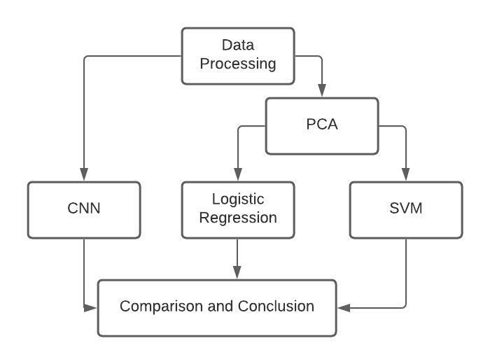
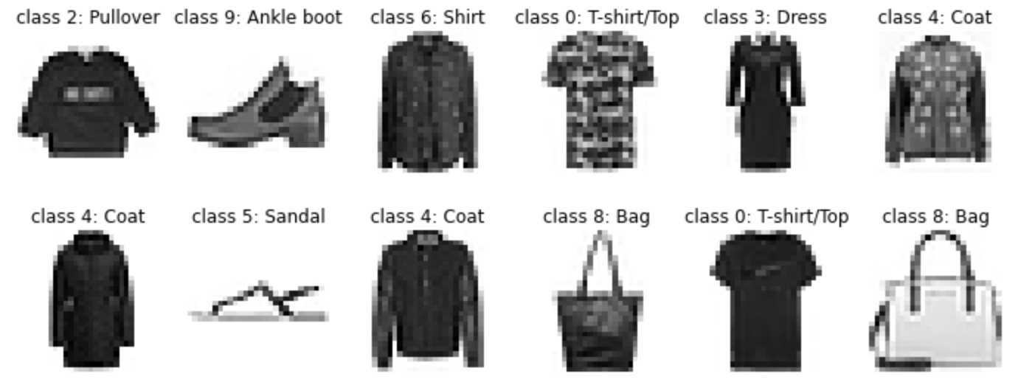
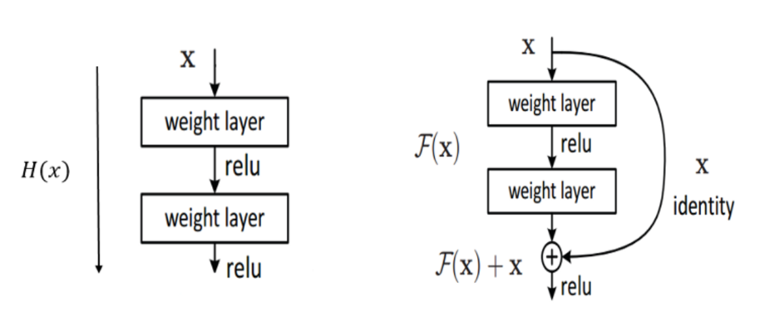
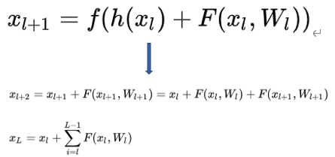
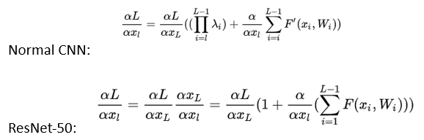
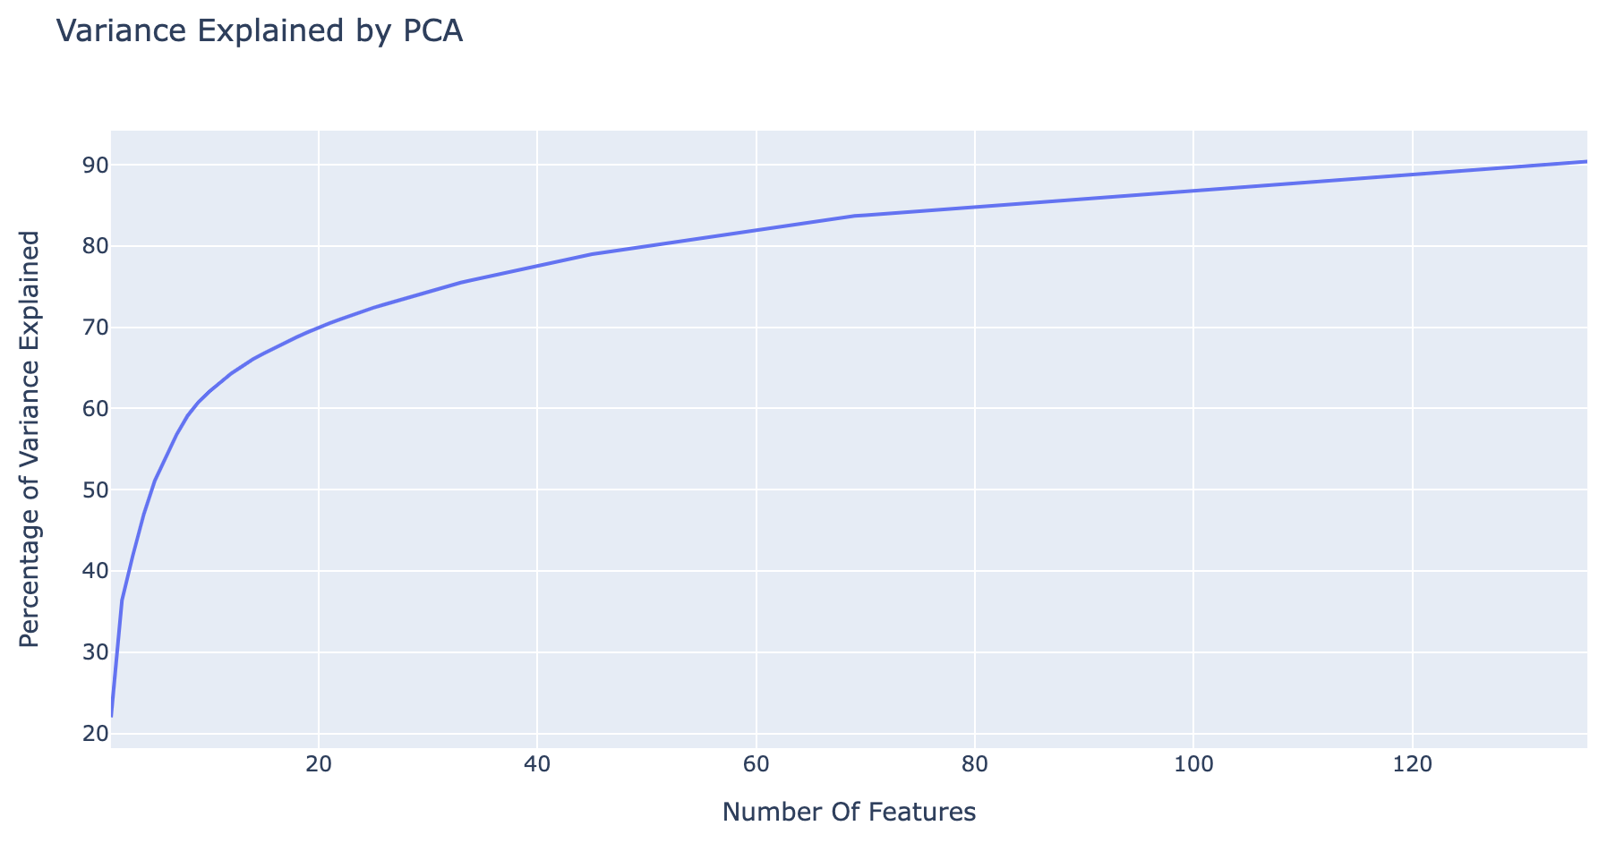
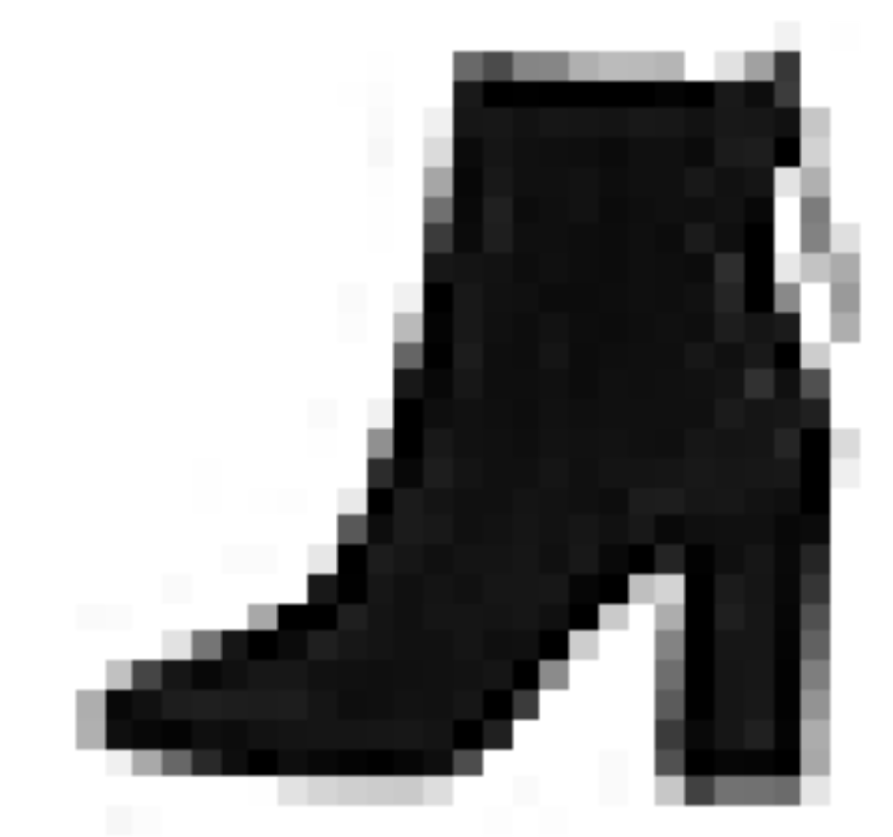
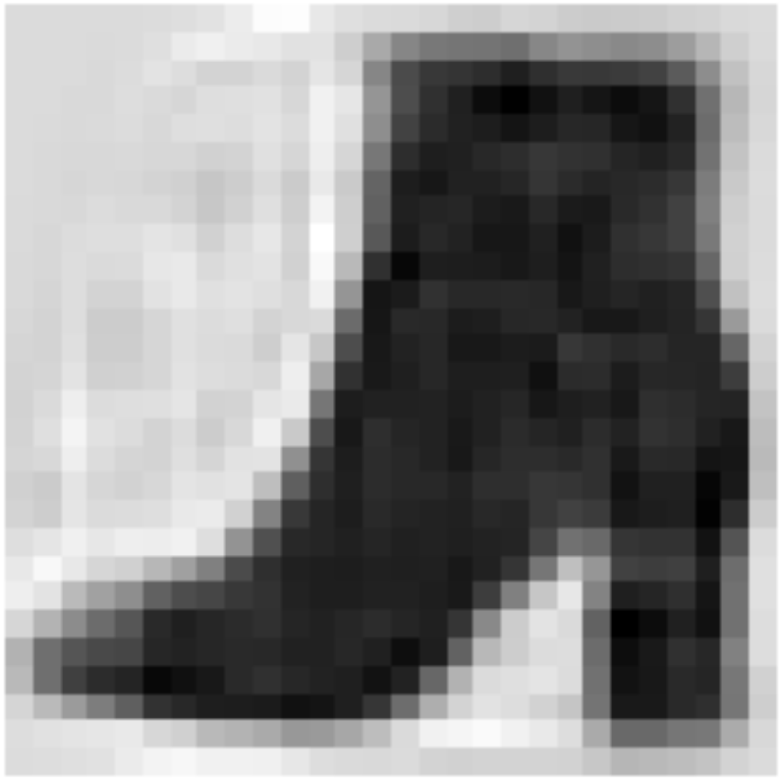
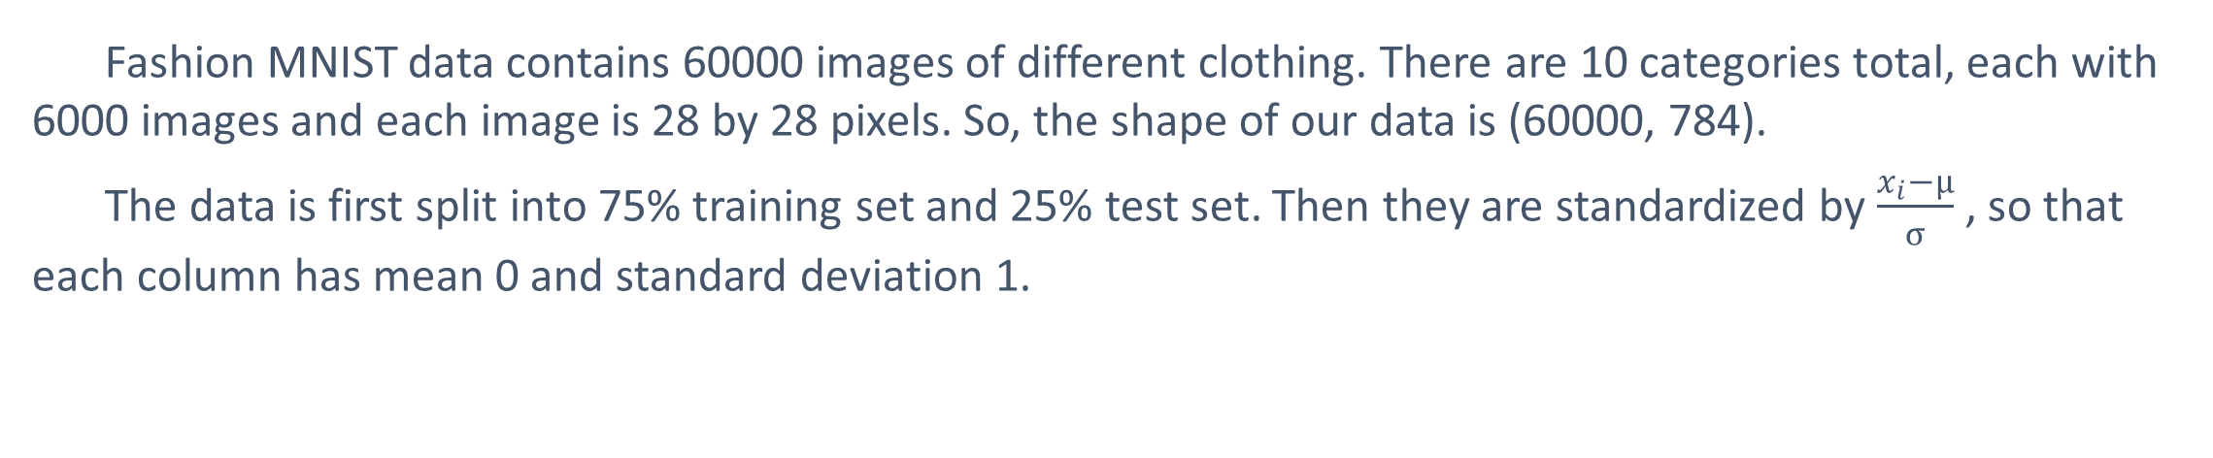

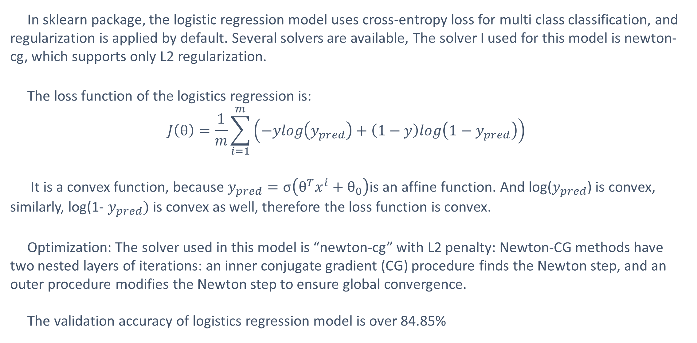
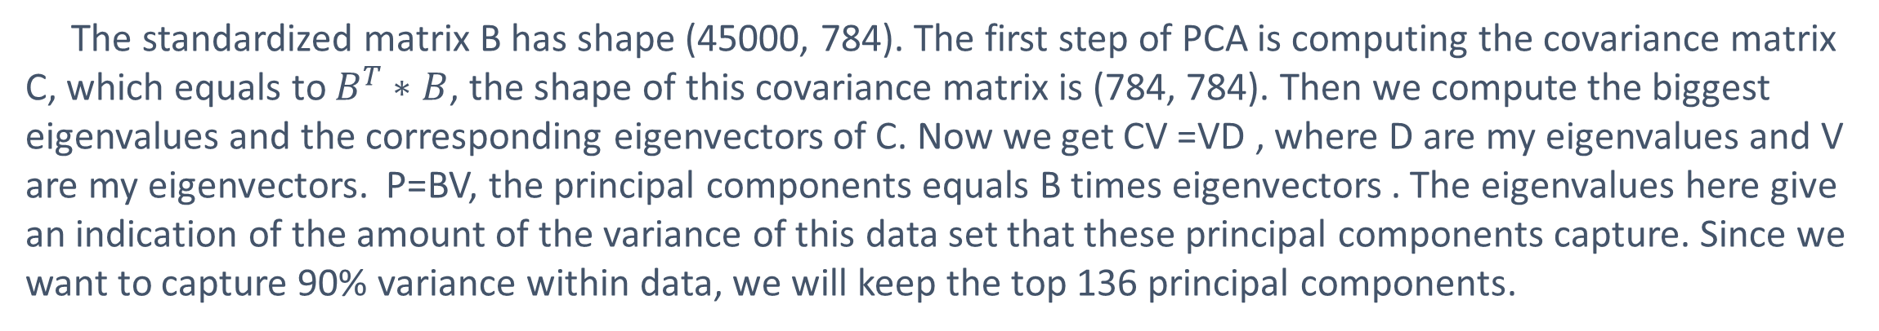
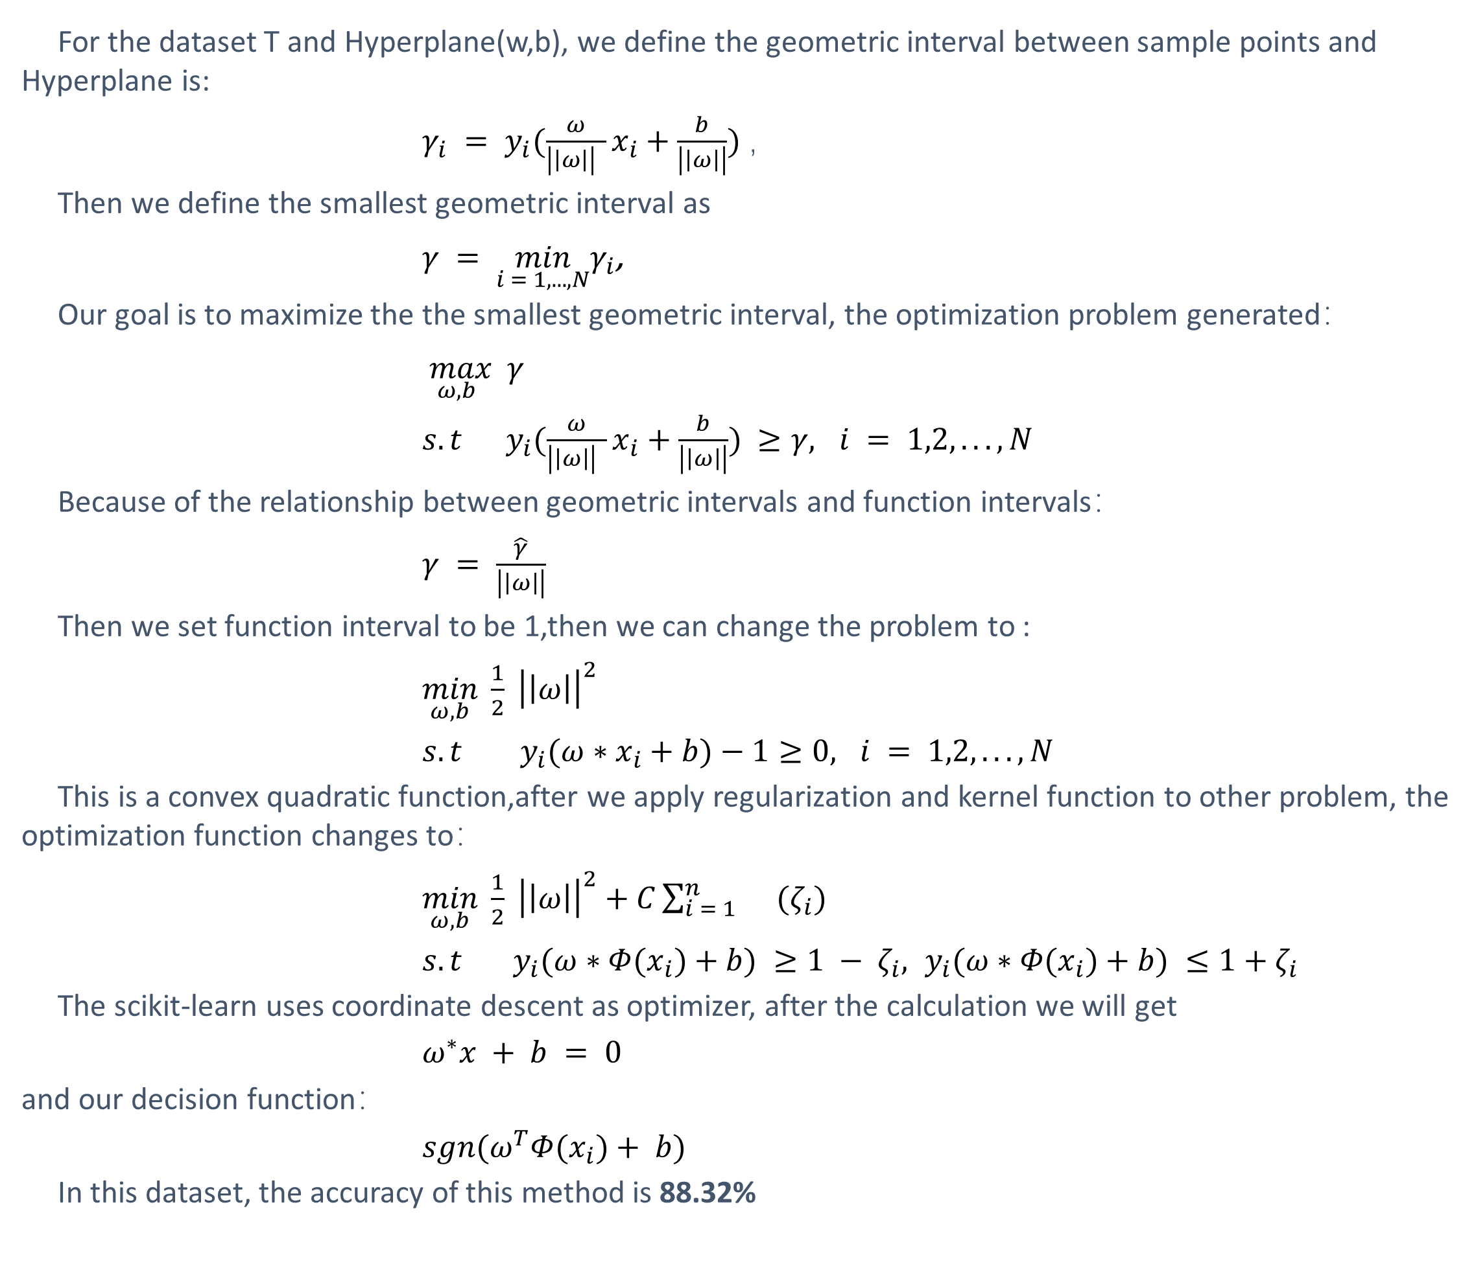
ML MODELS COMPARISON ON IMAGE CLASSIFICATION
Jiali Chen, Yongzheng Chen, Jieqiao Luo, Robin Wang
Georgetown University
Project GitHub Link: https://github.com/JieqLuo/561GroupProject
INTRODUCTION
LOGISTIC REGRESSION
This project study the difference between different machine learning models by applying them on the Fashion-MNIST dataset. The goal is to compare different classification methods used to predict the category of each image. PCA were performed before applying logistics regression and Support vector machine models. Same train-test split was used on the dataset for more direct comparison. Three machine learning algorithms were compared in this project, including:
Logistic Regression
Support Vector Machine
Convolutional Neural Networks
In sklearn package, the logistic regression model uses cross-entropy loss for multi class classification, and regularization is applied by default. Several solvers are available, The solver I used for this model is newton-cg, which supports only L2 regularization.
The loss function of the logistics regression is:
$$J\left(θ\right)=\frac{1}{m}\sum_{i=1}^{m}{\left(−ylog\left(y_{pred}\right)+\left(1−y\right)log\left(1−y_{pred}\right)\right)}$$
It is a convex function, because $y_{pred}=σ\left(θ^{T}x^{i}+θ_{0}\right)$is an affine function. And log($y_{pred}$) is convex, similarly, log(1- $y_{pred})$ is convex as well, therefore the loss function is convex.
Optimization: The solver used in this model is “newton-cg” with L2 penalty: Newton-CG methods have two nested layers of iterations: an inner conjugate gradient (CG) procedure finds the Newton step, and an outer procedure modifies the Newton step to ensure global convergence.
The validation accuracy of logistics regression model is over 84.85%
Fig. 1 Workflow
DATA DESCRIPTION
Fashion MNIST data contains 60000 images of different clothing. There are 10 categories total, each with 6000 images and each image is 28 by 28 pixels. So, the shape of our data is (60000, 784).
The data is first split into 75% training set and 25% test set. Then they are standardized by $\frac{x_{i}−μ}{σ}$ , so that each column has mean 0 and standard deviation 1.
CONVOLUTIONAL NEURAL NETWORKS
For ResNet-50 model, it is a convolutional neural network
Solve degradation problem in propagate processing
Solve vanishing gradient by using identity mappings
Backpropagation:
The loss function is categorical cross entropy: $LOSS=−\sum_{i=1}^{outputsize}{y_{i}log\hat{y_{i}}}$
Non-Convex but convergent for local minimum.
Activation: Rectified linear unit (ReLU) function: max(0, x)
Optimization approach: Adam (a first-order gradient-based algorithm for stochastic object function) used as optimization
The validation accuracy of ResNet-50 convolutional neural network model is 91.3%
Fig. 2 Class examples from data
PRINCIPAL COMPONENT ANALYSIS
The standardized matrix B has shape (45000, 784). The first step of PCA is computing the covariance matrix C, which equals to $B^{T}∗B$, the shape of this covariance matrix is (784, 784). Then we compute the biggest eigenvalues and the corresponding eigenvectors of C. Now we get CV =VD , where D are my eigenvalues and V are my eigenvectors. P=BV, the principal components equals B times eigenvectors . The eigenvalues here give an indication of the amount of the variance of this data set that these principal components capture. Since we want to capture 90% variance within data, we will keep the top 136 principal components.
CONCLUSION
ResNet-50 gives the highest accuracy 91.3%, SVM has the second highest accuracy 88.3%, Logistic regression has the third highest accuracy 84.5%. Logistic regression and SVM both use reduced 136 features after using PCA. While ResNet-50 model achieves the highest accuracy, it also took 4 hours to run whereas the other two models only took a few minutes.
Considering both accuracy and computational cost, we think SVM is the best model for this classification problem
Fig. 3 Variance Explained by PCA
Fig. 4 Raw image vs. Compressed image
SUPPORT VECTOR MACHINE
REFERENCES
For the dataset T and Hyperplane(w,b), we define the geometric interval between sample points and Hyperplane is:
$γ_{i} = y_{i}(\frac{ω}{\left|\left|ω\right|\right| }x_{i}+\frac{b}{\left|\left|ω\right|\right|})$，
Then we define the smallest geometric interval as
$γ = \min_{i = 1,...,N}γ_{i}$,
Our goal is to maximize the the smallest geometric interval, the optimization problem generated：
$\max_{ω,b} γ$
$s.t y_{i}(\frac{ω}{\left|\left|ω\right|\right| }x_{i}+\frac{b}{\left|\left|ω\right|\right|}) ≥γ, i = 1,2,...,N$
Because of the relationship between geometric intervals and function intervals：
$γ = \frac{\hat{γ}}{\left|\left|ω\right|\right|}$
Then we set function interval to be 1,then we can change the problem to :
$\min_{ω,b} \frac{1}{2} {\left|\left|ω\right|\right|}^{2}$
$s.t y_{i}(ω∗x_{i}+b)−1≥0, i = 1,2,...,N$
This is a convex quadratic function,after we apply regularization and kernel function to other problem, the optimization function changes to：
$\min_{ω,b} \frac{1}{2} {\left|\left|ω\right|\right|}^{2}+C\sum_{i = 1}^{n}{}(ζ_{i})$
$s.t y_{i}(ω∗Φ(x_{i})+b) ≥1 − ζ_{i}, y_{i}(ω∗Φ(x_{i})+b) ≤1+ζ_{i}$
The scikit-learn uses coordinate descent as optimizer, after the calculation we will get
$ω^{∗}x + b = 0$
and our decision function：
$sgn(ω^{T}Φ(x_{i})+ b)$
In this dataset, the accuracy of this method is 88.32%
Tsuboi: Fast Newton-CG Method for Batch Learning of Conditional Random Fields Tokyo (Japan): AAAI; c2011 [updated 2011 Jan 31; cited 2021 Dec 1]. Available from: https://www.aaai.org/ocs/index.php/AAAI/AAAI11/paper/viewFile/3448/3876#:~:text=Newton%2DCG%20methods%20are%20a,of%20the%20full%20Hessian%20matrices.
D. P. Kingma, J. Lei Ba, ADAM: A METHOD FOR STOCHASTIC OPTIMIZATION, the 3rd International Conference for Learning Representations, San Diego(CA), 2015.Available from: https://arxiv.org/pdf/1412.6980.pdf
Fashion-MNIST Dataset, Zalando Research, 2018 Available from: https://www.kaggle.com/zalando-research/fashionmnist
Chang C-C, Lin C-J. LIBSVM: A Library for Support Vector Machines. 2019 Nov 20. Available from: https://www.csie.ntu.edu.tw
Kaiming He, Xiangyu Zhang, Shaoqing Ren, Jian Sun. Deep Residual Learning for Image Recognition. 2015，arXiv:1512.03385 [cs.CV] Available from: https://arxiv.org/abs/1512.03385
CONTACT
Jiali Chen: jc3155@georgetown.edu
Yongzhen Chen: yc903@georgetown.edu
Jieqiao Luo: jl2616@georgetown.edu
Robin Wang: xw301@georgetown.edu

