Slide 1
Microglial Bulk Analysis: Gpnmb KO vs WT
Jieran Sun
03/01/2024

Slide 2
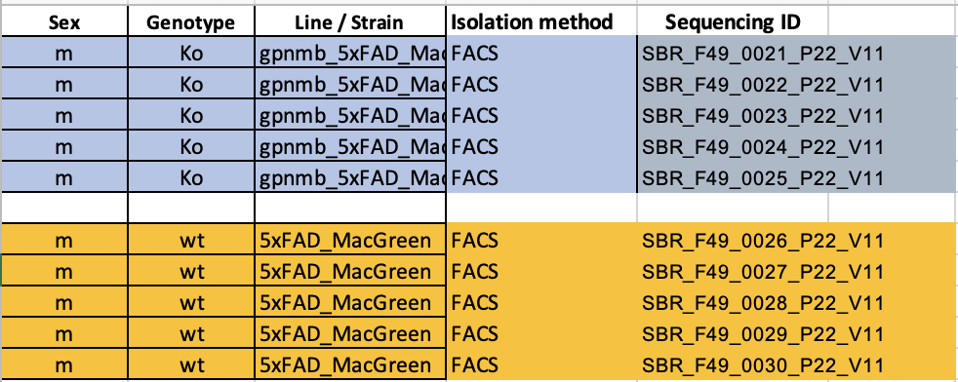
Workflow
DE-seq:
EdgeR Qusai-Likelihood
DESeq2 pipeline:
Deconvolution:
MuSiC workflow: Previously-obtained single cell cluster labels
Metadata:
Notes:
During the two months of my work
, Bilge and I work and meet 1-2 times a week to make sure the results we come up with align with what we expected, and also that the annotation results are interrpretable and make sense. And here are the list of deliverables that we previously agreed on

Slide 3
Gpnmb: the Gene
Encoding a type I transmembrane glycoprotein which shows homology to the pMEL17 precursor, a melanocyte-specific protein.
GPNMB shows expression in the lowly metastatic human melanoma cell lines and xenografts but does not show expression in the highly metastatic cell lines.
GPNMB may be involved in growth delay and reduction of metastatic potential.
Notes:
During the two months of my work
, Bilge and I work and meet 1-2 times a week to make sure the results we come up with align with what we expected, and also that the annotation results are interrpretable and make sense. And here are the list of deliverables that we previously agreed on

Slide 4
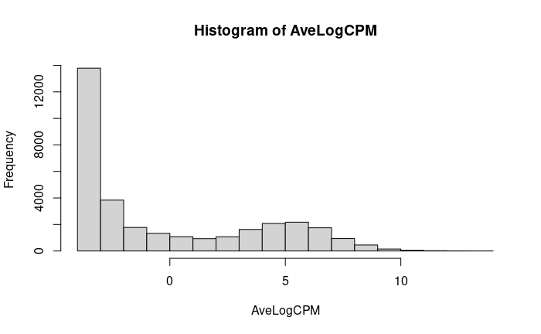
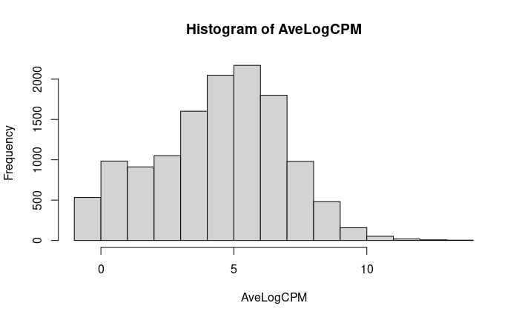
Preprocessing: Quality Control
Notes:
During the two months of my work
, Bilge and I work and meet 1-2 times a week to make sure the results we come up with align with what we expected, and also that the annotation results are interrpretable and make sense. And here are the list of deliverables that we previously agreed on

Slide 5
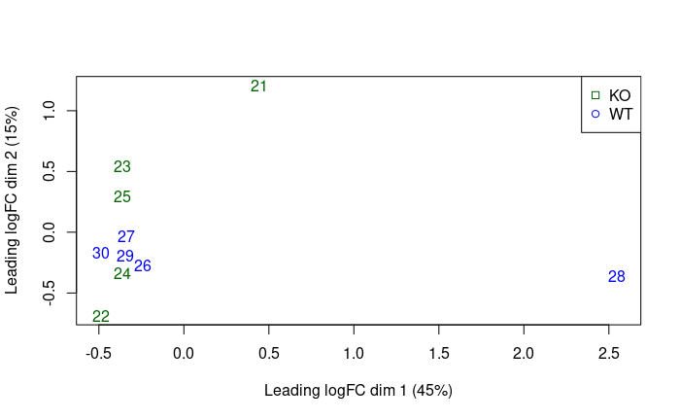
Sneak peek: MDS
Notes:
During the two months of my work
, Bilge and I work and meet 1-2 times a week to make sure the results we come up with align with what we expected, and also that the annotation results are interrpretable and make sense. And here are the list of deliverables that we previously agreed on

Slide 6
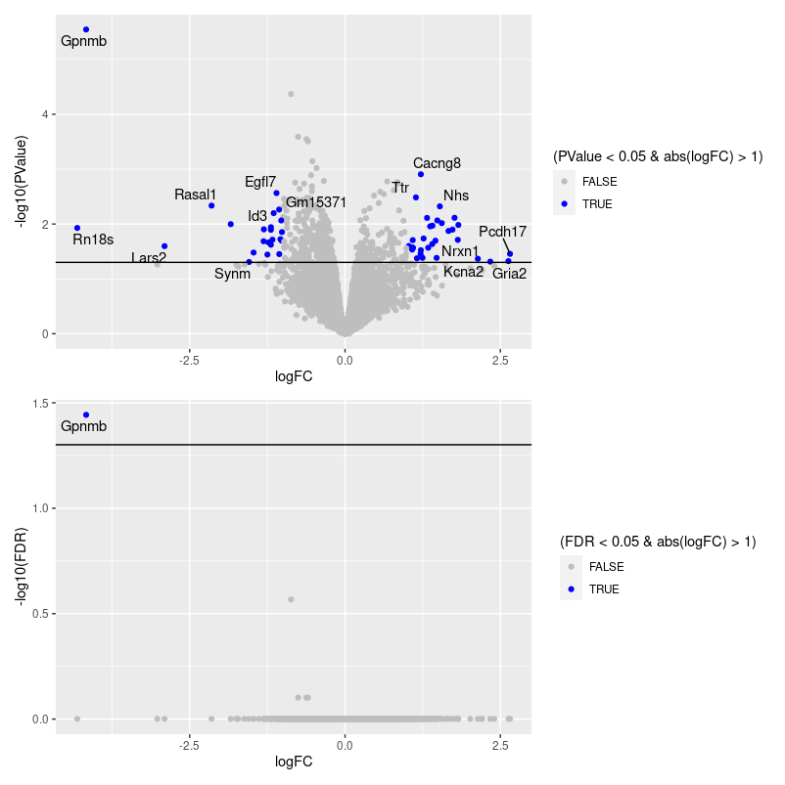
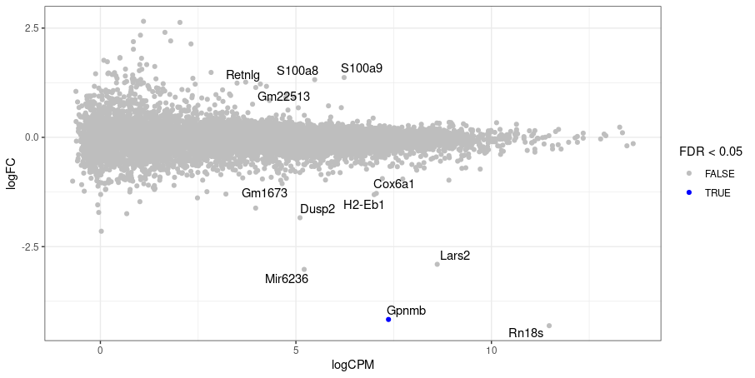
Results: EdgeR
Notes:
During the two months of my work
, Bilge and I work and meet 1-2 times a week to make sure the results we come up with align with what we expected, and also that the annotation results are interrpretable and make sense. And here are the list of deliverables that we previously agreed on

Slide 7
Results: EdgeR Variant
Remove Gpnmb: No differentially expressed genes
Remove sample 28: No differentially expressed genes (Gpnmb: FDR = 0.06)
Notes:
During the two months of my work
, Bilge and I work and meet 1-2 times a week to make sure the results we come up with align with what we expected, and also that the annotation results are interrpretable and make sense. And here are the list of deliverables that we previously agreed on

Slide 8
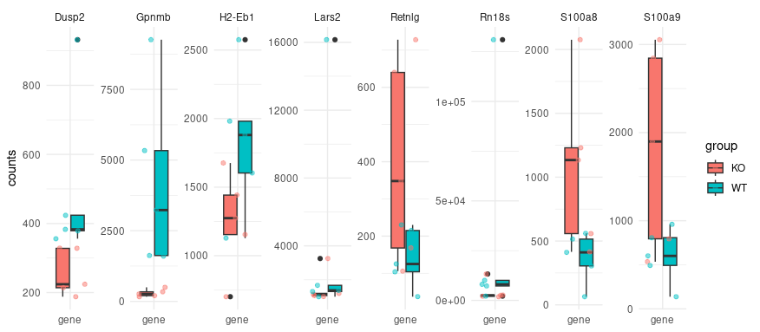
Results: Key Genes
Notes:
During the two months of my work
, Bilge and I work and meet 1-2 times a week to make sure the results we come up with align with what we expected, and also that the annotation results are interrpretable and make sense. And here are the list of deliverables that we previously agreed on

Slide 9
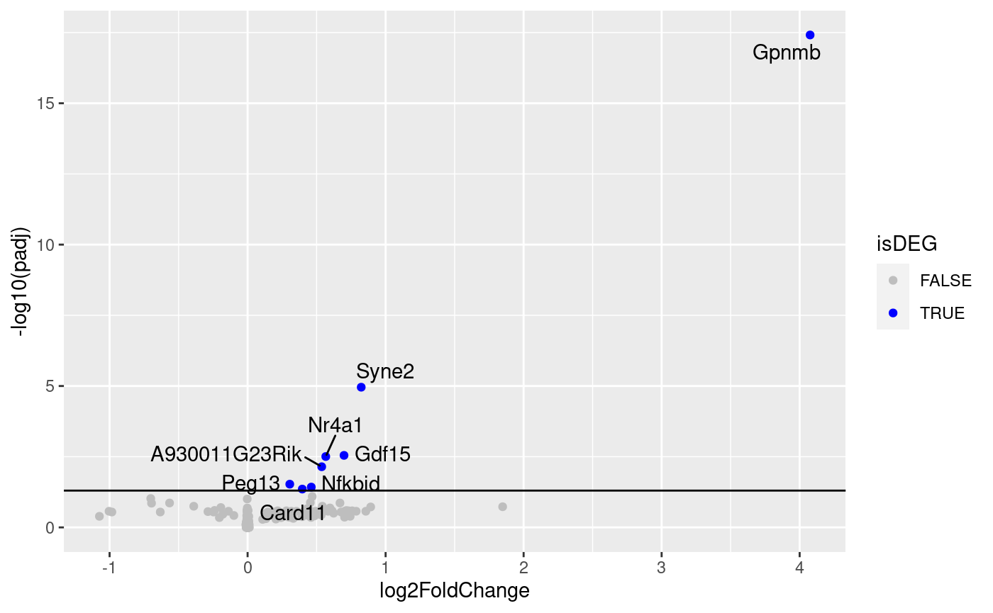
Results: DESeq
WT vs KO

Slide 10
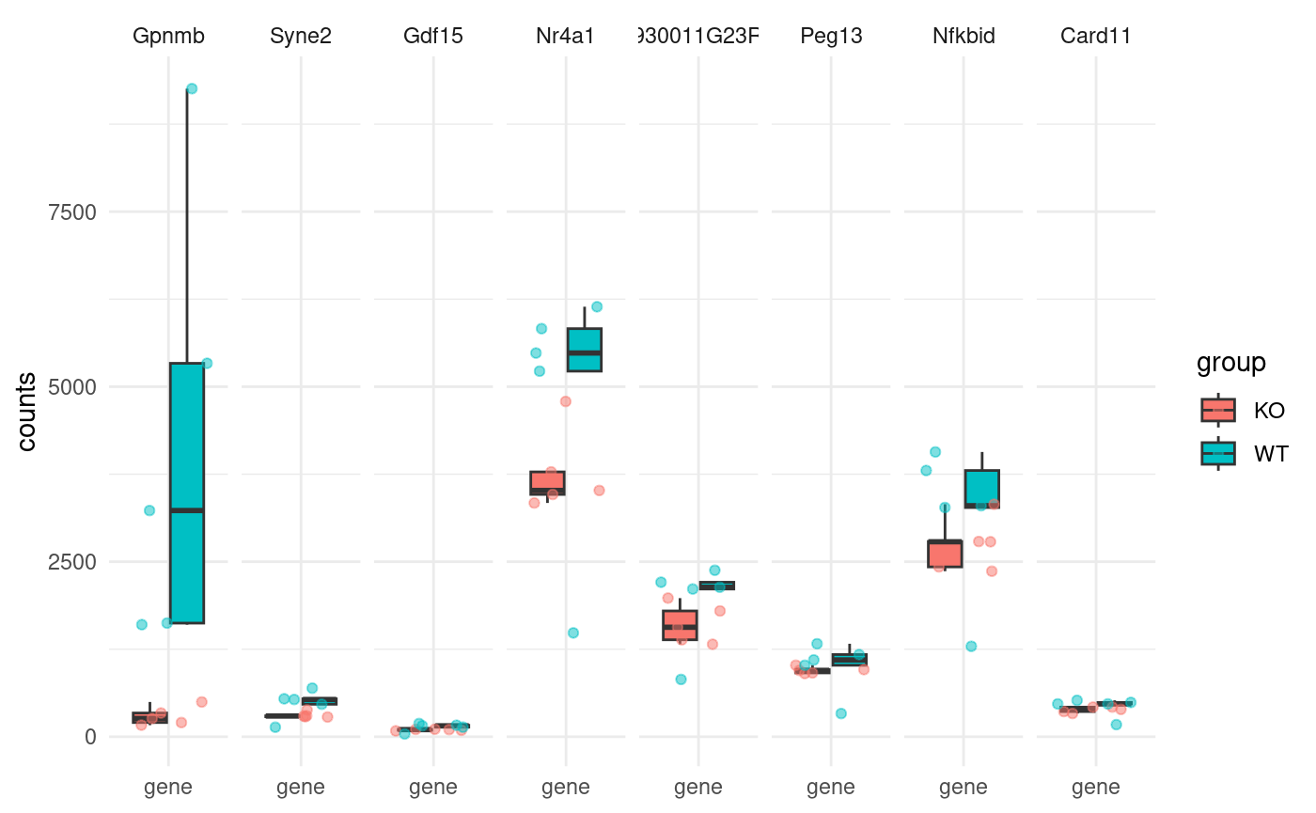
Results: DESeq Key Genes

Slide 11
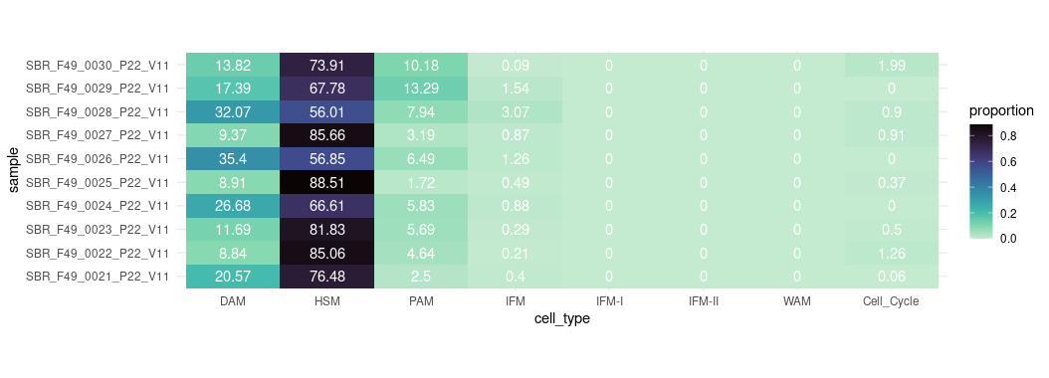
Results: Deconvolution
WT
Notes:
During the two months of my work
, Bilge and I work and meet 1-2 times a week to make sure the results we come up with align with what we expected, and also that the annotation results are interrpretable and make sense. And here are the list of deliverables that we previously agreed on

Slide 12
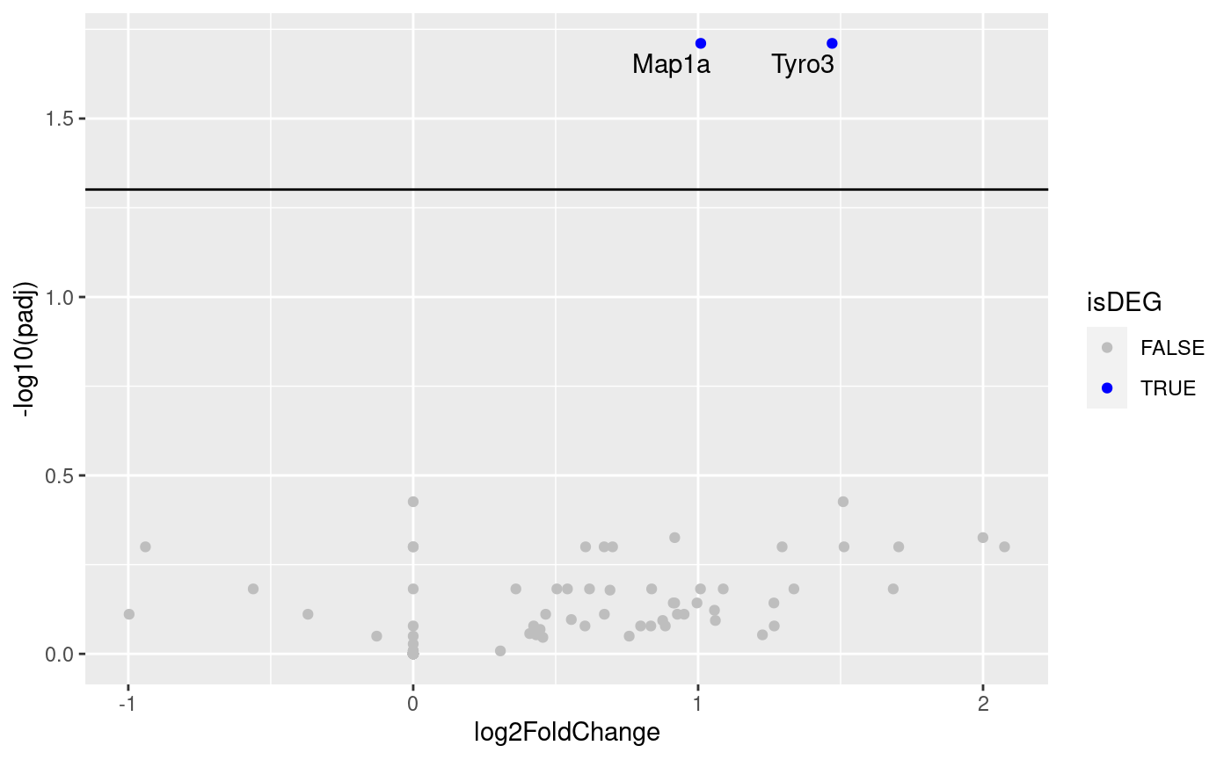
Results: DESeq Random Groups
Group1: 21, 23, 25, 27, 29
Group2: 22, 24, 26, 28, 30
Notes:
Randomly selected 2 groups and do a DESeq

Slide 13
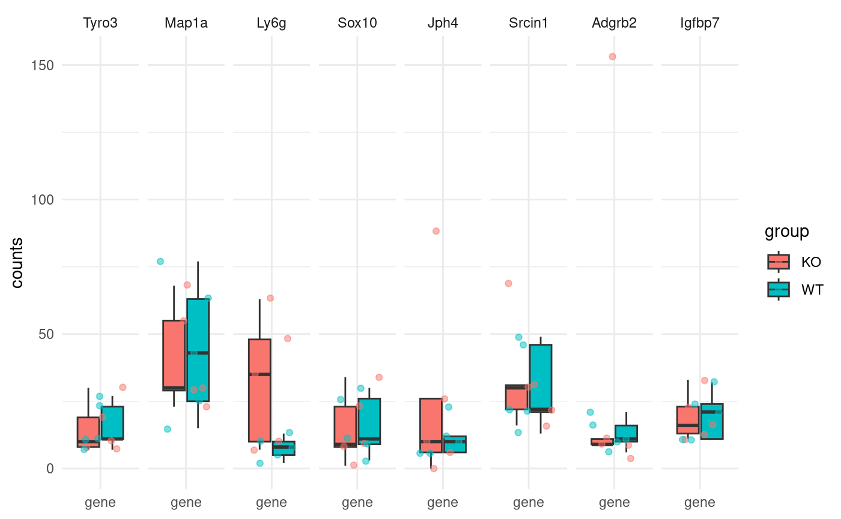
Results: DESeq Key Genes (Random)

Slide 14
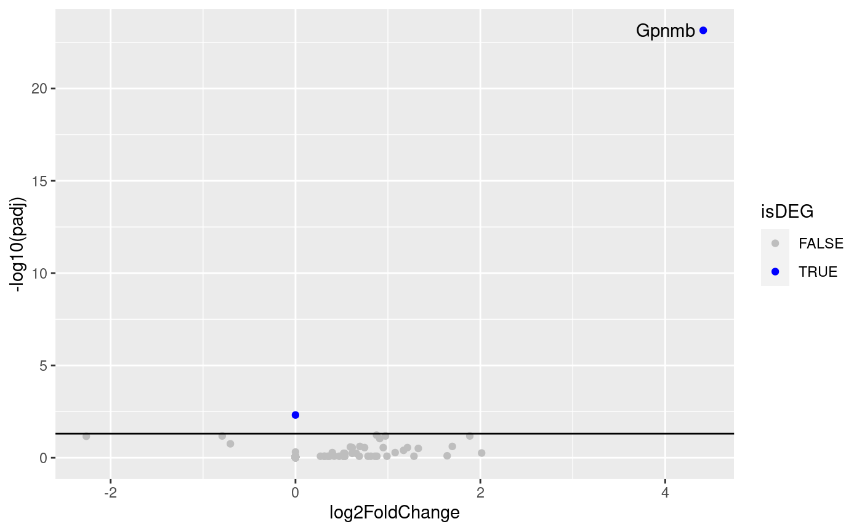
Results: DESeq subset groups
Group1: 22, 24, 25
Group2: 26, 28, 29

Slide 15
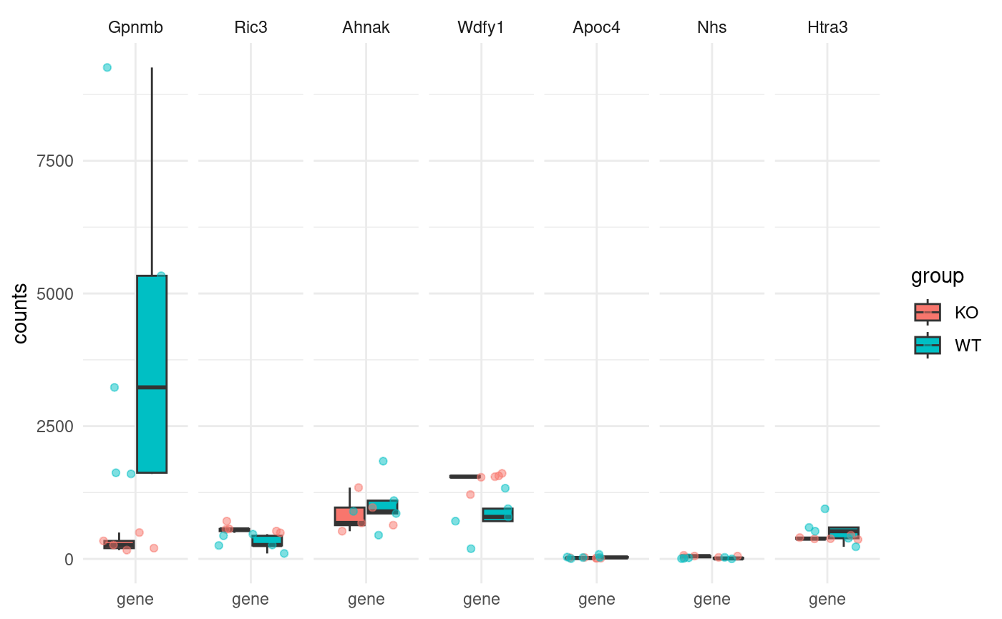
Results: DESeq Key Genes (Subset)

Slide 16
Thank you.

