Slide 1
PartyPlan
Created by: Teoh Khai Jiet
(Yes, an individual only )

Slide 2
What is PartyPlan?
PartyPlan is a membership website that will help you to plan a party after you became a member.

Slide 3
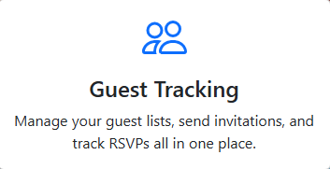
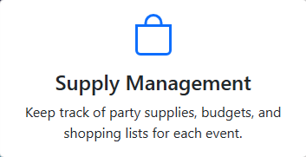
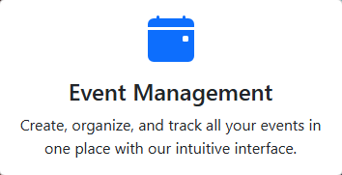
What does PartyPlan do?
These are the three features while using the website

Slide 4
Main concept for the website
This website was created to help host to arrange an important party much easier.

Slide 5
Thanks for watching!

