Slide 1

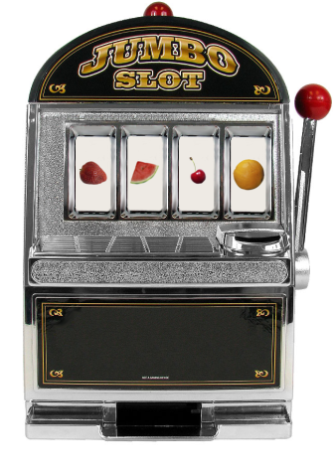
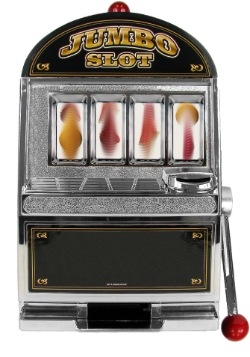
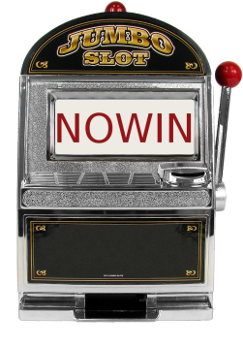
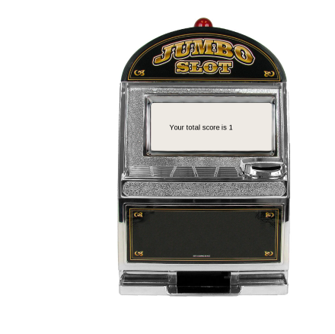
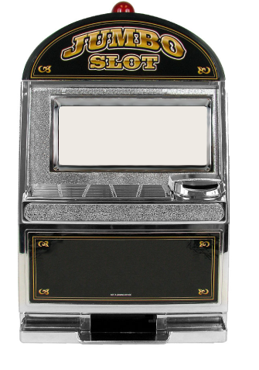

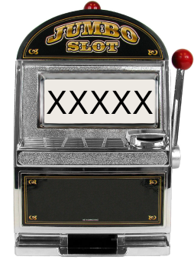
Start
Wait for
button push
After button push spin/ISI
2-8 sec
Receipt
“your total score is xx”
ITI
2-8 s
Win/Lose

Slide 2

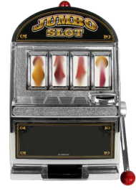

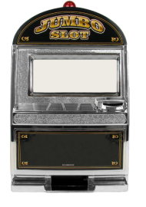
SOA=SD+ISI
2-8s, mu=4s
Anticipation
Epoch
1s
Button push
Event
.5s
Event
1s
Event
2-8s, mu=4s
ITI
2 pts
Start
Wait for
button push
After button push
spin/ISI
2-8 sec
Receipt
“your total score is xx”

