Slide 1
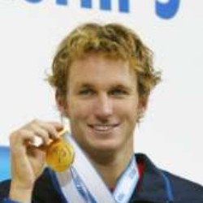
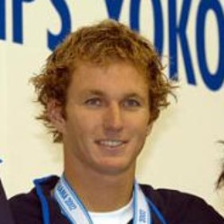
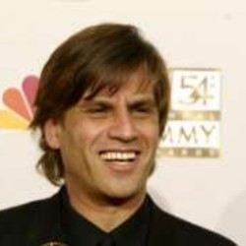
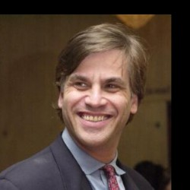
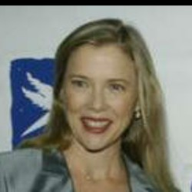
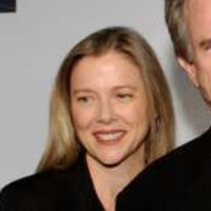
d = 0.111311
Aaron Peirsol
d = 0.166333
d = 0.220087
d = 0.251050
d = 0.174558
d = 0.149091
Aaron Sorkin
d = 0.213189
d = 0.317565
d = 0.246760
d = 0.178755
d = 0.138637
Annette Bening

