Slide 1
Typescript Basics
Notes:
Typescript popularity is exploding for many good reasons.
It is the superset of javascript helps you write better code faster and compiles to javascript that will run in any modern web browsers

Slide 2
01 Introduction
02 Installation
03 Typescript Basics
04 Features
Data Types Supported
Optional Static Type Annotation
Classes
Interface
Modules
Type Assertions
Ambient Declarations
05 References
Notes:
Talk about the objectives => cover good to know details about typescript, introductory session

Slide 3
01
What is Typescript ?

Slide 4
JavaScript is not originally designed for large complex applications (mostly a scripting language, with functional programming constructs), lacks structuring mechanisms like Class, Module, Interface.
Typescript is a typed superset of JavaScript that compiles to plain JavaScript.
Adds additional features like Static Type (optional), Class, Module etc. to JavaScript
Microsoft technology
Open Source

Slide 5
02
Installation

Slide 6
Via npm (the Node.js package manager)
$ npm install -g typescript
To know typescript version $ npm view typescript version

Slide 7
03
Typescript Basics

Slide 8
1) Basic Syntax : var message:string = "Hello World"
console.log(message) 2) Variable : A variable, by definition, is “a named space in the memory” that stores values. In other words, it acts as a container for values in a program. TypeScript variables must follow the JavaScript naming rules −
Variable names can contain alphabets and numeric digits.
They cannot contain spaces and special characters, except the underscore (_) and the dollar ($) sign.
Variable names cannot begin with a digit.
Example : var name : string = "John";
var score1:number = 50;
var score2:number = 42.50
var sum = score1 + score2
console.log("name“ + name)
console.log("first score: "+score1)
console.log("second score: "+score2)
console.log("sum of the scores: "+sum)

Slide 9
3) Operators: An operator defines some function that will be performed on the data. The data on which operators work are called operands. Consider the following expression −
7 + 5 = 12
Here, the values 7, 5, and 12 are operands, while + and = are operators. 4) Decision Making :
Decision-making structures require that the programmer specifies one or more conditions to be evaluated or tested by the program, along with a statement or statements to be executed if the condition is determined to be true, and optionally, other statements to be executed if the condition is determined to be false.
5) Loops :
when a block of code needs to be executed several number of times. In general, statements are executed sequentially: The first statement in a function is executed first, followed by the second, and so on.

Slide 10
Types of Loops :
1) Definite Loop
- For Loop
2) Indefinite Loop
- While Loop
- Do -while
Example :
var n:number = 5
while(n > 5) {
console.log("Entered while")
}
do {
console.log("Entered do…while")
}
while(n>5)

Slide 11
6) Functions: Functions are the building blocks of readable, maintainable, and reusable code. A function is a set of statements to perform a specific task.
Functions organize the program into logical blocks of code. Once defined, functions may be called to access code. This makes the code reusable.
Moreover, functions make it easy to read and maintain the program’s code.
Example :
function disp_details(id:number,name:string,mail_id?:string) {
console.log("ID:", id);
console.log("Name",name);
if(mail_id!=undefined)
console.log("Email Id",mail_id);
}
disp_details(123,"John");
disp_details(111,"mary","mary@xyz.com");

Slide 12
7) Arrays: An array is a homogenous collection of values. To simplify, an array is a collection of values of the same data type. It is a user defined type.
Example :
var alphas:string[];
alphas = ["1","2","3","4"]
console.log(alphas[0]);
console.log(alphas[1]);
8) Tuples :
At times, there might be a need to store a collection of values of varied types. Arrays will not serve this purpose. TypeScript gives us a data type called tuple that helps to achieve such a purpose.
It represents a heterogeneous collection of values. In other words, tuples enable storing multiple fields of different types.
var mytuple = [10,"Hello"]; //create a tuple
console.log(mytuple[0])
console.log(mytuple[1])

Slide 13
9) Numbers :
TypeScript like JavaScript supports numeric values as Number objects. A number object converts numeric literal to an instance of the number class. The Number class acts as a wrapper and enables manipulation of numeric literals as they were objects.
Example :
var month = 0
if( month<=0 || month >12) {
month = Number.NaN
console.log("Month is "+ month)
} else {
console.log("Value Accepted..")
}
Another example :
console.log("TypeScript Number Properties: ");
console.log("Maximum value that a number variable can hold: " + Number.MAX_VALUE);
console.log("The least value that a number variable can hold: " + Number.MIN_VALUE);
console.log("Value of Negative Infinity: " + Number.NEGATIVE_INFINITY);
console.log("Value of Negative Infinity:" + Number.POSITIVE_INFINITY);

Slide 14
10) Strings :
The String object lets you work with a series of characters. It wraps the string primitive data type with a number of helper methods.
For example :
charAt()
charCodeAt()
concat()
indexOf()
lastIndexOf()
Demo :
var str = new String("This is string");
console.log("str.charAt(0) is:" + str.charAt(0));
console.log("str.charAt(1) is:" + str.charAt(1));
console.log("str.charAt(2) is:" + str.charAt(2));
console.log("str.charAt(3) is:" + str.charAt(3));
console.log("str.charAt(4) is:" + str.charAt(4));
console.log("str.charAt(5) is:" + str.charAt(5));

Slide 15
04
Features

Slide 16
Data Types Supported
Any
Primitive
- Number
- Boolean
- String
- Void
- Null
- Undefined - Same as JS
Array
Enum

Slide 17
TypeScript Classes
Can implement interfaces
Inheritance
Instance methods/members
Static methods/members
Single constructor
Default/Optional parameter
ES6 class syntax

Slide 18
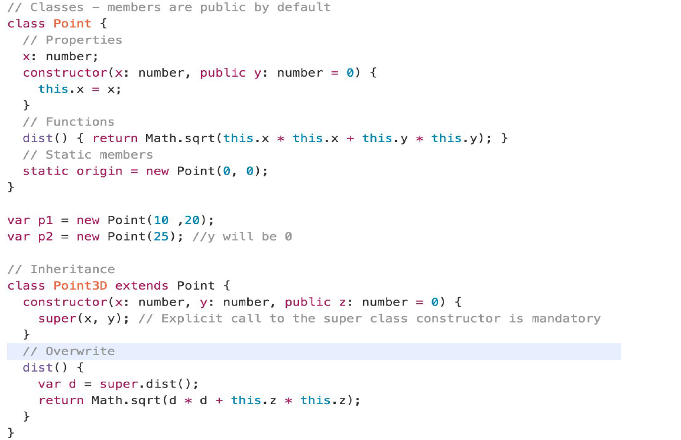

Slide 19
TypeScript Interfaces
Declared using interface keyword
Like other TS features it’s design time features i.e. no extra code would be emitted to resultant JS
Errors being shown when interface signature and implementation doesn’t match.

Slide 20
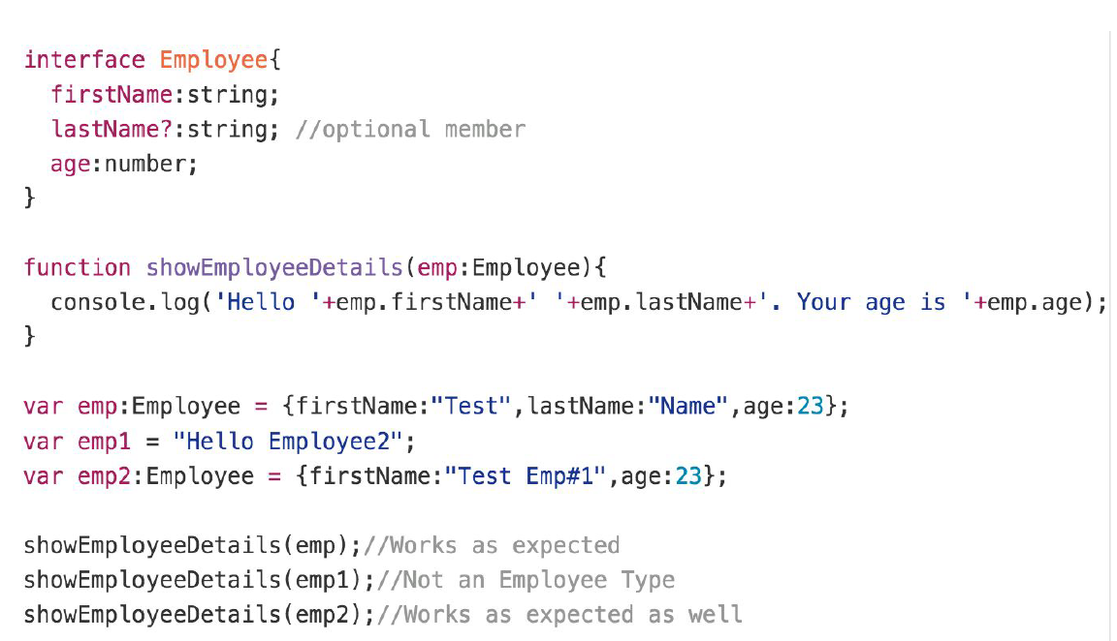
TypeScript Interfaces Example

Slide 21
TypeScript Modules
Modules can be defined using module keyword
A module can contains sub-modules, class, enums or interfaces. But can’t directly contains functions.
Modules can be nested(sub-modules).
Classes and Interfaces can be exposed using export keyword.

Slide 22
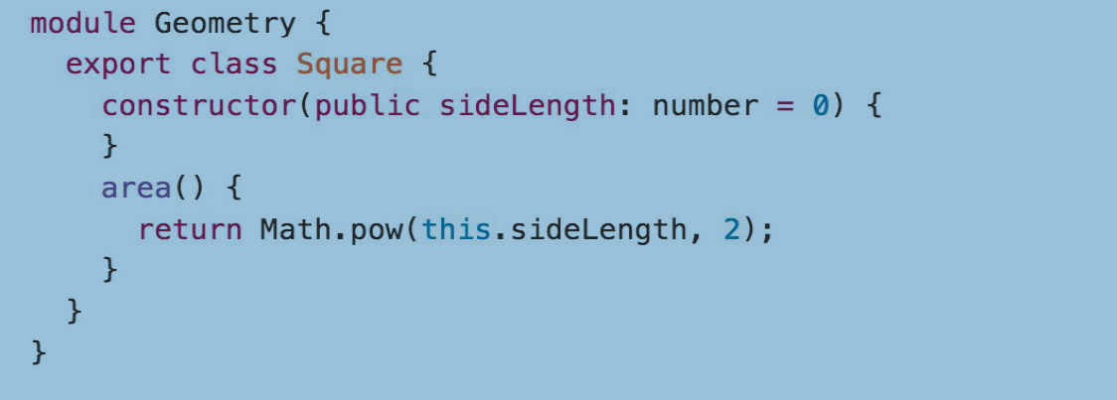
TypeScript Modules Example

Slide 23
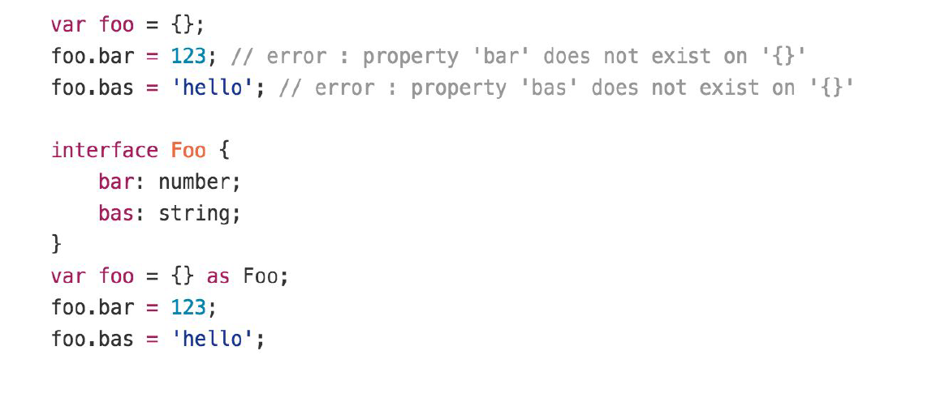
Type Assertions
TypeScript's type assertion are purely you telling the compiler that you know about the types better than it does, and that it should not second guess you.
Example :

Slide 24
Ambient Declarations
Ambient declarations are a way of telling the TypeScript compiler that the actual source code exists elsewhere.
When you are consuming a bunch of third party js libraries like jquery/angularjs/nodejs you can’t rewrite it in TypeScript.
Ensuring typesafety and intellisense while using these libraries will be challenging for a TypeScript programmer.
Ambient declarations help to seamlessly integrate other js libraries into TypeScript.
For Example :
<html>
<body style = "font-size:30px;">
<h1>Ambient Test</h1>
<h2>Calc Test</h2>
</body>
<script src = "CalcThirdPartyJsLib.js"></script>
<script src = "CalcTest.js"></script>
</html>

Slide 25
05
References

Slide 26
References
https://www.typescriptlang.org/docs/home.html
https://code.visualstudio.com/docs/typescript/typescript-tutorial
→For Playground :
http://www.typescriptlang.org/play/

