Slide 1



Product_Jigar_powerBI
View in Power BI
Last data refresh:
2/14/2024 7:44:58 AM UTC
Downloaded at:
2/14/2024 7:54:36 AM UTC

Slide 2
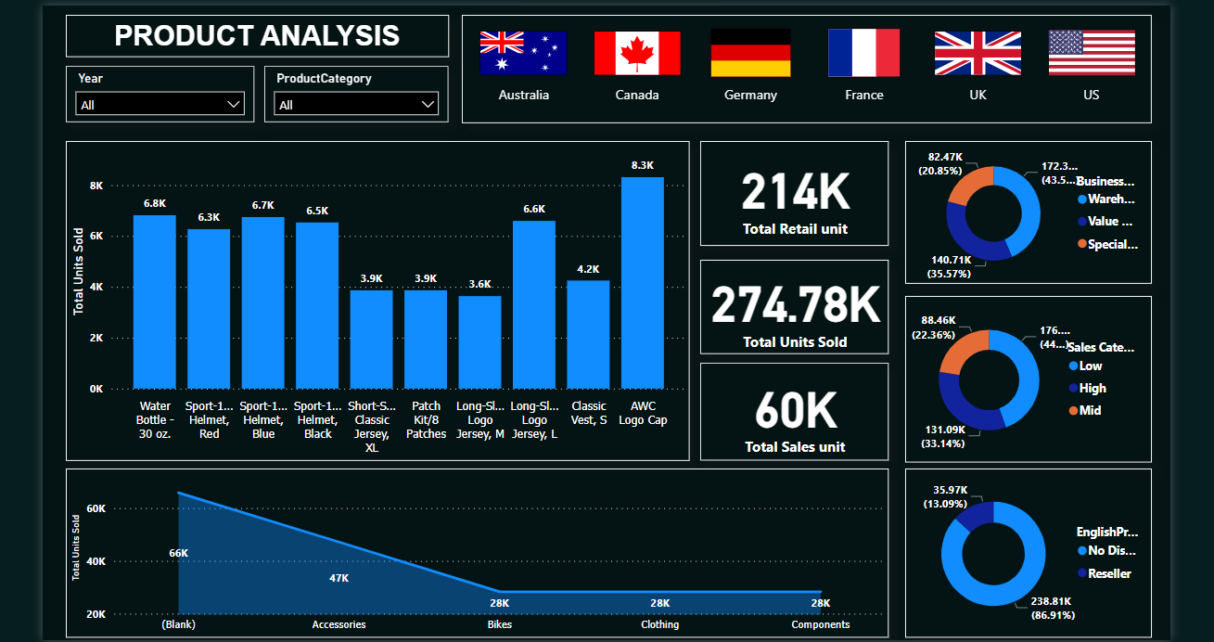
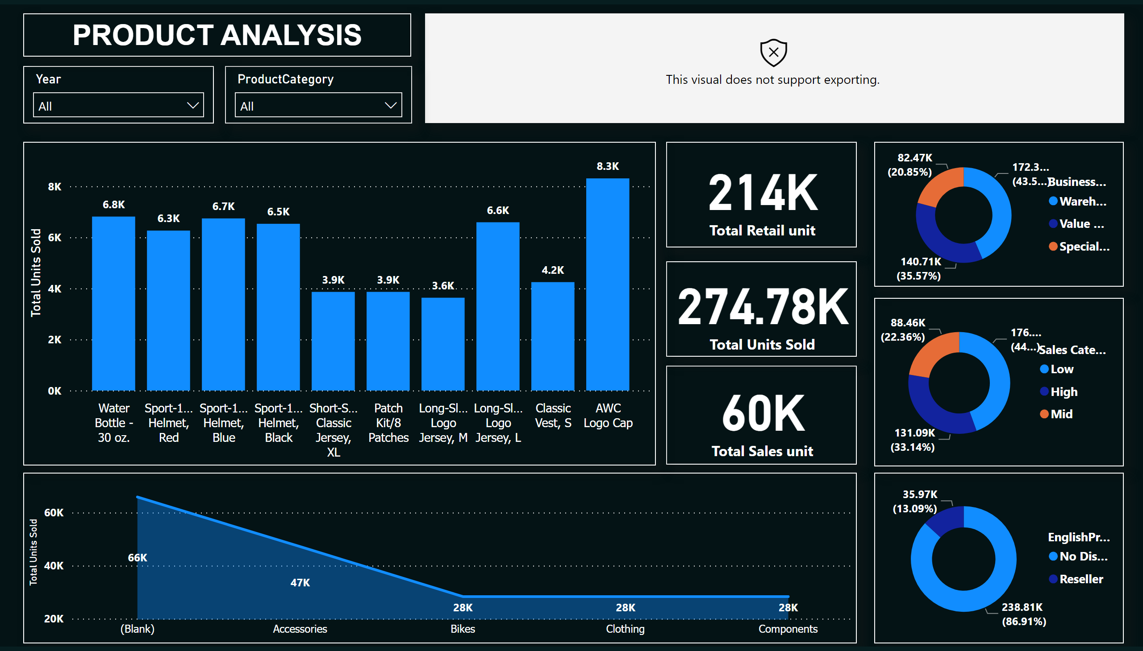
Page 1
Notes:
card
No alt text provided
enlightenWorldFlagsE887F52F76244B1C927F80CF9724AEF6
No alt text provided
card
No alt text provided
card
No alt text provided
donutChart
No alt text provided
donutChart
No alt text provided
clusteredColumnChart
No alt text provided
donutChart
No alt text provided
stackedAreaChart
No alt text provided
slicer
No alt text provided
slicer
No alt text provided
textbox
No alt text provided

