Slide 1



Tops_Assesment_Visualization
View in Power BI
Last data refresh:
4/1/2024 12:01:57 PM UTC
Downloaded at:
4/1/2024 12:03:23 PM UTC

Slide 2
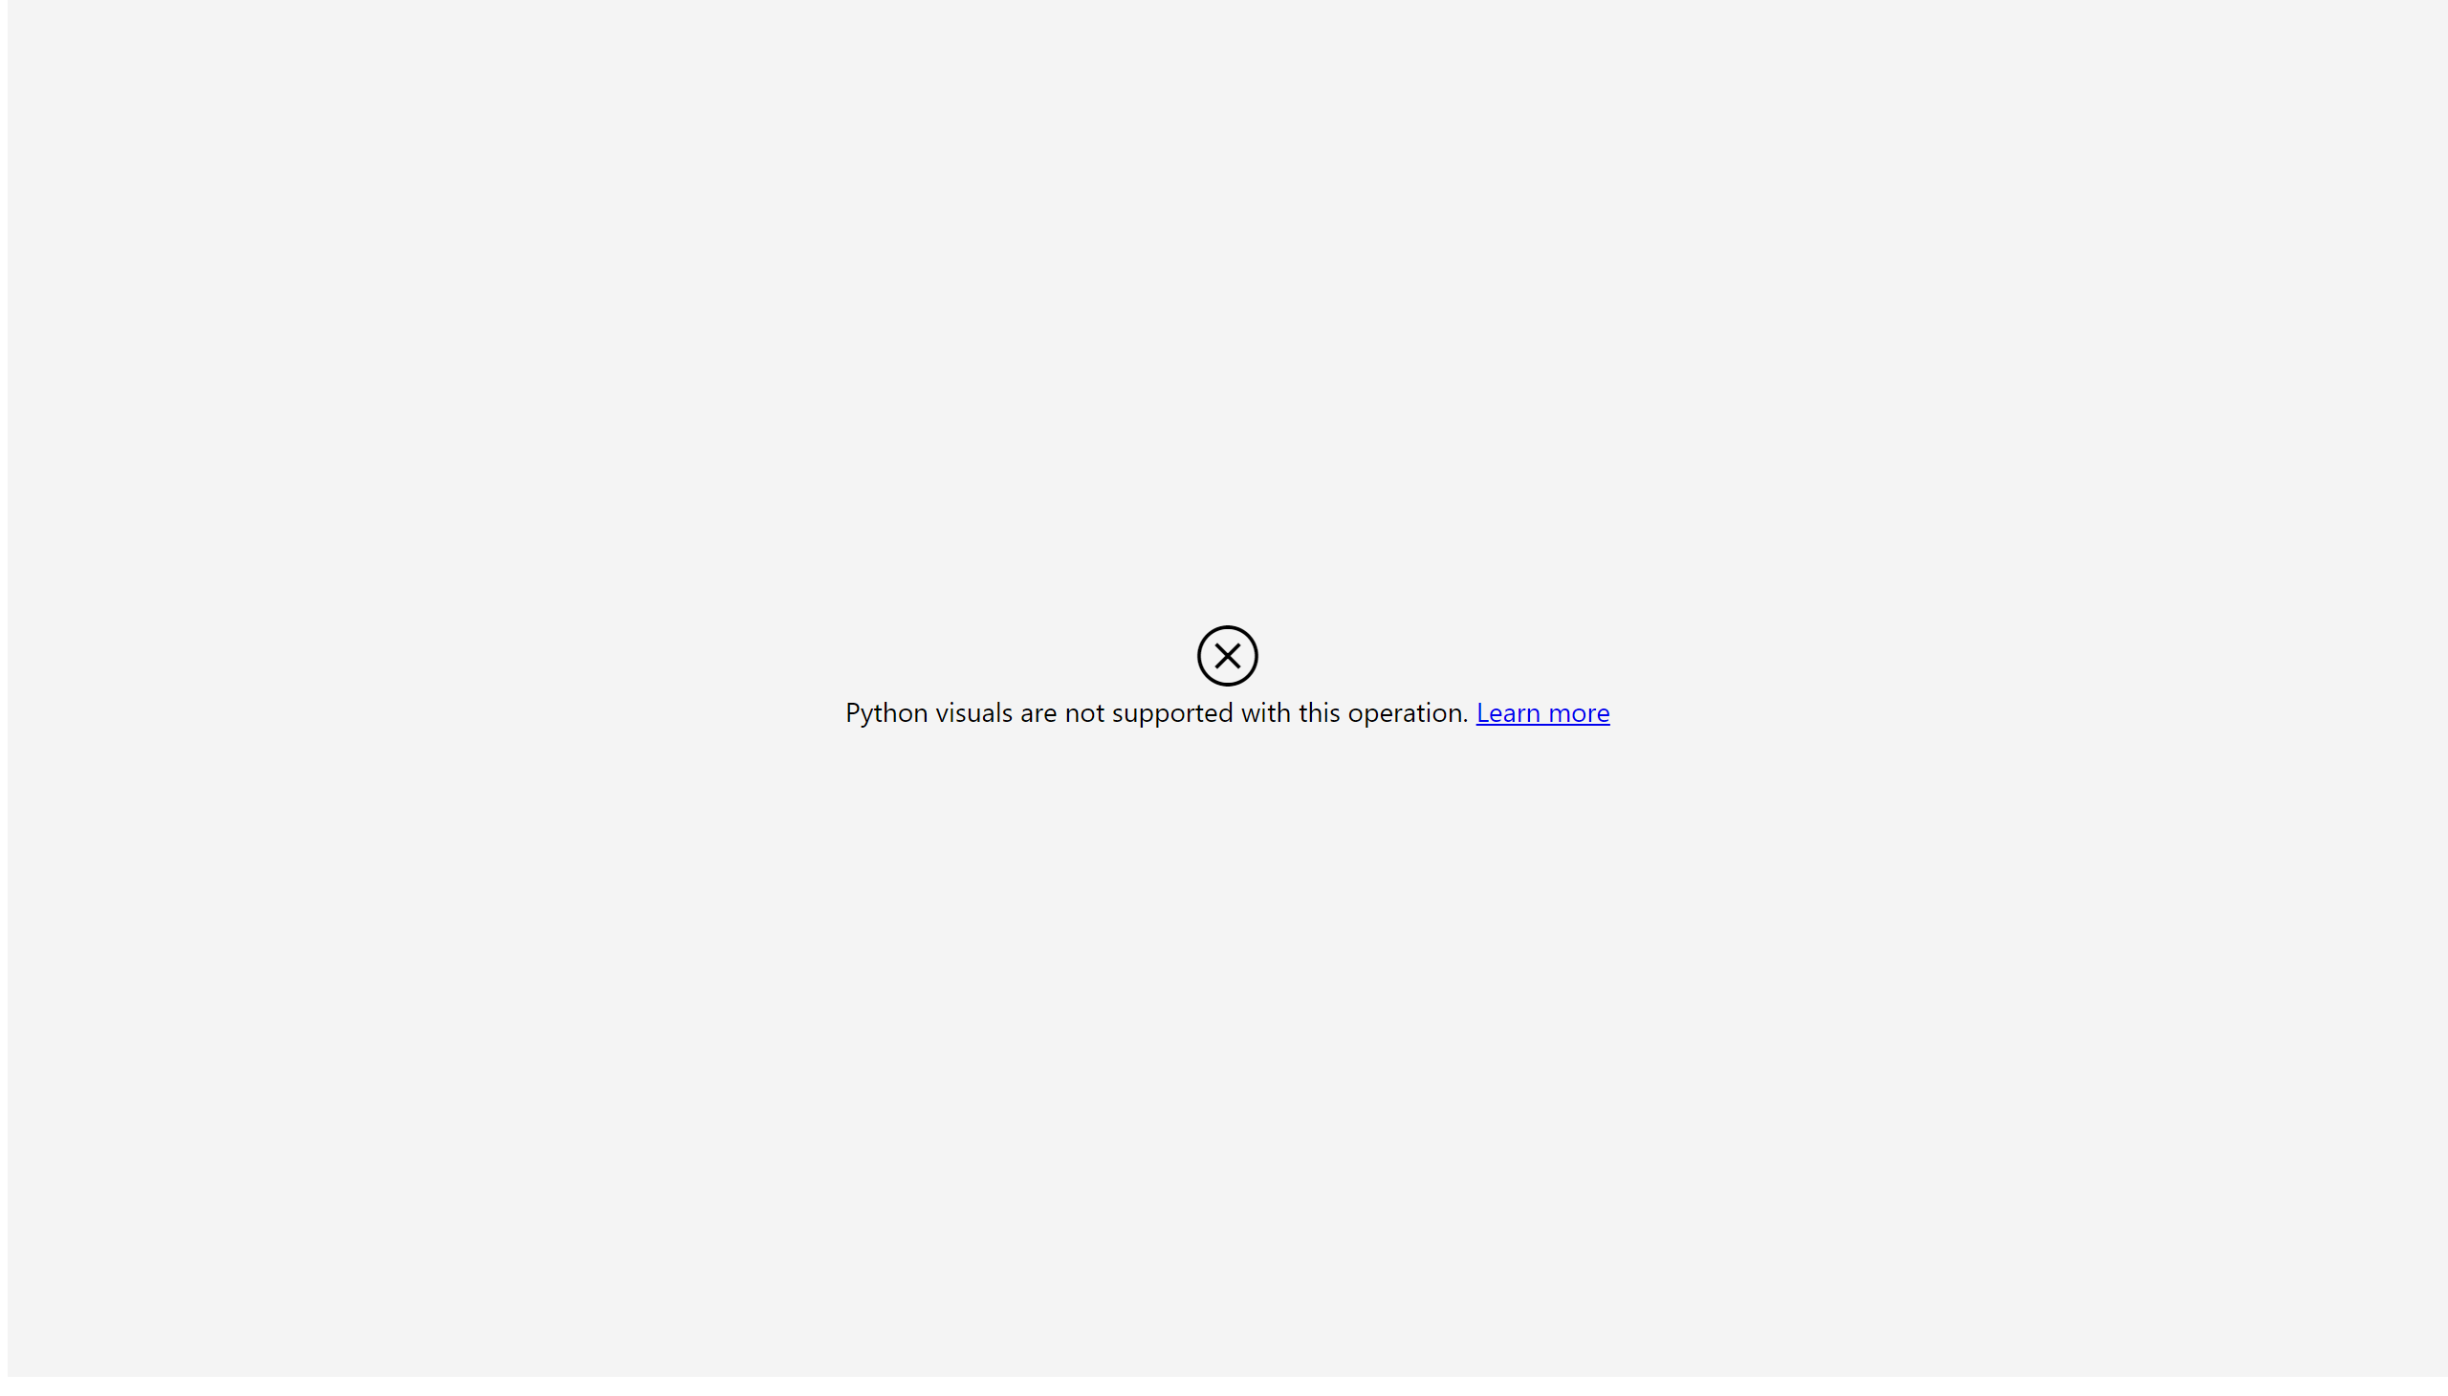
Page 1
Notes:
pythonVisual
No alt text provided

