Slide 1
Transition
Prepared By
Hruta Desai

Slide 2
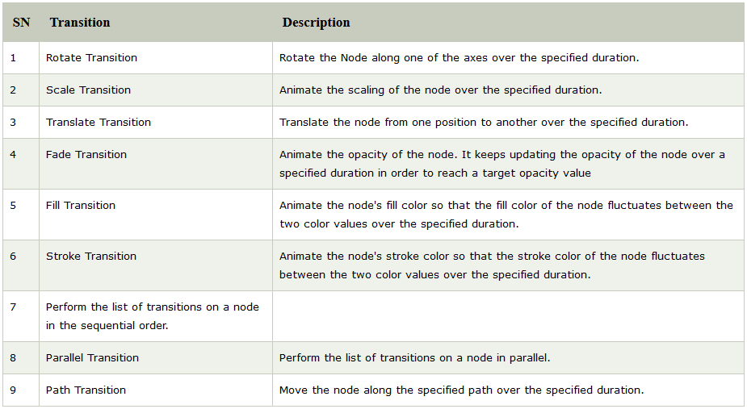

Slide 3
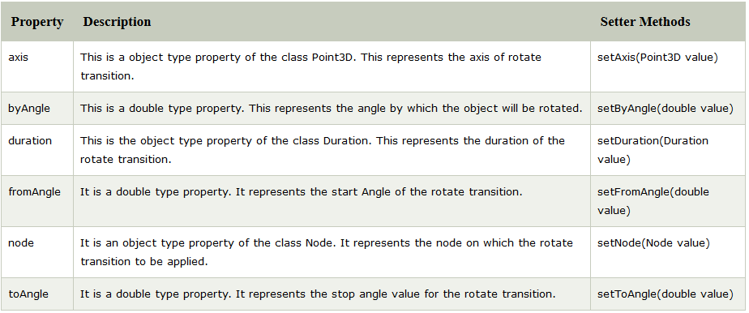
JavaFX Rotate Transition

Slide 4
Rectangle rect = new Rectangle(200,100,200,200);
rect.setFill(Color.LIMEGREEN);
rect.setStroke(Color.HOTPINK);
rect.setStrokeWidth(5);
RotateTransition rotate = new RotateTransition();
rotate.setAxis(Rotate.Z_AXIS);
rotate.setByAngle(360);
rotate.setCycleCount(500);
rotate.setDuration(Duration.millis(1000));
rotate.setAutoReverse(true);
rotate.setNode(rect);
rotate.play();
Image

Slide 5
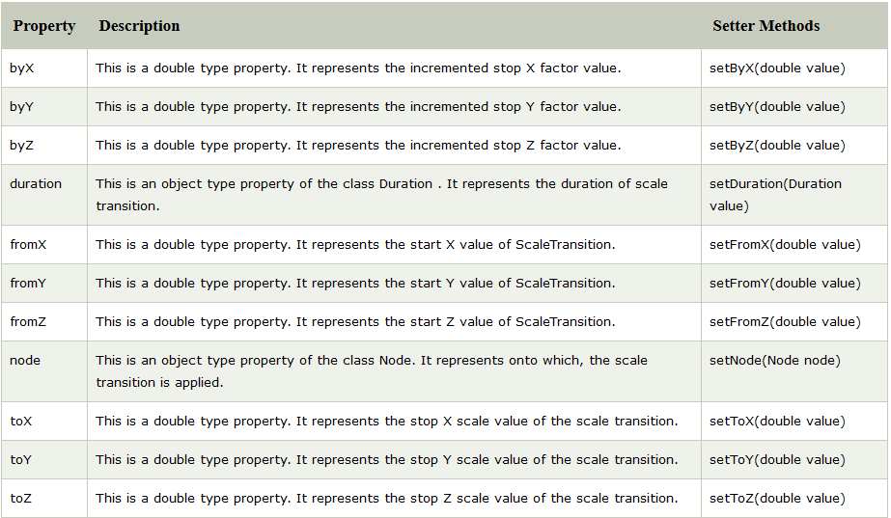
JavaFX Scale Transition

Slide 6
Circle circle = new Circle();
circle.setCenterX(300.0f);
circle.setCenterY(135.0f);
circle.setRadius(50.0f);
circle.setFill(Color.BROWN);
circle.setStrokeWidth(20);
ScaleTransition scaleTransition = new ScaleTransition();
scaleTransition.setDuration(Duration.millis(1000)); scaleTransition.setNode(circle);
scaleTransition.setByY(1.5);
scaleTransition.setByX(1.5);
scaleTransition.setCycleCount(50);
scaleTransition.setAutoReverse(false);
scaleTransition.play();
Image

Slide 7
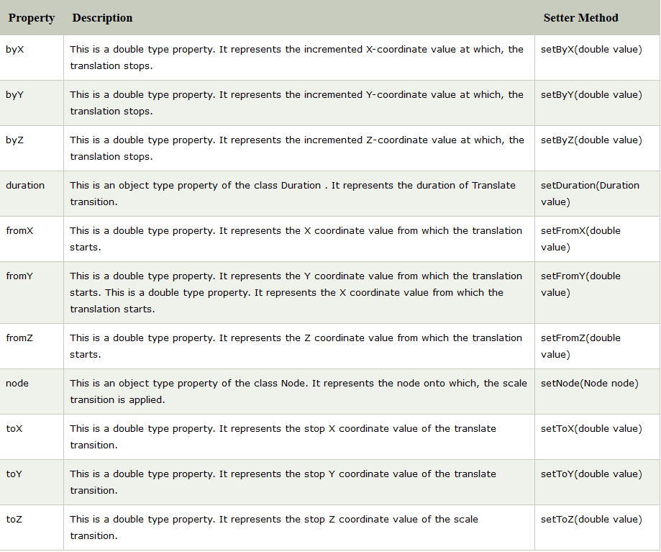
JavaFX Translate Transition

Slide 8
Circle cir = new Circle(50,100,50);
cir.setFill(Color.RED);
cir.setStroke(Color.BLACK);
TranslateTransition translate = new TranslateTransition();
translate.setByX(400);
translate.setDuration(Duration.millis(1000));
translate.setCycleCount(500);
translate.setAutoReverse(true);
translate.setNode(cir);
translate.play();
Image

Slide 9
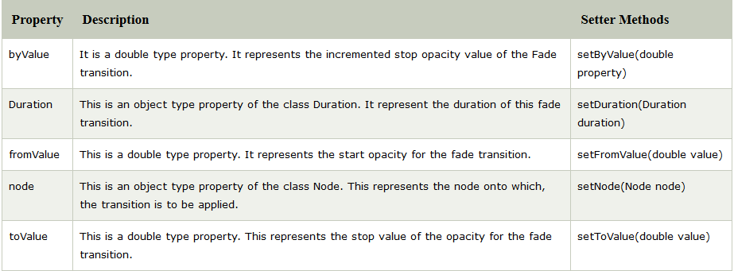
JavaFX Fade Transition

Slide 10
Circle cir = new Circle(250,120,80);
cir.setFill(Color.RED);
cir.setStroke(Color.BLACK);
FadeTransition fade = new FadeTransition();
fade.setDuration(Duration.millis(5000));
fade.setFromValue(10);
fade.setToValue(0.1);
fade.setCycleCount(1000);
fade.setAutoReverse(true);
fade.setNode(cir);
fade.play();
Image

Slide 11
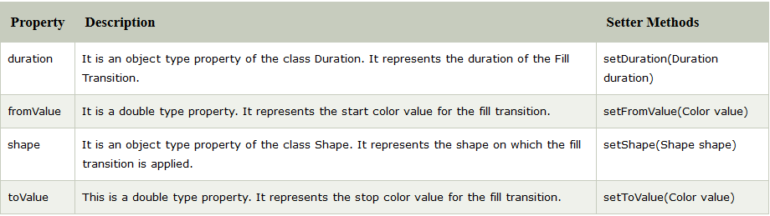
JavaFX Fill Transition

Slide 12
Polygon poly = new Polygon();
poly.getPoints().addAll(new Double[] {220.0,270.0,170.0,220.0,170.0,120.0,220.0,70.0,270.0,120.0,270.0,220.0});
poly.setStroke(Color.BLACK);
FillTransition fill = new FillTransition();
fill.setAutoReverse(true);
fill.setCycleCount(50);
fill.setDuration(Duration.millis(1000));
fill.setFromValue(Color.BLACK);
fill.setToValue(Color.WHITE);
fill.setShape(poly);
fill.play();
Image

Slide 13
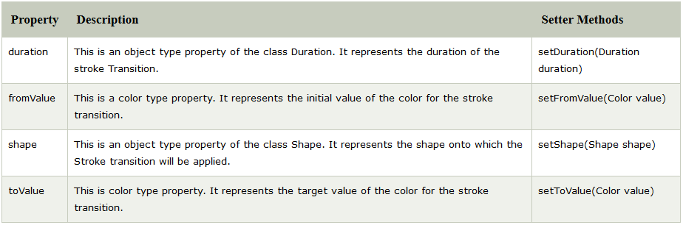
JavaFX Stroke Transition

Slide 14
Circle cir = new Circle(200,150,100); cir.setStroke(Color.BLUE);
cir.setFill(Color.RED);
cir.setStrokeWidth(10);
StrokeTransition stroke = new StrokeTransition();
stroke.setAutoReverse(true);
stroke.setCycleCount(500);
stroke.setDuration(Duration.millis(500));
stroke.setFromValue(Color.BLACK);
stroke.setToValue(Color.PURPLE);
stroke.setShape(cir);
stroke.play();
Image

Slide 15
JavaFX Sequential Transition
Polygon poly = new Polygon();
//Setting points for the polyogn
poly.getPoints().addAll(new Double[] {320.0,270.0,270.0,220.0,270.0,270.0,320.0,120.0,370.0,270.0,370.0,220.0});
poly.setFill(Color.LIMEGREEN);
poly.setStroke(Color.BLACK);
Duration dur1 = Duration.millis(1000);
Duration dur2 = Duration.millis(500);
PauseTransition pause = new PauseTransition(Duration.millis(1000));
FadeTransition fade = new FadeTransition(dur2);
fade.setFromValue(1.0f);
fade.setToValue(0.3f);
fade.setCycleCount(2);
fade.setAutoReverse(true);
TranslateTransition translate = new TranslateTransition(dur1);
translate.setToX(-150f);
translate.setCycleCount(2);
translate.setAutoReverse(true);
RotateTransition rotate = new RotateTransition(dur2);
rotate.setByAngle(180f);
rotate.setCycleCount(4);
rotate.setAutoReverse(true);
ScaleTransition scale = new ScaleTransition(dur1);
scale.setByX(1.5f);
scale.setByY(1.2f);
scale.setCycleCount(2);
scale.setAutoReverse(true);
SequentialTransition seqT = new SequentialTransition (poly,rotate, pause, fade, translate, scale);
seqT.play();
Image

Slide 16
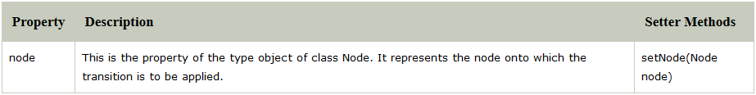
JavaFX Parallel Transition
Polygon poly = new Polygon();
poly.getPoints().addAll(new Double[] {320.0,270.0,270.0,220.0,270.0,270.0,320.0,120.0,370.0,270.0,370.0,220.0});
poly.setFill(Color.LIMEGREEN);
poly.setStroke(Color.BLACK);
Duration dur1 = Duration.millis(1000);
Duration dur2 = Duration.millis(1000);
PauseTransition pause = new PauseTransition(Duration.millis(1000));
FadeTransition fade = new FadeTransition(dur2);
fade.setFromValue(1.0f);
fade.setToValue(0.3f);
fade.setCycleCount(5);
fade.setAutoReverse(true);
TranslateTransition translate = new TranslateTransition(dur1);
translate.setToX(-150f);
translate.setCycleCount(5);
translate.setAutoReverse(true);
RotateTransition rotate = new RotateTransition(dur2);
rotate.setByAngle(360f);
rotate.setCycleCount(5);
rotate.setAutoReverse(true);
ScaleTransition scale = new ScaleTransition(dur1);
scale.setByX(1.5f);
scale.setByY(1.2f);
scale.setCycleCount(5);
scale.setAutoReverse(true);
ParallelTransition seqT = new ParallelTransition (poly,rotate, pause, fade, translate, scale);
seqT.play();
Image
Image2

Slide 17
JavaFX Pause Transition
Polygon poly = new Polygon();
poly.getPoints().addAll(new Double[] {320.0,270.0,270.0,220.0,270.0,270.0,320.0,120.0,370.0,270.0,370.0,220.0});
poly.setFill(Color.LIMEGREEN);
poly.setStroke(Color.BLACK);
RotateTransition rt = new RotateTransition(Duration.millis(500),poly);
rt.setByAngle(180);
rt.setCycleCount(2);
rt.setAutoReverse(true);
TranslateTransition translate = new TranslateTransition(Duration.millis(500),poly);
translate.setToX(-150f);
translate.setCycleCount(2);
translate.setAutoReverse(true);
FadeTransition fade = new FadeTransition(Duration.millis(500),poly);
fade.setFromValue(1.0f);
fade.setToValue(0.5f);
fade.setCycleCount(2);
fade.setAutoReverse(true);
SequentialTransition seqTransition = new SequentialTransition (fade,new PauseTransition(Duration.millis(2000)),rt,
new PauseTransition(Duration.millis(2000)),translate);
seqTransition.play();
Image

Slide 18
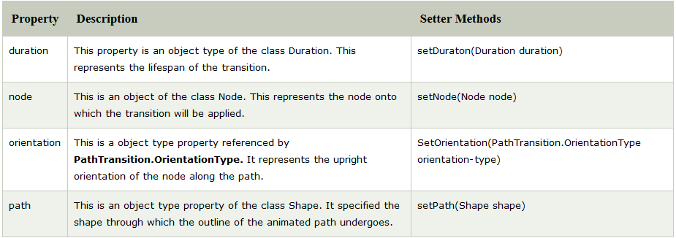
JavaFX Path Transition

Slide 19
Polygon poly = new Polygon();
poly.getPoints().addAll(new Double[] {320.0,270.0,270.0,220.0,270.0,270.0,320.0,120.0,370.0,270.0,370.0,220.0});
poly.setFill(Color.LIMEGREEN);
poly.setStroke(Color.BLACK);
Path path = new Path();
path.getElements().add (new MoveTo (150f, 70f));
path.getElements().add (new CubicCurveTo (240f, 230f, 500f, 340f, 600, 50f));
PathTransition pathTransition = new PathTransition();
pathTransition.setDuration(Duration.millis(1000));
pathTransition.setNode(poly);
pathTransition.setPath(path);
pathTransition.setOrientation(OrientationType.ORTHOGONAL_TO_TANGENT);
pathTransition.setCycleCount(10);
pathTransition.setAutoReverse(true);
pathTransition.play();
Image

