Slide 1
UDP
DatagramPacket
&
DatagramSocket

Slide 2
Introduction
UDP : user data gram protocol
UDP is a connection - less protocol
In java following two classes are used for the UDP protocol.
DatagramProtocol
DatagramSocket

Slide 3
DisAdvantages
there is no guarantee of
its content
arrival
arrival time.

Slide 4
DatagramSocket
This class is use to represent the connection less socket for sending and receiving the data.

Slide 5
Contructors
DatagramSocket() throws SocketException
DatagramSocket(int port) throws SocketException
DatagramSocket(InetAddress add,int port) throws SocketException

Slide 6
DatagramSocket() throws SocketException
it creates a datagram socket and binds it with the available Port Number on the localhost machine.
Generally use to create server

Slide 7
DatagramSocket(int port) throws SocketException
it creates a datagram socket and binds it with the given Port Number
Generally use to create the client.

Slide 8
DatagramSocket(InetAddress add,int port) throws SocketException
it creates a datagram socket and binds it with the specified port number and host address

Slide 9
methods
void send(DatagramPacket)
void receive(DatagramPacket)

Slide 10
DatagramPacket class
Use to create the packets which will be send or receive by the DatagramSocket.

Slide 11
Constructors
DatagramPacket(byte[],int length,InetAddress,int port)throws SocketException
Ex
DatagramPacket(msg.getBytes(),msg.length(),inet,1000);
Generally use to send the packets

Slide 12
Constructor
DatagramPacket(byte[],int size);
Ex:
DatagramPacket(b,1024);

Slide 13
methods
void setData(byte[])
byte[] getData()

Slide 14
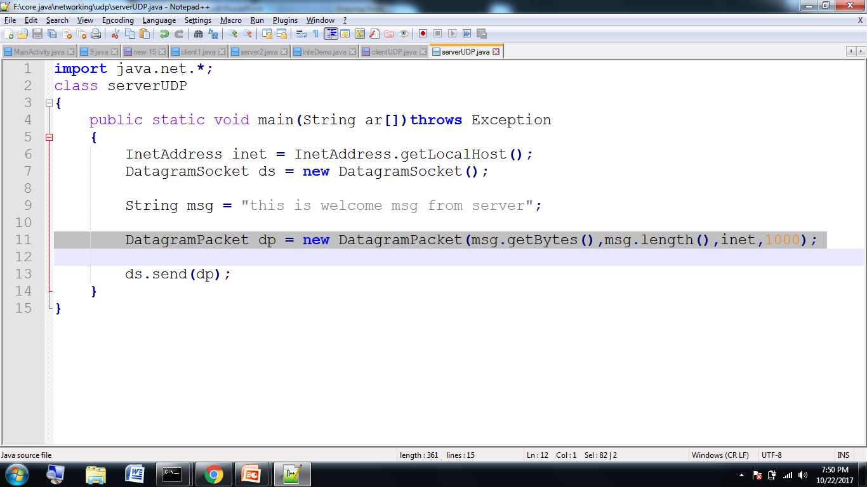
Server program

Slide 15
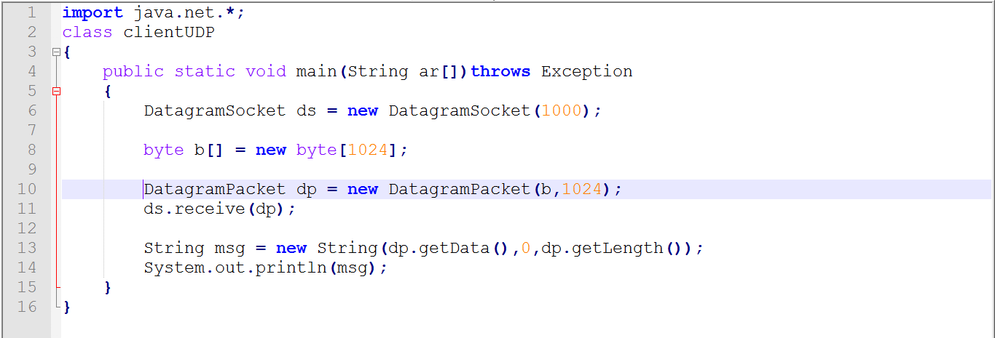
Client program

