Slide 1
inetAddress class in java

Slide 2
Introduction
Java.net.InetAddress
class is use to represents the IP address.
This class is use to get the IP address from the host name
Ex:
InetAddress getByHostName(www.gisurat.com);

Slide 3
class InetAddress extends Object implements Serializable
{
}

Slide 4
Methods of the class
public String getHostName();
public byte[] getAddress();
public String getHostAddress();
public InetAddress getByName(String);
public InetAddress[] getAllByName(String);
public InetAddress getLocalHost();

Slide 5
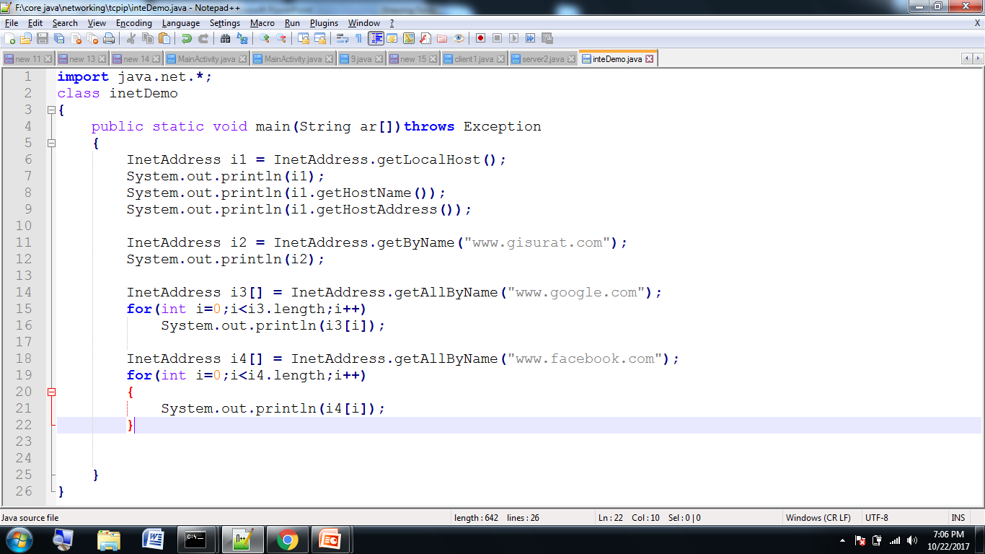
program

Slide 6
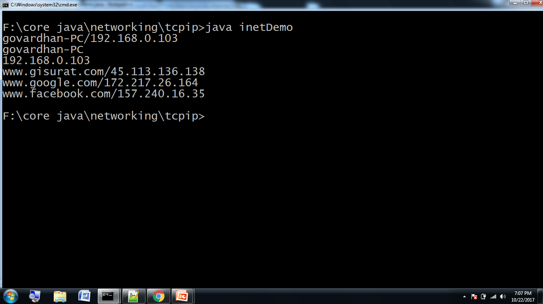
output

