Slide 1
Leveraging Semantics Information to Recognizing Seen and Unseen Locations Using a Mobile Rover
Supervisor : Prof. Rahul Mishra
Prepared By : Jigar Shekhat (202211004)

Slide 2
Contents
Mobile Rover
What is Semantic Information?
Seen and Unseen Locations
Literature Survey
Motivation
Problem Statement
Objective
Workflow
Previous work
Main Work Flowchart
Data Collection
YOLO Object Detection
Results
Conclusion and Future Work
Reference

Slide 3
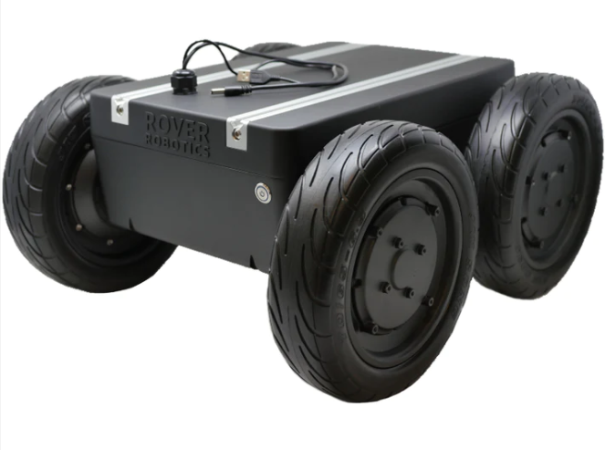
Autonomous Mobile Rover
Robotic vehicle designed to navigate and operate within different environments.
Rovers are equipped with some form of artificial intelligence to help them navigate, avoid obstacles, and perform specific tasks.
Application :
Home/Office Assistance
Environmental Monitoring
Agriculture
Security and Surveillance
Figure 1 : Mobile Rover*
*https://roverrobotics.com/products/miti-unmanned-ground-vehicle

Slide 4
What is Semantic Informations ?
Meaning or interpretation associated with data or elements in a particular context.
The semantic information derived from the presence of these items leads to the inference that the place may be.
It involves understanding the significance and relationships between various pieces of data within a given context.
In simple terms inferring the name of a class from external information, as shown in Figure.
Specifically, describing an entity or class via its features rather than its name.
Monitor
Cupboard
Keyboard Mouse
Fan
Chair
LAB
Room
Bench
Whiteboard
Window
Table
Chair
Classroom
Figure 2 : Related Objects

Slide 5
Seen and Unseen Locations
Seen Locations
Locations that are part of the rover's training set.
The rover has encountered and learned about these locations during its training phase.
It can accurately recognize and identify these places based on its training data.
Unseen Locations
Locations that are not part of the rover's training set.
The rover has not encountered or learned about these locations during its training phase.
Despite not having specific training data for these locations, the rover can still obtain semantic information about its surroundings.
The ability to gather semantic information in unseen locations enhances the rover's adaptability to new environments using the information about the seen locations.

Slide 6
Literature Survey
Ref. | Method | Drawbacks
[ 1 ] | WiFi localization and navigation for autonomous indoor mobile robots. | Limited Coverage Area Multipath Propagation Signal Interference
[ 2 ] | Integrate object detection from images into the localization process | Dependence on Training Data Difficulty with Small Objects Difficulty in Handling Occlusions Resolution Sensitivity
[ 3 ] | Satellites facilitate accurate positioning and navigation across outdoor environments | Multipath Reflections Signal Attenuation Limited Number of Satellites

Slide 7
Motivation
To solve all drawbacks, We build system that combine all of this method into one and give better results in compare to all of these individual techniques.
So that, mobile rover will be better able to understand their environment if they are equipped with this system that provides semantic information relating to location.

Slide 8
Problem Statement
How mobile rover recognize seen and unseen location using semantic information from the seen environment?

Slide 9
Objective
Our goal is to develop a system that is capable of obtaining semantic information about the interior space, while autonomously navigating in seen and unseen locations.
The system employs three parameters:
Outdoor Location (GPS coordinates),
Indoor Location (WiFi signal intensities),
Proximity Objects (objects in the surrounding and their relation).
With this knowledge, a mobile rover can move around an indoor space with effectiveness and be able to comprehend and adjust to its changing surroundings even if the location is unseen.

Slide 10
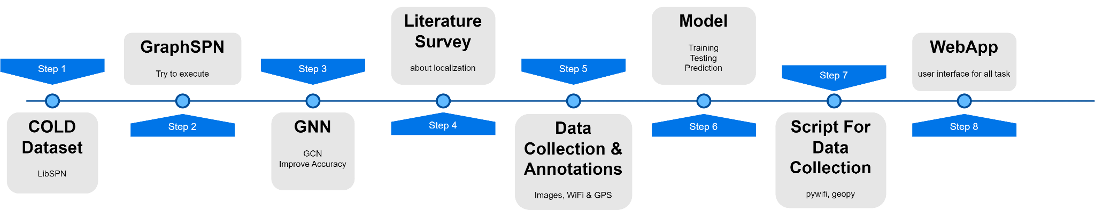
Workflow
[ Jan ‘23 - May ‘23 ]
[ June ‘23 - Oct ‘23 ]
Figure 3 : Workflow of Project

Slide 11
Previous Work
Dataset - COLD
Graph Sum-Product Network : GraphSPN is a probabilistic graphical model that extends Sum-Product Networks (SPNs) to handle graph-structured data. GraphSPN extends this capability to graphs, allowing for modeling and reasoning over complex relational data.
Graph Convolutional Network : GCN is a deep learning model designed for processing graph-structured data. It extends convolutional neural networks (CNNs) to operate on graph data by leveraging the neighborhood relationships between nodes.

Slide 12
COLD Dataset
Cognitive rObot Localization Database (COLD), a large database of localization, sensory information and local environment representations (place scans), as well as topological maps, completely annotated with semantic place categories.
There are 100 sequences in total, collected by a mobile rover in three buildings at three different locations:
Stockholm (40 seqs)
Freiburg (26 seqs)
Saarbrucken (34 seqs)

Slide 13
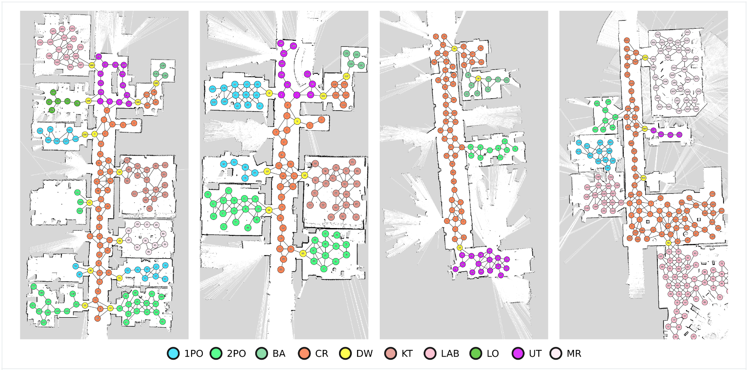
TopoMaps Dataset
Figure 4 : TopoMap Example
https://www.coldb.org/site/topo_map_dataset/

Slide 14
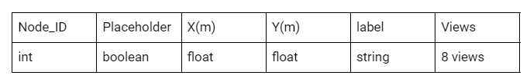
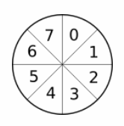
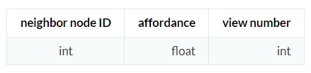
Characteristic TopoMaps
node.dat
Figure 5 : Schema of node.dat
views
Figure 6 : format of views
Figure 7 : 8 views

Slide 15
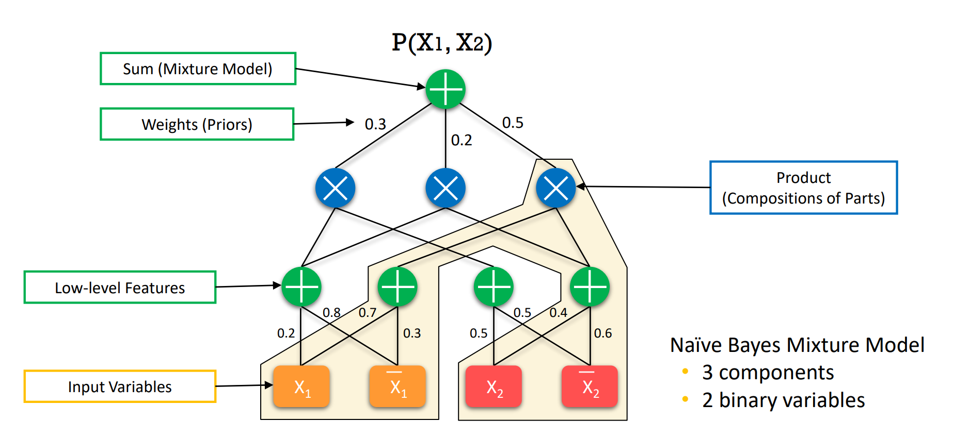
SPN - Sum Product Network
Figure 8 : Sum Product Network
Zheng, Kaiyu, Andrzej Pronobis, and Rajesh Rao. "Learning graph-structured sum-product networks for probabilistic semantic maps." Proceedings of the AAAI Conference on Artificial Intelligence. Vol. 32. No. 1. 2018.

Slide 16
GraphSPN
Graph Sum-Product Network is a type of probabilistic graphical model that extends the Sum-Product Network (SPN) framework to handle graph-structured data.
GraphSPN represents a probability distribution over a set of graphs using a hierarchical structure of sum and product nodes, where the nodes operate over local subgraphs.
One of the main advantages of GraphSPN is its ability to handle variable-sized graphs and to capture the dependencies and patterns within them.
This makes it suitable for a wide range of applications.
Zheng, Kaiyu, Andrzej Pronobis, and Rajesh Rao. "Learning graph-structured sum-product networks for probabilistic semantic maps." Proceedings of the AAAI Conference on Artificial Intelligence. Vol. 32. No. 1. 2018.

Slide 17
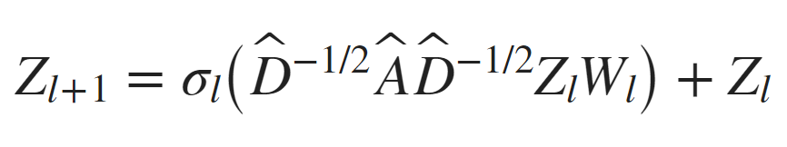
GCN
convolutional neural networks (CNNs) to operate on graphs instead of grid-structured data like images.
σl is the activation function.
Z1=X.
Wl is the weight matrix for the multiplication.
A’=A+IN is the adjacency matrix of graph G with added self-connections. IN is the identity matrix.
D’ is the degree matrix of A’
https://in.mathworks.com/help/deeplearning/ug/node-classification-using-graph-convolutional-network.html

Slide 18
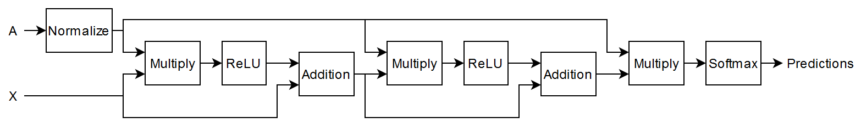
GCN Architecture
Figure 9 : Architecture of GCN
https://in.mathworks.com/help/deeplearning/ug/node-classification-using-graph-convolutional-network.html

Slide 19
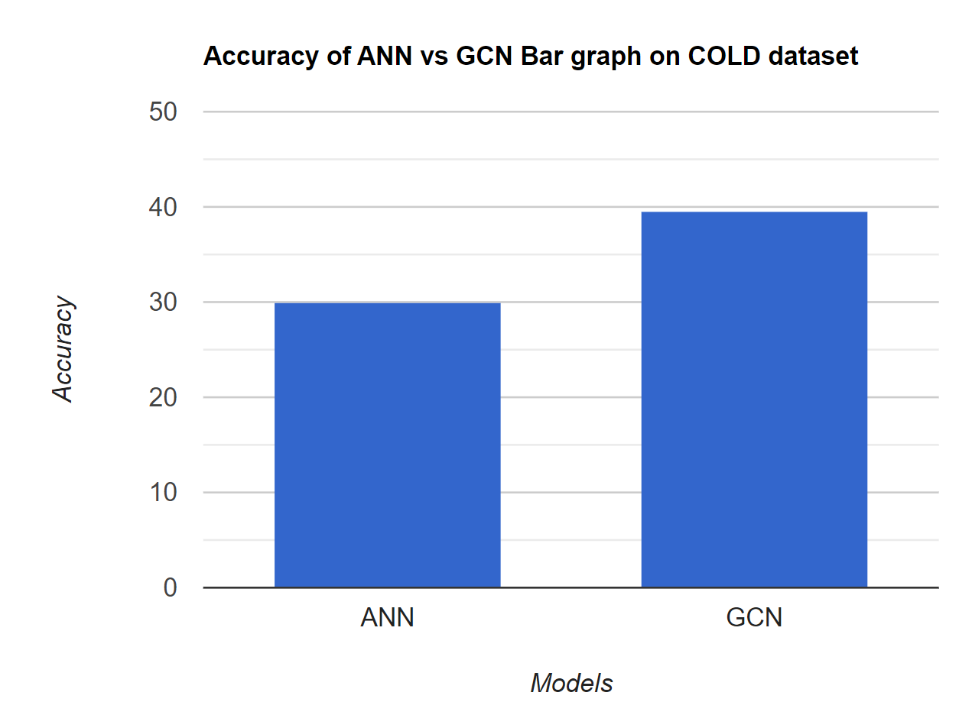
Results of Previous Work
Figure 10 : Accuracy Comparison

Slide 20
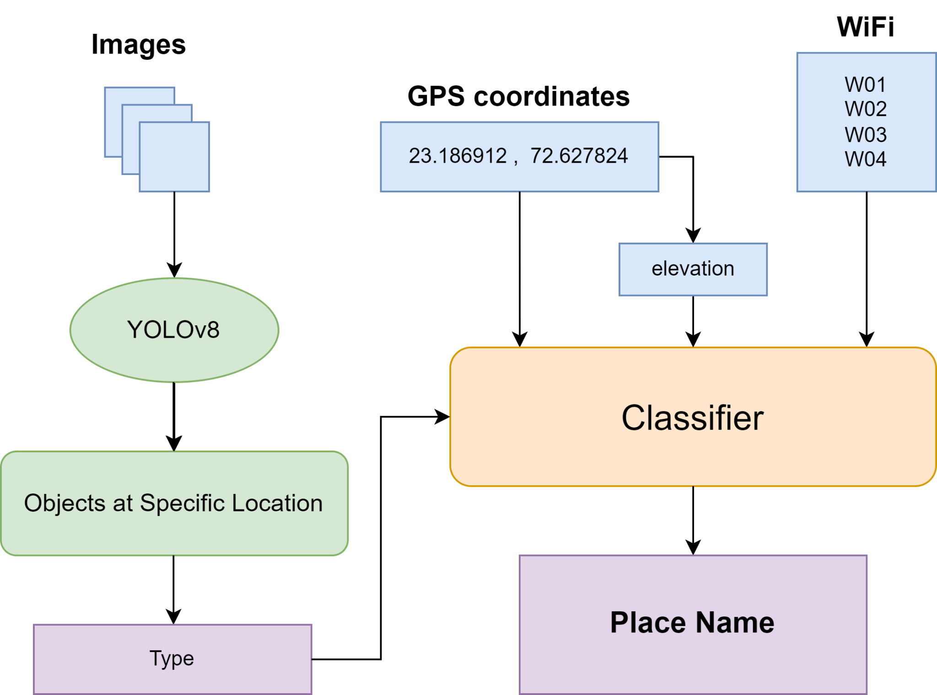
Work Flowchart
Figure 11 : Flowchart of work

Slide 21
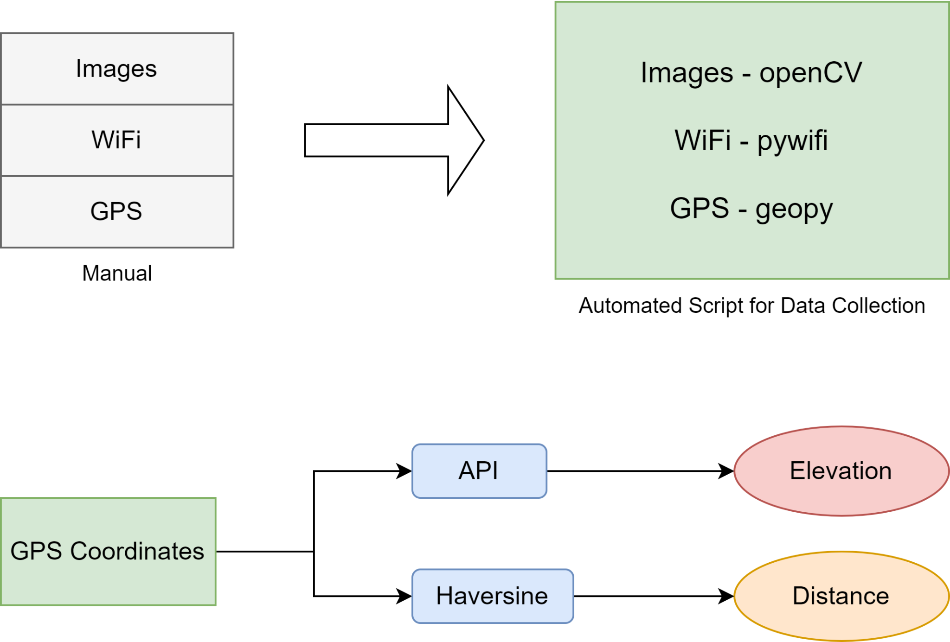
Data Collection
Figure 12 : Data Collection

Slide 22
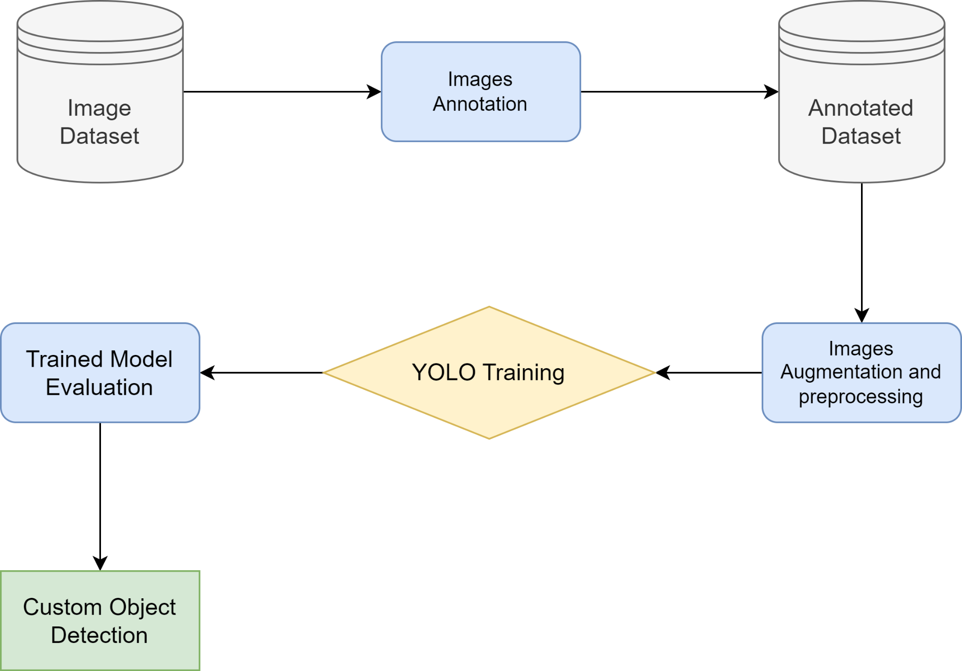
YOLO Object Detection
Figure 13 : Custom Object Detection Process

Slide 23
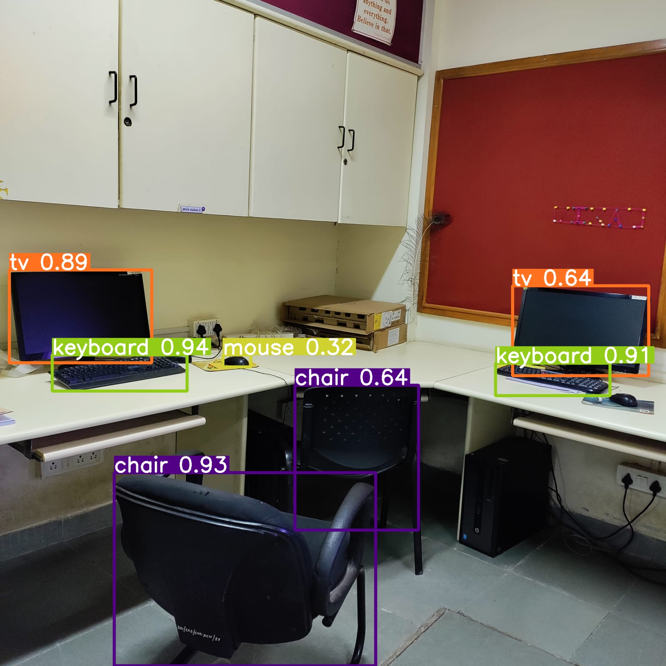
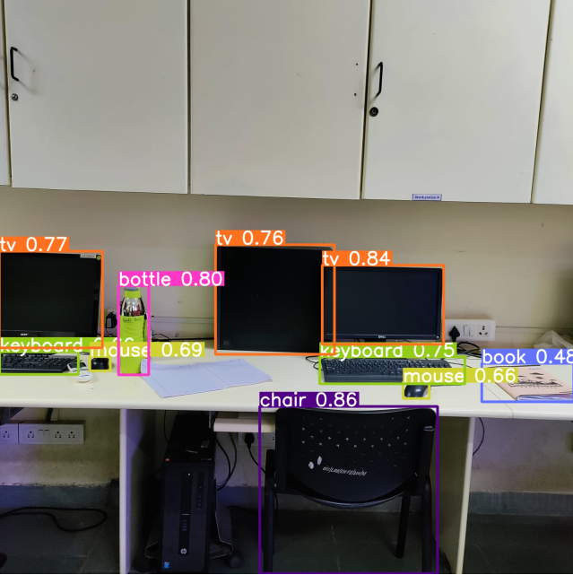
Results - YOLO (Object Detection)
Figure 14 : Object Detection Example 1
Figure 15 : Object Detection Example 2

Slide 24
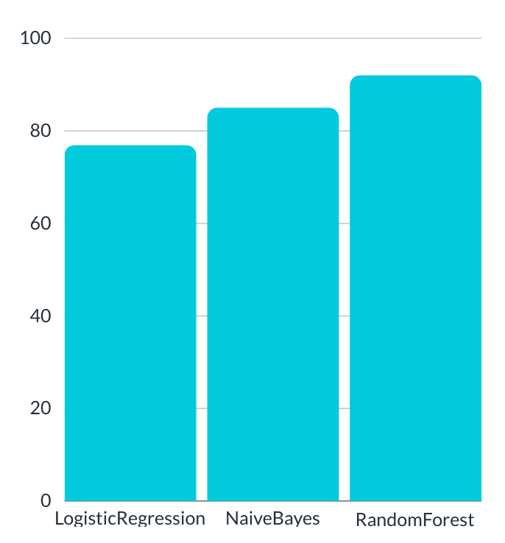
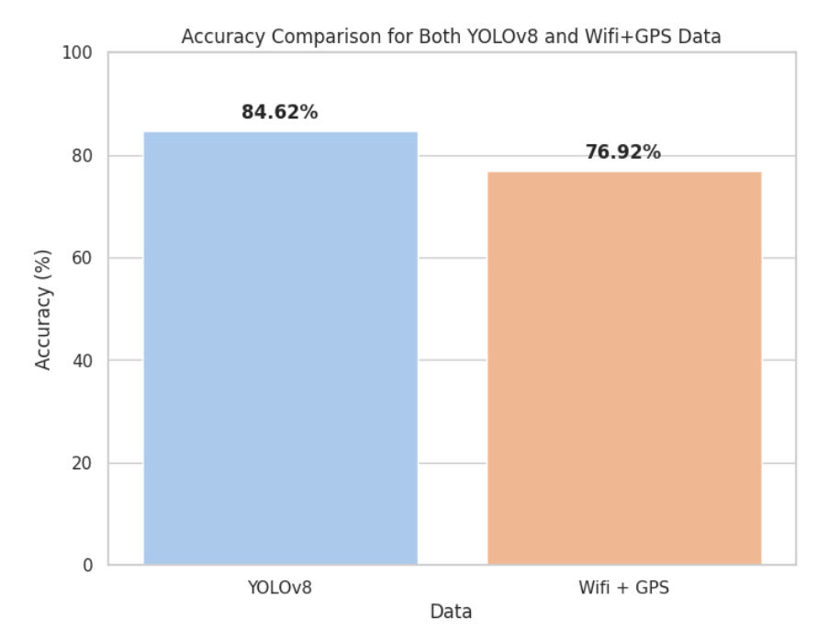
Results
Figure 16 : YOLOv8 and Wifi+GPS Accuracy
Figure 17 : Classifier Accuracy Comparison

Slide 25
Conclusion
We find that more accurate results can be obtained by combining room images with GPS and wifi data.
Semantic information about locations that are seen and unseen is being received by the mobile rover.
However, occasionally YOLOv8 is unable to recognize the correct object. for that, We have a large annotated dataset for custom object detection. and Building structures frequently block the infiltration of GPS signals.

Slide 26
Future Scope
Handling Dynamic and Undefined Objects.
(bottle, person)
Fine-Tuning Object Detection with proper large annotated dataset of image.

Slide 27
References
Joydeep Biswas and Manuela Veloso. Wifi localization and navigation for autonomous indoor mobile robots. In 2010 IEEE international conference on robotics and automation, pages 4379–4384. IEEE, 2010
Raul Mur-Artal, Jose Maria Martinez Montiel, and Juan D Tardos. Orb-slam: a versatile and accurate monocular slam system. IEEE transactions on robotics, 31(5):1147–1163, 2015
Paul D Groves. Principles of gnss, inertial, and multisensor integrated navigation systems, [book review]. IEEE Aerospace and Electronic Systems Magazine, 30(2):26– 27, 2015
Ismail Guvenc and Chia-Chin Chong. A survey on toa based wireless localization and nlos mitigation techniques. IEEE Communications Surveys & Tutorials, 11(3):107–124, 2009.
Zheng, Kaiyu, Andrzej Pronobis, and Rajesh Rao. "Learning graph-structured sum-product networks for probabilistic semantic maps." Proceedings of the AAAI Conference on Artificial Intelligence. Vol. 32. No. 1. 2018.
Zheng, Kaiyu, and Andrzej Pronobis. "From pixels to buildings: End-to-end probabilistic deep networks for large-scale semantic mapping." 2019 IEEE/RSJ International Conference on Intelligent Robots and Systems (IROS). IEEE, 2019.

Slide 28
Thank You

