Slide 1
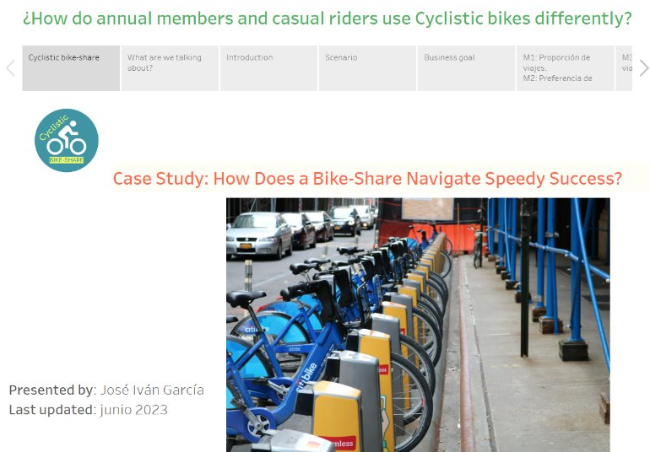
https://goo.su/kndPkbz

