Slide 1
Rate model of the Spreizer network
Figures:
Steepness influences mean activity
Dopamine patches

Slide 2
Steepness influences mean activity
Three different values for the steepness
  10
  1.0
  0.1

Slide 3
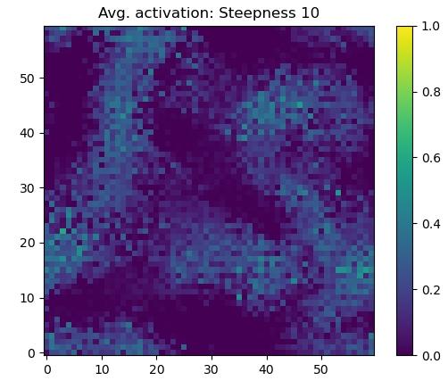

Slide 4
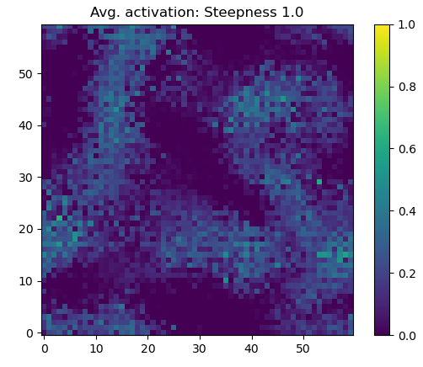

Slide 5
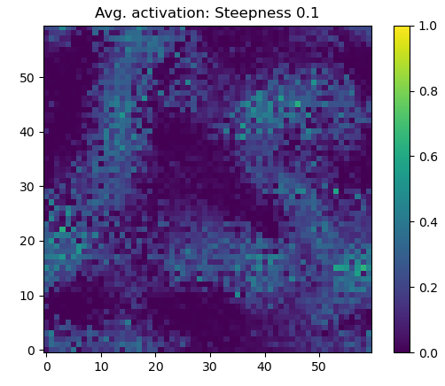

Slide 6
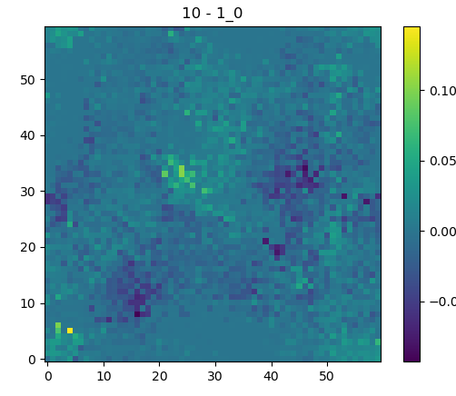

Slide 7
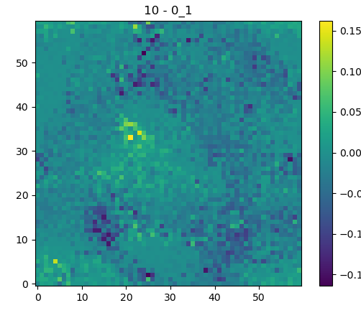

Slide 8
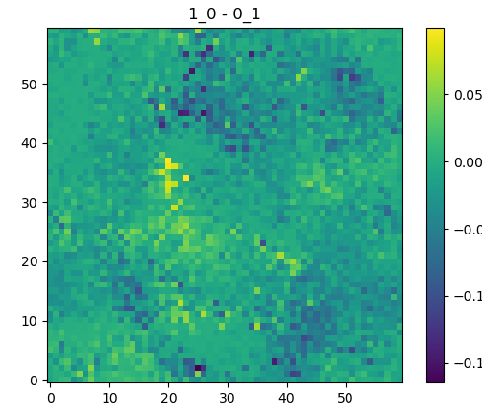

Slide 9
Dopamine patches
Three positions
  In…
  Near…
  Out of…
  … a sequence

Slide 10
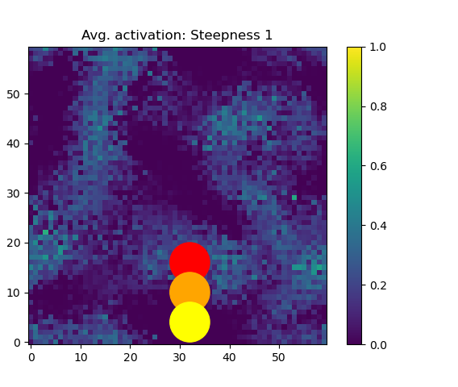
Red: in
Orange: edge
Yellow: out

Slide 11
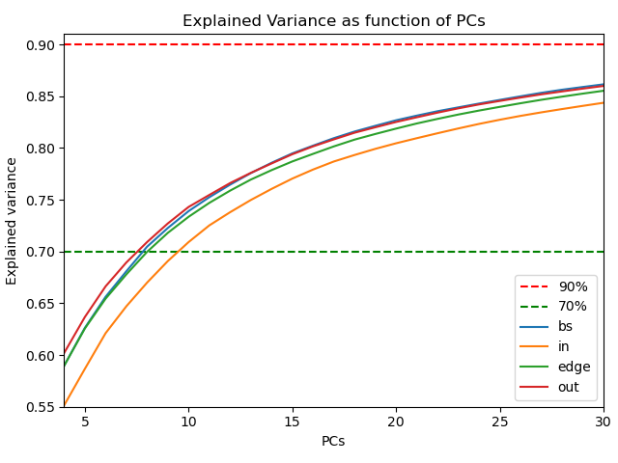

Slide 12


Slide 13
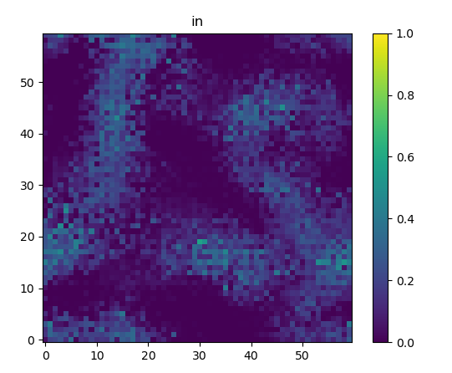

Slide 14
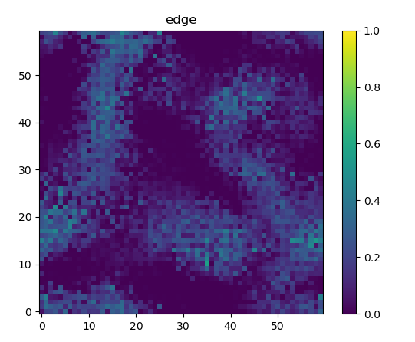

Slide 15


Slide 16
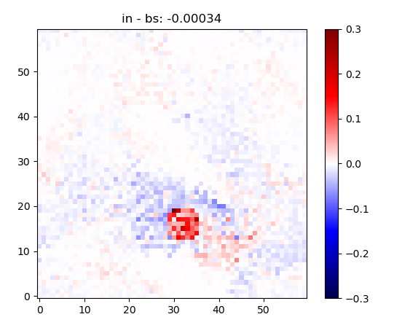

Slide 17
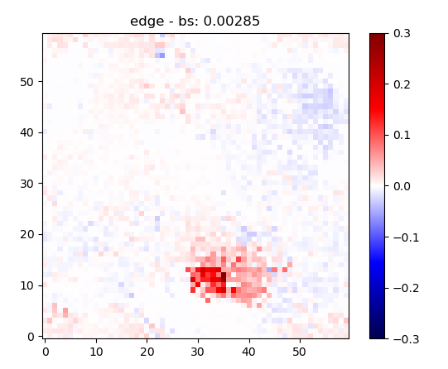

Slide 18
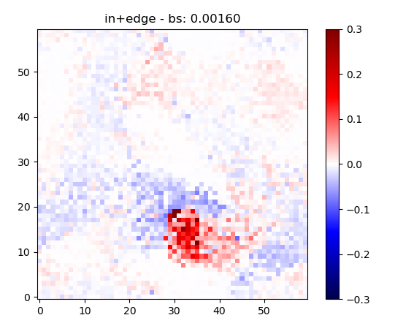

Slide 19
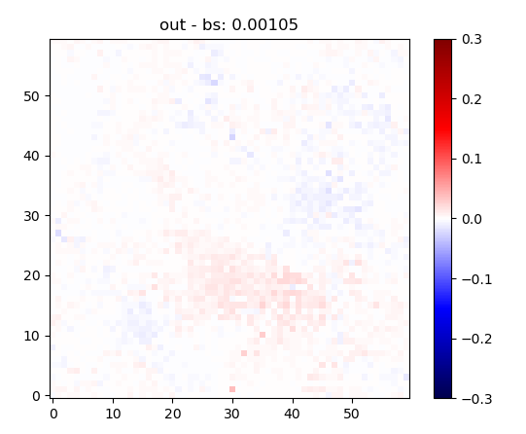

Slide 20
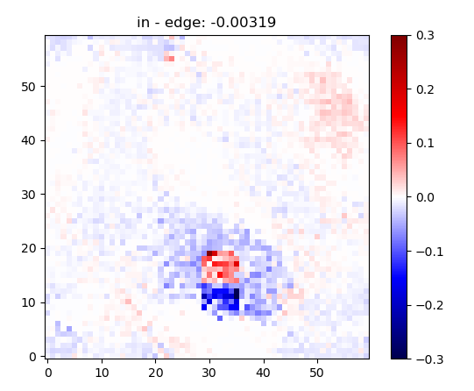

Slide 21
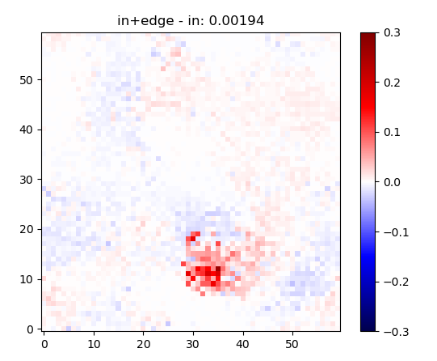

Slide 22
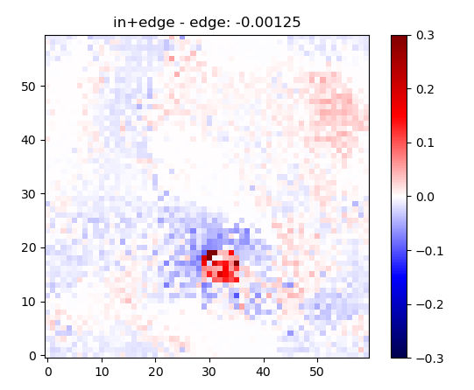

Slide 23
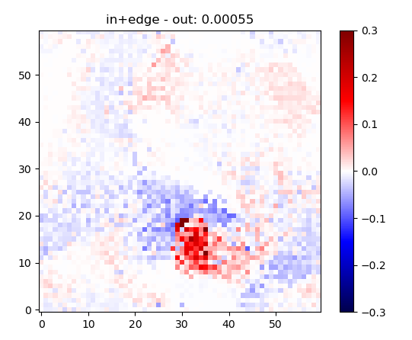

Slide 24
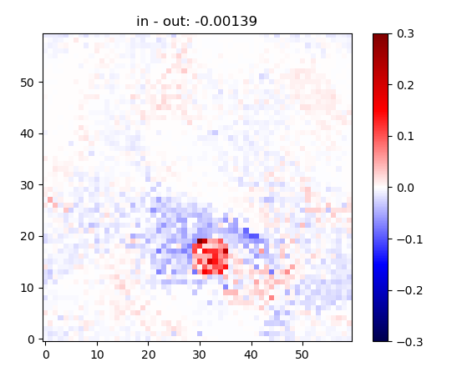

Slide 25
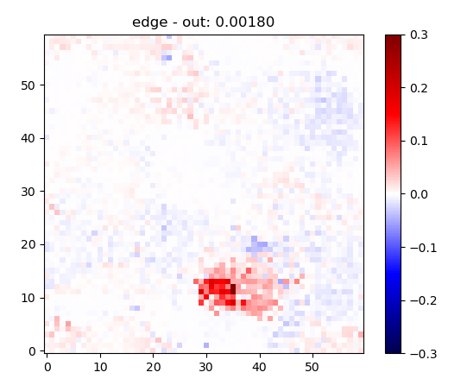

Slide 26
g configuration
Different g’s as factor of inhibition over excitation
  5.5
  6.0
  7.0
  8.0

Slide 27
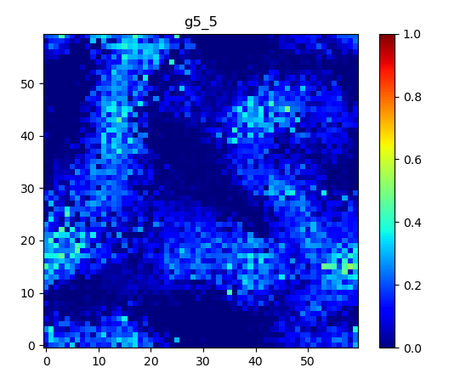

Slide 28
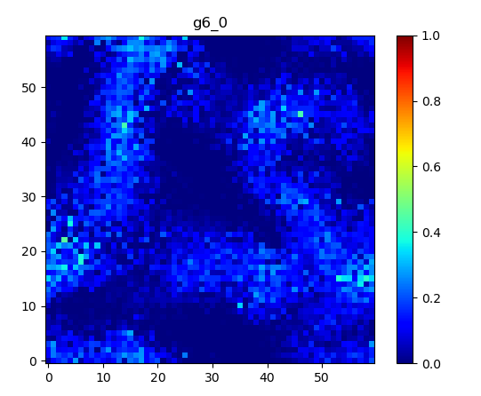

Slide 29
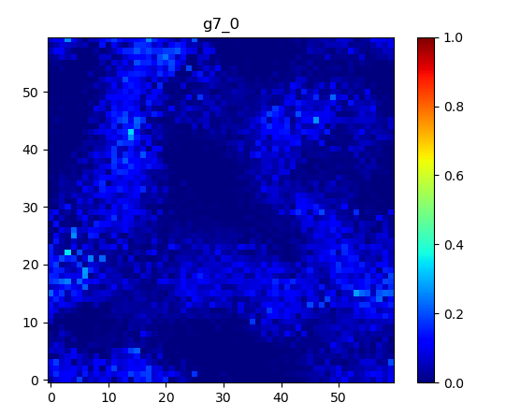

Slide 30
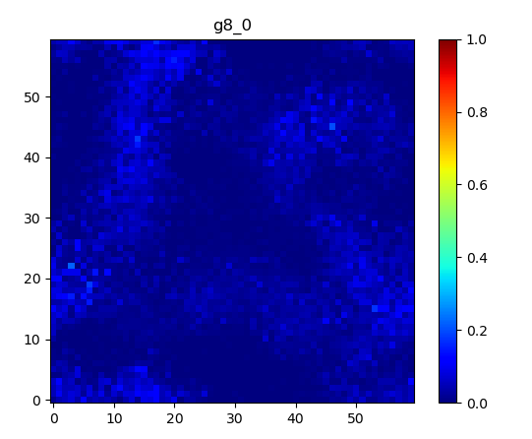

Slide 31
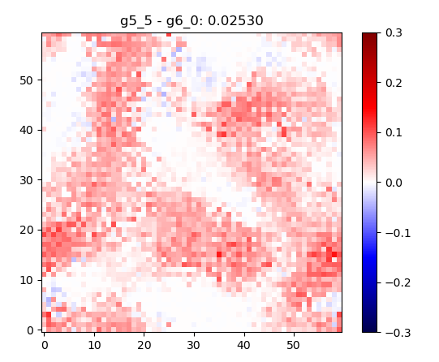

Slide 32
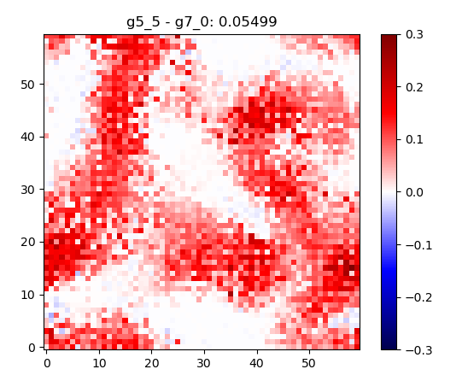

Slide 33
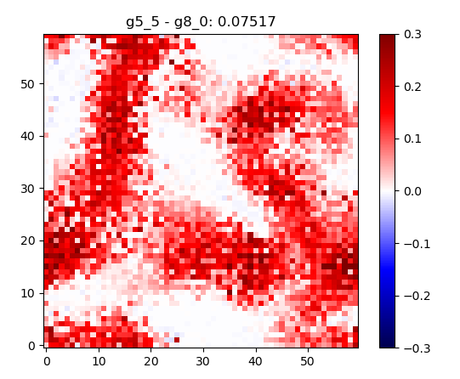

Slide 34
Differences in the Perlin scale
Perlin scale…
  … 4 (higher relationship among neurons)
  … 5 (lower relationship among neurons)
With J = 2.5 and g = 6

Slide 35
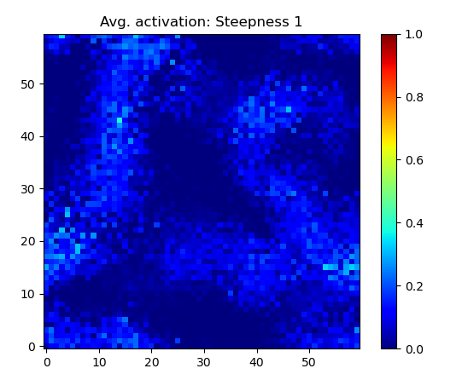
Solid: main
sequence
Dashed:
occasionally
occurring
sequences

Slide 36
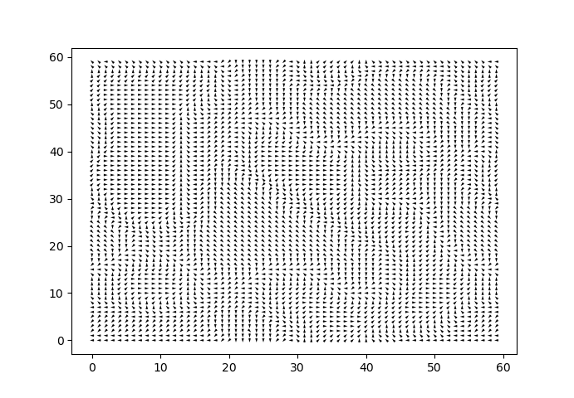

Slide 37
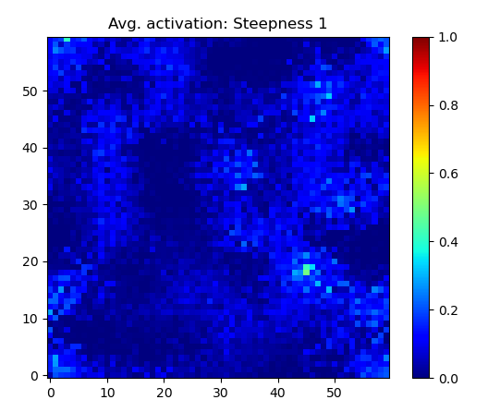
Solid: main
sequence
Dashed:
occasionally
occurring
sequences
Orange:
Main A
Green:
Main B

Slide 38
Linker patch
J = 2.5 and g = 6
A patch to link/enhance the branch
Results:
  Much more activation on the branch (activation most of the time → stable activity in that branch)
  The branch merges to the main sequence at around (45, 18) and leading to a stronger main sequence in general
    And suppressing a sequence at ~(30, 50) which branches from the left part
    … but get inhibited stronger from the more activated right sequence.

Slide 39

Baseline

Slide 40
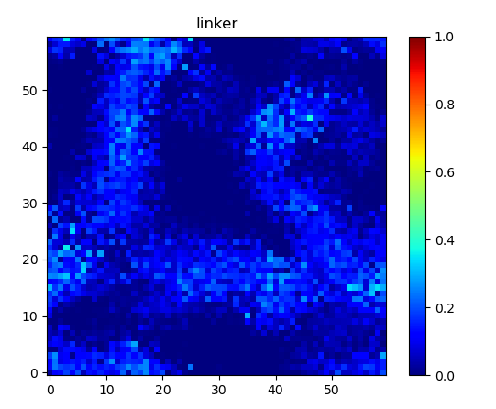
Patch at (18, 20)
with r=4

Slide 41
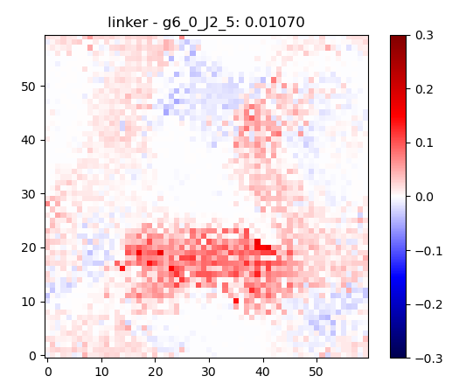

Slide 42
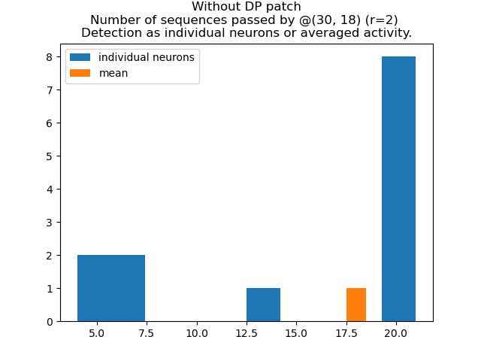

Slide 43
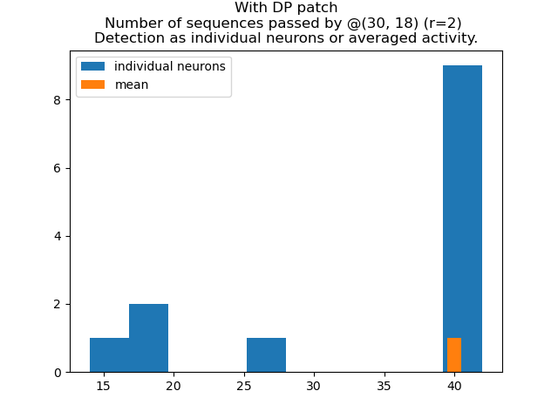

Slide 44
Reference of the “baseline”

Slide 45
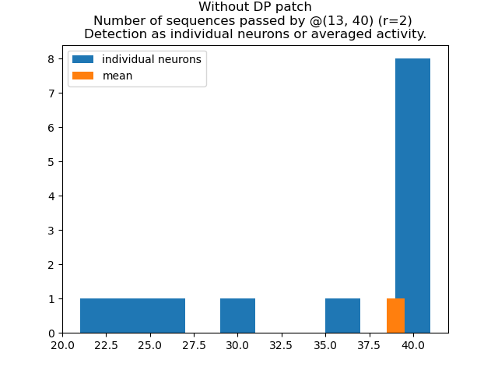
Reference analysis in the
main sequence

Slide 46
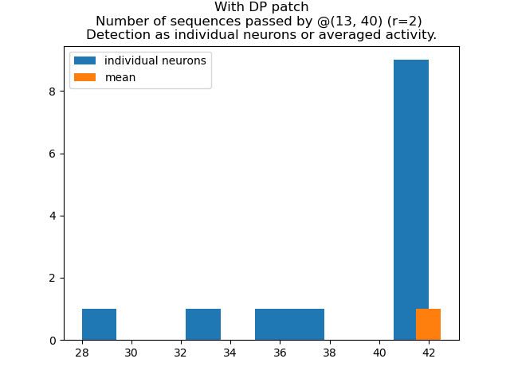
Reference analysis in the
main sequence

Slide 47
ACh patch
Reducing the syn. weights by 20%
Effectively reducing the transmission in a branch

Slide 48
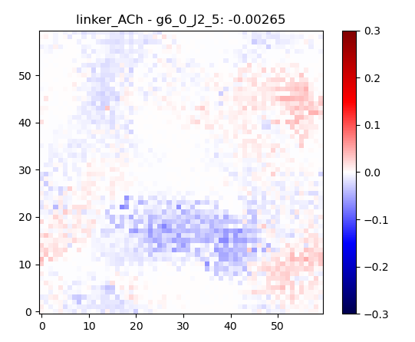

Slide 49
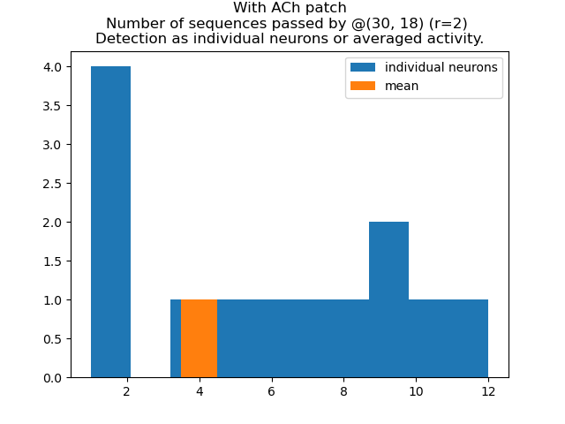

Slide 50
Dopamine as repeater
Using a lower J, and a higher external drive (mean of two instead of zero) → main is fading sometimes
  Lower avg. activation of the main (slide 51 against slide 52)
  The higher J (if the main is active once, it is active throughout the simulation, as in the previous linker slides) as reference for an active main sequence (slide 56)
  Low activity → lower number of sequences in the main path (slide 54)
  Repeater patch → re-activate the stability of the main path resulting in more sequences passing by again (slide 55)

Slide 51
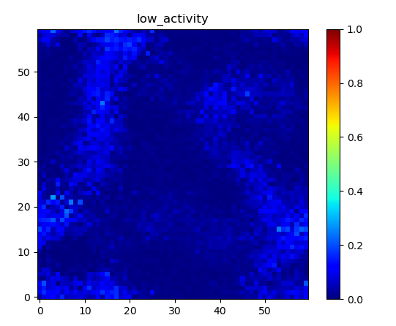
Baseline

Slide 52
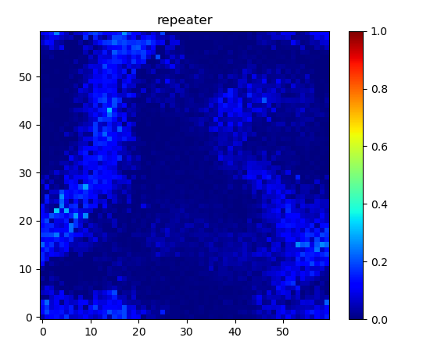
Patch at (7, 24)
with r=4

Slide 53
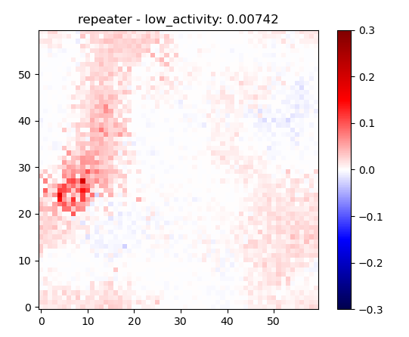

Slide 54
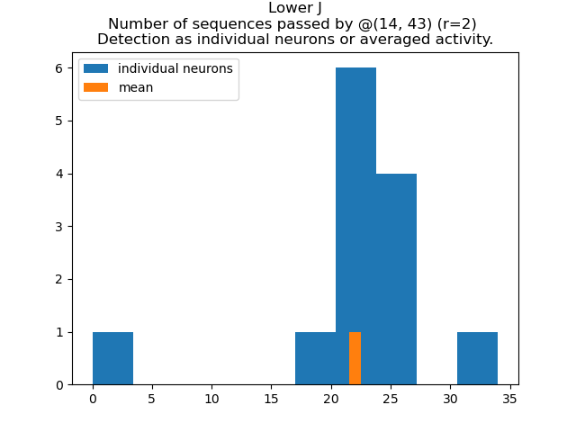

Slide 55
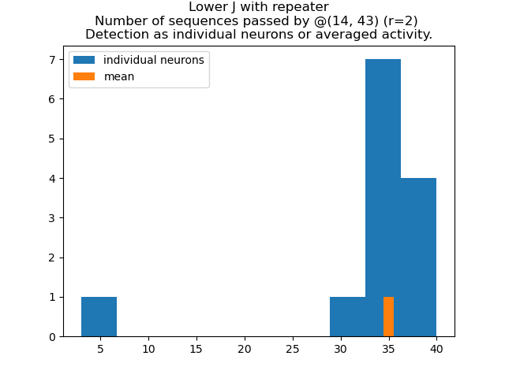

Slide 56
