Slide 1

AML – 1114 Data Science and Machine Learning
[Data Science]
The study of data to gain insights and knowledge; involves methods of recording, storing, and analyzing data to effectively extract useful information.

Slide 2
Learning Outcomes
Principles, concepts and understanding of Data Science Weeks: 1, 2
Data Management Weeks: 3, 4, 5
Data Science in Business Weeks: 6
Data Science Tools and Data Pre-processing Weeks: 7
Data Science Methodology and Machine Learning Models Weeks: 8, 9, 10
Statistical and Mathematical Background of Data Science Weeks: 11, 12, 13

Slide 3
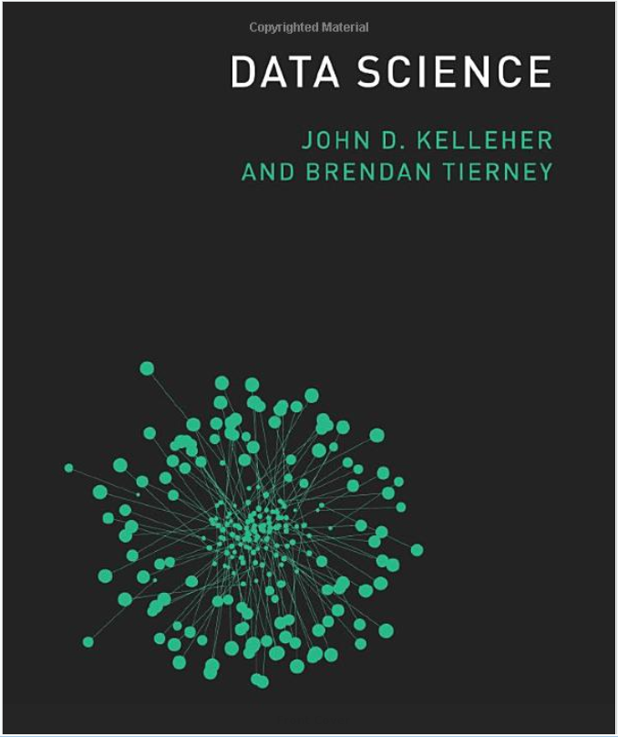
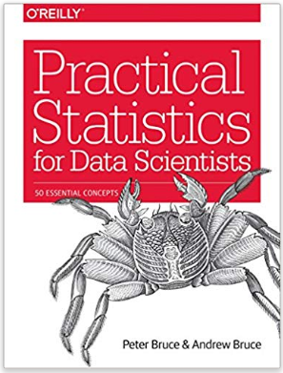
Required Materials
Text Books
A) Data Science
John D. Kelleher , Brendan Tierney
ISBN-13: 978-0262535434
280 pages
April 2018
B) Practical Statistics for Data Scientists: 50 Essential Concepts
Peter Bruce, Andrew Bruce
ISBN-13: 978-1491952962
318 pages
May 2017
2. Personal Computer PC, MAC, Linux: You will need a modern Internet browser and an SSH terminal

Slide 4
Evaluation
Evaluation methods
Evaluation Method | Weight
Tests (2 @ 30%) | 60%
Assignments (1 @ 10%) | 10%
Term Project (1 @ 30%) | 30%
Total | 100%
2. Marking Scheme
Mark(%) | Grade | Mark(%) | Grade
94-100 | A+ | 67-69 | C+
87-93 | A | 63-66 | C
80-86 | A- | 60-62 | C-
77-79 | B+ | 50-59 | D
73-76 | B | 0-49 | F
70-72 | B-

Slide 5
Any questions so far? Any comments?

Slide 6
Topic 1 Principles, concepts and understanding of Data Science
Major Topics:
Basic terminology and concept
Data Science domain: closely related disciplines
Data Science practices and applications
Data Science process
Data Science ecosystem

Slide 7
Data Science Concepts
Math and Statistics
AI / Machine Learning/
Coding
Data Science
Data Science encompasses a set of principles, problem definitions, algorithms and processes for extracting nonobvious and useful patterns from large data sets.
Database Systems

Slide 8
Data Science Concepts
Data Science
The study of data to gain insights and knowledge.
Involves methods of
Data collection & management at large scale
Data visualization
Analytics on the collected data, and
Representation of results

Slide 9
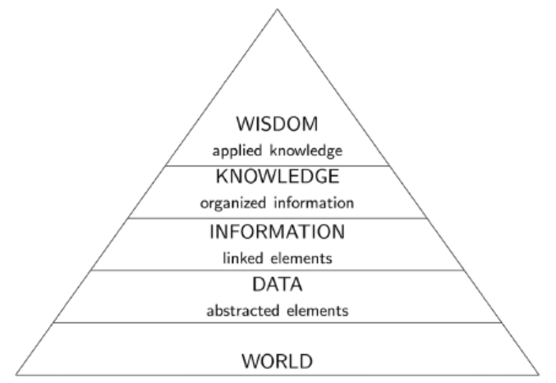
Basic Terminology
DIKW pyramid
Standard model of structural relationship between wisdom, knowledge, information and data.

Slide 10
Basic Terminology
Data is created through abstractions or measurements taken from the world.
These are the facts and statistics collected together for reference or analysis.
Example: The height of the students in this class in centimeter.
Information is data that have been processed, structured or contextualized so that it is meaningful to humans.
Knowledge is information that has been interpreted and understood by a human so that he/she can act on it if required.
Wisdom is acting on knowledge in an appropriate way.

Slide 11
Basic Terminology
Data Analysis
Data analysis is a process of inspecting, cleansing, transforming and modeling data with the goal of discovering useful information, informing conclusion and supporting decision-making.
Data Visualization
Data visualization is the graphic representation of data.
Involves producing images that communicate relationships among the represented data

Slide 12
Basic Terminology
Data Mining
Process of analyzing vast amount of data to discover additional knowledge or new information about the data such as patterns or rules or interesting structure in data.

Slide 13
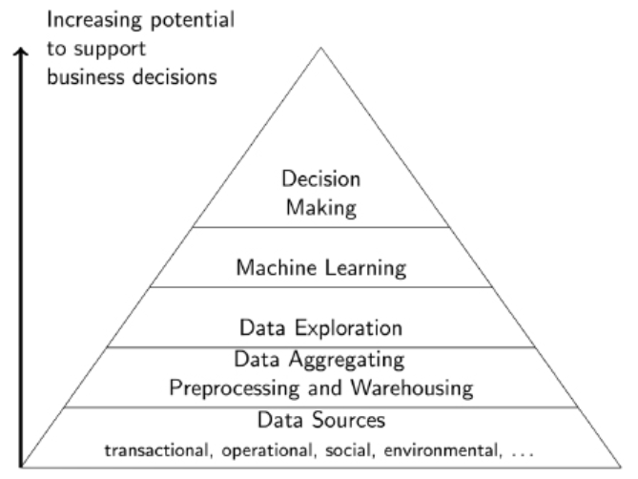
Basic Terminology
Data Science Pyramid

Slide 14
Data Science Applications
Data Science Usability
Information retrieval
Text analysis
Natural language processing
Image recognition
Anomaly detection
Web mining
Pattern recognition
Recommendation
Sentiment analysis

Slide 15
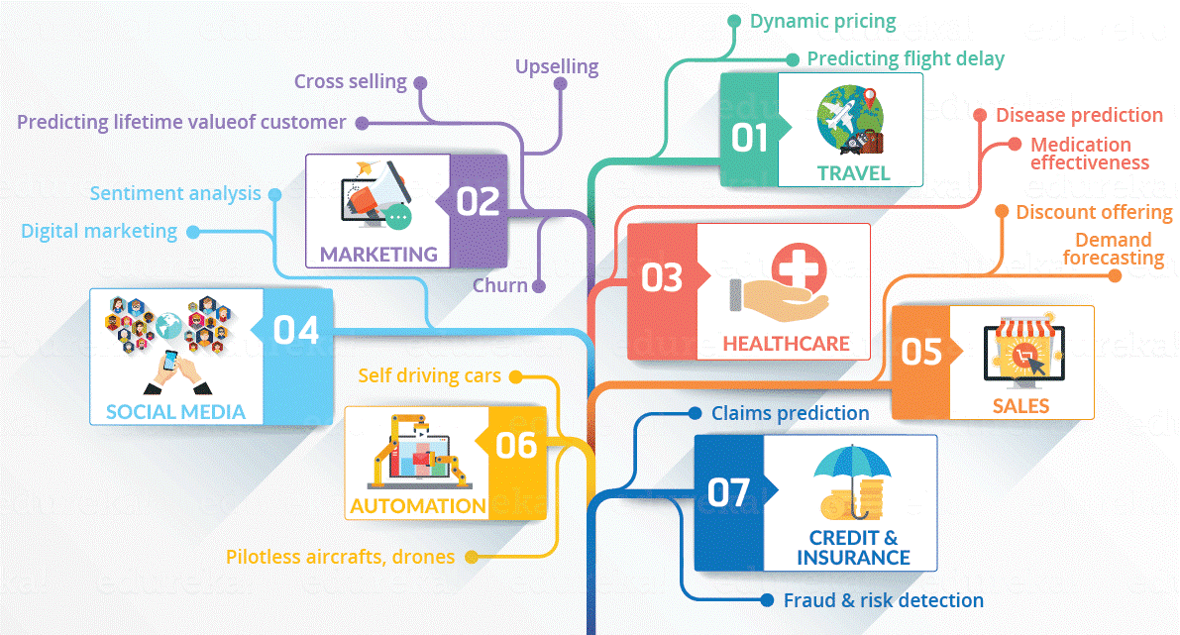
Data Science Applications

Slide 16
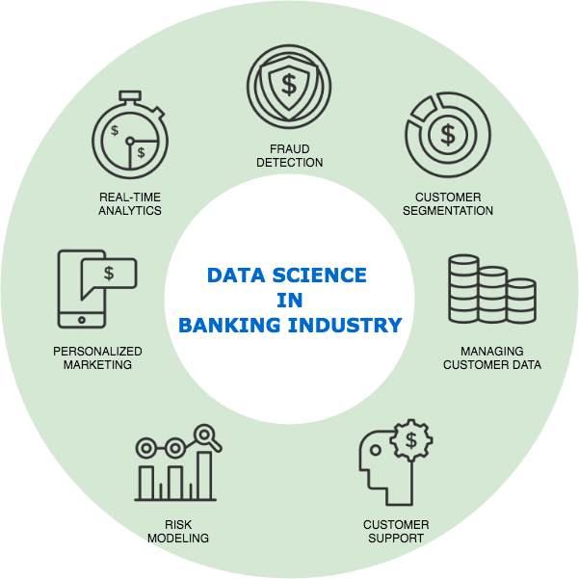
Data Science Applications
Banking and Financial Sector
Fraud and Risk Detection.
Claim Prediction
Risk Estimation
Personalized Marketing

Slide 17
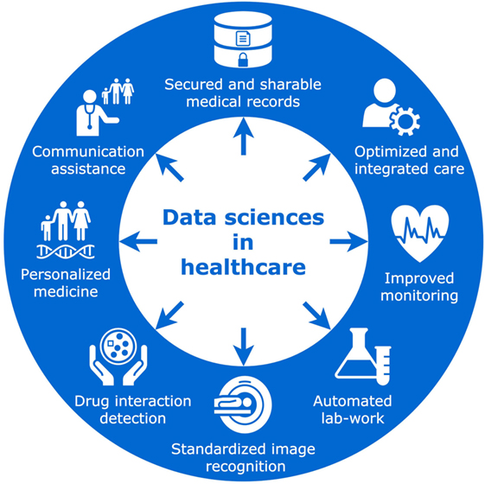
Data Science Applications
Healthcare
Optimized and integrated care.
Image analysis and problem detection
Communication assistance
Medication effectiveness
Personalized medicine

Slide 18
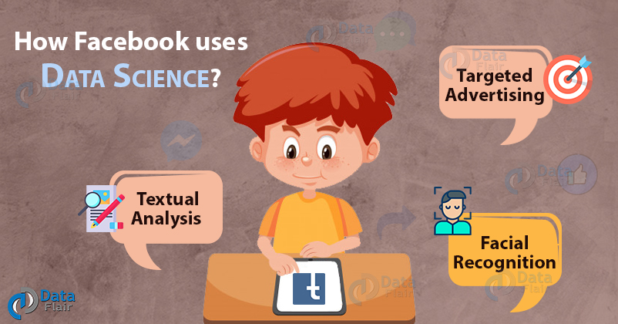
Data Science Applications
Social Media
Sentiment analysis
User segmentation
Image recognition
Digital marketing

Slide 19

Data Science Applications
Travel
Dynamic pricing
Customer segmentation
Personalized marketing
Flight delay prediction
Route optimization
Digital marketing

Slide 20

Data Science Applications
Marketing and Sales
Customer segmentation
Demand forecasting
Tracking customer behavior
Personalized marketing
Upselling and cross selling
Discount offering

Slide 21
Any questions so far? Any comments?

