Slide 1

AML – 1114 Data Science and Machine Learning
[Data Science]
The study of data to gain insights and knowledge; involves methods of recording, storing, and analyzing data to effectively extract useful information.

Slide 2
Data Science Process
Topics
Data Science Process
CRISP-DM
OSEMN
TDSP
Data Science Ecosystem

Slide 3
Data Science Process
Goal
Capture and Integrate customer data
Drive Insight from data
Turn Insight into Action
Data Science Processes
Cross Industry Standard Process for Data Mining (CRISP-DM)
Obtain, Scrub, Explore, Model, and iNterpret (OSEMN) framework
Team Data Science Process (TDSP)
Knowledge Discovery in Databases (KDD)

Slide 4
Data Science Process
CRISP-DM Process
Cross Industry Standard Process for Data Mining (CRISP-DM)
Designed to be independent of software, vendor or data-analysis technique
Preferred process indicated by various industry surveys
CRISP-DM life cycle stages
Business understanding
Data understanding
Data preparation
Modeling
Evaluation and
Deployment

Slide 5
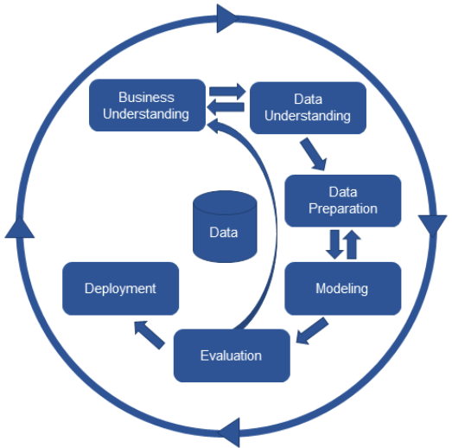
Data Science Process
CRISP-DM
life cycle stages

Slide 6
Data Science Process
The OSEMN framework
Obtain, Scrub, Explore, Model, and iNterpret (OSEMN).
Covers every step of the data science project lifecycle
Proposed by Hilary Mason and Chris Wiggins.
Well suited for using Machine Learning (ML); ML fits into the “E” and “M” tasks

Slide 7
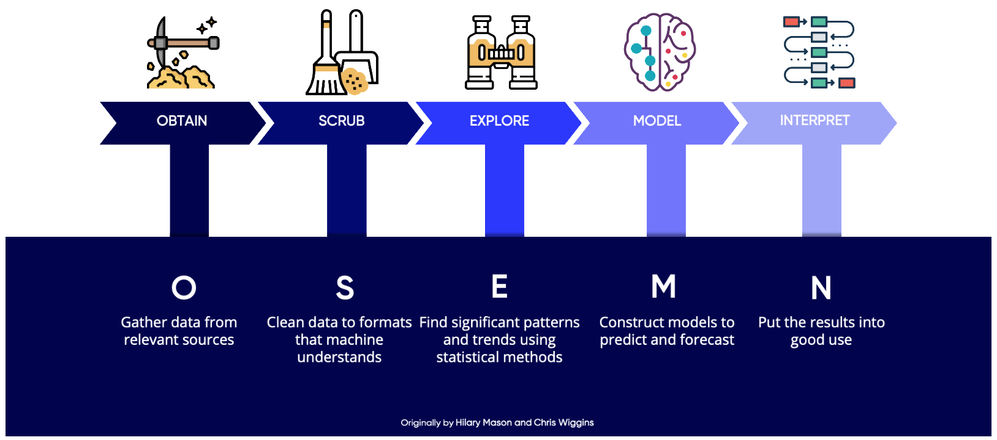
Data Science Process

Slide 8
Data Science Process
TDSP life cycle
Team Data Science Process (TDSP)
Used by Microsoft
Designed for data-science projects that are intended to ship as part of intelligent applications.
TDSP life cycle stages
Business understanding
Data acquisition and understanding
Modeling
Deployment
Customer acceptance

Slide 9
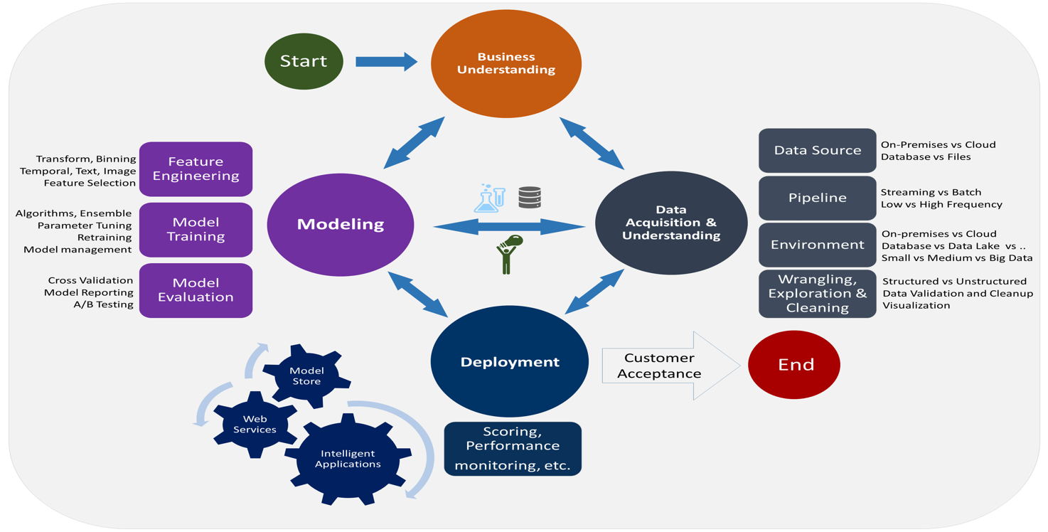
Data Science Process
TDSP life cycle

Slide 10
Data Science Process
KDD life cycle
Knowledge Discovery in Databases (KDD)
is the process of discovering useful knowledge from a collection of data.
Uses Data mining as the pattern extraction phase.
KDD Phases
Data selection
Data processing (cleansing and enrichment)
Data transformation and encoding
Data mining
Reporting and displaying discovered knowledge

Slide 11
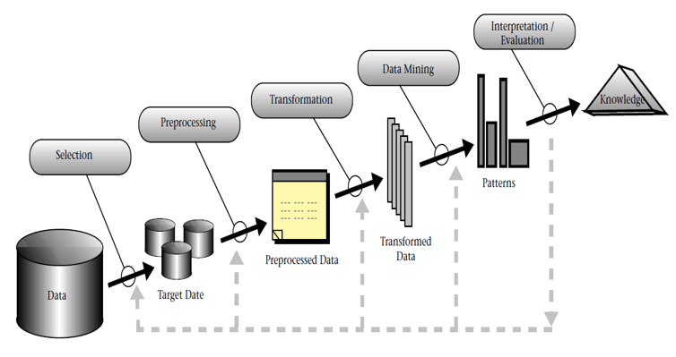
Data Science Process
KDD Phases

Slide 12
Data Science Ecosystem
Data Science Ecosystem
A collection of infrastructure, analytics, and applications used to capture and analyze data.
It provide companies with data that they rely on
to understand their customers and
to make better pricing, operations, and marketing decisions.
Data ecosystems are intended to evolve over time.

Slide 13
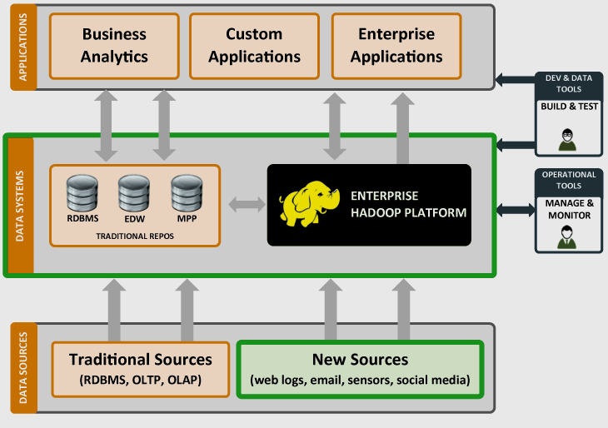
Data Science Ecosystem
Architecture for Data Science

Slide 14
Data Science Ecosystem
Data Ecosystem Components
Infrastructure
Analytics
Application
Infrastructure
The foundation of Ecosystem.
The hardware and software services that capture, collect, and organize data.
Includes servers for storage, search languages like SQL, and hosting platform.

Slide 15
Data Science Ecosystem
Analytics
Platforms search and summarize the data stored within the infrastructure
Tie pieces of the infrastructure together so all data is available in one place.
Find out the correlation within data and predict.
Applications
Services and systems that act upon the data and make it usable.

Slide 16
Any questions so far? Any comments?

Slide 17
Supporting materials
References
[1]https://www.ibm.com/support/knowledgecenter/SS3RA7_15.0.0/com.ibm.spss.crispdm.help/crisp_overview.htm
[2] https://www.analyticsinhr.com/blog/advanced-data-analysis-techniques-applied-to-people-analytics/
[3] https://mixpanel.com/topics/what-is-a-data-ecosystem/
[4] https://docs.microsoft.com/en-us/azure/machine-learning/team-data-science-process/lifecycle
[5] https://www.forbes.com/sites/charlesrtaylor/2019/07/18/3-ways-to-better-target-digital-ads/#6fe39e4450ea

