Slide 1

AML – 1114 Data Science and Machine Learning
[Data Science]
The study of data to gain insights and knowledge; involves methods of recording, storing, and analyzing data to effectively extract useful information.

Slide 2
Topic 2 Introduction to Statistics and Data Analysis
Major Topics:
Introduction to Statistics
Samples and Populations
Introduction to Data Analysis
Summarizing Data

Slide 3
Introduction to Statistics
Definition
Research Project Steps
Population vs Sample
Sampling Methods

Slide 4
Introduction to Statistics
What is Statistics?
Statistics is a branch of applied mathematics that involves the collection, description, analysis, and inference of conclusions from quantitative data.
application of mathematical methods by different fields such as physics, engineering, medicine, biology, finance, business, computer science, and industry
data that can be counted or measured in numerical values

Slide 5

Introduction to Statistics
Why do I need it in my life?
Statistics help in understanding the phenomena of nature. It helps in planning almost everything.

Slide 6

Introduction to Statistics
Steps in a research project
Planning/design of the study
Data collection
Data analysis
Interpretation
Focus of this course
Reporting and presentation
Application of findings

Slide 7
Introduction to Statistics
Samples and Population
Population
Sample
A population is the entire group that you want to draw conclusions about
A sample is the specific group that you will collect data from

Slide 8
Introduction to Statistics
Samples and Population
Population | Sample
Advertisements for IT jobs in the Canada | The top 20 search results for advertisements for IT jobs in the Canada on Apr 1, 2023
Undergraduate students in the Canada | 100 undergraduate students from three Canadian universities who volunteer for your psychology research study
All countries of the world | Countries with published data available on birth rates and GDP since 2000

Slide 9
Introduction to Statistics
Why Sampling is important?
Practicality: It’s easier and more efficient to collect data from a sample.
Cost-effectiveness: There are fewer participant, laboratory, equipment, and researcher costs involved.
Manageability: Storing and running statistical analyses on smaller datasets is easier and reliable.

Slide 10
Introduction to Statistics
Sampling methods
Random sampling
Cluster sampling
Systematic sampling
Stratified sampling

Slide 11
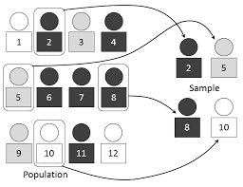
Introduction to Statistics
Sampling methods – Random Sampling
For studies it is optimal if the sample which provides the data is representative of the population under study
Spoiler Alert!
In practice: almost never truly random!

Slide 12
Introduction to Statistics
Sampling methods – Random Sampling
Simple random sampling:
One of the main practices of selecting a representative sample
A sampling scheme in which every possible subsample of size n from a population is equally likely to be selected
If a sample is randomly selected from a population, the characteristics of the sample should (imperfectly) mimic those of the population

Slide 13
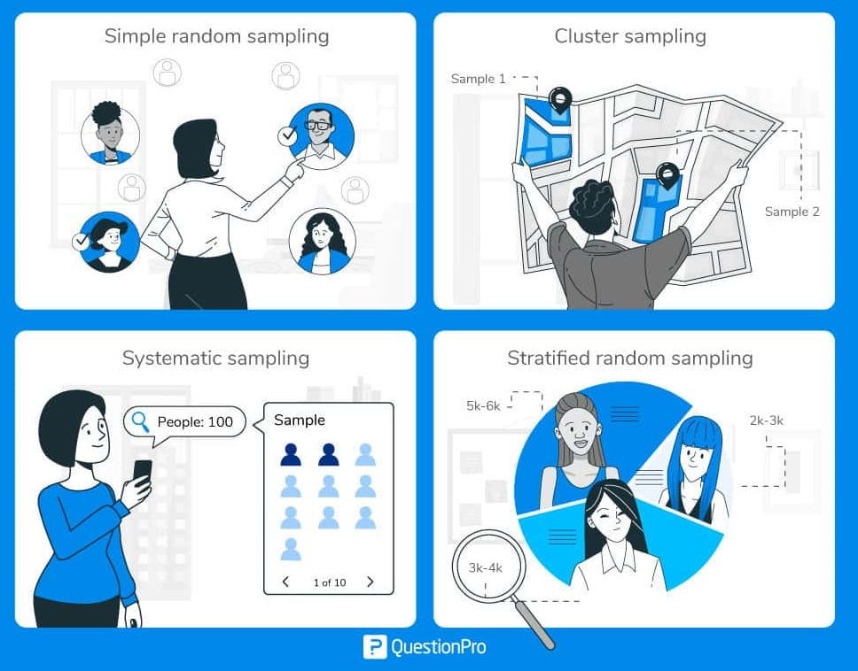
Introduction to Statistics
Sampling methods – Other methods
Clustering: divide a population into smaller groups then randomly select among these clusters to form a sample
Systematic: select members of the population at a regular interval – for example, select every 12th person on a list of the population
Stratified: divide subjects into subgroups called strata based on characteristics that they share and then randomly sample them

Slide 14
Introduction to Data Analysis
Definition
Types of variables
Summarizing the data

Slide 15
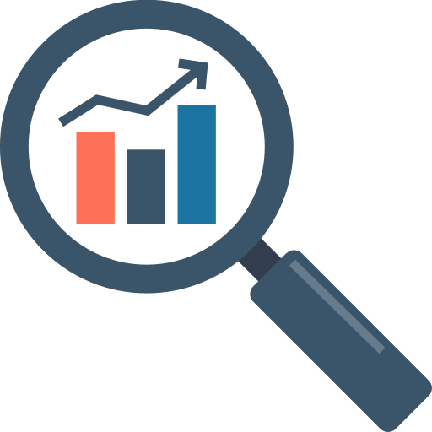
Introduction to Data Analysis
Data Analysis
Descriptive analysis
Summarizing, presenting and exploring the data in the sample.
e.g., frequency, mean, median, mode, standard deviation, interquartile range, percentile, etc.
2. Inferential analysis
Statements about unknown population parameters.
e.g., parameter estimations, confidence interval, hypothesis test, etc.

Slide 16
Introduction to Data Analysis
Types of Variables
Data
Variables
Quantitative
(numeric)
Qualitative (categorical)
Continuous
Discrete
Nominal
Ordinal
Continuous
Discrete

Slide 17
Introduction to Data Analysis
Types of Variables - Quantitative
Continuous: Data that takes an infinite number of real values within a given interval.
Example: The height of a student. It can’t be negative, and it can’t be higher than three meters. But between 0 and 3, the number of possible values is theoretically infinite.
Discrete: Data that only takes certain values. Commonly in the form of whole numbers or integers, this is data that can be counted and has a finite number of values.
Example: The number of employees in a department / The number of products currently in an inventory

Slide 18
Introduction to Data Analysis
Types of Variables - Qualitative
Nominal: Data that takes on one of a limited, and usually fixed, number of possible values to a particular group.
Example: gender
Ordinal: Data that have natural, ordered categories and the distances between the categories are not known.
Example: education level, income level

Slide 19
Introduction to Data Analysis
Summarizing the Data
Descriptive summary
Descriptive statistics, e.g. mean, median, mode, etc.
Data visualization, e.g. Histogram, Boxplot, etc.
2. Inferential summary
Inferential statistics, e.g. parameter estimation, 95% confidence interval, etc.

Slide 20
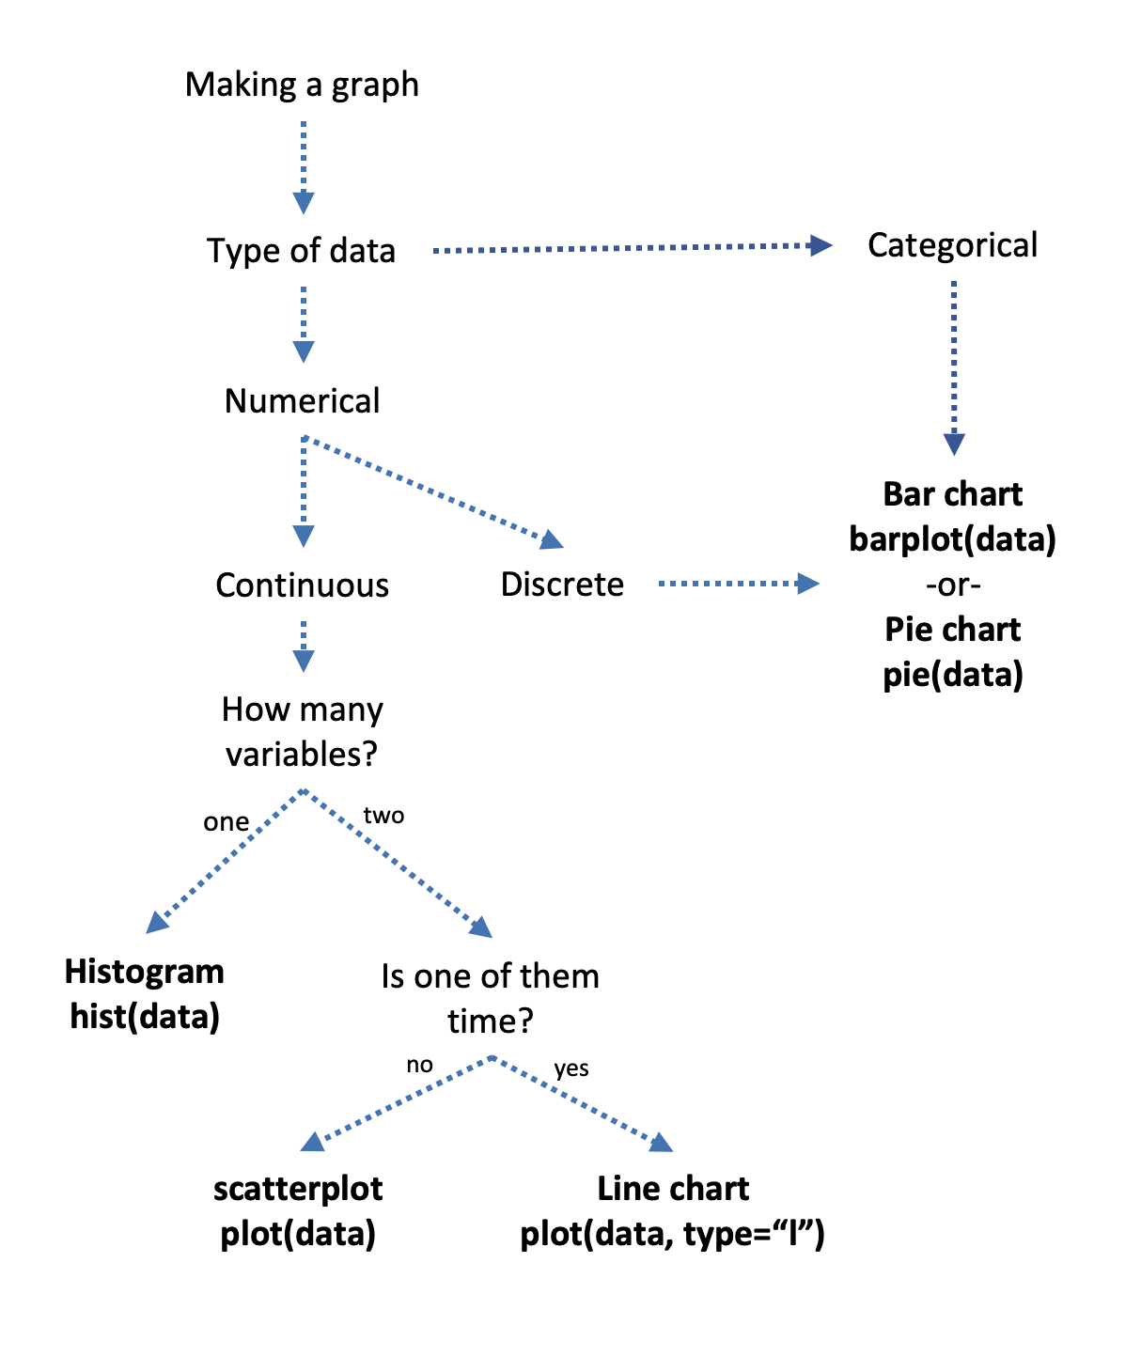
Introduction to Data Analysis
Summarizing the Data
There’s no one best type of graph for all situations - but there is a best type of graph depending on the data you have.
And sometimes we’ll make the definitions we developed above a little less clear and more complicated as we start to actually work with the data.

Slide 21
Introduction to Data Analysis
Scatter Plot
When you want to graph two continuous variables from your data, and neither is time a scatter plot is the most likely way forward.
Scatter plots are an excellent way to see if there is a relationship between the variable on the x-axis and the y-axis.
A scatter plot gets its name from the way that data scatters across the graph.
Notes:
https://bookdown.org/ejvanholm/Textbook/displaying-data.html

Slide 22
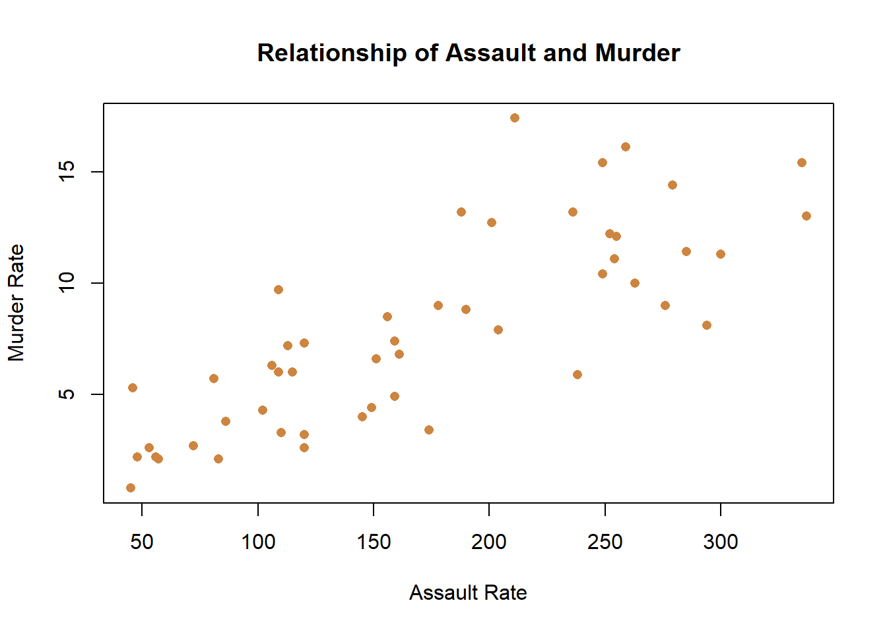
Introduction to Data Analysis
Scatter Plot
Look to the right graph, what can you conclude from the plot?
Notes:
https://bookdown.org/ejvanholm/Textbook/displaying-data.html

Slide 23
Introduction to Data Analysis
Scatter Plot
- That data is very scattered, but it does show a relationship.
Knowing the assault rate of a state would help you to predict the murder rate.
- That’s good to know if you’re wondering what a state’s murder rate is, but you only know the assault rate.
- They aren’t perfectly related, knowing one doesn’t exactly predict the other, but it’s a useful relationship.
Notes:
https://bookdown.org/ejvanholm/Textbook/displaying-data.html

Slide 24
Introduction to Data Analysis
Scatter Plot
- That data is very scattered, but it does show a relationship.
Knowing the assault rate of a state would help you to predict the murder rate.
- That’s good to know if you’re wondering what a state’s murder rate is, but you only know the assault rate.
- They aren’t perfectly related, knowing one doesn’t exactly predict the other, but it’s a useful relationship.
Notes:
https://bookdown.org/ejvanholm/Textbook/displaying-data.html

Slide 25
Introduction to Data Analysis
Line Chart
Sometimes though we want to look at two variables, and in particular the relationship between two variables.
If one of the variables we’re interested in is time, a line chart is probably the best choice. A line chart is ideal for showing the changes that one variables has undergone over time.
Notes:
https://bookdown.org/ejvanholm/Textbook/displaying-data.html

Slide 26
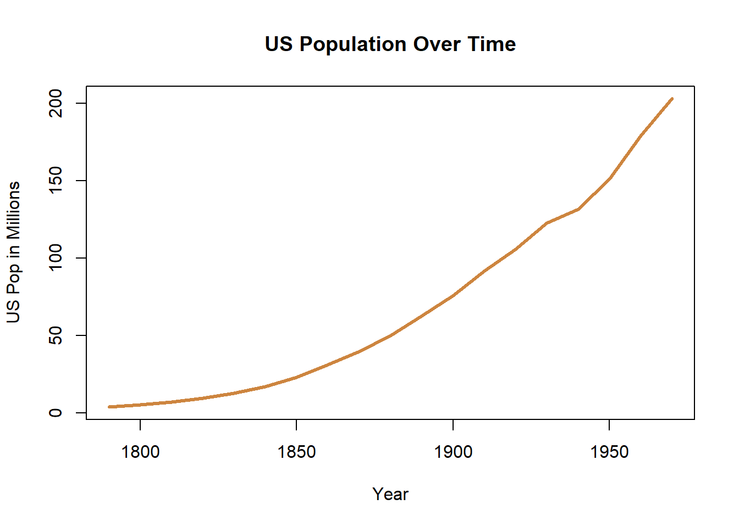
Introduction to Data Analysis
Line Chart
What might we want to graph using a line chart?
- First and foremost, something that has changed over time.
- For instance, let’s see how the population of the United States has changed between 1790 and 1970.
Notes:
https://bookdown.org/ejvanholm/Textbook/displaying-data.html

Slide 27
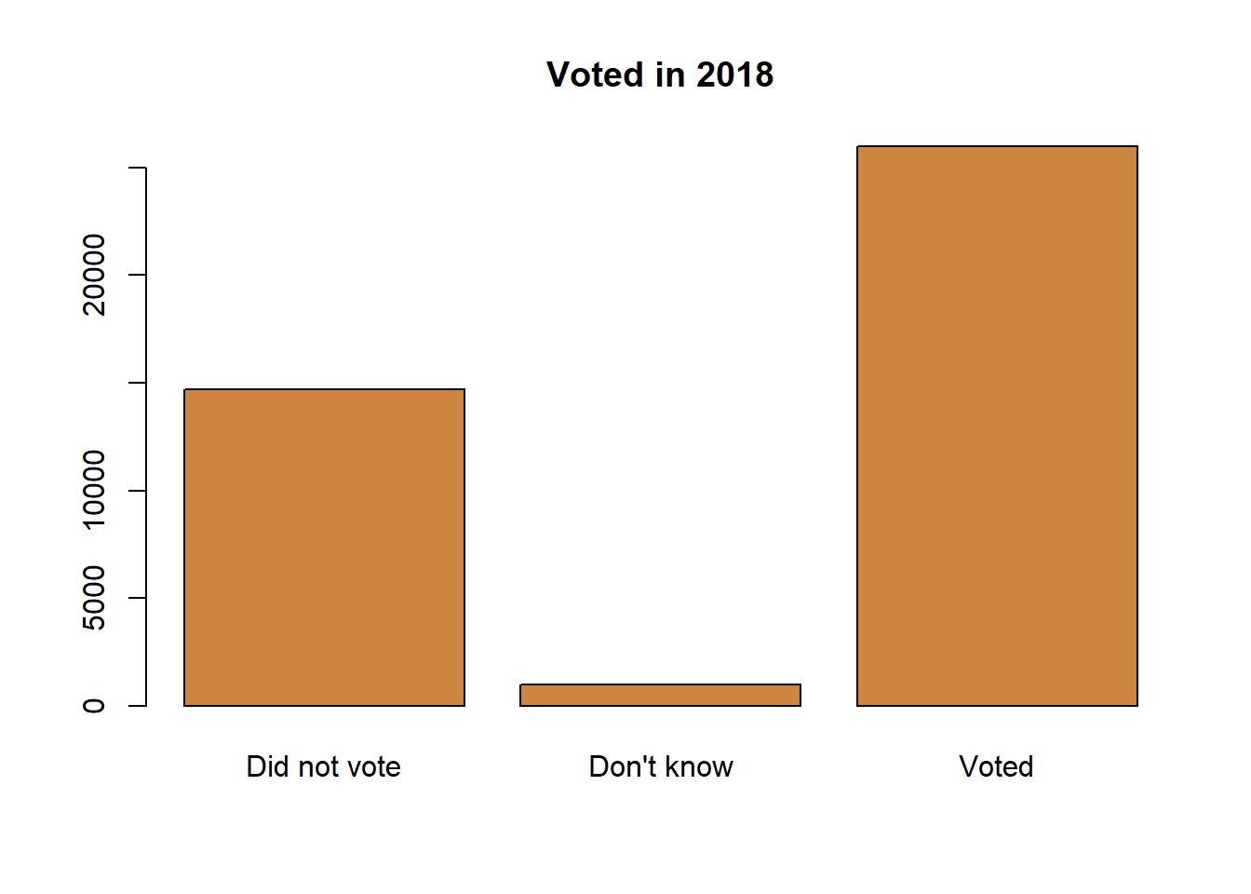
Introduction to Data Analysis
Bar Chart
With categorical or discrete data a bar chart is typically your best option.
A bar chart places the separate values of the data on the x-axis and the height of the bar indicates the count of that category.
Notes:
https://bookdown.org/ejvanholm/Textbook/displaying-data.html

Slide 28
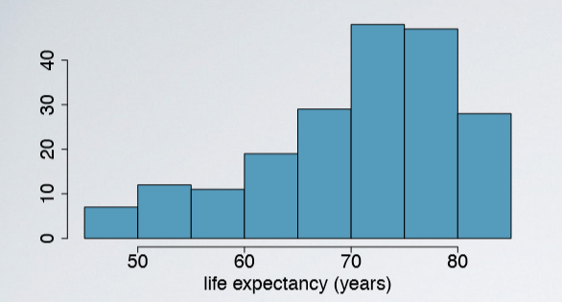
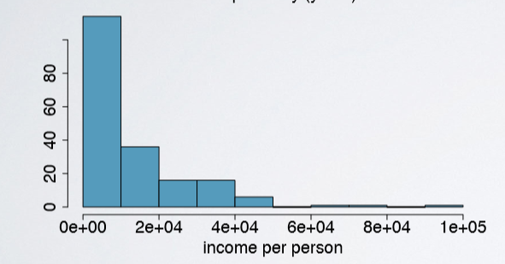
Introduction to Data Analysis
Histogram
A Histogram is a chart in which data values are grouped together and put into different classes.
This grouping (bins) allows you to see how frequently data in each class occur in the data set.

Slide 29
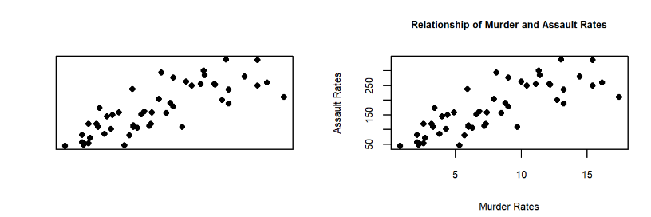
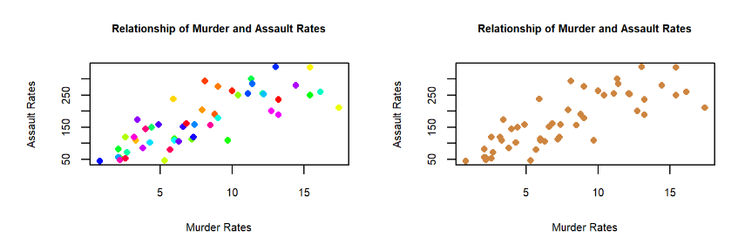
Data Visualization in Python
Good Graphing Habits
Labeling
Colors
Fits the data

Slide 30
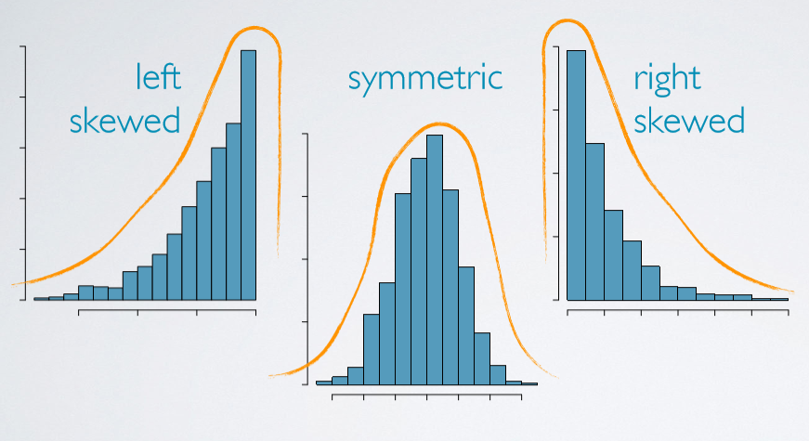
Introduction to Data Analysis
Histogram
Skewness: distributions are skewed to the side of the long tail

Slide 31
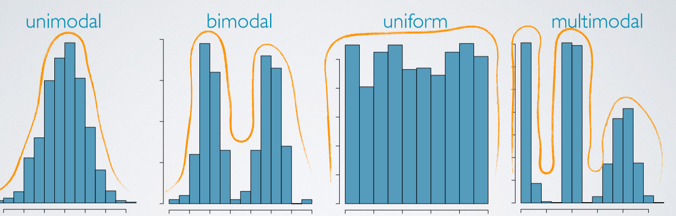
Introduction to Data Analysis
Modality

Slide 32
Introduction to Data Analysis
Boxplot
The center of the data (the median – the center line of the box).
The variation or spread of the data (interquartile range – the box height).
The skewness of the data (the relative size of the box halves).
Presence or absence of unusual values (outliers: “outside” and “far outside” values).
Boxplots are typically put side-by-side to visually compare groups of data.

Slide 33
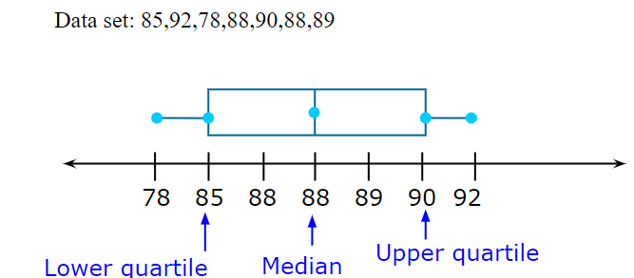
Introduction to Data Analysis
Boxplot
Useful to find outliers in data

Slide 34
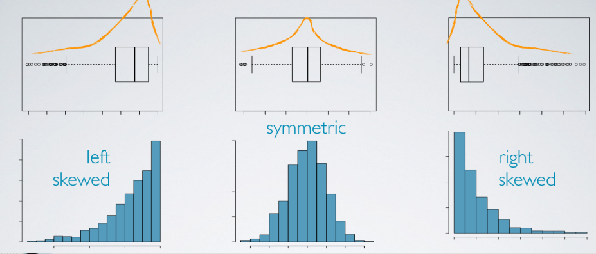
Introduction to Data Analysis
Boxplot vs Histogram

Slide 35
Introduction to Data Analysis
Descriptive Analysis: Summary Measures
- Measures of location (centre):
Mean: arithmetic average (x̅ = sample mean & µ = population mean)
Median: midpoint of the distribution (50th percentile)
Mode: most frequent observation
Sample statistics is a point estimate of the population parameter

Slide 36
Introduction to Data Analysis
Descriptive Analysis: Summary Measures
- Measures of spread:
Range: (max - min)
Variance
Standard deviation
Interquartile range (difference between 25th and 75th percentiles)

Slide 37
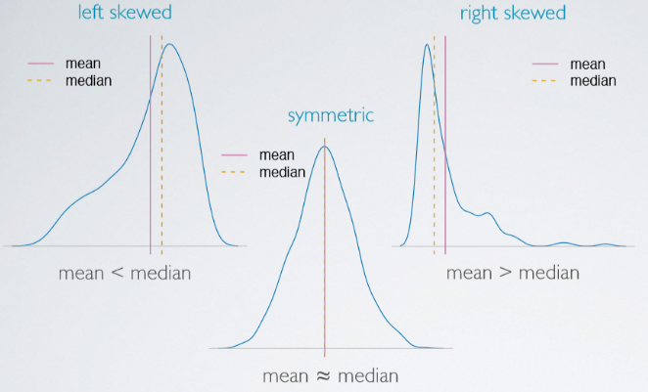
Introduction to Data Analysis
Skewness vs Measure of Center

Slide 38
Introduction to Data Analysis
Variance and Standard Deviation
- Measures of dispersion of the values around the mean
If the numbers are near the mean, variance is small
If numbers are far from the mean, the variance is large
- The standard deviation is an estimate of the variability of observations. It is a summary of how widely dispersed the values are around the mean.

Slide 39
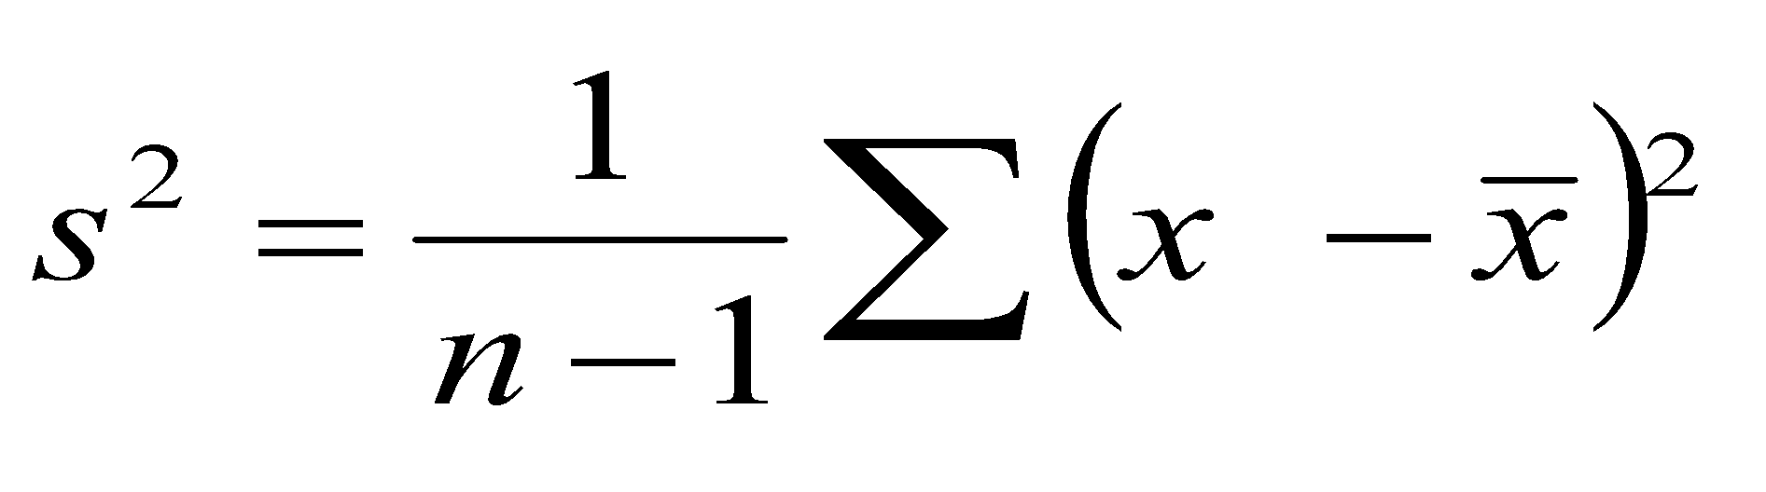
Introduction to Data Analysis
Variance
Roughly the average squared deviation from the mean
Sample variance = s²
Population variance = σ²

Slide 40
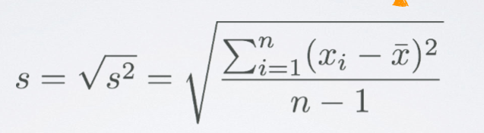
Introduction to Data Analysis
Standard Deviation
Roughly the average deviation around the mean, and has the same units as the data.
Sample standard deviation = s
Population standard deviation = σ

Slide 41
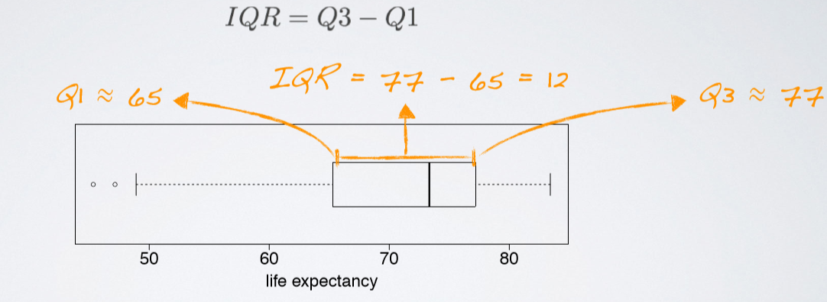
Introduction to Data Analysis
Interquartile Range: IQR
Range of the middle 50% of the data, distance between the ﬁrst quartile (25th percentile) and third quartile (75th percentile)

Slide 42

Introduction to Data Analysis
Let’s get into the Python coding!

Slide 43


Data Visualization in Python
Libraries
Matplotlib
Seaborn

Slide 44
Data Visualization in Python
Matplotlib
plt.plot() for plotting line chart similarly in place of plot other functions are used for plotting. All plotting functions require data and it is provided in the function through parameters.
plot.xlabel , plt.ylabel for labeling x and y-axis respectively.
plt.xticks , plt.yticks for labeling x and y-axis observation tick points respectively.
plt.legend() for signifying the observation variables.
plt.title() for setting the title of the plot.
plot.show() for displaying the plot.

Slide 45
Data Visualization in Python
Matplotlib
Histogram: plt.hist(x, bins=None)
Scatter plot: plt.scatter(x, y)
Line Chart: plt(x, y)
Bar plot: plt.bar(x, height)
Box plot: plt.boxplot(x)

Slide 46
Data Visualization in Python
Seaborn
Histogram: sns.histplot(data, x=None, y=None)
Scatter plot: sns.scatterplot(data, x=None, y=None)
Line Chart: sns.lineplot(data, x=None, y=None)
Bar plot: sns.barplot(data, x=None, y=None)
Box plot: sns.boxplot(x)

Slide 47
Data Visualization in Python
Workshop
https://www.kaggle.com/code/benhamner/python-data-visualizations
https://www.kaggle.com/code/sanikamal/data-visualization-using-matplotlib
https://www.kaggle.com/code/saurav9786/seaborn-tutorial

