Slide 1

AML – 1114 Data Science and Machine Learning
[Data Science]
The study of data to gain insights and knowledge; involves methods of recording, storing, and analyzing data to effectively extract useful information.

Slide 2
Topic 3 Introduction to Pandas and Data Structure
Major Topics:
Introduction to Data and Data Structure
Introduction to Pandas

Slide 3
Introduction to Data Structure
Definition of Data
Structured Data
Non-Structured Data
Missing Values
Types of Missing Values
Handling Missing Values

Slide 4
Data and Information
Data
Data are raw, unorganized facts gathered about someone or something
Usually simple and random
Records and observation that need to be processed
Information
Organized and structured fact concerning a particular event/ subject.
Gathered by processing and presented in a given context
Obtained by analysis and often useful

Slide 5
Data and Information
Examples:
Student’s score in exam can be considered as data. But the mean test score of the class will be considered as information.
Temperature of a decade all over the world can be considered as data. Finding out the increasing trend can be considered as information.
Travel history of people of a country can be considered data. The migration trend (inward or outward) can be considered as information.

Slide 6
Introduction to Data Structures
Data Structures – Structured Data
Data that can be stored in a tabular form
Every instance has the same structure
Can be easily stored, organized, searched, recorded and merged with other structured data.
Suitable for integration into an analytics records.
Example: The demographic data for a population where each row in the table describe one person (attributes: name, age, date of birth, gender, address, education, employment status etc.)

Slide 7
Introduction to Data Structures
Data Structures – Unstructured Data
Structure of data might not necessarily the same in every instance
Each instance might have its own internal structure
More common data type in real world; email tweets, text, posts, image, music, video, input from sensors etc. can be some examples.
Difficult to analyze due to variation in structure.
Example: Dataset of webpages; each website might have data of an unique type).

Slide 8
Introduction to Data Structures
Data Structures – Missing Values
A variable in an observation does not have any value recorded.
Common in most real-world datasets (examples: incomplete or partial data for an observation, missing sequence, incomplete feature, reporting error etc.)
Importance
Can have serious performance effect if not taken care of
Missing data fields needs to be transformed to fit into ML modeling and further analysis

Slide 9
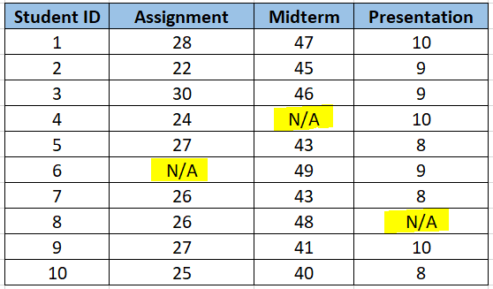
Introduction to Data Structures
Data Structures – Missing Value Example
Student test scores of a class in certain point in time
Student-6 missed the assignment
Student-4 test score not recorded by mistake
Student-8 presentation score on hold for re-submission

Slide 10
Introduction to Data Structures
Data Structures – Missing Value Types
Missing Completely at random (MCAR)
When we say data are missing completely at random, we mean that the missingness is nothing to do with the person being studied
Example: a questionnaire might be lost in the post, or a blood sample might be damaged in the lab

Slide 11
Introduction to Data Structures
Data Structures – Missing Value Types
Missing at Random (MAR)
When the missingness is to do with the person but can be predicted from other information about the person
Example: A child does not attend an educational assessment because the child is (genuinely) ill, this might be predictable from other data we have about the child’s health, but it would not be related to what we would have measured had the child not been ill.

Slide 12
Introduction to Data Structures
Data Structures – Missing Value Types
Missing Not at Random (MNAR)
When the missingness is specifically related to what is missing.
Example: A person does not attend a drug test because the person took drugs the night before.

Slide 13
Introduction to Data Structures
Data Structures – Missing Value Handling
There are several strategies which can be applied:
Try to obtain the missing data
Leave out incomplete cases and use only those for which all variables are available
Replace missing data by a conservative estimate, e.g. the sample mean
Try to estimate the missing data from the other data on the person

Slide 14
Introduction to Data Structures
Data Structures – Missing Value Handling
Missing data reduces the representativeness of the sample.
Makes it difficult to process the data for many analysis models / algorithms.
Three main approaches to deal with missing values:
Imputation
Omission
Analysis

Slide 15
Introduction to Data Structures
Data Structures – Missing Value Handling - Imputation
Imputation Values are filled in the place of missing data
Works well for situation where analysis tools are not robust to missing values
Dataset sizes are not reduced but noise gets imposed with the imputation
Approaches: mean, mode, regression, maximum likelihood estimation and approximate Bayesian bootstrap

Slide 16
Introduction to Data Structures
Data Structures – Missing Value Handling - Omission
Where samples with invalid data are discarded from further analysis
Creates a subset of dataset with no missing values
Works well for models that are not robust against data missingness
Approaches: list-wise deletion, pair-wise deletion

Slide 17
Data Structures – Missing Value Handling - Analysis
Samples with invalid data are discarded from further analysis
Model-based techniques used to determine missing values

Slide 18
Introduction to Pandas
Key Terms
Data Frame Structure
Estimates of Location and Variability
Pandas related functions
Handling missing values in Pandas

Slide 19

Introduction to Pandas
Pandas
Pandas is a fast, powerful, flexible and easy to use open-source data analysis and manipulation tool, built on top of the Python programming language

Slide 20
Introduction to Pandas
Pandas – Key Terms
Data frame: Rectangular data (like a spreadsheet) is the basic data structure for statistical and machine learning models.
Record: Records A row within a table is commonly referred to as a record
Synonyms
case, example, instance, observation, pattern, sample

Slide 21
Introduction to Pandas
Pandas – Key Terms
Feature: A column within a table commonly referred to as a feature.
Synonyms
attribute, input, predictor, variable
Outcome: Many data science projects involve predicting an outcome - often a yes/no out or a time.
Synonyms
dependent variable, response, target, output

Slide 22
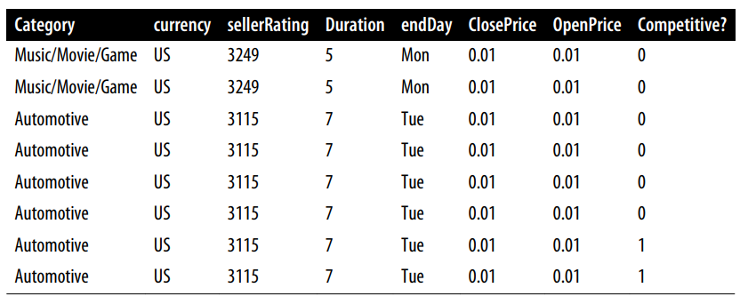
Introduction to Pandas
Pandas – Data Frame Overview
Outcome
Features
Record

Slide 23
Introduction to Pandas
Pandas – Data Frame as Indexes
Traditional database tables have one or more columns designated as an index, essentially a row number. This can vastly improve the efficiency of certain database queries.
In Python, with the pandas library, the basic rectangular data structure is a DataFrame object.
By default, an automatic integer index is created for a DataFrame based on the order of the rows.

Slide 24
Introduction to Pandas
Pandas – Data Frame Types
Rectangular: It is a type of in which each column is a variable (feature), and each row is a case or record.
i.e., not time-series or repeated measure
Non-rectangular: It is a type of in which the same variable is measured over time. It’s typically in the form of a time series.
Time series data records successive measurements of the same variable. It is the raw material for statistical forecasting methods.

Slide 25
Introduction to Pandas
Pandas – Data Frame Types
Rectangular: It is a type of in which each column is a variable (feature), and each row is a case or record.
i.e., not time-series or repeated measure
Non-rectangular: It is a type of in which the same variable is measured over time. It’s typically in the form of a time series.
Time series data records successive measurements of the same variable. It is the raw material for statistical forecasting methods.

Slide 26
Introduction to Pandas
Pandas Variables – Estimates of Location
Variables with measured or count data might have thousands of distinct values.
A basic step in exploring your data is getting a “typical value” for each feature (variable):
an estimate of where most of the data is located (i.e., its central tendency).

Slide 27
Introduction to Pandas
Estimates of Location
Mean: The sum of all values divided by the number of values.
Synonym
average
Median: The value such that one-half of the data lies above and below.
Synonym
50th percentile

Slide 28
Introduction to Pandas
Estimates of Location
Robust: Not sensitive to extreme values.
Synonym
resistant
Percentile: The value such that P percent of the data lies below.
Synonym
quantile

Slide 29
Introduction to Pandas
Estimates of Location
Outlier: A data value that is very different from most of the data.
Synonym
extreme value

Slide 30
Introduction to Pandas
Estimates of Location - Pandas Functions
Mean: dataframe[“column”].mean() **
Median: dataframe[“column”].median() **
** DataFrame.select_dtypes(include=None, exclude=None)
Return a subset of the DataFrame’s columns based on the column dtypes.
https://pandas.pydata.org/docs/reference/api/pandas.DataFrame.select_dtypes.html

Slide 31
Introduction to Pandas
Estimates of Location - Pandas Functions
Note:
The basic metric for location is the mean, but it can be sensitive to extreme values (outlier)
Other metrics (median, trimmed mean) are more robust

Slide 32
Introduction to Pandas
Estimates of Variability
Location is just one dimension in summarizing a feature.
A second dimension, variability, also referred to as dispersion, measures whether the data values are tightly clustered or spread out.

Slide 33

Introduction to Pandas
Estimates of Variability
Deviation: The difference between the observed values and the estimate of location.
Synonyms
errors, residuals
Variance: The sum of squared deviations from the mean divided by $N−1$ where $N$ is the number of data values
Synonyms
mean-squared-error

Slide 34
Introduction to Pandas
Estimates of Variability
Standard Deviation: The square root of the variance.
Synonyms
l2-norm, Euclidean norm
Range: The difference between the largest and the smallest value in a data set.

Slide 35
Introduction to Pandas
Estimates of Variability
Percentile: a value on a scale of 100 that indicates the percent of a distribution that is equal to or below it.
Synonyms
quantile
Interquartile Range: The difference between the 75th percentile and the 25th percentile.
Synonyms
IQR

Slide 36
Introduction to Pandas
Estimates of Location - Pandas Functions
Var: dataframe[“column”].var()
STD: dataframe[“column”].std()
IQR: dataframe[“column”]
[
dataframe[“column“].between(
dataframe[“column”].quantile(0.25), dataframe[“column”].quantile(0.75),
inclusive=True)
]

Slide 37
Introduction to Pandas
Exploring Categorical Data
Mode: The most commonly occurring category or value in a dataset.
For example, the mode of the cause of delay at Dallas/Fort Worth airport is “Inbound”.
As another example, in most parts of the United States, the mode for religious preference would be Christian.
The mode is a simple summary statistic for categorical data, and it is generally not used for numeric data.

Slide 38
Introduction to Pandas
Exploring Categorical Data
Bar Charts: The frequency or proportion for each category plotted as bars.
Pie Charts: The frequency or proportion for each category plotted as wedges in a pie.

Slide 39
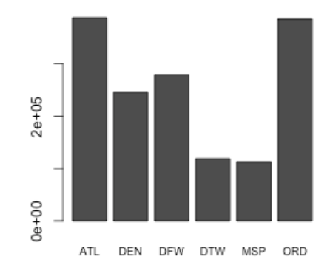
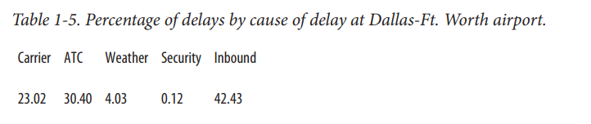
Introduction to Pandas
Exploring Categorical Data
Getting a summary of a binary variable, or a categorical variable with a few categories, is a fairly easy matter –
we just figure out the proportion of 1’s, or of
the important categories

Slide 40
Introduction to Pandas
Exploring Categorical Data - Pandas Functions
Mode: dataframe[“column”].mode()

Slide 41
Introduction to Pandas
Find Missing Values in Pandas Data Frame
Pandas isnull(), isna() functions are used to detect missing values.
df.isna() returns the dataframe with boolean values indicating missing values
notna() is another method which is the opposite of isna()
df.isna().any() returns a boolean value for each column. If there is at least one missing value in that column, the result is True
df.isna().sum() returns the number of missing values in each column.

Slide 42
Introduction to Pandas
Find Missing Values in Pandas Data Frame
Pandas isnull(), isna() functions are used to detect missing values.
df.isna() returns the dataframe with boolean values indicating missing values
notna() is another method which is the opposite of isna()
df.isna().any() returns a boolean value for each column. If there is at least one missing value in that column, the result is True
df.isna().sum() returns the number of missing values in each column.

Slide 43
Introduction to Pandas
Handle Missing Values in Pandas Data Frame
Not all missing values come in nice and clean NaN or None format. For example, “?” and “- -“ or “” characters in column can be represented as missing values, too.
You can use pandas replace() function to handle these values after a dataframe is created.
DataFrame.replace(old_value, new_value, inplace=True)

Slide 44
Introduction to Pandas
Handle Missing Values in Pandas Data Frame
Drop missing values:
DataFrame.dropna(axis=0, thresh=5, inplace=True)
Replace missing values:
DataFrame.fillna(value, inplace=True)
DataFrame.fillna(axis=0, method=“ffill” inplace=True)

Slide 45
Introduction to Pandas
Workshop
Comprehensive Data Analysis with Pandas
https://www.kaggle.com/code/prashant111/comprehensive-data-analysis-with-pandas

