Slide 1

AML – 1114 Data Science and Machine Learning
[Data Science]
The study of data to gain insights and knowledge; involves methods of recording, storing, and analyzing data to effectively extract useful information.

Slide 2
Lecture 5 Introduction to Big Data and Databases
Major Topics:
Introduction to Big Data
Big Data Characteristics
Hadoop
Databases
Database Type

Slide 3
Introduction to Big Data
What is Big Data?
It refers to extremely large data sets that may be analyzed computationally to reveal patterns, trends, and associations, especially relating to human behavior and interactions.
As described by Oracle,
Big data is larger, more complex data sets, especially from new data sources.
Data sets are so voluminous that traditional data processing software just can’t manage them.
These massive volumes of data can be used to address business problems you wouldn’t have been able to tackle before.

Slide 4
Introduction to Big Data
Big Data Characteristics
The definition of big data is data that contains greater variety, arriving in increasing volumes and with more velocity. This is also known as the three Vs.
Volume
Velocity
Variety

Slide 5
Introduction to Big Data
Big Data Characteristics
Volume:
With big data, high volumes of low-density, unstructured data needs to be processed.
This can be data of unknown value, such as Twitter data feeds, clickstreams on a webpage or a mobile app, or sensor-enabled equipment.
For some organizations, this might be tens of terabytes of data. For others, it may be hundreds of petabytes

Slide 6
Introduction to Big Data
Big Data Characteristics
Velocity:
Velocity is the fast rate at which data is received and (perhaps) acted on
Normally, the highest velocity of data streams directly into memory versus being written to disk.
Some internet-enabled smart products operate in real time or near real time and will require real-time evaluation and action.

Slide 7
Introduction to Big Data
Big Data Characteristics
Variety:
Variety refers to the types of data that are available.
Traditional data types were structured and fit neatly in a relational database.
With the rise of big data, data comes in new unstructured data types.
Unstructured and semi-structured data types, such as text, audio, and video, require additional preprocessing to derive meaning and support metadata.

Slide 8
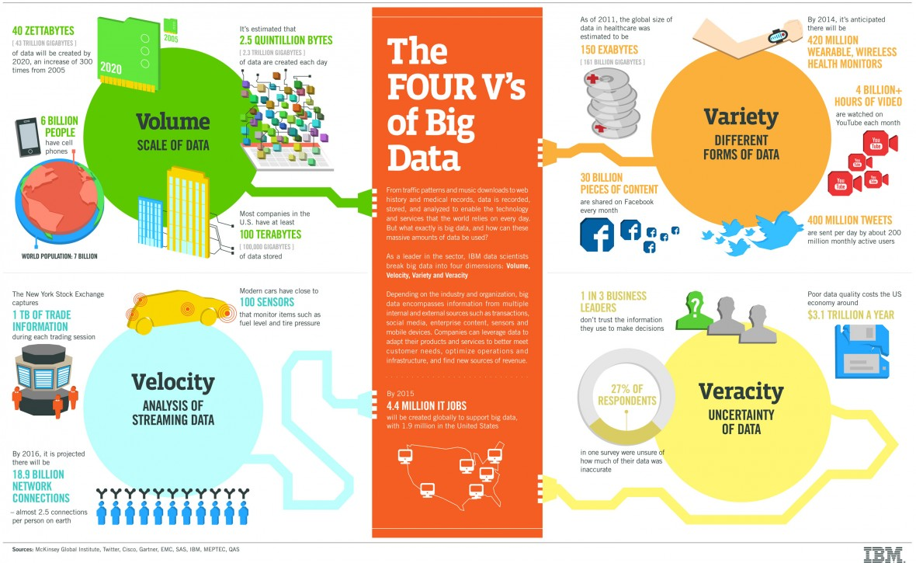
Introduction to Big Data

Slide 9
Introduction to Big Data
Benefits of Big Data
Big data helps to achieve more complete/accurate answers with the help of huge information.
Enhanced confidence in the data
Potential to apply different approach to tackling problems

Slide 10
Introduction to Big Data
Hadoop
Apache Hadoop is an open-source framework that is used to efficiently store and process large datasets ranging in size from gigabytes to petabytes of data.
Instead of using one large computer to store and process the data, Hadoop allows clustering multiple computers to analyze massive datasets in parallel more quickly.

Slide 11
Introduction to Big Data
Hadoop – Main Modules
Hadoop Distributed File System (HDFS) – A distributed file system that runs on standard or low-end hardware. HDFS provides better data throughput than traditional file systems, in addition to high fault tolerance and native support of large datasets.
Yet Another Resource Negotiator (YARN) – Manages and monitors cluster nodes and resource usage. It schedules jobs and tasks.

Slide 12
Introduction to Big Data
Hadoop – Main Modules
MapReduce – A framework that helps programs do the parallel computation on data. The map task takes input data and converts it into a dataset that can be computed in key value pairs. The output of the map task is consumed by reduce tasks to aggregate output and provide the desired result.
Hadoop Common – Provides common Java libraries that can be used across all modules

Slide 13
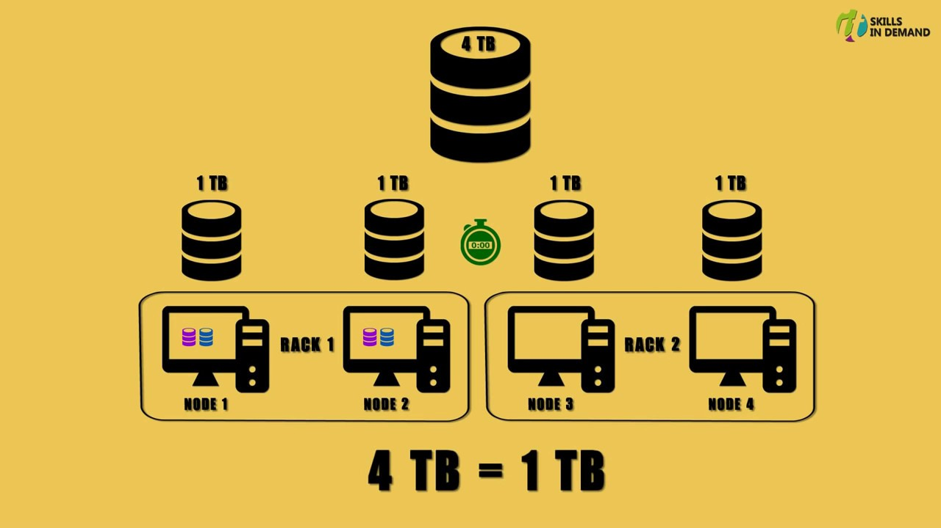
Introduction to Big Data
Hadoop – How it works?
https://www.youtube.com/watch?v=NeqC6t1J1dw

Slide 14
Topic 3 Introduction to Big Data
Major Topics:
Introduction to Statistics
Samples and Populations
Introduction to Data Analysis
Summarizing Data

Slide 15
Introduction to Databases
Databases
A database is an organized collection of structured information, or data, typically stored electronically in a computer system.
A database is usually controlled by a database management system (DBMS). Together, the data and the DBMS, along with the applications that are associated with them, are referred to as a database system, often shortened to just database.

Slide 16
Introduction to Databases
Databases
Data within the most common types of databases in operation today is typically modeled in rows and columns in a series of tables to make processing and data querying efficient.
The data can then be easily accessed, managed, modified, updated, controlled, and organized. Most databases use structured query language (SQL) for writing and querying data.

Slide 17
Introduction to Databases
What is Structured Query Language
SQL is a programming language used by nearly all relational databases to query, manipulate, and define data, and to provide access control.
SQL was first developed at IBM in the 1970s with Oracle as a major contributor, which led to implementation of the SQL ANSI standard, SQL has spurred many extensions from companies such as IBM, Oracle, and Microsoft.
Although SQL is still widely used today, new programming languages are beginning to appear

Slide 18
Introduction to Databases
Evolution of the Databases
Navigational databases such as the hierarchical database (which relied on a tree-like model and allowed only a one-to-many relationship), and the network database (a more flexible model that allowed multiple relationships), were the original systems used to store and manipulate data.
More recently, NoSQL databases came about as a response to the growth of the internet and the need for faster speed and processing of unstructured data.

Slide 19
Introduction to Databases
What’s the difference between a database and a spreadsheet?
Databases and spreadsheets (such as Microsoft Excel) are both convenient ways to store information. The primary differences between the two are:
How the data is stored and manipulated
Who can access the data
How much data can be stored

Slide 20
Introduction to Databases
What’s the difference between a database and a spreadsheet?
Spreadsheets were originally designed for one user, and their characteristics reflect that. They’re great for a single user or small number of users who don’t need to do a lot of incredibly complicated data manipulation.
Databases, on the other hand, are designed to hold much larger collections of organized information—massive amounts, sometimes. Databases allow multiple users at the same time to quickly and securely access and query the data using highly complex logic and language.

Slide 21
Introduction to Databases
Types of Databases
There are many different types of databases. The best database for a specific organization depends on how the organization intends to use the data.
Relational databases
Object-oriented databases
Distributed databases
Data warehouses
NoSQL databases
Graph databases
…

Slide 22

Introduction to Databases
Types of Databases – Relational Database
A relational database is a type of database that stores and provides access to data points that are related to one another.
In a relational database, each row in the table is a record with a unique ID called the key.
The columns of the table hold attributes of the data, and each record usually has a value for each attribute, making it easy to establish the relationships among data points.

Slide 23

Introduction to Databases
Types of Databases – NoSQL Database
NoSQL databases (aka "not only SQL") are non-tabular databases and store data differently than relational tables. NoSQL databases come in a variety of types based on their data model.
The main types are document, key-value, wide-column, and graph. They provide flexible schemas and scale easily with large amounts of data and high user loads.

Slide 24
Introduction to Databases
Types of Databases – Examples
Relational Databases provides strong consistency and high availability.
Examples: SQL Server, MySQL, Oracle database,
PostgresSQL, IBM DB2
Non-relational Databases provides Availability and Partition Tolerance or (Consistency and Partition Tolerance) needs.
Examples: Memcached, Redis, Coherence, Hbase,
BigTable, Accumulo, MongoDB, CouchDB

Slide 25
Introduction to Databases
Types of Databases – Comparison of Databases
Relational DBMSs represent data in a flat way; Non-relational DBMSs allow data to be represented in a hierarchical way.
Relational databases use Structured Querying Language (SQL), joins works well here but not true for Non-relational database.
Relational database is suitable to enforce the ACID (Atomicity, Consistency, Isolation, Durability) principles.
No-SQL database are suitable for Rapid Application Development situation.

Slide 26
Introduction to Databases
Database Management System (DBMS)
Mechanism and systematic approach used to optimize and manage the storage and retrieval of data from databases in an accurate and effective way.
DBMS holds information within database and builds database logic structure
Facilitate access, modification and disaster recovery of databases

Slide 27
Supporting materials
References
[1] https://www.oracle.com/big-data/guide/what-is-big-data.html#link3
[2] https://docs.microsoft.com/en-us/azure/architecture/data-guide/big-data/non-relational-data
[3]https://www.abs.gov.au/websitedbs/a3121120.nsf/home/statistical+language+-+types+of+error
[4]https://www.abs.gov.au/websitedbs/a3121120.nsf/home/statistical+language+-+types+of+error

