Slide 1
DrugEA
Evolutionary Search for Drug-Like EGFR Inhibitors
Evolutionary Computing · Prof. Francesca · 2026
10⁶⁰
6
100%
molecules in search space
pharmacological constraints
chemical validity (SELFIES)

Slide 2
Problem & Approach
The Problem
Our Approach
Target: EGFR kinase — overexpressed in lung & colorectal cancers Scale: Chemical space ≈ 10⁶⁰ drug-like molecules Cost: Wet-lab screening: $2.6B and 12 years per drug Goal: Find feasible, tightly-binding molecules computationally
An Evolutionary Algorithm searches the chemical space.
A PyTorch MLP (AffinityMLP) trained on
10,721 EGFR molecules from ChEMBL203 predicts binding free energy ΔG_bind, replacing expensive molecular docking.
CSP Formulation (Lecture 13)
Unified Fitness Function
S
Search space of fragment-assembled molecules (~10⁶⁰)
eval(x) = −ΔG_bind(x) + Σⱼ wⱼ · vⱼ(x)
C
6 hard constraints: MW, logP, HBD, HBA, SA, PAINS
−ΔG_bind predicted binding energy (minimize → tighter binding) wⱼ · vⱼ(x) penalty for violated pharmacological constraints feasible when penalty term = 0 (all 6 constraints satisfied)
N
Neighborhood: fragment substitution / insertion / deletion

Slide 3
Code Architecture — 6 Modules
representation.py
fitness.py
operators.py
Chromosome · SELFIES decode · 39-token vocab
6 Lipinski constraints · AffinityMLP surrogate
Mutation (4 ops) · Crossover (2 ops) · σ/w adaptation
▶
▶
selection.py
main.py
tuning.py
Fitness sharing · Tournament · (μ+λ) · Archive
EA loop · CLI · per-gen logging
REVAC hyperparameter tuning (50 evaluations)
▶
▶
surrogate/model.py + train.py → loaded by fitness.py

Slide 4
Molecular Representation — Group SELFIES
Why SELFIES?
SMILES-based mutation: 30–50% of offspring are chemically invalid → wasted evaluations Group SELFIES (Nigam et al., 2023): every possible token sequence decodes to a valid molecule by construction → 0% failure rate. Tested: 200/200 random chromosomes valid.
Chromosome Structure
Fragment Vocabulary (|V| = 39)
b₁ … bₖ
Integer index into 39-token SELFIES vocabulary.
Controls which chemical building block occupies each position.
10
Aromatic cores
Fragment genes
benzene, pyridine, indole, quinoline…
9
Ring systems
σ₁ … σₖ
Per-fragment mutation probability.
Self-adapted by EA — low σ = frozen core; high σ = exploring.
piperidine, piperazine, morpholine…
Step-size genes
8
Linkers/pharma
w₁ … w₆
Per-constraint penalty coefficient.
Self-adapted — high w = EA learned this constraint is hard.
amide, sulfonamide, urea, ester…
Penalty weights
12
R-group decorators
methyl, methoxy, amine, halomethyl…
K is variable length (K_MIN=2, K_MAX=8) — insertion and deletion operators change chromosome length.

Slide 5
EA Algorithms — Four Course Mechanisms
Self-Adaptive Step Sizes σᵢ
Lecture 15
Self-Adaptive Penalty Weights wⱼ
Lecture 17
Each chromosome carries its own mutation rates — one per fragment position.
σᵢ′ = σᵢ · exp(τ′·N(0,1) + τ·Nᵢ(0,1))
Fragments whose mutation consistently hurts fitness evolve σᵢ → 0 (frozen). Peripheral positions keep σᵢ high (exploring).
Each chromosome carries its own penalty coefficients — one per constraint.
wⱼ′ = wⱼ · exp(η·N(0,1))
Chromosomes that evolve higher weight on a hard constraint produce more feasible offspring and are selected more often, propagating high wⱼ.
Fitness Sharing over Tanimoto
Lecture 16
(μ+λ) Selection + Elitist Archive
Lecture 16
F′(i) = F(i) · Σⱼ sh(d(i,j))
sh(d) = 1 − (d/σ_share)^α if d ≤ 0.3
d(i,j) = 1 − Tanimoto(fp_i, fp_j)
Crowded chemical regions get penalised → population forced to explore multiple distinct drug scaffolds simultaneously.
Best μ survivors from μ parents + λ offspring.
Rank: feasible first, then by fitness.
ElitistArchive: stores all-time best feasible molecule. If a generation loses all feasible individuals, the archive champion is reinjected — best solution is never permanently lost.

Slide 6
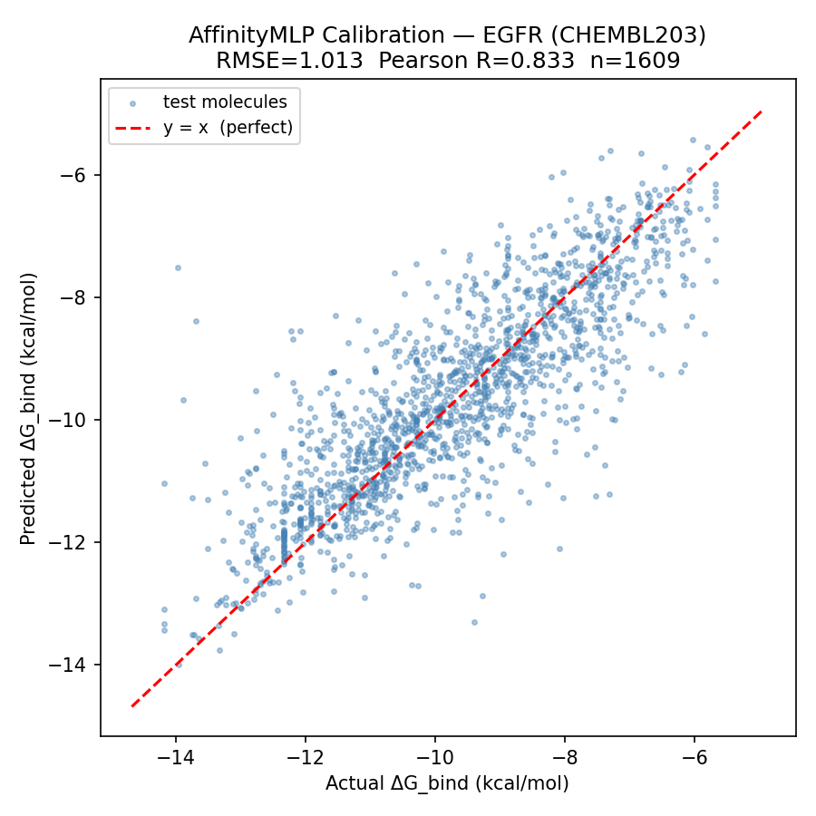
Surrogate Model — AffinityMLP
Architecture
Morgan Fingerprint (radius=2, 2048 bits)
↓
Linear 2048 → 512 + BatchNorm + ReLU
↓
Dropout(0.2)
↓
Linear 512 → 128 + BatchNorm + ReLU
↓
Dropout(0.2)
↓
Linear 128 → 1
↓
ΔG_bind (kcal/mol)
1,116,161 parameters · MC Dropout: 50 passes → mean ± std
1.01
0.83
0.955
RMSE (<1.5 target ✓)
Pearson R
Spearman ρ (σ=0.5 noise)

Slide 7
Main EA Results — 100 Generations
Best Molecule Found
Fitness
3.18
ΔG_bind
−3.18 kcal/mol
MW
489.6 Da
logP
4.00
HBD / HBA
3 / 10
SA score
5.51
PAINS alerts
0
Feasible
Yes ✓
Premature Convergence: RESOLVED
Mock surrogate: ~3 improvements, plateau at gen 30 Real AffinityMLP: 17 improvements, still improving at gen 100
17
6.45
3.18
archive improvements
gen 0 best fitness
gen 100 best fitness

Slide 8
RQ1 — Do Self-Adapted σᵢ Recover the Pharmacophore?
σᵢ Interpretation
< 0.25
Frozen
EA decided not to mutate this fragment — it's critical for binding.
0.25–0.55
Transitional
Moderate exploration — position partially converged.
> 0.55
Active
Still exploring — position not yet critical.
Fragment categories:
Aromatic core
Ring system
Key Finding:
N-heterocycles (imidazole 0.026, pyrazine 0.10, pyridine 0.18) converged to near-zero σ — the EA independently discovered that nitrogen-rich aromatics are the EGFR pharmacophore. This matches medicinal chemistry consensus.
R-group

Slide 9
RQ2 — Which Pharmacological Constraints Are Hardest?
#1
w = 1.72
Aromatic fragment stacking pushes lipophilicity past the logP ≤ 5 limit. The EA learned to punish it hardest.
logP
#2
w = 1.48
Reactive electrophiles and structural alerts appear in certain fragment combinations. EA evolved resistance.
PAINS
#3
w = 1.48
More fragments = better binding but higher MW. EA enforces balance.
MW
#6
w = 0.74
logP ranked #1 hardest (1.72). PAINS #2, MW #3. SA is easiest (0.74 — dropped below init because fragment assembly rarely violates synthetic accessibility). EA correctly inferred difficulty from first principles.
Fragment SELFIES builds from pre-synthesizable units — SA constraint almost never violated.
SA

Slide 10
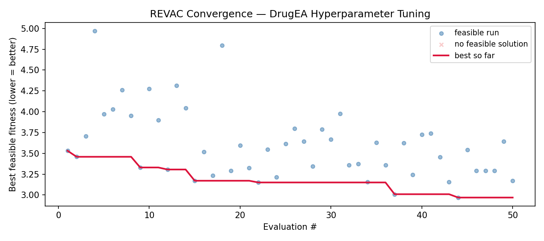
REVAC — Principled Hyperparameter Tuning (Lecture 17)
Parameter Relevance (from final selected pool)
Parameter
Best
Norm. std
Relevance
μ (pop. size)
100
0.105
HIGH ★
λ/μ (offspring ratio)
4.0
0.108
HIGH ★
σ_share (niche radius)
0.215
0.123
HIGH ★
What REVAC Found:
tournament_k
4
0.233
MEDIUM
μ and λ/μ are HIGH relevance → large diverse populations with many offspring consistently outperform small ones
σ_share HIGH relevance → tight niching (0.215) best; the EA must enforce diversity aggressively
α is irrelevant → sharing mechanism matters; its exact shape does not
Best quality: 2.97 kcal/mol (vs 3.53 default) — a 16% improvement
α (sharing exponent)
1.64
0.434
low
Best configuration → python main.py --pop 100 --lambda_ 400 --share 0.2146 --gens 100

Slide 11
Key Findings
200/200
17 vs 3
0.026
SELFIES Validity Guarantee
Real Surrogate Resolves Convergence
σᵢ Recovers EGFR Pharmacophore
Every chromosome — including random mutations and crossover products — decodes to a chemically valid molecule. Zero rejections. Solved architecturally, not by post-hoc filtering.
AffinityMLP (RMSE=1.01, R=0.83) produces a meaningful fitness landscape. Archive improvements: 17 with real surrogate vs. ~3 with mock heuristic. Still improving at generation 100.
Self-adapted step sizes converged N-heterocycles (imidazole, pyrazine, pyridine, indole) to near-zero σ. The EA independently identified the nitrogen-rich aromatic pharmacophore from binding data alone.
logP #1
HIGH ×3
4 novel
wⱼ Reveals Constraint Difficulty
REVAC: μ, λ/μ, σ_share All Critical
Novel vs. Literature
Evolved penalty weights rank logP (1.72) and PAINS (1.48) as hardest. SA dropped below init (0.74) — SELFIES fragments are pre-synthesizable so SA is rarely violated. EA learned this automatically.
Three of five parameters are HIGH relevance. α is irrelevant — the sharing mechanism matters, not its shape. Best config (μ=100, λ=400, σ_share=0.215) achieved quality 2.97 kcal/mol.
All surveyed GA-based drug design methods use fixed parameters. This project is the first to combine: (1) self-adaptive σᵢ, (2) self-adaptive wⱼ, (3) Tanimoto fitness sharing, and (4) REVAC tuning on a fragment-based EA.

