Slide 1
Hotel Review Sentiment& Aspect Rating Analysis
Machine Learning Mini-Project | NLP + Traditional Machine Learning
Predicting overall hotel ratings and aspect-specific ratings from review text using n-gram features, TF-IDF, class balancing and supervised learning.
TEAM MEMBERS
JIGNAS , PES2UG24AM110
PRASANNA . MACHARLA , PES2UG24AM143
NLP
TEXT CLASSIFICATION
FEATURE ENGINEERING
MODEL COMPARISON
Machine Learning Mini-Project
1

Slide 2
Project Objective & Problem Formulation
What is the model actually learning?
INPUT
PRIMARY OUTPUT
SECONDARY OUTPUTS
Hotel review text
Title + review body
Example: “Clean room, great location, fair price.”
Overall rating
Five possible classes:
1 ★ 2 ★ 3 ★ 4 ★ 5 ★
Multi-class classification
Aspect ratings:
• Rooms
• Location
• Value
• Cleanliness
• Sleep quality
Sentiment / polarity formulation
NEGATIVE
NEUTRAL
POSITIVE
1–2 stars
3 stars
4–5 stars
Hotel Review Sentiment & Aspect Rating Analysis
2

Slide 3
Dataset & Data Preparation
The implementation uses a smaller public substitute dataset.
1,000
1–5
5
2/3 : 1/3
usable reviews
overall labels
aspect labels
train : test
• Review text is created by concatenating the title and body.
• Ratings are coerced to numeric values; only valid 1–5 overall ratings are retained.
• Available aspects: cleanliness, value, location, rooms and sleep_quality.
• Missing aspect labels are omitted only for that aspect.
• The original study used a much larger dataset, so this project is an approximation rather than an exact reproduction.
• A fixed random state of 42 is used for reproducibility.
Hotel Review Sentiment & Aspect Rating Analysis
3

Slide 4
End-to-End Methodology
The complete supervised NLP pipeline
1
2
3
4
5
6
Raw review
Preprocess
Vectorize
Train
Evaluate
Predict
• Preprocessing: combine title + body and validate target labels.
• Vectorization converts language into a sparse numerical feature matrix.
• The model learns a mapping from feature vectors to rating classes.
• The test set remains unseen during fitting and is used only for evaluation.
• The same general pipeline is reused for overall and aspect-specific models.
Hotel Review Sentiment & Aspect Rating Analysis
4

Slide 5
Text Feature Engineering
Raw text cannot be directly consumed by classical ML models.
CHARACTER 5-GRAMS
WORD 2/3-GRAMS
COUNT VS TF-IDF
WORD UNIGRAMS
Five-character sequences.
Captures fragments, morphology and spelling variations.
Useful when word boundaries are imperfect.
Short phrases.
“clean room”
“very clean room”
Captures local context and word order.
Counts measure occurrence.
TF-IDF downweights terms common across many documents and emphasizes more informative terms.
One word at a time.
“clean room station” → clean, room, station
Captures individual word evidence.
TF-IDF INTUITION
TF-IDF(t,d) = TF(t,d) × IDF(t). A term gets a higher weight when it is frequent in a particular review but less common across the entire collection.
Hotel Review Sentiment & Aspect Rating Analysis
5

Slide 6
Algorithms Used
Three learning formulations were compared.
MULTINOMIAL NAIVE BAYES
LINEAR SVM / LinearSVC
LINEAR REGRESSION
• Probabilistic classifier.
• Learns class-specific feature distributions.
• Uses the conditional-independence assumption.
• Particularly natural for word/count features.
<b>Purpose:</b> establish a fast, traditional NLP baseline.
• Learns linear decision boundaries.
• Maximizes the separation margin between classes.
• Works well with high-dimensional sparse vectors.
• Class weights can change the penalty for minority-class errors.
<b>Purpose:</b> strong text-classification model.
• Predicts a continuous numerical score.
• Output is converted/clipped to the 1–5 rating range.
• Represents rating prediction as regression rather than direct class prediction.
<b>Purpose:</b> compare a continuous formulation with classifiers.
Hotel Review Sentiment & Aspect Rating Analysis
6

Slide 7
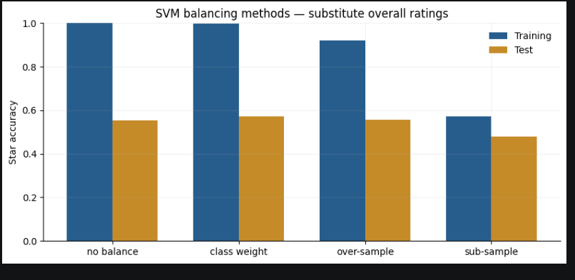
Class Imbalance Handling
Ratings are not necessarily distributed evenly.
No balancing
Class weighting
Oversampling
Undersampling
55.4%
57.2%
55.7%
47.9%
• No balancing: standard training objective.
• Class weighting: increase the influence of minority-class mistakes
without deleting data.
• Oversampling: duplicate minority-class examples in the training
data.
• Undersampling: remove some majority-class examples.
• In this experiment, class weighting produced the best result.
Hotel Review Sentiment & Aspect Rating Analysis
7

Slide 8
Evaluation Metrics
Why exact-star accuracy and polarity accuracy are both reported.
ACCURACY
BALANCED ACCURACY
MACRO F1
Correct predictions / total predictions.
For star accuracy, predicting 4 instead of actual 5 is incorrect.
Average recall across classes.
Useful when class frequencies are unequal.
F1 combines precision and recall.
Macro averaging gives each class equal importance.
POLARITY ACCURACY
Star ratings are collapsed into three groups: 1–2 = negative, 3 = neutral, 4–5 = positive. This task is less granular than exact five-class prediction.
Hotel Review Sentiment & Aspect Rating Analysis
8

Slide 9
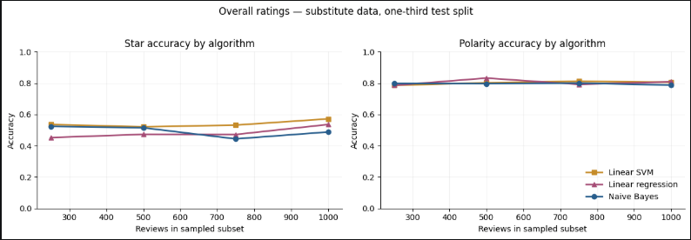
Algorithm Comparison — Results
Word unigram + TF-IDF setting
BEST EXACT-STAR MODEL
Linear SVM
57.2% star accuracy
POLARITY
Linear Regression reaches 80.8% polarity accuracy, but exact-star prediction is the more granular task.
Interpretation: SVM is the strongest direct 1–5 classifier in this comparison.
Hotel Review Sentiment & Aspect Rating Analysis
9

Slide 10
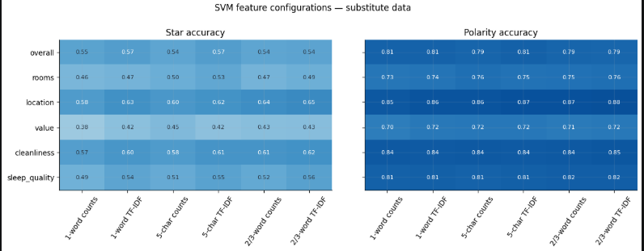
Feature Representation — Results
Overall-rating experiment
BEST STAR RESULT
Unigram TF-IDF and character-5 TF-IDF both reach 57.2%.
BEST POLARITY RESULT
Character-5 TF-IDF reaches 81.1% polarity accuracy.
Key lesson: there is no single feature representation that wins on every metric.
Hotel Review Sentiment & Aspect Rating Analysis
10

Slide 11
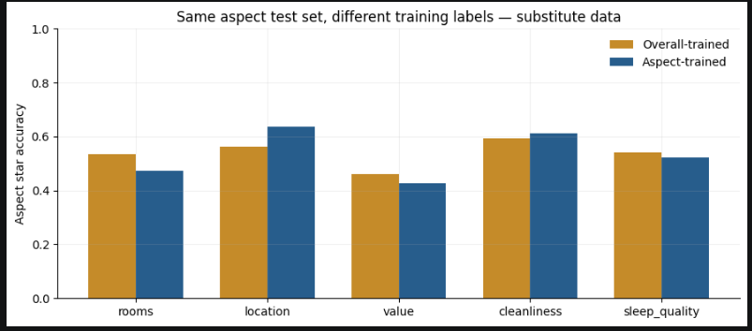
Aspect-Specific Modelling
Does training directly on an aspect improve its prediction?
IMPROVED
Location: 56.3% → 63.8%
Cleanliness: 59.3% → 61.1%
DID NOT IMPROVE
Rooms, value and sleep quality performed worse with aspect-specific training.
Conclusion: aspect-specific modelling is target-dependent, not universally better.
Hotel Review Sentiment & Aspect Rating Analysis
11

Slide 12
Final Model & Live Demonstration
How a new review moves through the trained system.
NEW REVIEW
VECTORIZE
CLASS-WEIGHTED
LINEAR SVM
1–5 RATING
POLARITY
DEMO INPUT
MODEL OUTPUT
Title: “Convenient stay”
Review describes a great location near a station, a quiet clean room and fair value.
Overall: 4 → Positive
Rooms: 5 → Positive
Location: 5 → Positive
Value: 3 → Neutral
Cleanliness: 5 → Positive
Sleep quality: 4 → Positive
Hotel Review Sentiment & Aspect Rating Analysis
12

Slide 13
Limitations & Future Work
Important points for technical Q&A
• Dataset size: 1,000 reviews is much smaller than the original study's 235,793 reviews.
• Dataset mismatch: the substitute dataset does not contain all aspect categories used in the original study.
• Random review-level splitting means the same hotel can potentially appear in both train and test sets.
• Small-sample feature rankings and model performance may change on a larger or differently distributed dataset.
• Aspect models may predict a rating even when a review contains limited explicit information about that aspect.
• Future work: larger data, hotel-level splitting, hyperparameter tuning, richer preprocessing and transformer/BERT comparison.
Hotel Review Sentiment & Aspect Rating Analysis
13

Slide 14
Conclusion & Key Takeaways
The complete story in five points
1. REPRESENT
2. COMPARE
Reviews were converted into numerical text features using n-grams and TF-IDF.
Naive Bayes, Linear SVM and Linear Regression were evaluated.
3. BALANCE
4. ANALYSE
Class weighting performed best among the imbalance strategies.
Feature choice and aspect-specific training materially affected performance.
5. DEMO
The final pipeline can predict overall and aspect-level ratings for a new review.
Thank you
Hotel Review Sentiment & Aspect Rating Analysis
14

