Slide 1

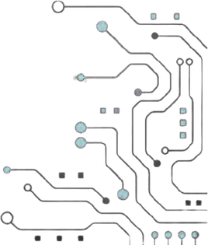



TEAM NAME : TEAM REBELS
PROBELM STATEMENT NO : PS 01
PROBLEM STATEMENT TITLE : Design and Verification of a Low-Power Clock Gating Controller for Mobile SoC
PS Category - Hardware

Slide 2
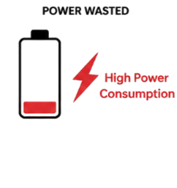
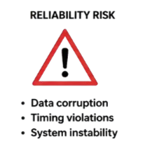
Problem Statement
High Power Consumption: Inactive blocks keep receiving clock signals, wasting battery power.
Unsafe Clock Gating: Improper gating can cause glitches and incomplete clock pulses.
Strict Timing: Clock gating must be fast, reliable, and maintain less than 5% duty-cycle distortion.

Slide 3
yOur Solution
Project name : Low-Power Integrated Clock Gating for Mobile System-on-Chip.
One-line solution : Safely disable inactive block clocks to reduce power and restore them quickly without glitches.
How it solves the problem :
Saves Power: Turns OFF clocks for inactive blocks, reducing unnecessary switching.
Ensures Safety: Handles wake-up safely and restores the clock within one cycle without glitches or incomplete pulses.

Slide 4
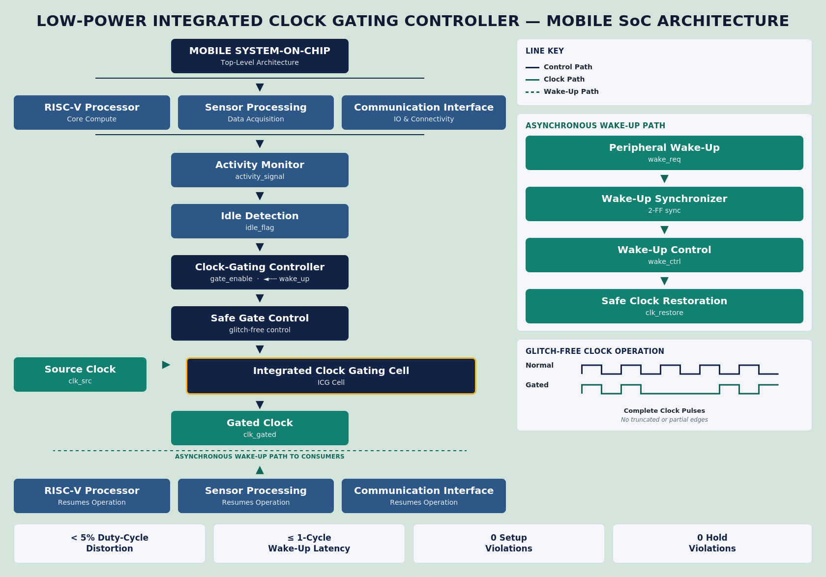
Architectural Block Diagram

Slide 5
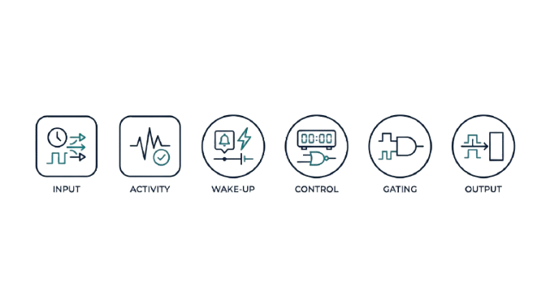
Purpose of Blocks
Input Block – Receive clock, activity, and wake-up signals from the System-on-Chip
Processing Block – Detect idle conditions and decide when to safely gate or restore the clock.
Output Block – Provide controlled gated clocks to the required functional blocks.
Additional control and synchronization logic is introduced to achieve lower power consumption and reliable, glitch-free clock operation.

Slide 6
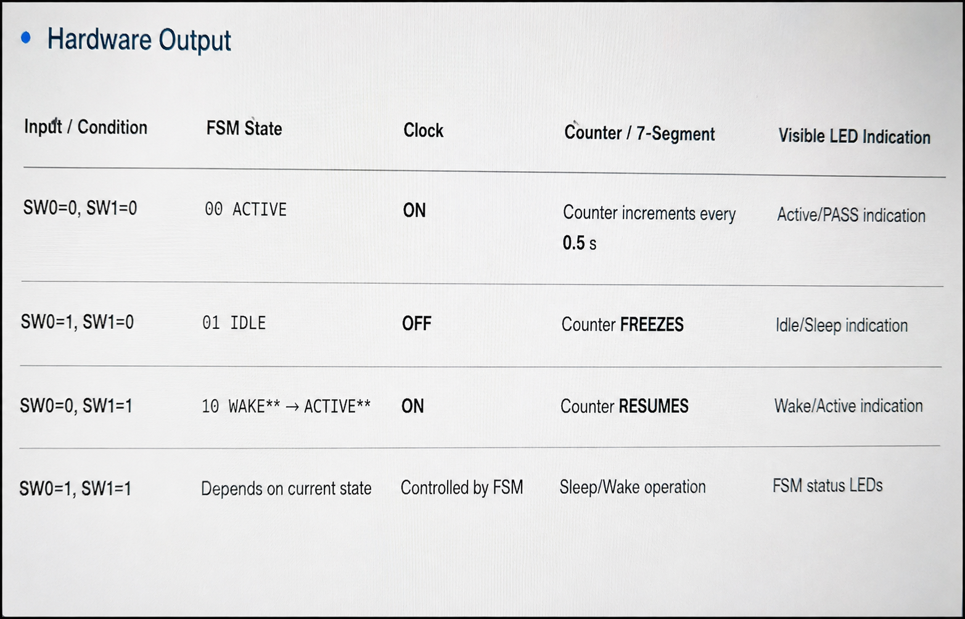
OUTPUTS AND RESULTS

Slide 7
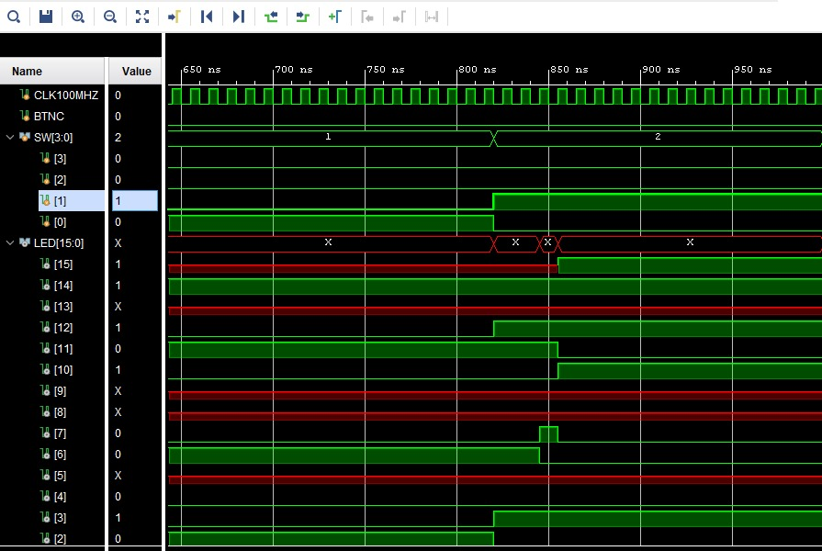
OUTPUTS AND RESULTS

Slide 8
RESEARCH AND REFERENCES
IEEE: Glitch-Free Integrated Clock Gating — https://doi.org/10.1109/CICC.1997.606671
IEEE: Clock-Gating for Low-Power Design — https://doi.org/10.1109/ISCAS.2019.8702507
Arm — AMBA Low Power Interface: Arm AMBA Low Power Interface
AMD Xilinx: Vivado Design Suite — AMD Vivado Design Suite

