Slide 1

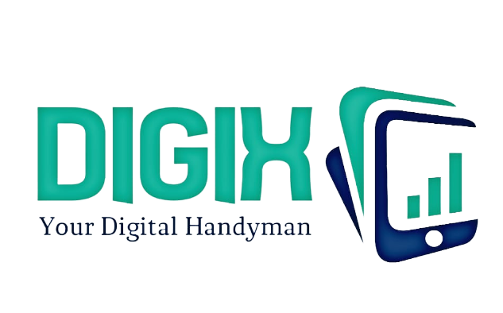
Business Proposal
- Dyson

Slide 2

Who are we ?
Consultants of innovative solutions in the world of emerging big data technologies. Our team of innovators consists of highly experienced and result oriented Analysts, Engineers and Developers delivering the best output. We believe in transforming the path of doing the business through our design led innovation process to extract the most of digital big data technologies and innovate a new intelligence in business. Our goal is to provide high-end tech solutions, including building websites/intuitive apps to establish a creative brand in market. Our cost effectiveness and end-to-end experiences helps your business to lead towards the future growth of innovative advantage.

Slide 3


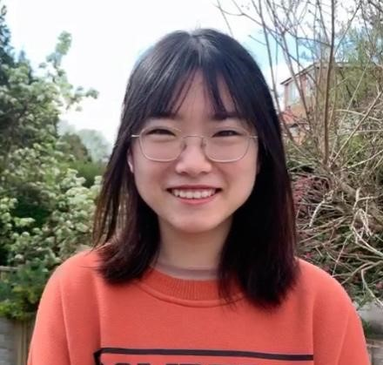


About Our Team
Jignesh Manocha
Project Manager
Yalan Chen
Data Scientist
Xiaowen Hu
Software Engineer
Saif Widyatmoko
Digital Marketing Analyst
Haoran Sun Business Analyst

Slide 4
Dyson---Current Customer Journey
Dyson already has a mature digital marketing basis, facilitating sales through purchase link in multiple channels.
REACH ACT CONVERT ENGAGE
Online
Phone and Online
Instore and Online
Marketing Automation
Click + Collect / Delivery
Catalogue Marketing
Instore and Offline
Machine Register
Offline shops
Event Invitations
Re-engagement email Program
Purchase Link
Social Customer Service
Customer Value
Social Media Accounts
Website
Reviews Interaction
Influencer Outreach
Pop-up store & Showroom
Virtual Demo Store
Remarketing
Social Media Ads
Search Engines
magazine
TV
News
WOM
Repeat Customer
Loyal Customer
1st Purchase
Lapsed Customer
Window shopper
Indecisive Customer
Notes:
Yalan
As we can see from dyson’s customer journey map, in each phase of the RACE model, Besides the characteristic offline demo shops strategy, Dyson has already built a quite mature digital marketing system, conducting marketing campaigns through instagram, Youtube, twitter, google and other mainstream online medias , converting to products consumption through online purchase links attached to multiple online channels. And Dyson’s own website has a very mature system in the field of presenting products, after-sell services, digital assistants for answering questions and collecting feedbacks and etc. However, our company noticed that a prosperate and high-tech company like Dyson hasn’t had a phone app that could interact better with customers as well as selling customised products. As a result, we think we can pitch Dyson to develop a better phone app. But building a complete phone app is a long-term, continuous and iterative project, we divide the whole project into different phases. In today’s proposal, we only introduce the first 4-month project phase.

Slide 5
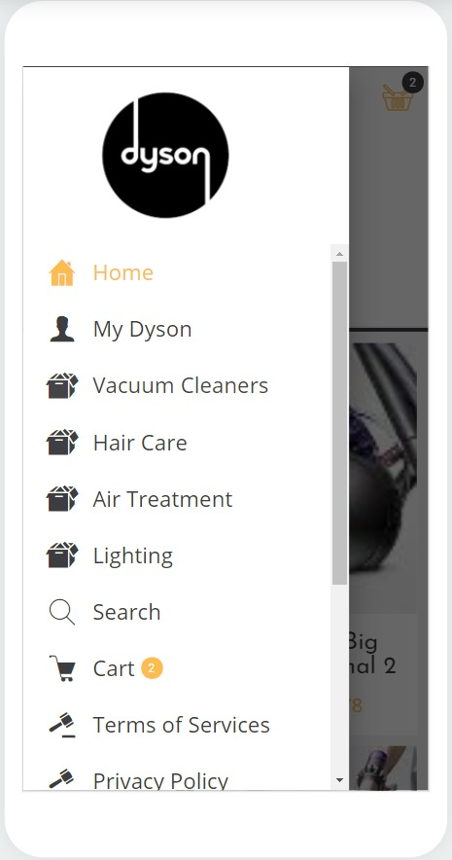
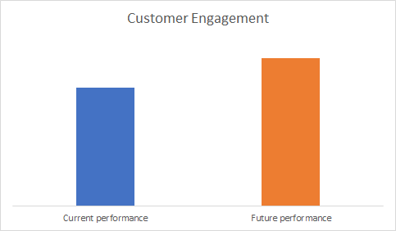
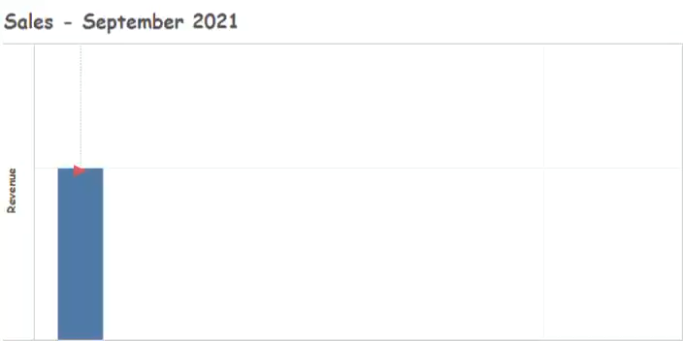
Proposal for Dyson
Increase customer engagement and convert casual customers to loyal customers towards the brand. The best way in doing this is through the development of a new Dyson app.
App Objectives
Improve overall customer engagement and profiling for Dyson
Open a direct marketing communication channel with customers

Slide 6

App Function Introduction
Online Shopping
Function
Purpose
App Users can:
Log into ‘MyDyson’ account to get personalised products
Browse the organisation’s full product Catalogue
Receive ads/promotions information of relative products through emails or app accounts
Improve app usage convenience
Save time and transaction fee
Better react and engage with customers
More conversion and purchase
Data Analytics Process
Data analysed
Search history
Sales data for existing customers(products purchased)
Techniques
Recommender Systems
Marketing application
Segment registered customers into different groups based on search history and products purchase history
Target the most suitable customers for marketing purpose based on customer segmentation
Position the right products to the right group of customers
Notes:
YALAN

Slide 7
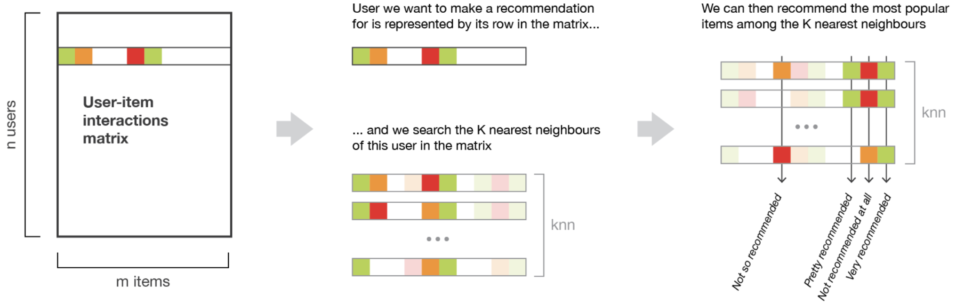
Big Data Technology
Key big data technologies involved in the proposal
1
Recommender System
Recommender Systems are algorithms aimed at suggesting relevant items to users. In this case, Digix will apply Memory Collaborative Methods based on the past interactions between users and products in order to produce new recommendations. Basically, it will find the closest users from a user of interest and suggest the most popular items among these neighbours.
Methodology
Memory Collaborative Methods
User-item Interactions Matrix
User-user Method
Matrix Factorisation
Notes:
XIAOWEN
Recommender system:
Version 1: Recommender System involves various algorithms to recommend items to users. In this case, Digix will focus on memory collaborative methods with the help of User-item interactions matrix. In summary, based on users’ history interactions with products, this method will find the closest users from a user of interest and suggest the most popular items among these neighbours. In order to tackle the cold start problem, it will recommend new products to the most active user while recommend the most popular products to new users.(42 seconds)
Version 2: Recommender System involves various algorithms to recommend items to users. In this case, Digix will focus on Content Based Methods by building a model based on the available “features”, like age, gender, etc, that explain the observed user-item interactions. For example, it probably will recommend hair curler to young school girls. In summary, this method drive pen-profile of certain product category lovers and recommend to new customers who share with the similar features.(33 seconds)

Slide 8
App Function Introduction
Interest Clubs
Function
Purpose
App Users can:
Send ads/promotions information of relative clubs through emails or app accounts
Engage with other customers through community posts
Improve app usage frequency
Better react and engage with customers
Bring genuine insights towards Dyson
Data Analysis Process
Data analysed
Transactional data( categories of products purchased)
Psychographic data (e.g. personality type, interests, values)
Customer interactions in interest clubs
Techniques
Text Analytics Clustering
Marketing Application
Segment registered customers into different groups based on data analysed, allowing better formulated pre-launch marketing for different Dyson products
Notes:
SAIF

Slide 9
Big Data Technology
Key big data technologies involved in the proposal
2
TEXT Analytics
Text Analytics involves several algorithms to extract meaning out of text. Basically, this technique focuses on finding themes, trends and sentiment with no need to read all comments from customers manually. In this case, sentiment and topic analysis would be involved to reflect the customer attitude and interests trend over time.
Methodology
Text Feature Extraction (TfidfVectorizer)
Topic Modelling (LDA, NMF)
Classification Model (Naive Bayes Classifier)
Notes:
XIAOWEN
Text Analytics Model:
Text analytics uses algorithms to analyze text without reading all words manually. Normally, for product-based company, text analytics is focused on analyzing customer feedbacks on the product and brand, including sentiment analysis, topic analysis, etc., to get better understanding of customer attitude and interest over time. In this case, several machine learning techniques will be implemented to proceed the text analytics, including Vectorizer in text feature extraction, LDA or NMF in dimension reduction and topic generating, Classification models, for example Naive Bayes Classifier in content similarity analysis.
Regression Model:
Regression analysis is a form of predictive modelling technique which investigates the relationship between a dependent (target) outcome and independent variables. This technique is used for forecasting, for example, how many people are willing to pay to change the old Dyson machine for the latest model. There are many regression model in machine learning, including Linear Regression, Polynomial regression and so on. We wilL use MAE, MSE and R-squared to measure the model performance.

Slide 10
App Function Introduction
Product Exchange Offer
Function
Purpose
App Users can:
Exchange old products with new ones (same category) with great deals.
Receive notifications via sms, emails etc.
Intervene customer churn
Improve customer loyalty
Contribute to sales revenue and profit
Data Analysis Process
Data analysed
Customer behavioural data(via customer transaction history)
Demographic data (e.g. gender, age, location)
Techniques
Classification Model Clustering
Marketing Application
Segment customers on the result they accept or reject the offer
Target the similar customers who may have interests in the offer
Position the offer invitation proactively to the potential offer-takers
Notes:
SAIF

Slide 11
Big Data Technology
Key big data technologies involved in the proposal
Classification Model
3
A classification model tries to draw some conclusion from the input variables given for training. It will predict the labels for the new dataset. In this case, the classification model aims to predict the result (will accept or reject the offer) of customers who have not considered the exchange product offer based on the the training dataset of customers who have considered and made the decision.
Methodology
Random Forest Classifier
Logistic Regression
Naive Bayes Classifier
XGboost Classifier

Slide 12
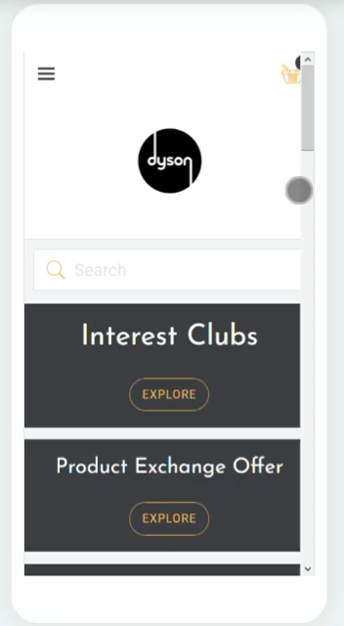
Dyson’s APP Demo
A mobile ‘Website’
Every function that is available on Dyson’s website is included on our app, bringing more convenience for the customers
A ‘Social Media’
A communication platform for Dyson’s fans and technology lovers
A Window
A window for potential customers to explore more of Dyson

Slide 13
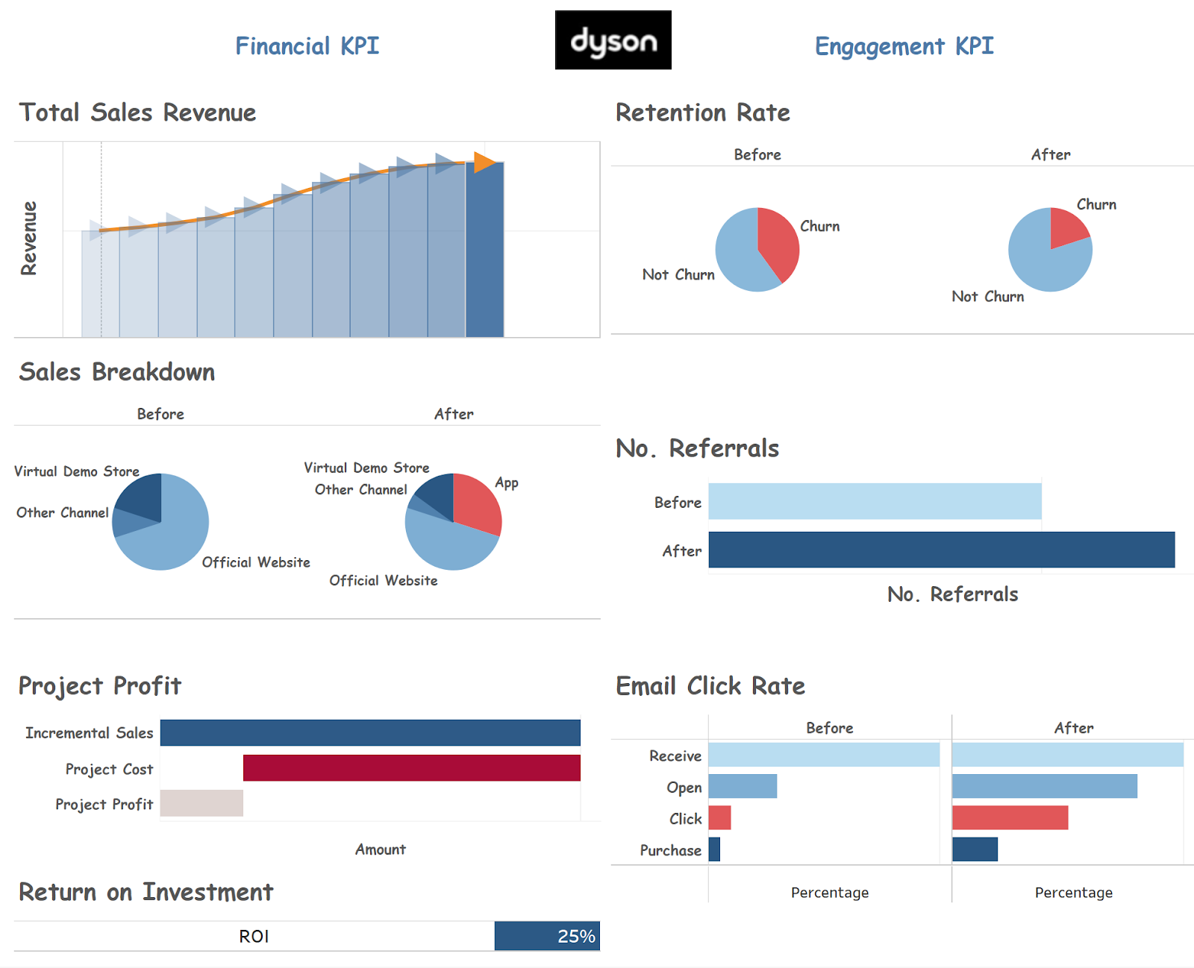
Performance Measurement
KPIs and Dashboard
Sales Revenue
Project Profit
Return on Investment(ROI)
Retention Rate and Churn Rate
No. Customer Referrals
Email Click Through Rate

Slide 14
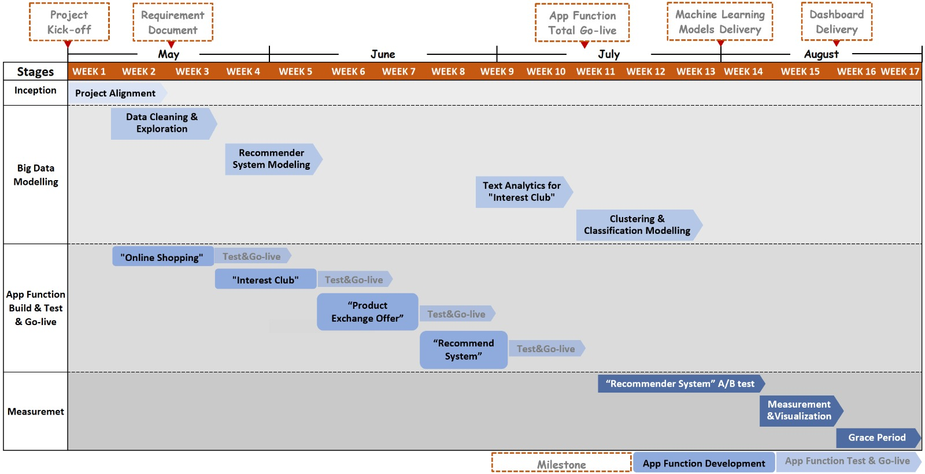
Project Scheduling
Gantt Chart
Notes:
Xiaowen
The whole project will be proceeded in 4 stages. After project detail alignment with Dyson, big data modeling and App new functions development, test and go-live will start in parallel leading by data scientist team and software engineer team correspondingly. Online shopping and interest clubs functions will go-live first, followed by the product exchange offer function after the regression model is done, the recommender system will go-live at last after the recommender system modelling is done, all developments will be finished before July. Then 4-week A/B testing will be implemented to measure the performance of Recommender System. After one-month running of the interest club, text analytics will come to stage to analyze customer attitude and interest tren. In the end, We will measure and visualize the whole project performance for insights for future marketing campaigns.(1min)

Slide 15
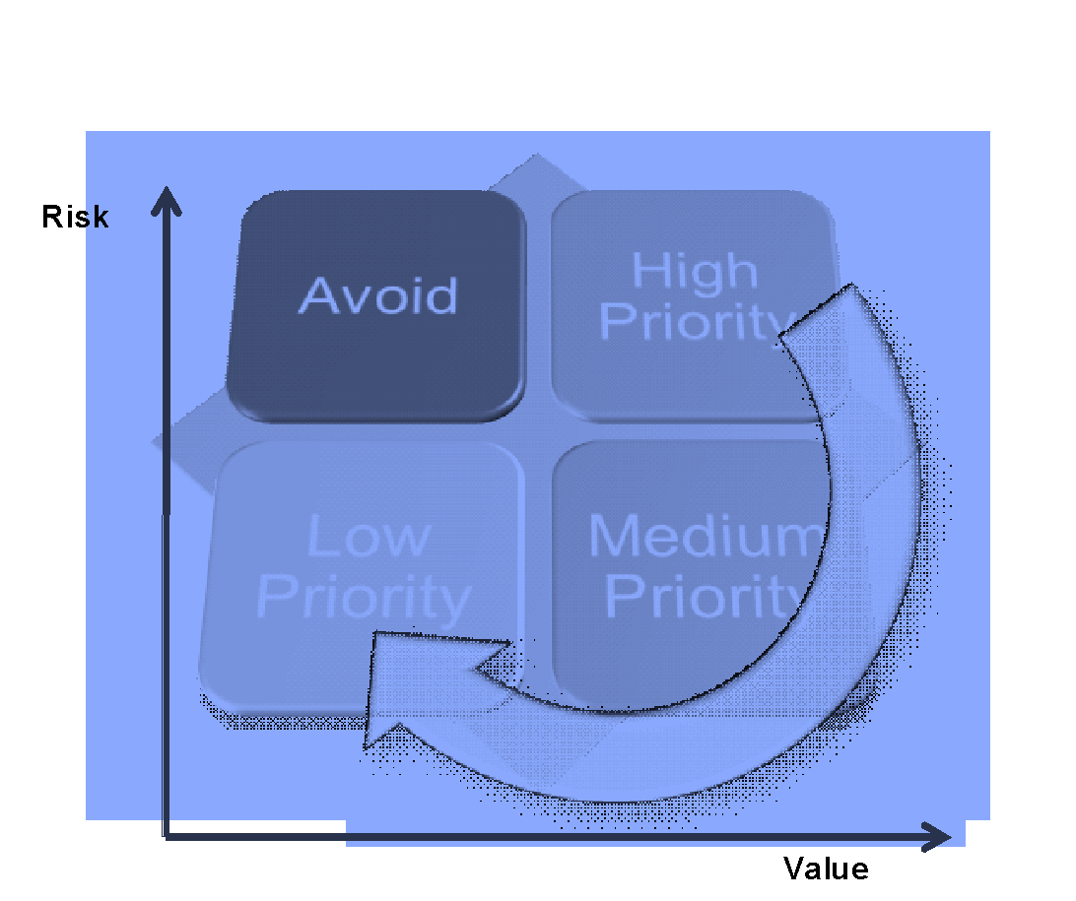
Project Management Method
Agile Philosophy
Process
requirements
design
1
2
value
5
3
develop
deploy
4
test
Benefits
Shorter Time to Market
Faster and more accurate delivery
More frequent test
Transparent and visible
Earlier recognize and remove risks
Notes:
Yalan
During the whole project, the Agile method will be used to manage the process in order to ensure a more effective,more productive and best requirements-fitted project. All the processes are transparent and visible, communications and feedbacks between our teams and Dyson will be more timely and accurate. A better and faster delivery would be guaranteed, bringing most values to the market.

Slide 16





What We Need
Resource planning
Job | Quantity | Contracted time (Weeks) | Staffing cost
Data scientist | 2 | 13 | £25,000.00
Digital Marketing Analyst | 1 | 17 | £12,423.08
Business Analyst | 2 | 17 | £20,923.08
Software engineer (front end) | 1 | 11 | £10,365.38
Software engineer (back end) | 2 | 11 | £22,846.15
Project Manager | 1 | 17 | £15,528.85
£110,000
Annual Maintenance cost: £22,000
Notes:
Saif
Script:
So who will we need to create this app? Firstly, we would need a marketing analyst and business analysts to create insights from the data we have. From there we need data scientists to convert big data into insights and statistical models. We will need a developer to create the app and transform the models from our data scientist into app features. And finally we need a project manager to streamline the whole process and conduct quality assurance methods.
The table represents the staffing requirements needed for Dyson to create this app. This will be a contract based project therefore the staffing costs will vary depending on resources required for each role. It is important to note that these roles will work in conjunction with each other in different processes of the app making process as shown in our Gantt chart. For example, the data scientist will be working close with the business analyst in order to meet the requirements that the business analyst has for the data while the back end software engineer will be working closely with the data scientist to help convert these statistical models into features for the app. The project manager will oversee the whole operation ensuring everyone is working efficiently towards the deadline.

Slide 17
Data Privacy
Review
Customer transactional data
Customers’ posts
Psychographic data of loyal customers( from customer survey)
Data Analyzed
Search history
Demographic data
…
Ethics and Privacy
The privacy policy of the new APP will follow Dyson's terms(abide GDPR)
Only collect the personal data for services, products and experiences improvement
Never sell customers’ personal data and only share it as outlined in privacy policy

Slide 18
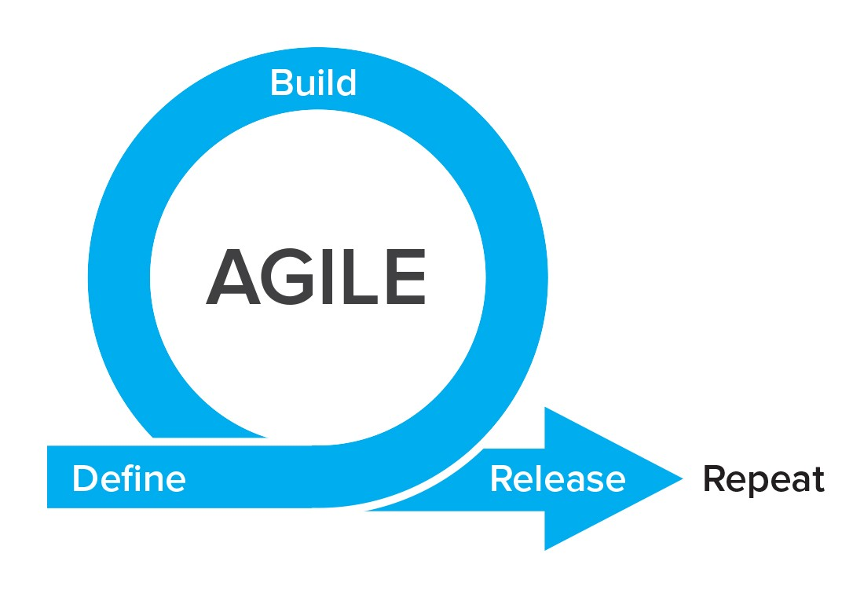
Implementation Plan Conclusions and Expectations
02
Phase Two
…
01
Phase One
~4 months
Measurement& Visualization
Supplements
Paralleled
Modelling
Function development and test
online interactive activity--- Theme challenge in interest club
Demo Activities Announcement and Reservation Channels
1.5 months
2.5 months
A/B testing (1 months)
Function measurement
App pages visualization
development
test
Project Alignment
Regression Model
Recommender System Model
Text Analytics
“Online shopping”
“Interest Club”
“Product Exchange Offer”
Recommender System
Test paralleled after each function built
Component tests within each function
Data & Operation Management
Continuous Delivery
Maintenance
Demand Mining
Iteration
Notes:
First: Yalan
second phase : xiaowen
Wording:saif
Second phase:
Two further marketing and analytics could be driven for Dyson.
Firstly, Dyson can run different offline activities for different interest clubs which can book via the App. Generating the pen-profile of people who make a purchase after taking part in the activity, then invitations could be sent by email to potential customers who are more likely to make a purchase based on classification models.
Secondly, theme challenges can be held in the interest club in response to the new model launch plan. For example, if Dyson plan to launch a new model of hair curler, several weeks before the launch, a challenge called “10 min to curl your hair” which encourages people to post videos or photos recording their experience with Dyson hair curler, can be started by Dyson. Text analytics could be run to analyze how the challenge improve customers engagement and feedback.

Slide 19
