Slide 1

FoodCorps
Data At Scale
Coursework Presentation
2020-21
By- Jignesh Manocha
Id- 20249953

Slide 2
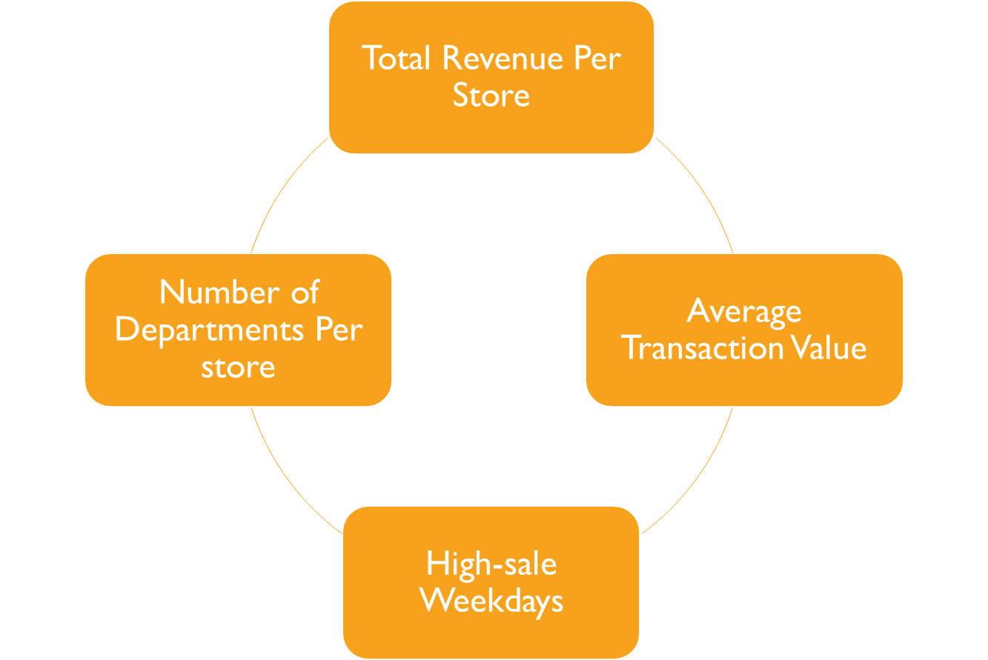
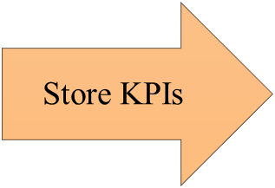

Slide 3
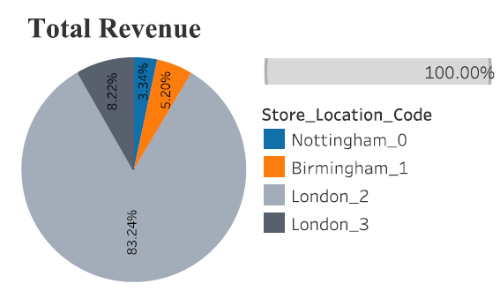
TOTAL REVENUE PER STORE

Slide 4
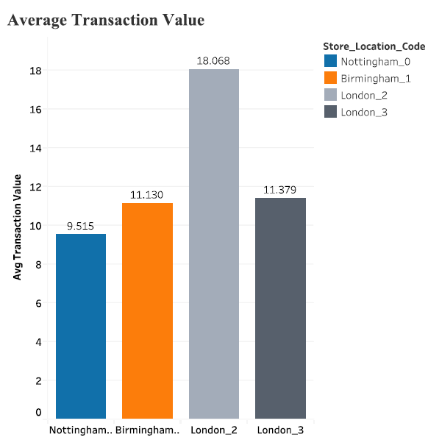
AVERAGE TRANSACTION VALUE PER STORE

Slide 5
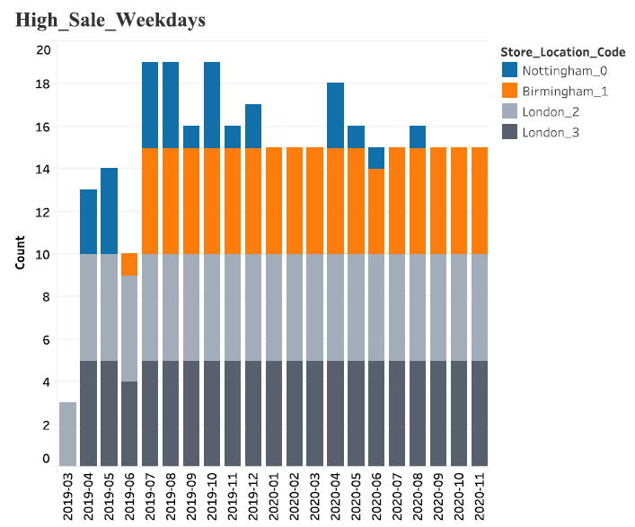
HIGH SALE WEEKDAYS PER MONTH

Slide 6
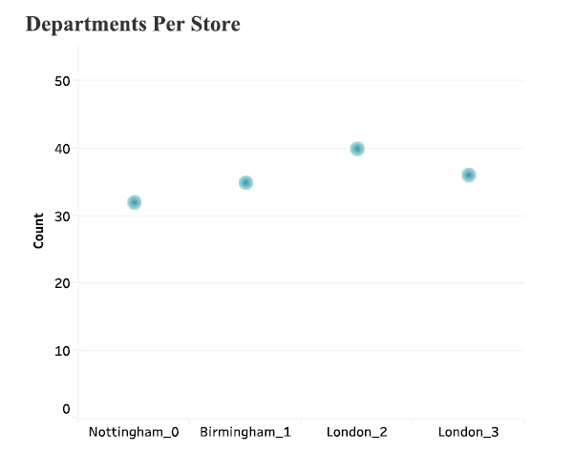
DEPARTMENTS PER STORE

Slide 7
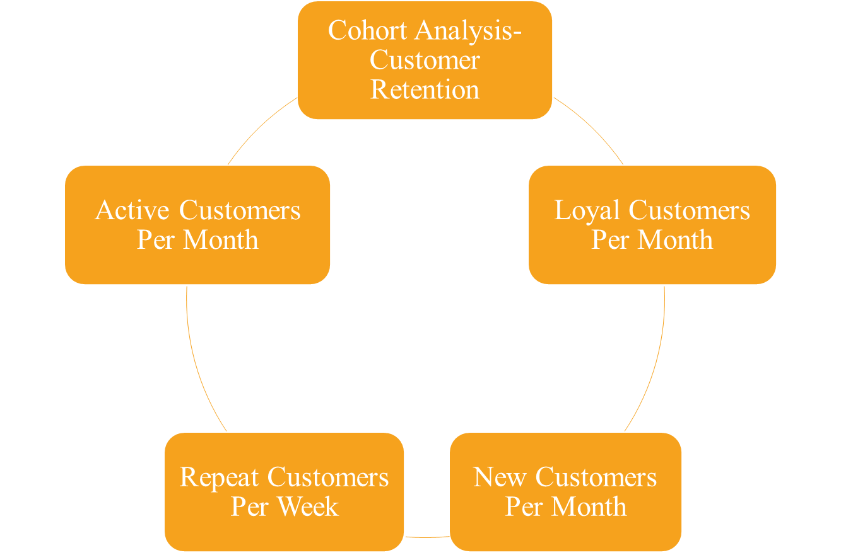

Customer KPIs

Slide 8
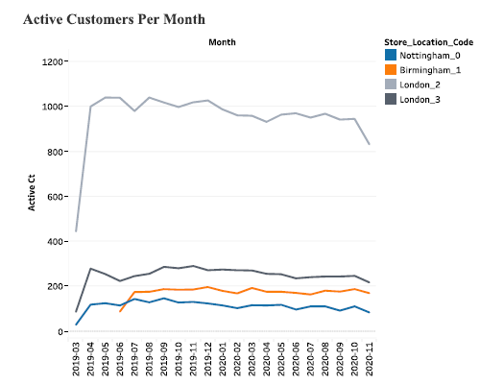
ACTIVE CUSTOMERS PER MONTH

Slide 9
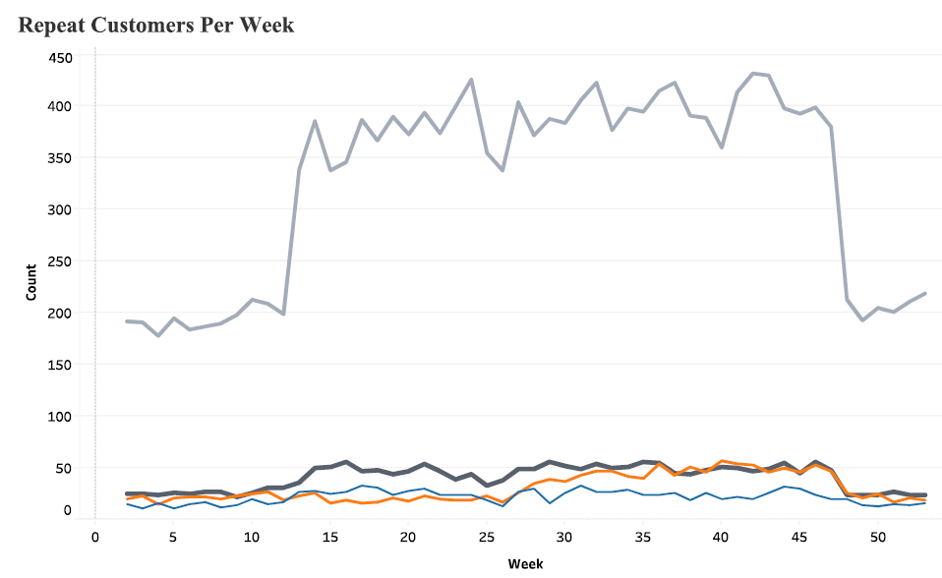
REPEAT CUSTOMERS PER WEEK

Slide 10
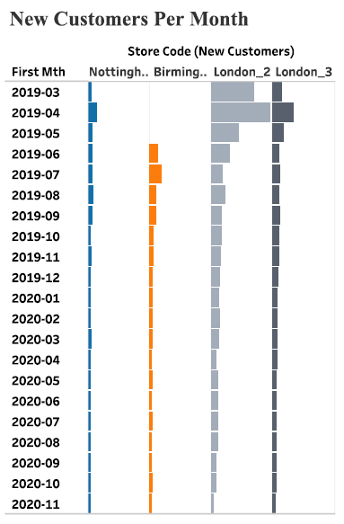
NEW CUSTOMERS PER MONTH

Slide 11
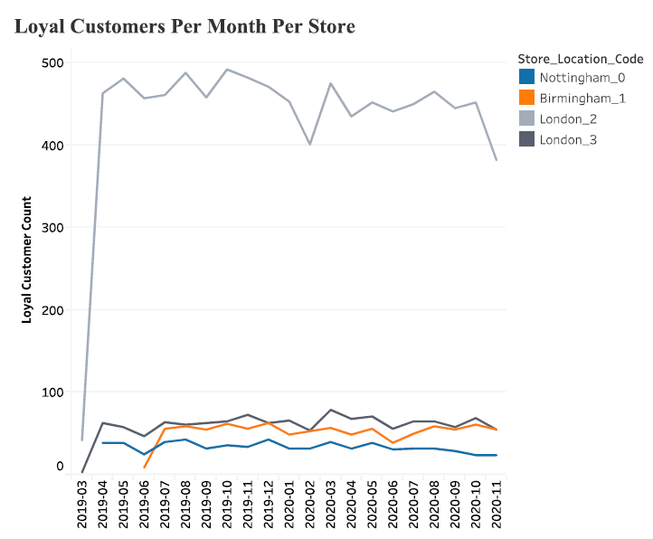
LOYAL CUSTOMERS PER MONTH

Slide 12
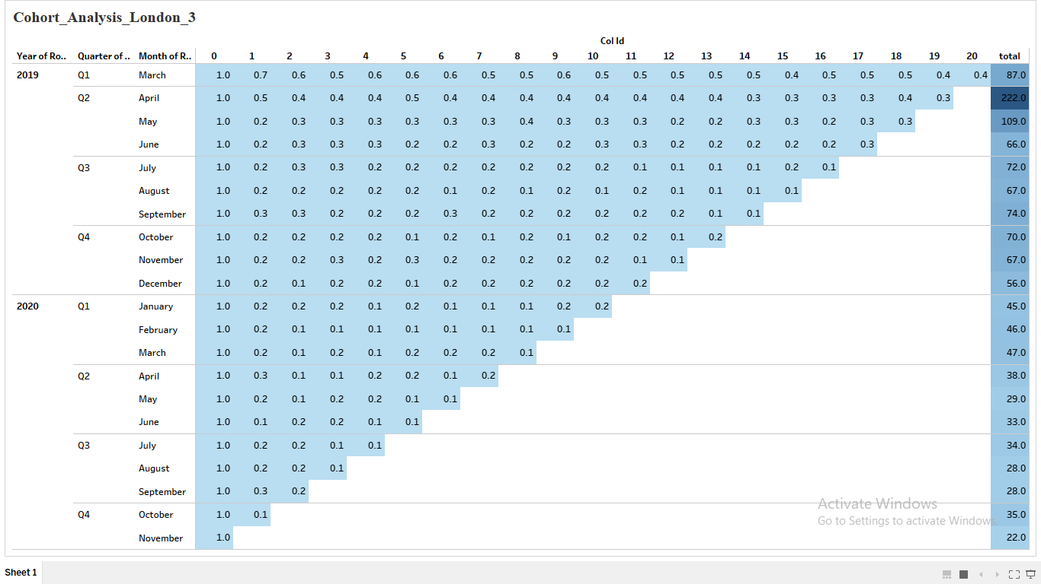
COHORT ANALYSIS- LONDON_3

Slide 13
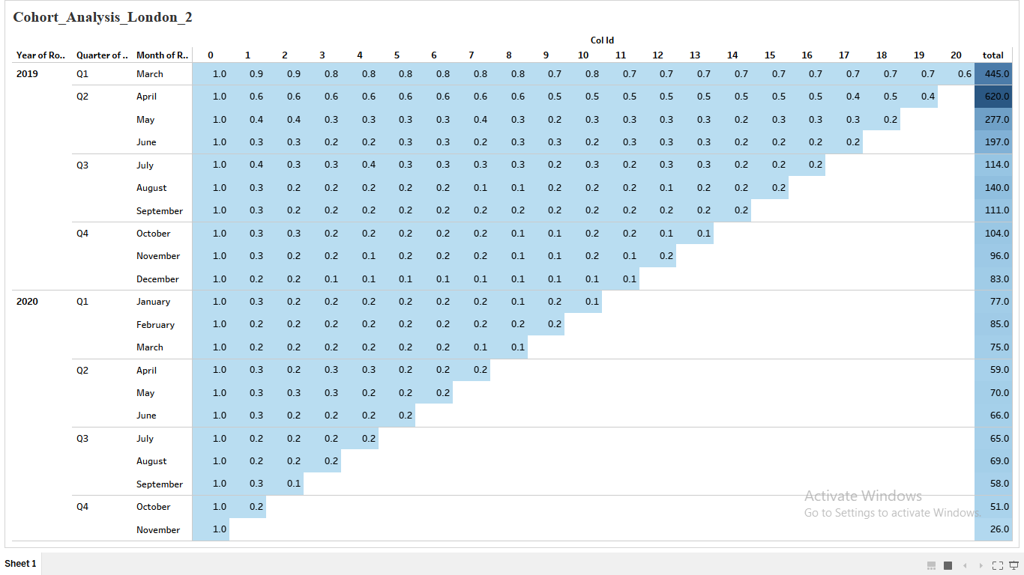
LONDON STORE 2

Slide 14
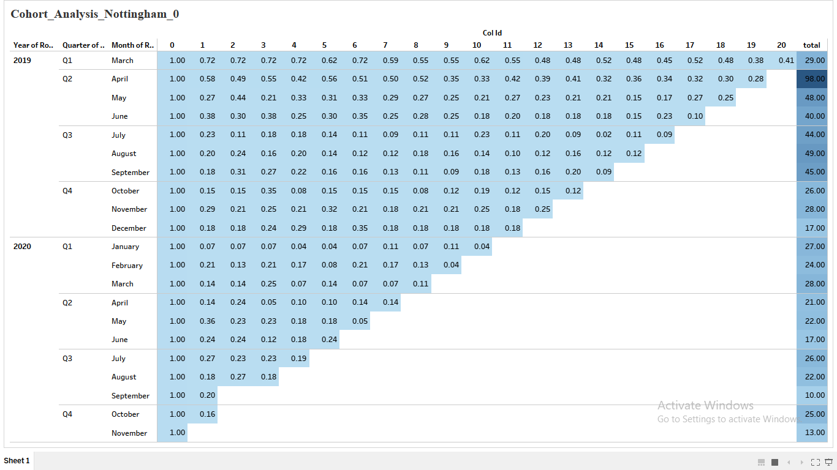
NOTTINGHAM STORE

Slide 15
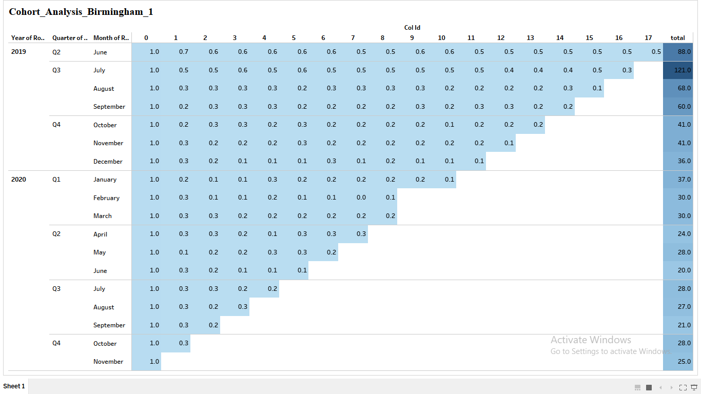
BIRMINGHAM STORE

Slide 16
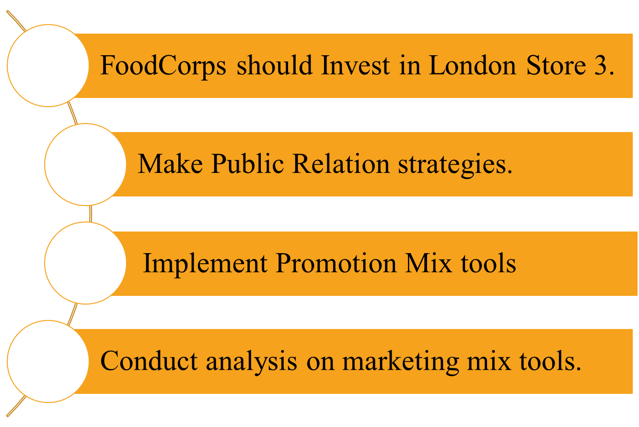
RECOMMENDATIONS

