Slide 1
CSS3
Janak Shah

Slide 2
Agenda
Today’s Special
Introduction to Css
Types of Css
Css Declaration
Selectors in Css
Box Model
Priority schemes
Display
Inline , block , Inline-block , none
Visibility
hidden, visible
Today’s Special
Position
Static, Relative, Fixed, Absolute
Float
Left, Right, Clear
Border
Box Shadow
Transformation
Multiple Columns

Slide 3
What / Why Css ?
CSS stands for Cascading Style Sheets.
Styles define how to display HTML elements.
CSS is used to control the style and layout of Web pages.
CSS specifies a priority scheme to determine which style rules apply if more than one rule matches against a particular element.

Slide 4
Types of CSS
External
<link href="path/to/file.css" rel="stylesheet">
Internal
Inline
<p style=“color:#ffffff;"> ...... </p>
<style type="text/css"> ...... </style>

Slide 5
CSS Selectors
Declaration
body { margin: 10px 20px; }
Selector
Property
Value
Selectors
ID
Class
Element

Slide 6
CSS Selectors
body { margin: 10px 20px; }
#slider-container { margin: 10px 20px 30px; }
.blue-btn { color: blue; }

Slide 7
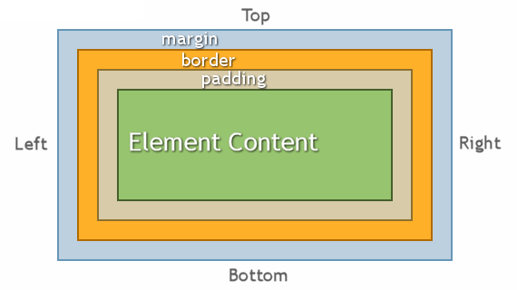
Box Model
The CSS box model is essentially a box that wraps around HTML elements, and it consists of:
Margins
Borders
Padding
The actual content

Slide 8
Box Model
Margin:
Clears an area around the border. The margin does not have a background color, it is completely transparent.
Border:
A border that goes around the padding and content. The border is inherited from the color property of the box.
Padding:
Clears an area around the content. The padding is affected by the background color of the box.
Content:
The content of the box, where text and images appear.

Slide 9
CSS – What’s the difference
div { margin: 10px 20px; }
.blue-btn { margin: 15px; }
#slider-container { margin: 10px 20px 15px; }
<div id=“slider-container” class=“blue-btn”> … </div>
What if 2 same properties are assigned to one element ?

Slide 10
Display
Inline | Block | Inline-block
Respect left & right margins and padding, but not top & bottom. | Respect all of those – top, bottom, left and right margins & paddings. | Respect all of those – top, bottom, left and right margins & paddings.
Cannot have a width and height. | Force a line break after the element. Default width is 100%. | Respect height and width.
An inline element has no line break before or after it, and it tolerates HTML elements next to it. | A block element has some whitespace above and below it and does not tolerate any HTML elements next to it. | An inline-block element is placed as an inline element (on the same line as adjacent content), but it behaves as a block element.

Slide 11
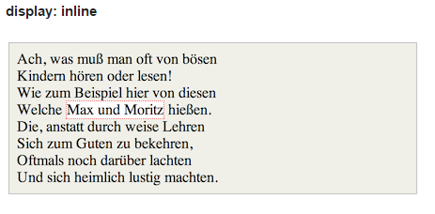
Display: inline;
Imagine a <span> element inside a <div>.
If you give the <span> element a height of 100px and a red border, it will look like this with.

Slide 12
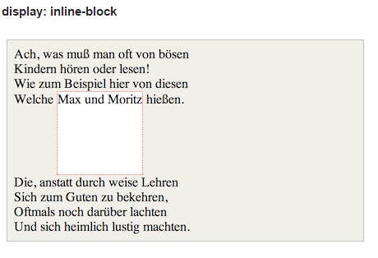
Display : inline-block;
Imagine a <span> element inside a <div>.
If you give the <span> element a height of 100px and a red border, it will look like this with.

Slide 13
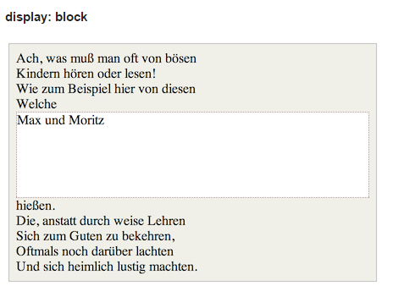
Display : block;
Imagine a <span> element inside a <div>.
If you give the <span> element a height of 100px and a red border, it will look like this with.

Slide 14
Visibility
By default the visibility of any element is set to “visible”
If you want to hide any element while retaining the space occupied by that same element, use visiblity: “hidden”.

Slide 15
Position: static;
This is the default for every single page element.
Static doesn't mean much, it just means that the element will flow into the page as it normally would.
The only reason you would ever set an element to position: static is to forcefully-remove some positioning that got applied to an element outside of your control.

Slide 16
Position: relative;
What it really means is "relative to itself".
If you set position: relative; on an element but no other positioning attributes (top, left, bottom or right), it will no effect on it's positioning at all, it will be exactly as it would be if you leave it as position: static.

Slide 17
Position: relative;
There are two other things that you should be aware of when you set position: relative on an element
It introduces z-index on that element, which means that the element will now appear on top of any other statically positioned element.
It limits the scope of absolutely positioned child elements.

Slide 18
Position: absolute;
This is a very powerful type of positioning that allows you to literally place any page element exactly where you want it.
You use the positioning attributes top, left bottom and right to set the location.
Remember that these values will be relative to the next parent element with relative positioning.
The trade-off, and most important thing to remember, about absolute positioning is that these elements are removed from the flow of elements on the page.

Slide 19
Position: fixed;
A fixed position element is positioned relative to the viewport, or the browser window itself.
The viewport doesn't change when the window is scrolled, so a fixed positioned element will stay right where it is when the page is scrolled.
It is usually used to place navigation panes available to the user all the time. Example of this could be social connect icon / header.

Slide 20
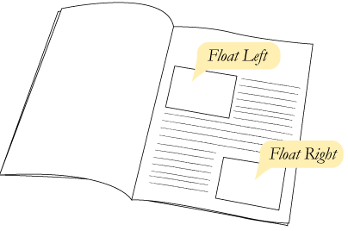
Float
With CSS float, an element can be pushed to the left or right, allowing other elements to wrap around it.
Float is often used with images, but it is also useful when working with layouts.
A floated element will move as far to the left or right as it can. Usually this means all the way to the left or right of the containing element.

Slide 21
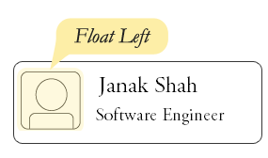
Float
If you place several floating elements after each other, they will float next to each other if there is any room for it.
Elements after the floating element will flow around it. To avoid this, use the clear property.
The clear property specifies which sides of an element other floating elements are not allowed.

Slide 22
border
border-width
The border-width property is used to set the width of the border.
border-style
The border-style property specifies what kind of border to display.
border-color
The border-color property is used to set the color of the border.
border-radius
The border-radius property is used to give curves to the border-edges of the element.

Slide 23
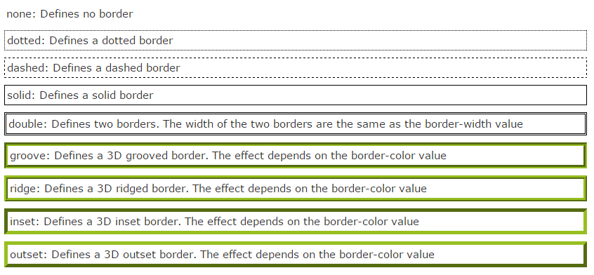
border-style
border-style
The border-style property specifies what kind of border to display.

Slide 24
border-color
border-color
The border-color property is used to set the color of the border.
The color can be set by:
name – border-color: red;
RGB – border-color: rgb(255,0,0);
Hex – border-color: #ff0000;

Slide 25
Border-radius
border-radius
The border-radius property is used to give curves to the border-edges of the element.
The border-radius property is a shorthand property for setting the four border-*-radius properties.
border-top-left-radius
border-top-right-radius
border-bottom-right-radius
border-bottom-left-radius

Slide 26
border
So, to have a border to a div, we need to specify.
border-width: 1px;
border-style: dotted;
border-color: blue;
border-top-left-radius: 2px;
border-top-right-radius : 2px;
border-bottom-right-radius : 2px;
border-bottom-left-radius : 2px;
Isn’t it tedious to write so much of text just to have one small border ???

Slide 27
Border - shorthand
border-width: 1px;
border-style: dotted;
border-color: blue;
Border: 1px dotted blue;
border-top-left-radius: 2px;
border-top-right-radius : 2px;
border-bottom-right-radius : 2px;
border-bottom-left-radius : 2px;
Border-radius: 2px;

Slide 28
box-shadow
You can give shadows to your elements to give various effects
box-shadow: [shadow-type] | x-offset | y-offset | blur | blur-offset | color
shadow-type To specify the type of shadow.
x-offset To position the shadow along the x-axis.
y-offset To position the shadow along the y-axis.
blur To set the amount of blur.
blur-offset To set the reach of blur.
color To set the color of the shadow.

Slide 29
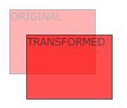
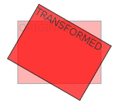
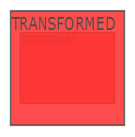
Transformation
Translate
transform: translate(50px,100px);
Rotate
transform: rotate(30deg);
Scale
transform: scale(2,4);

Slide 30
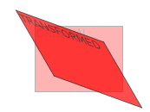
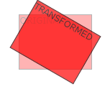
Transformation
Skew
transform: skew(30deg,20deg);
Matrix
transform:
matrix(0.866, 0.5, -0.5, 0.866 ,0,0);
(rotate, scale, translate, skew)

Slide 31
Transition
Transitions allow the values of CSS properties to change over time, essentially providing simple animations.
For example, if a link changes color on hover, you can have it gradually fade from one color to the other, instead of a sudden change
Here are the steps to create a simple transition using only CSS:
Declare the original state of the element in the default style declaration.
Declare the final state of your transitioned element; for example, in a hover state.
Include the transition functions in your default style declaration, using a few different properties: transition-property, transition-duration,transition-timing-function, and transition-delay.

Slide 32
Transition
list of properties that can be transitioned:
background-color | Left | Letter-spacing | Text-indent
background-position | Right | Vertical-align | Text-shadow
border-color | color | Visibility | Line-height
border-spacing | Font-size | Word-spacing | Margin
border-width | Height | Z-index | padding
Top | width | bottom | Opacity

Slide 33
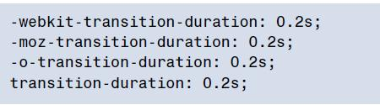
Transition-duration
The transition-duration property sets how long the transition will take. You can specify this either in seconds (s) or milliseconds (ms). We’d like our animation to be fairly quick, so we’ll specify 0.2 seconds, or 200 milliseconds:

Slide 34
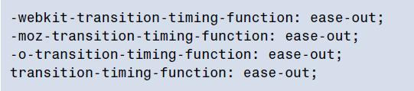
Transition-timing-function
The transition-timing-function lets you control the pace of the transition in even more granular detail. Do you want your animation to start off slow and get faster, start off fast and end slow.
You can specify one of the key terms ease, linear, ease-in, ease-out, or easein-out.
The best way to familiarize yourself with them is to play around and try them all.

Slide 35
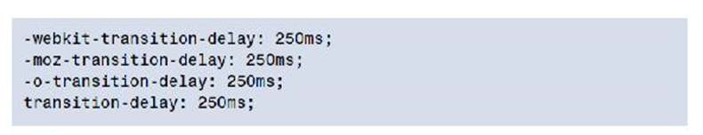
Transition-delay
Finally, by using the transition-delay property, it’s also possible to introduce a delay before the animation begins. Normally, a transition begins immediately, so the default is 0. Include the number of milliseconds (ms) or seconds (s) to delay the transition:

Slide 36
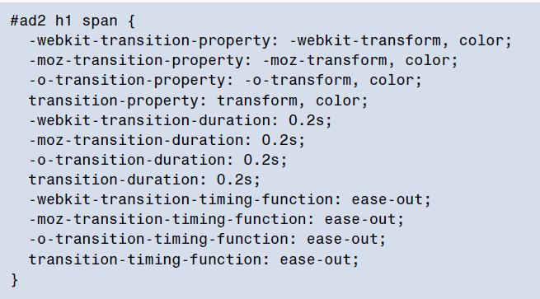
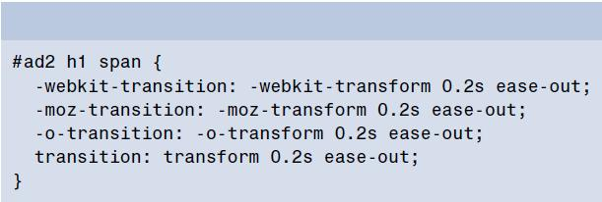
Transition-shorthand
With four transition properties and three vendor prefixes, you could wind up with 16 lines of CSS for a single transition.
The transition property is shorthand for the four transition functions described above.
Transition-original property
Transition-shorthand property

Slide 37
Transition-shorthand-rule
Note that order of the values is important and must be as follows (though you don’t need to specify all four values):
transition-property
transition-duration
transition-function
transition-delay

Slide 38
Multiple columns
With CSS3 columns, the browser determines when to end one column and begin the next without requiring any extra markup
column-width
The column-width property is like having a min-width for your columns. The browser will include as many columns of at least the given width as it can to fill up the element
column-gap
The column-gap property specifies the width of the space between columns.
column-count
The column-count property specifies the number of columns desired, and the maximum number of columns allowed. The default value of auto means that the element has one column.

Slide 39
Multiple columns
With CSS3 columns, the browser determines when to end one column and begin the next without requiring any extra markup
#articlex {
-webkit-column-width: 150px;
-moz-column-width: 150px;
column-width: 150px;
}
#articlex {
-webkit-column-count: 3;
-moz-column-count: 3;
column-count: 3;
}
#articlex {
-webkit-column-gap: 10px;
-moz-column-gap: 10px;
column-gap: 10px;
}

Slide 40
Thank You!

