Slide 1
HTML5
Janak Shah

Slide 2
Agenda
Today’s Special
Multimedia
Storage
Semantics
Graphics

Slide 3




Features of HTML5
Semantics
Graphics
Multimedia
Offline Storage
<header>
<footer>
<nav>
<article>
<section>
<figure>
<figcaption>
<aside>
SVG
Canvas
3D
Audio
Video
Local Storage
Session Storage

Slide 4
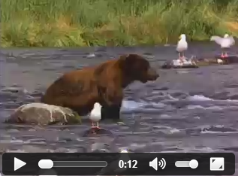
Multimedia
<audio>
<audio controls> <source src="horse.ogg" type="audio/ogg"> <source src="horse.mp3" type="audio/mpeg"> </audio>
<video>
<video width="320" height="240" controls> <source src="movie.mp4" type="video/mp4"> <source src="movie.ogg" type="video/ogg"> </video>

Slide 5
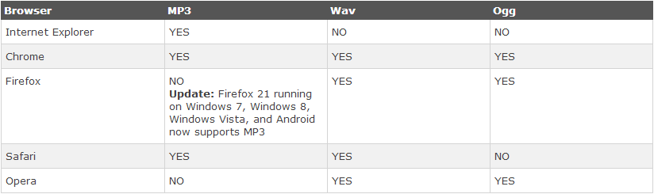
Multimedia
Vendor Supports for audio

Slide 6
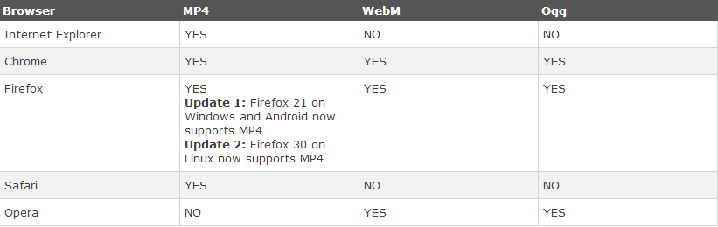
Multimedia
Vendor Supports for video

Slide 7
Offline Storage
In HTML5, web pages can store data locally within the user's browser.
Earlier, this was done with cookies. However, Web Storage is more secure and faster. The data is not included with every server request, but used ONLY when asked for. It is also possible to store large amounts of data, without affecting the website's performance.
The data is stored in key/value pairs, and a web page can only access data stored by itself.
HTML5 Web Storage defines two types of key-value storage types.

Slide 8
Offline Storage
Local Storage
Stores data with no expiration date.
The data will not be deleted when the browser is closed, and will be available the next day, week, or year.
5MB per app per browser. According to the HTML5 spec, this limit can be increased by the user when needed.
localStorage.clickcount=Number(localStorage.clickcount)+1;
Session Storage
Stores data for one session.
Session storage is per-page-per-window and is limited to the lifetime of the window. The data is deleted when the user closes the browser window
The sessionStorage object is equal to the localStorage object, except that it stores the data for only one session.
sessionStorage.clickcount=1;

Slide 9
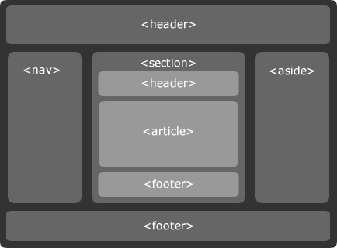
Semantic
HTML5 offers new semantic elements to clearly define different parts of a web page
<header>
<nav>
<section>
<article>
<aside>
<figcaption>
<figure>
<footer>

Slide 10
Semantic
New input types
Color
Date
datetime
email
month
number
range
search
tel
time
url
week
Attributes for <input>:
autocomplete
autofocus
formaction
formmethod
formnovalidate
formtarget
height and width
min and max
multiple
pattern (regexp)
placeholder
required

Slide 11
Graphics
SVG
Scalable Vector Graphics
SVG is used to define vector-based graphics for the Web
SVG graphics do NOT lose any quality if they are zoomed or resized
Every element and every attribute in SVG files can be animated
SVG defines the graphics in XML format

Slide 12
Graphics
CANVAS
The HTML5 canvas element uses JavaScript to draw graphics on a web page.
A canvas is a rectangular area, and you control every pixel of it.
The canvas element has several methods for drawing paths, boxes, circles, characters, and adding images.
Canvas – as the name suggests is an object that lets you draw many objects with itself.

