Slide 1
Javascript
Authored by : Jignesh Patel Presented by : Jignesh Patel

Slide 2
Agenda
To learn and understand JS concepts and its use in HTML
  JS Intro
  Core JS, basic understanding of what is and how JS works
  JS Display Data
  Integration with HTML
  JS HTML DOM
  CSS changes using JS
  JS Forms

Slide 3
JS Intro
Basic Overview
  A basic programming language of HTML and Web
  JavaScript Can Change HTML Content
  One of many HTML methods is getElementById().
  JavaScript Can Change HTML Styles (CSS)
  It Captures the user interaction and in a way communicates with the server.
  Widely known as client-side scripting language

Slide 4
What is JavaScript
“JavaScript is a high level, dynamic, untyped and interpreted programming language.”
By Wikipedia
Developed by Brendan Eich in Netscape navigator 2.0 in Sep 1995
Supported by all major browsers
Runs by browser’s JavaScript engine.

Slide 5
JavaScript Editor
Simple text editor such as notepad is enough
Brackets, sublime etc.
Online editors – jsbin, jsfiddle etc.
Browser’s developer tool.

Slide 6
JS Facts and Comments
JavaScript Comments
  Single-line
  Multi-line
JavaScript syntax
  JavaScript syntax mostly similar to JAVA
  JavaScript is case sensitive

Slide 7
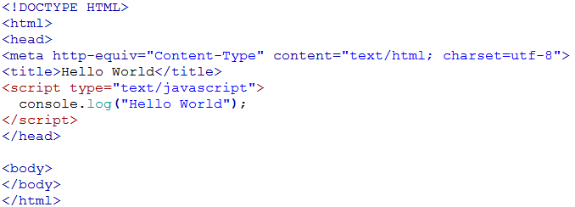
Simple – “Hello World” Example

Slide 8
Data Types
In JavaScript values are typed, it’s not the variables
Built in types are as below
  String
  Number
  Boolean
  Null and undefined
  Object

Slide 9
Inspecting Data Types
var a;
console.log(typeof a); // underfined
var a = “hello world”;
console.log(typeof a); // string
var a=50;
console.log(typeof a); // number
var a=true;
console.log(typeof a); // Boolean
var a=null;
console.log(typeof a); // object – weird
var a=undefined;
console.log(typeof a); // underfined
var a={b:”c”};
console.log(typeof a); // object

Slide 10
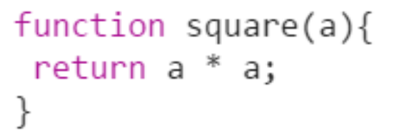
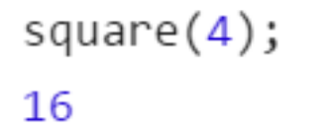
JS Functions
A JavaScript function is a block of code designed to perform a particular task.
Functions is a value
  It can be assigned to a variable
  It can be passed as parameter to other function
  It can be returned from other function
Function is executed when "something" invokes it (calls it).
  function myFunction(p1, p2) {
  return p1 * p2; // The function returns the product of p1 and p2
  }
Declaring function Calling a function

Slide 11
JS Events
Event handlers can be used to handle, and verify, user input, user actions, and browser actions:
  Things that should be done every time a page loads
  Things that should be done when the page is closed
  Action that should be performed when a user clicks a button
  Content that should be verified when a user inputs data
  And more ...
Many different methods can be used to let JavaScript work with events:
  HTML event attributes can execute JavaScript code directly
  HTML event attributes can call JavaScript functions
  You can assign your own event handler functions to HTML elements
  You can prevent events from being sent or being handled
  And more ...

Slide 12
JS Strings
Method | Description
charAt() | Returns the character at the specified index (position)
charCodeAt() | Returns the Unicode of the character at the specified index
concat() | Joins two or more strings, and returns a copy of the joined strings
fromCharCode() | Converts Unicode values to characters
indexOf() | Returns the position of the first found occurrence of a specified value in a string
lastIndexOf() | Returns the position of the last found occurrence of a specified value in a string
localeCompare() | Compares two strings in the current locale

Slide 13
JS Strings
Method | Description
match() | Searches a string for a match against a regular expression, and returns the matches
replace() | Searches a string for a value and returns a new string with the value replaced
search() | Searches a string for a value and returns the position of the match
slice() | Extracts a part of a string and returns a new string
split() | Splits a string into an array of substrings
substr() | Extracts a part of a string from a start position through a number of characters

Slide 14
JS Strings
Method | Description
toLocaleLowerCase() | Converts a string to lowercase letters, according to the host's locale
toLocaleUpperCase() | Converts a string to uppercase letters, according to the host's locale
toLowerCase() | Converts a string to lowercase letters
toString() | Returns the value of a String object
toUpperCase() | Converts a string to uppercase letters
trim() | Removes whitespace from both ends of a string
valueOf() | Returns the primitive value of a String object

Slide 15
JS Numbers
Property | Description
MAX_VALUE | Returns the largest number possible in JavaScript
MIN_VALUE | Returns the smallest number possible in JavaScript
NEGATIVE_INFINITY | Represents negative infinity (returned on overflow)
NaN | Represents a "Not-a-Number" value
POSITIVE_INFINITY | Represents infinity (returned on overflow)

Slide 16
JS Numbers
Method | Description
toString() | Returns a number as a string
toExponential() | Returns a string, with a number rounded and written using exponential notation.
toFixed() | Returns a string, with a number rounded and written with a specified number of decimals.
toPrecision() | Returns a string, with a number written with a specified length
valueOf() | Returns a number as a number

Slide 17
JS Arrays
JavaScript arrays are used to store multiple values in a single variable.
An array is a special variable, which can hold more than one value at a time.
An array can hold many values under a single name, and you can access the values by referring to an index number.

Slide 18
JS Conditions
Conditional statements are used to perform different actions based on different conditions.
In JavaScript we have the following conditional statements:
  Use if to specify a block of code to be executed, if a specified condition is true
  Use else to specify a block of code to be executed, if the same condition is false
  Use else if to specify a new condition to test, if the first condition is false
  Use switch to specify many alternative blocks of code to be executed

Slide 19
Integrating with HTML
Selectors
Attribute Change
<script>
JavaScript gets all the power it needs to create dynamic HTML:
  JavaScript can change all the HTML elements in the page
  JavaScript can change all the HTML attributes in the page
  JavaScript can change all the CSS styles in the page
  JavaScript can remove existing HTML elements and attributes
  JavaScript can add new HTML elements and attributes
  JavaScript can react to all existing HTML events in the page
  JavaScript can create new HTML events in the page

Slide 20
DOM
The DOM is a W3C (World Wide Web Consortium) standard.
"The W3C Document Object Model (DOM) is a platform and language-neutral interface that allows programs and scripts to dynamically access and update the content, structure, and style of a document.“
The W3C DOM standard is separated into 3 different parts:
  Core DOM - standard model for all document types
  XML DOM - standard model for XML documents
  HTML DOM - standard model for HTML documents
What is the HTML DOM?
  The HTML DOM is a standard object model and programming interface for HTML.
  It defines:
    The HTML elements as objects
    The properties of all HTML elements
    The methods to access all HTML elements
    The events for all HTML elements
  In other words: The HTML DOM is a standard for how to get, change, add, or delete HTML elements.

Slide 21
DOM Methods
DOM Methods are actions you can perform
DOM properties are values which can be changed/set.
In DOM all elements are defined as OBJECT
Finding HTML Elements
Method | Description
document.getElementById() | Find an element by element id
document.getElementsByTagName() | Find elements by tag name
document.getElementsByClassName() | Find elements by class name

Slide 22
DOM Methods
Changing HTML Elements
Method | Description
element.innerHTML= | Change the inner HTML of an element
element.attribute= | Change the attribute of an HTML element
element.setAttribute(attribute,value) | Change the attribute of an HTML element
element.style.property= | Change the style of an HTML element

Slide 23
DOM Methods
Adding and Deleting Elements
Method | Description
document.createElement() | Create an HTML element
document.removeChild() | Remove an HTML element
document.appendChild() | Add an HTML element
document.replaceChild() | Replace an HTML element
document.write(text) | Write into the HTML output stream

Slide 24
DOM Elements
Finding HTML elements by id
Finding HTML elements by tag name
Finding HTML elements by class name
Finding HTML elements by CSS selectors
Finding HTML elements by HTML object collections
DOM CSS
DOM Events
  Examples:
    When a user clicks the mouse
    When a web page has loaded
    When an image has been loaded
    When the mouse moves over an element
    When an input field is changed
    When an HTML form is submitted
    When a user strokes a key

Slide 25
DOM Event Listener
addEventListener
  The addEventListener() method attaches an event handler to the specified element.
  The addEventListener() method attaches an event handler to an element without overwriting existing event handlers.
  You can add many event handlers to one element.
  You can add many event handlers of the same type to one element, i.e two "click" events.
  You can add event listeners to any DOM object not only HTML elements. i.e the window object.
  The addEventListener() method makes it easier to control how the event reacts to bubbling.
  When using the addEventListener() method, the JavaScript is separated from the HTML markup, for better readability and allows you to add event listeners even when you do not control the HTML markup.
  You can easily remove an event listener by using the removeEventListener() method.

Slide 26
Event Bubbling or Event Capturing
There are two ways of event propagation in the HTML DOM, bubbling and capturing.
Event propagation is a way of defining the element order when an event occurs. If you have a <p> element inside a <div> element, and the user clicks on the <p> element, which element's "click" event should be handled first?
  In bubbling the inner most element's event is handled first and then the outer: the <p> element's click event is handled first, then the <div> element's click event.
  In capturing the outer most element's event is handled first and then the inner: the <div> element's click event will be handled first, then the <p> element's click event.
  With the addEventListener() method you can specify the propagation type by using the "useCapture" parameter, default is false which uses bubbling propagation.

Slide 27
Any Questions?

Slide 28
Thank you!

