Slide 1
MVC Architecture
Sachin Varma

Slide 2
What is MVC Architecture?

Slide 3
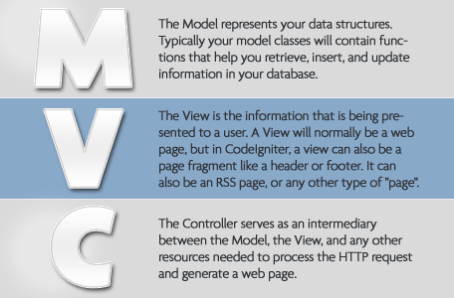
Model–View-Controller

Slide 4
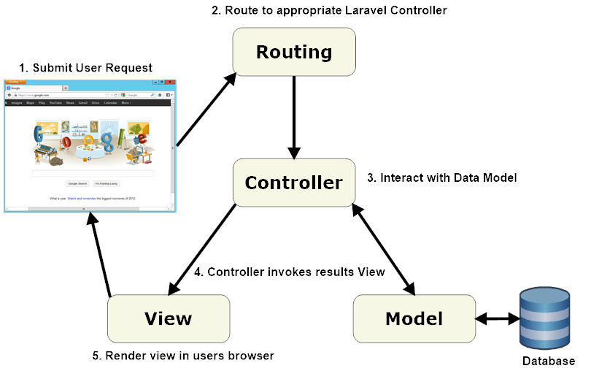
Workflow in MVC

Slide 5
Why MVC?
Separation of concern
Easy to maintain and extend
More Structural
More suitable for future Implementations
Large numbers of Frame work available (Angular, Backbone, ASP.net, Zend) which
help us to do more with minimum code.

Slide 6
Example
Pocker
Model
Raise, Quit
Application State, Behavior, Data Operation
View
Raise - > Some animation
Quit - > Some animation
Controller
Manage User input from View and pass it to Model. Model updates state of game, data on bases of logic and sent notification back to view directly or through Controller to update view.

Slide 7
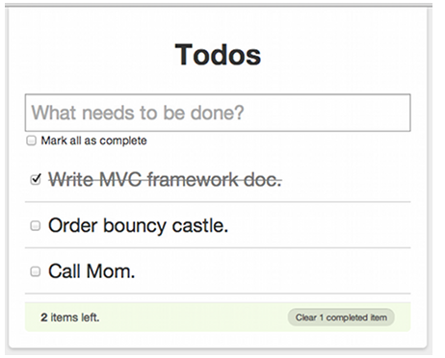
Identify Model, View and Controller in your application.

Slide 8
Some MVC Frameworks
Angular
Backbone
Sencha
Rails
Zend Framework
ASP.Net MVC framework

Slide 9
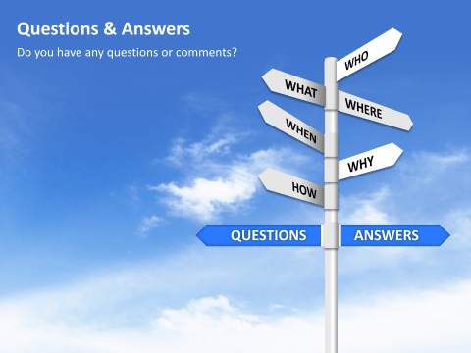
Questions & Answers?

