Slide 1
AngularJS
Authored & Presented by: Mariyam Khambhati

Slide 2
Agenda
SPA challenges
Anatomy of a basic Angular page
Scope, controller and data-binding
Data display and forms
DI, Modules, and Services
Filters

Slide 3
SPA
URL does not change
Content updated based on actions

Slide 4
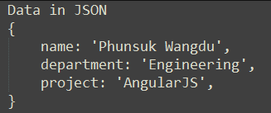
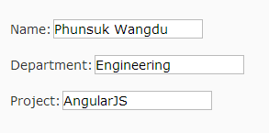
SPA
Server
Browser

Slide 5
SPA
Bring data from server
Generate/change UI content
Capture updates
Send data back to server
Handle navigations

Slide 6
SPA - problems
Too many aspects - large codebase
Boilerplate code
DOM generation/manipulation
Event handling & Navigation
Testing

Slide 7
Angular – Overcoming Challenges
Separation of concerns (MV*) – structure
Templating (expressions)
Two-way data-binding
Testability

Slide 8
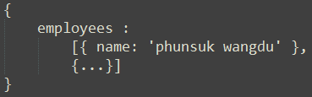
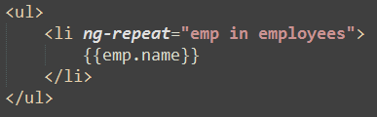
Client
Server
JSON
Memory - Model
employees = [
{ name: ‘phunsuk’}, …. ]
Template
DOM
<ul>
<li>phunsuk wangdu</li>
</ul>

Slide 9
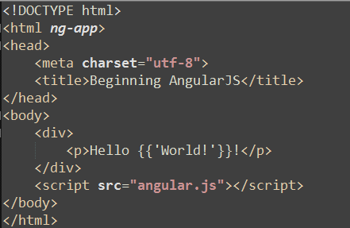
Anatomy

Slide 10
Anatomy – ngApp
Auto-bootstrap application
Indicates root of application
Only ONE allowed
Manual bootstrap for multiple
Nesting of angular apps not allowed
Notes:
compile the DOM treating the ng-app directive as the root of the compilation. This allows you to tell it to treat only a portion of the DOM as an Angular application.

Slide 11
Anatomy - Scope
rootScope, created by ng-app
Glue that connects model, controller & templates
Refers to the application model
Hierarchical structure mimicking DOM

Slide 12
Best Practices / Tips
Bind to object properties in scope rather than scope properties
{{something.name}} preferred to {{name}}

Slide 13
Controller
Code/logic for user interaction, manage model for the view
Tied to specific piece of the DOM that they’re in charge of managing
Used to:
Setup initial state of $scope
Expose model and functions to view through $scope
Watch model for changes and take action
Notes:
The controllers are classes or types you write to tell Angular which objects or primitives make up your model by assigning them to the $scope object passed into your controller:
Controllers have three responsibilities in your app:
• Set up the initial state in your application’s model
• Expose model and functions to the view (UI template) through $scope
• Watch other parts of the model for changes and take action
We’ve seen many examples of the first two in this chapter already. We’ll get to that last one in a bit. The conceptual purpose of controllers, however, is to provide the code or logic to execute the user’s wishes as they interact with the view.
To keep your controllers small and manageable, our recommendation is that you create one controller per functional area in your view.
but to be explicit, controllers are tied to a
specific piece of the DOM that they’re in charge of managing. The two main ways of associating a controller with a DOM node are specifying it in the template by declaring it in an ng-controller attribute, and associating it with a dynamically loadable DOM template fragment, called a view, through a route.
The $scope object passed to our controllers is the mechanism we use to expose model data to views.
You can think of scopes as a context that you use to make changes to your model observable.

Slide 14
Directives - Layout
Interpolation - {{ }}
ng-bind
ng-show/ng-hide, ng-if, ng-switch-*
ng-class, ng-class-even, ng-class-odd
ng-repeat
ng-src, ng-href
Notes:
Ng-repeat – neesd a container – limitation
If we want to physically remove or add DOM nodes conditionally the family of ng-switch directives (ng-switch, ng-switch-when, ng-switch-default) will come handy: < div ng-switch on =" showSecret" > < div ng-switch-when =" true" > Secret </ div > < div ng-switch-default > Won't show you my secrets! </ div > </ div >
The main difference between the ng-show/ ng-hide and the ng-switch directives is the way the DOM elements are treated. The ng-switch directive will add/ remove DOM elements from the DOM tree while the ng-show/ ng-hide will simply apply style =" display: none;" to hide elements. The ng-switch directive is creating a new scope. The ng-show/ ng-hide directives are easy to use but might have unpleasant performance consequences if applied to large number of DOM nodes. If you spot performance issues related to the size of DOM tree you should lean towards using more verbose ng-switch family of directives. The problem with the ng-switch family of directives is that the syntax can get quite verbose for simple use-case. Fortunately AngularJS has one more directive in its arsenal: ng-if. It behaves similarly to the ng-switch directive (in the sense that it adds / removes elements from the DOM tree) but has very simple syntax: < div ng-if =" showSecret" > Secret </ div >
Ng-class
Expression whose evalution can be any of
A string representing space-delimited class names
• An array of class names
• A map of class names to boolean values
When data binding to an <img> or <a> tag, the obvious path of using {{ }} in the src or
href attributes won’t work well. Because browsers are aggressive about loading images
parallel to other content, Angular doesn’t get a chance to intercept data binding requests.
While the obvious syntax for an <img> might be:
<img src="/images/cats/{{favoriteCat}}">
Instead, you should use the ng-src attribute and write your template as:
<img ng-src="/images/cats/{{favoriteCat}}">
Similarly, for the <a> tag, you should use ng-href:
<a ng-href="/shop/category={{numberOfBalloons}}">some text</a>

Slide 15
Directives - Events
ng-click, ng-dblclick
ng-change, ng-blur
ng-mousedown, ng-mouseup, ng-mouseenter, ng-mouseleave, ng-mousemove, ng-mouseover
ng-keydown, ng-keyup, ng-keypress
Notes:
AngularJS has the built-in support for the different events with the following directives: Click events: ngClick and ngDblClick Mouse events: ngMousedown, ngMouseup, ngMouseenter, ngMouseleave, ngMousemove and ngMouseover Keyboard events: ngKeydown, ngKeyup and ngKeypress Input change event (ngChange): The ngChange directive cooperates with the ngModel one, and let us to react on model changes initiated by user input. Mentioned DOM event handlers can accept a special argument $event in their expression, which represents the raw dom event

Slide 16
Directives - Forms
Input Directives:
Text input, checkbox, radio, select, URL, number, email
Validations:
ng-required, ng-min-length, ng-max-length, ng-pattern

Slide 17
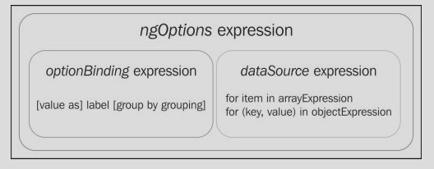
Directives – ngOptions
Select uses ng-options for option elements

Slide 18
Directives - Forms
$pristine
$valid
$invalid
$dirty
Notes:
Modules
While we’re discussing practices that will save you in the long run, in the previous
example, we’ve created TextController in the global scope. While this is fine for examples,-
the right way to define a controller is as part of something called a module, which provides a namespace for related parts of your application. The updated code
would look like the following:
Services
Services are singleton (single-instance) objects that carry out the tasks necessary to
support your application’s functionality. Angular comes with many services like $loca
tion, for interacting with the browser’s location, $route, for switching views based on
location (URL) changes, and $http, for communicating with servers.
You can, and should, create your own services to do all of the tasks unique to your
application. Services can be shared across any controllers that need them. As such,
they’re a good mechanism to use when you need to communicate across controllers and
share state. Angular’s bundled services start with a $, so while you can name them
anything you like, its a good idea to avoid starting them with $ to avoid naming collisions.

Slide 19
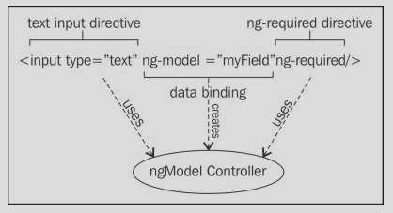
ng-model & ngModelController
Creates two-way binding between model and input field value
Notes:
Modules
While we’re discussing practices that will save you in the long run, in the previous
example, we’ve created TextController in the global scope. While this is fine for examples,-
the right way to define a controller is as part of something called a module, which provides a namespace for related parts of your application. The updated code
would look like the following:
Services
Services are singleton (single-instance) objects that carry out the tasks necessary to
support your application’s functionality. Angular comes with many services like $loca
tion, for interacting with the browser’s location, $route, for switching views based on
location (URL) changes, and $http, for communicating with servers.
You can, and should, create your own services to do all of the tasks unique to your
application. Services can be shared across any controllers that need them. As such,
they’re a good mechanism to use when you need to communicate across controllers and
share state. Angular’s bundled services start with a $, so while you can name them
anything you like, its a good idea to avoid starting them with $ to avoid naming collisions.

Slide 20
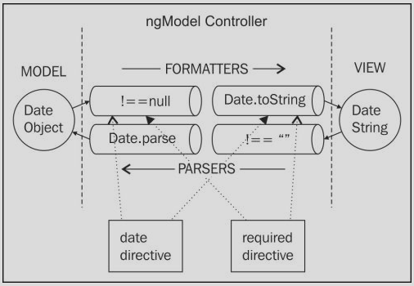
ng-model & ngModelController
Transformation pipeline
Notes:
Modules
While we’re discussing practices that will save you in the long run, in the previous
example, we’ve created TextController in the global scope. While this is fine for examples,-
the right way to define a controller is as part of something called a module, which provides a namespace for related parts of your application. The updated code
would look like the following:
Services
Services are singleton (single-instance) objects that carry out the tasks necessary to
support your application’s functionality. Angular comes with many services like $loca
tion, for interacting with the browser’s location, $route, for switching views based on
location (URL) changes, and $http, for communicating with servers.
You can, and should, create your own services to do all of the tasks unique to your
application. Services can be shared across any controllers that need them. As such,
they’re a good mechanism to use when you need to communicate across controllers and
share state. Angular’s bundled services start with a $, so while you can name them
anything you like, its a good idea to avoid starting them with $ to avoid naming collisions.

Slide 21
ng-model & ngModelController
Transformation pipeline
Track if value has changed
$pristine
$dirty
Track if value is valid
$valid
$invalid
Notes:
Directives on an input element can also tell the ngModelController whether they believe the value is valid or invalid. This is normally done by hooking into the transformation pipeline and checking the value rather than transforming it. The ngModelController tracks the validity and applies the ng-valid or ng-invalid CSS classes accordingly. We can provide further styles to change the appearance of the element based on these classes:

Slide 22
ngFormController
Created by form or ng-form
ngModelController registers itself with first parent in the upwards hierarchy
HTML | Scope | Controller
<form name=“form1”> | form1 : { $valid, $invalid, $pristine, $dirty, … } | ngFormController
<input name=“field1” ng-model=“model1” /> | field1: { $valid, $invalid, $pristine, $dirty, … } | ngModelController
Notes:
Directives on an input element can also tell the ngModelController whether they believe the value is valid or invalid. This is normally done by hooking into the transformation pipeline and checking the value rather than transforming it. The ngModelController tracks the validity and applies the ng-valid or ng-invalid CSS classes accordingly. We can provide further styles to change the appearance of the element based on these classes:

Slide 23
ngFormController
Nested forms
Notes:
Directives on an input element can also tell the ngModelController whether they believe the value is valid or invalid. This is normally done by hooking into the transformation pipeline and checking the value rather than transforming it. The ngModelController tracks the validity and applies the ng-valid or ng-invalid CSS classes accordingly. We can provide further styles to change the appearance of the element based on these classes:

Slide 24
Best Practices / Tips
Do not manipulate DOM elements in controllers.

Slide 25
Modules
Namespace / container for related Angular managed objects (controllers, services, etc.)
Group & resolve dependencies
ng-app=“module name”
Configuration and Post-instantiation one-time logic
Notes:
Modules
While we’re discussing practices that will save you in the long run, in the previous
example, we’ve created TextController in the global scope. While this is fine for examples,-
the right way to define a controller is as part of something called a module, which provides a namespace for related parts of your application. The updated code
would look like the following:
Services
Services are singleton (single-instance) objects that carry out the tasks necessary to
support your application’s functionality. Angular comes with many services like $loca
tion, for interacting with the browser’s location, $route, for switching views based on
location (URL) changes, and $http, for communicating with servers.
You can, and should, create your own services to do all of the tasks unique to your
application. Services can be shared across any controllers that need them. As such,
they’re a good mechanism to use when you need to communicate across controllers and
share state. Angular’s bundled services start with a $, so while you can name them
anything you like, its a good idea to avoid starting them with $ to avoid naming collisions.

Slide 26
Best Practices / Tips
Do not use globally defined controller functions in larger, real life apps

Slide 27
Dependency Injection
"To function correctly I need a dependency:
I don't know from where it should be coming or how it should be created;
I just know that I need one, so please provide it!”
Notes:
DI:
The $scope object that does our data binding is passed to us automatically; we didn’t have to create it by calling any function. We just asked for it by putting it in HelloController’s constructor. As we’ll find out in later chapters, $scope isn’t the only thing we can ask for.
If we want to data bind to the location URL in the user’s browser, we can ask for an object that manages this by putting $location in our constructor, like so:
function HelloController($scope, $location) {
$scope.greeting = { text: 'Hello' };
// use $location for something good here...
}
We get this magical effect through Angular’s dependency injection system. Dependency injection lets us follow a development style in which, instead of creating dependencies, our classes just ask for what they need.
This follows a design pattern called the Law of Demeter, also known as the principle of least knowledge. Since our HelloController’s job is to set up the initial state for the greeting model, this pattern would say that it shouldn’t worry about anything else, like how $scope gets created, or where to find it.
This feature isn’t just for objects created by the Angular framework.

Slide 28
Dependency Injection
Declarative specification of dependency by an object.
Understands a dependency specification
Find the needed collaborator/dependency
Wire up objects together
Notes:
DI:
The $scope object that does our data binding is passed to us automatically; we didn’t have to create it by calling any function. We just asked for it by putting it in HelloController’s constructor. As we’ll find out in later chapters, $scope isn’t the only thing we can ask for.
If we want to data bind to the location URL in the user’s browser, we can ask for an object that manages this by putting $location in our constructor, like so:
function HelloController($scope, $location) {
$scope.greeting = { text: 'Hello' };
// use $location for something good here...
}
We get this magical effect through Angular’s dependency injection system. Dependency injection lets us follow a development style in which, instead of creating dependencies, our classes just ask for what they need.
This follows a design pattern called the Law of Demeter, also known as the principle of least knowledge. Since our HelloController’s job is to set up the initial state for the greeting model, this pattern would say that it shouldn’t worry about anything else, like how $scope gets created, or where to find it.
This feature isn’t just for objects created by the Angular framework.

Slide 29
Services
Singleton created and managed by DI
Lazily instantiated – only when a component depends on it
Built-in services - $http, $resource, etc.
Register the recipe for construction
Service
Factory
Provider
Notes:
DI:
The $scope object that does our data binding is passed to us automatically; we didn’t have to create it by calling any function. We just asked for it by putting it in HelloController’s constructor. As we’ll find out in later chapters, $scope isn’t the only thing we can ask for.
If we want to data bind to the location URL in the user’s browser, we can ask for an object that manages this by putting $location in our constructor, like so:
function HelloController($scope, $location) {
$scope.greeting = { text: 'Hello' };
// use $location for something good here...
}
We get this magical effect through Angular’s dependency injection system. Dependency injection lets us follow a development style in which, instead of creating dependencies, our classes just ask for what they need.
This follows a design pattern called the Law of Demeter, also known as the principle of least knowledge. Since our HelloController’s job is to set up the initial state for the greeting model, this pattern would say that it shouldn’t worry about anything else, like how $scope gets created, or where to find it.
This feature isn’t just for objects created by the Angular framework.

Slide 30
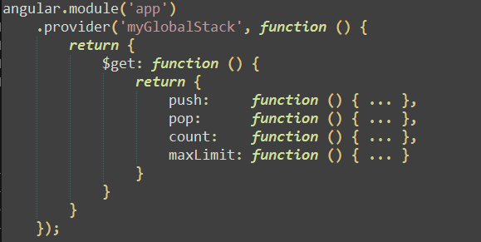
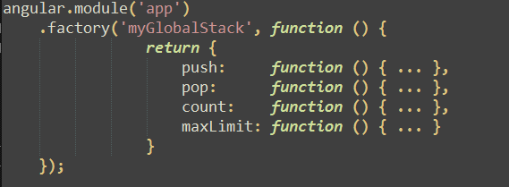
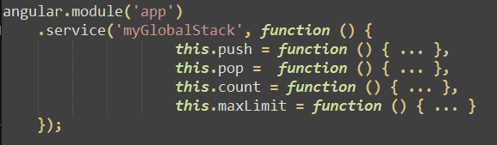
myGlobalStack
push()
pop()
count()
maxLimit()
Notes:
DI:
The $scope object that does our data binding is passed to us automatically; we didn’t have to create it by calling any function. We just asked for it by putting it in HelloController’s constructor. As we’ll find out in later chapters, $scope isn’t the only thing we can ask for.
If we want to data bind to the location URL in the user’s browser, we can ask for an object that manages this by putting $location in our constructor, like so:
function HelloController($scope, $location) {
$scope.greeting = { text: 'Hello' };
// use $location for something good here...
}
We get this magical effect through Angular’s dependency injection system. Dependency injection lets us follow a development style in which, instead of creating dependencies, our classes just ask for what they need.
This follows a design pattern called the Law of Demeter, also known as the principle of least knowledge. Since our HelloController’s job is to set up the initial state for the greeting model, this pattern would say that it shouldn’t worry about anything else, like how $scope gets created, or where to find it.
This feature isn’t just for objects created by the Angular framework.

Slide 31

Services - $provide
is the same as…
Notes:
DI:
The $scope object that does our data binding is passed to us automatically; we didn’t have to create it by calling any function. We just asked for it by putting it in HelloController’s constructor. As we’ll find out in later chapters, $scope isn’t the only thing we can ask for.
If we want to data bind to the location URL in the user’s browser, we can ask for an object that manages this by putting $location in our constructor, like so:
function HelloController($scope, $location) {
$scope.greeting = { text: 'Hello' };
// use $location for something good here...
}
We get this magical effect through Angular’s dependency injection system. Dependency injection lets us follow a development style in which, instead of creating dependencies, our classes just ask for what they need.
This follows a design pattern called the Law of Demeter, also known as the principle of least knowledge. Since our HelloController’s job is to set up the initial state for the greeting model, this pattern would say that it shouldn’t worry about anything else, like how $scope gets created, or where to find it.
This feature isn’t just for objects created by the Angular framework.

Slide 32
Module Loading
Configuration blocks
Recipes are collected and configured
Providers can be injected
.config() method
Run blocks
Post instantiation logic
Instances can be injected
.run() method
Notes:
Module Loading & Dependencies
A module is a collection of configuration and run blocks which get applied to the application during the bootstrap process. In its simplest form the module consist of collection of two kinds of blocks:
Configuration blocks - get executed during the provider registrations and configuration phase. Only providers and constants can be injected into configuration blocks. This is to prevent accidental instantiation of services before they have been fully configured.
Run blocks - get executed after the injector is created and are used to kickstart the application. Only instances and constants can be injected into run blocks. This is to prevent further system configuration during application run time.

Slide 33
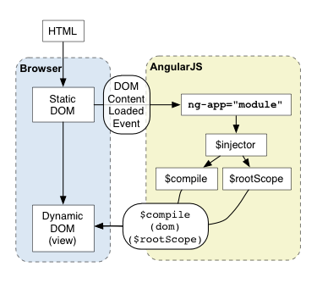
Module lifecycle

Slide 34
Filters
Formatting & model transformation
Globally available named functions -
| - identify & invoking and pipelining
: - parameters

Slide 35
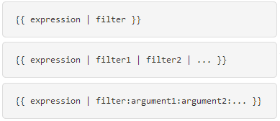
Filters
student.birthdate | date:’yyyy-MM-dd’
user.about | limitTo:100 | lowercase

Slide 36
Built-in filters
Formatting
currency
date
number
lowercase
uppercase
json
Array-transforming
limitTo
filter
orderBy

Slide 37
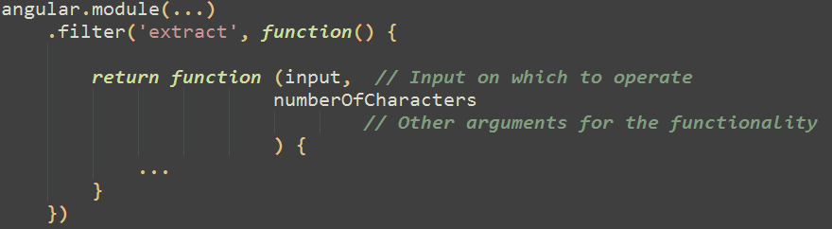
Filters

Slide 38
Filters
Use / Dependency in code
$filter service - $filter(‘limitTo’)
filter name with Filter suffix – function (limitToFilter)

Slide 39
Routing
Hashbang URL’s
http://myhost.com/#!admin/users/list
http://myhost.com/#!admin/users/new
http://myhost.com/#!admin/users/[userId]
http://myhost.com/#!admin/users/list#bottom
HTML5 History API
http://myhost.com/admin/users/list
http://myhost.com/admin/users/new
http://myhost.com/admin/users/[userId]
http://myhost.com/admin/users/list#bottom
Notes:
We’ve made a tradeoff, however, in making twitter.com into an application using the hash, which is that it now cannot be both an app and a site at the same time. This capability might not sound compelling, but it is. For instance, browsers without JavaScript cannot access content that has been shared using the URL hash, since that is a marker to the JS app, not to a Web page. In a perfect world, we would have been able to use the original URL structure with the hashes for our application, and served both the site and the app simultaneously. This would be the absolute best thing for users of all kinds, and this debate would not be happening.
There is hope on the horizon, in the form of the HTML5 History API. This new browser feature will allow developers to change the entire URL path and query string without incurring a page refresh. By using this, we could drop the hash, and get all the benefits of traditional Web sites with all the benefits of a desktop-class application. Support for this has been in Chrome and Safari for some time (albeit with a bug we found (now fixed)), and will arrive in Firefox 4. Internet Explorer currently has no plans to implement this in IE9, which is a shame. Had it not been for the bug we found, we would have shipped #newtwitter with HTML5 History on day one (and in fact, the integration is already built).
Hashbangs reduce two of the most fundamental usability issues with web interfaces: responsiveness and context. The web is made of links, and every link we click causes a full page refresh. We have to wait for that page to refresh (the responsiveness problem) and while we wait, we have a visual gap between the previous page and the next page (the context problem). Interfaces in our native applications don't generally have these problems. They can smoothly and quickly transition between contexts in ways that don't require users to re-orient themselves
happy HTML5 has already solved it for us. <a href="http://badassjs.com/post/840846392/location-hash-is-dead-long-live-html5-pushstate">window.history.pushState()</a> allows sites to change the URL in a browser without a page refresh. Because pushState is using standard URLs, this giv

Slide 40
Routing - $location
$location
API abstracting URL behaviors
$anchorScroll
Monitors hash fragments and navigate within document
Notes:
We’ve made a tradeoff, however, in making twitter.com into an application using the hash, which is that it now cannot be both an app and a site at the same time. This capability might not sound compelling, but it is. For instance, browsers without JavaScript cannot access content that has been shared using the URL hash, since that is a marker to the JS app, not to a Web page. In a perfect world, we would have been able to use the original URL structure with the hashes for our application, and served both the site and the app simultaneously. This would be the absolute best thing for users of all kinds, and this debate would not be happening.
There is hope on the horizon, in the form of the HTML5 History API. This new browser feature will allow developers to change the entire URL path and query string without incurring a page refresh. By using this, we could drop the hash, and get all the benefits of traditional Web sites with all the benefits of a desktop-class application. Support for this has been in Chrome and Safari for some time (albeit with a bug we found (now fixed)), and will arrive in Firefox 4. Internet Explorer currently has no plans to implement this in IE9, which is a shame. Had it not been for the bug we found, we would have shipped #newtwitter with HTML5 History on day one (and in fact, the integration is already built).
Hashbangs reduce two of the most fundamental usability issues with web interfaces: responsiveness and context. The web is made of links, and every link we click causes a full page refresh. We have to wait for that page to refresh (the responsiveness problem) and while we wait, we have a visual gap between the previous page and the next page (the context problem). Interfaces in our native applications don't generally have these problems. They can smoothly and quickly transition between contexts in ways that don't require users to re-orient themselves
happy HTML5 has already solved it for us. <a href="http://badassjs.com/post/840846392/location-hash-is-dead-long-live-html5-pushstate">window.history.pushState()</a> allows sites to change the URL in a browser without a page refresh. Because pushState is using standard URLs, this giv

Slide 41
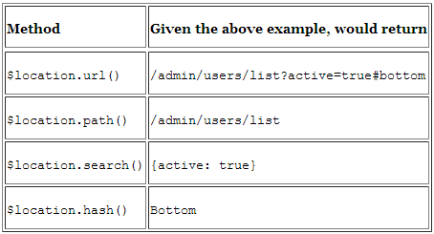
Routing - $location
Hashbang - http://myhost.com/admin/users/list?active=true#bottom
HTML5 - http://myhost.com/#/admin/users/list?active=true#bottom
Notes:
We’ve made a tradeoff, however, in making twitter.com into an application using the hash, which is that it now cannot be both an app and a site at the same time. This capability might not sound compelling, but it is. For instance, browsers without JavaScript cannot access content that has been shared using the URL hash, since that is a marker to the JS app, not to a Web page. In a perfect world, we would have been able to use the original URL structure with the hashes for our application, and served both the site and the app simultaneously. This would be the absolute best thing for users of all kinds, and this debate would not be happening.
There is hope on the horizon, in the form of the HTML5 History API. This new browser feature will allow developers to change the entire URL path and query string without incurring a page refresh. By using this, we could drop the hash, and get all the benefits of traditional Web sites with all the benefits of a desktop-class application. Support for this has been in Chrome and Safari for some time (albeit with a bug we found (now fixed)), and will arrive in Firefox 4. Internet Explorer currently has no plans to implement this in IE9, which is a shame. Had it not been for the bug we found, we would have shipped #newtwitter with HTML5 History on day one (and in fact, the integration is already built).
Hashbangs reduce two of the most fundamental usability issues with web interfaces: responsiveness and context. The web is made of links, and every link we click causes a full page refresh. We have to wait for that page to refresh (the responsiveness problem) and while we wait, we have a visual gap between the previous page and the next page (the context problem). Interfaces in our native applications don't generally have these problems. They can smoothly and quickly transition between contexts in ways that don't require users to re-orient themselves
happy HTML5 has already solved it for us. <a href="http://badassjs.com/post/840846392/location-hash-is-dead-long-live-html5-pushstate">window.history.pushState()</a> allows sites to change the URL in a browser without a page refresh. Because pushState is using standard URLs, this giv

Slide 42

Routing - $location
Angular default configuration is hashbang URL

Slide 43
Routing
Define routes in a consistent, maintainable manner
Synchronize application’s state (model and screen) in response to URL changes”

Slide 44
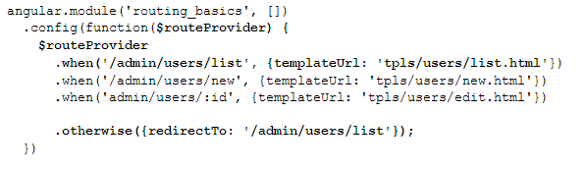
Routing - $route Service
Configure routes
Define UI partial area to update – ngView
<div ng-view>…</div>

Slide 45
Routing - $routeParams Service
$routeParams
Access route parameter values
Example: access $routeParams.userid -
Route /admin/users/:userid
Route /admin/users/edit, with URL /admin/users/edit?userid=1234

Slide 46
Routing - $route Service
Specify controllers in route definition
controller: ‘’

Slide 47
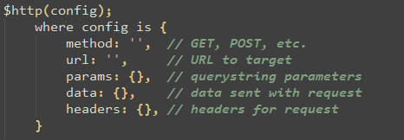
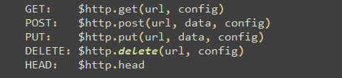
Communication with server - $http
$http service usage
Shortcut methods

Slide 48
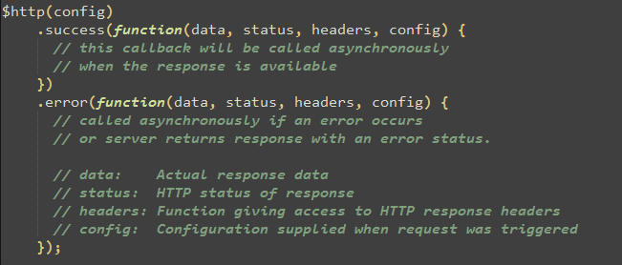
Communication with server - $http

Slide 49
Promises
$q.defer()
resolve()
reject()
promise
promise
then(success, error)
Notes:
$ q.defer() method which returns a deferred object. Conceptually it represents a task that will be completed (or will fail in the future). The deferred object has two roles: It holds a promise object (in the promise property). Promises are placeholders for the future results (success or failure) of a deferred task. It exposes methods to trigger future task completion (resolve) or failure (reject). There are always two players in the Promise API: one that controls future task execution (can invoke methods on the deferred object) and another one that depends on the results of the future task execution (holds onto promised results). Note The deferred object represents a task that will complete or fail in the future. A promise object is a placeholder for the future results of this task completion.
In the synchronous world chaining function calls (invoking a function with a result of another function) and handling exceptions (with try/ catch) is straightforward. In the asynchronous world, we can't simply chain function calls; we need to rely on callbacks. Callbacks are fine when dealing with just one asynchronous event, but things start to get complicated as soon as we need to coordinate multiple asynchronous events. Exceptional situation handling is particularly tough in this case. To make asynchronous programming easier the Promise API was recently adopted by several popular JavaScript libraries. The concepts behind the Promise API are not new, and were proposed in the late seventies, but only recently those concepts made it into the mainstream JavaScript programming.

Slide 50
Security
Same origin policy for AJAX requests
Alternatives
JSONP
CORS

Slide 51
$resource
Rest services
Advanced $http – interceptors

Slide 52
Directives
Directives – declarative expression of what is needed
Notes:
Data-binding:
DI:
The $scope object that does our data binding is passed to us automatically; we didn’t have to create it by calling any function. We just asked for it by putting it in HelloController’s constructor. As we’ll find out in later chapters, $scope isn’t the only thing we can ask for.
If we want to data bind to the location URL in the user’s browser, we can ask for an object that manages this by putting $location in our constructor, like so:
function HelloController($scope, $location) {
$scope.greeting = { text: 'Hello' };
// use $location for something good here...
}
We get this magical effect through Angular’s dependency injection system. Dependency injection lets us follow a development style in which, instead of creating dependencies, our classes just ask for what they need.
This follows a design pattern called the Law of Demeter, also known as the principle of least knowledge. Since our HelloController’s job is to set up the initial state for the greeting model, this pattern would say that it shouldn’t worry about anything else, like how $scope gets created, or where to find it.
This feature isn’t just for objects created by the Angular framework.
Directives
One of the best parts of Angular is that you can write your templates as HTML. You can do this because at the core of the framework we’ve included a powerful DOM transformation engine that lets you extend HTML’s syntax.
We’ve already seen several new attributes in our templates that aren’t part of the HTML specification. Examples include the double-curly notation for data binding, ngcontroller for specifying which controller oversees which part of the view, and ngmodel, which binds an input to part of the model. We call these HTML extension directives.
Angular comes with many directives that help you define the view for your app. These directives can define what we commonly view as the template. They can declaratively set up how your application works or be used to create reusable components.
And you’re not limited to the directives that Angular comes with. You can write your own to extend HTML’s template abilities to do anything you can dream of.

Slide 53
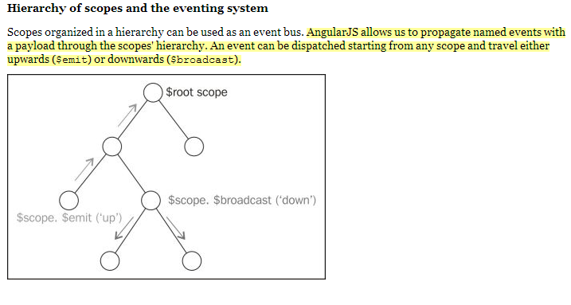

Slide 54
What more
Angular with requireJS
Grunt, karma, etc?
Injector
Bootstrapping explained, with manual bootstrap, multiple modules (https://code.angularjs.org/1.2.18/docs/guide/bootstrap)

Slide 55
Any Questions?
Notes:
Use controllers to:
Set up the initial state of the $scope object.
Add behavior to the $scope object.

Slide 56
Thank you!
Notes:
$watch; $apply;
Emit, broadcast
Angu;ar with requireJS

