Slide 1
AN INTRO TO CSS REPROCESSING
Authored by : Mrugesh Presented by : Harshal Sawant

Slide 2
Document History
Version No. | Authored/Modified by | Remark/Change History | Date <dd- mon-yy >
1.0 | Harshal Sawant | - | 09-05-14

Slide 3
Learning Objectives
Understanding CSS preprocessing

Slide 4
Course Structure
Target audience
Level
Pre-requisites | Basic Knowledge of HTML, CSS and Javascript
Training methods
Evaluation

Slide 5
Agenda
    What is CSS preprocessing
    Tools
    SCSS
      Installation
      Use

Slide 6
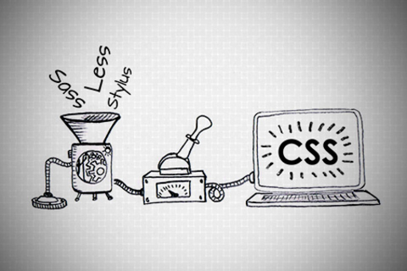
AN INTRO TO CSS PREPROCESSING

Slide 7
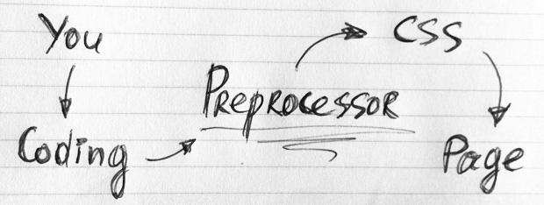
What is CSS Preprocessor
Primarily intended to make authoring CSS more dynamic, organized and productive

Slide 8
WHY WHY WHY??
First, they don’t break browser compatibility
Another advantage is preprocessors make our CSS DRY

Slide 9
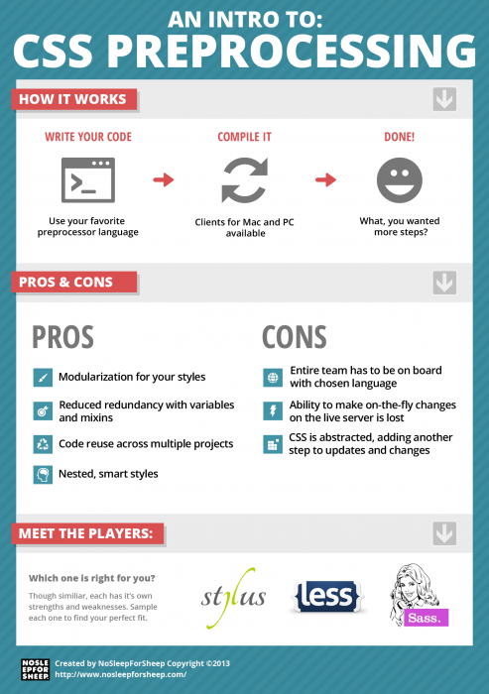

Slide 10

There are a number of CSS Preprocessor.
The question is, which of them does the job best?

Slide 11
Installation
Sass is running on Ruby while LESS is a JavaScript library (which it was actually also built on Ruby at first).
Sass: Sass needs Ruby in order to work
LESS: LESS is built upon JavaScript, so intalling LESS is as easy as linking JavaScript library to your HTML document.
Score so far: Sass (0) – LESS (1)

Slide 12
Extensions
Sass - Compass the current and popular Sass-based extension. Compass has a number of Mixins to write CSS3 syntax in less time.
Compass is beyond just CSS3 Mixins, it has added other very useful features such as Helpers, Layout, Typography, Grid Layout and even Sprite Images.
Compass is an all-in-one package to do web development with Sass
LESS: LESS also has several extensions, but unlike Compass that has all we need in one place
need to take some time to choose the right extensions that suit workflow
  CSS3 Mixins: LESS Elements, Preboot, LESS Mixins.
  Grid: 960.gs, Frameless, Semantic.gs
  Layout: Even.less
  Misc: Twitter Bootstrap
Score so far: Sass (1) – LESS (1)

Slide 13
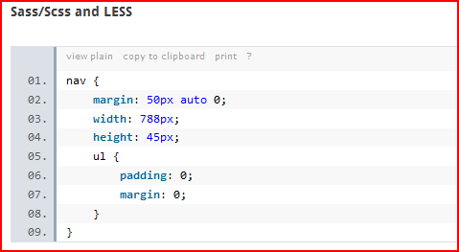
Nesting
But Sass/Scss takes this method a step further by allowing us to also nest individual properties
Score so far: Sass (2) – LESS (1)

Slide 14
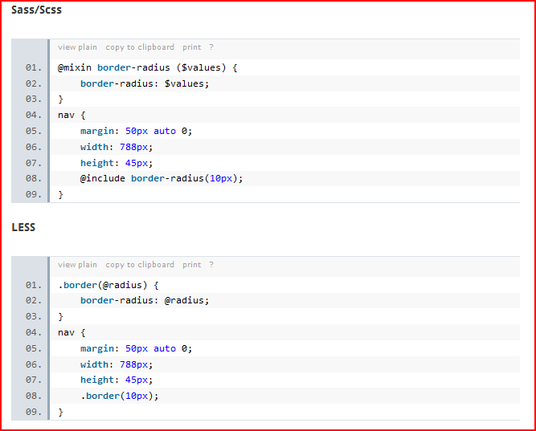
Mixins and Selector Inheritance

Slide 15
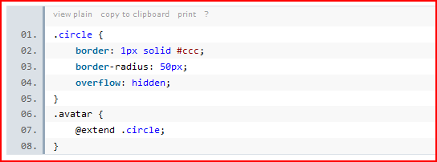
In Sass, this method is taken further with Selector Inheritance
Score so far: Sass (3) – LESS (1)

Slide 16
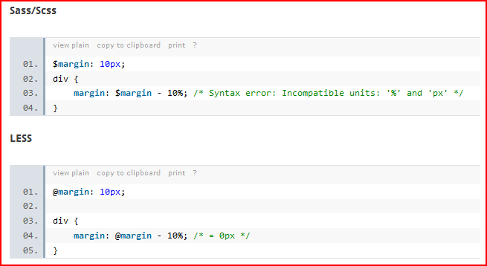
Operations
% and px is not equivalent, it should return an error
Score so far: Sass (4) – LESS (1)

Slide 17
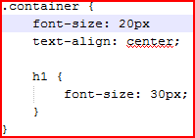

Error Notifications
SASS: In this case we will remove one semicolon on line 2, and this should turn to an error.
LESS: With the same error scenario, LESS notification is more well-presented and it also appears to be more accurate
Score: Sass (4) – LESS (2)

Slide 18
Documentation
The LESS documentation presentation is better, although Sass has more comprehensive documentation, so I think we can call this one a tie.
Score so far: Sass (5) – LESS (3).

Slide 19
Final Thought
Sass is better with a total score of 5 versus 3 for LESS; However, it doesn’t mean that LESS is bad.
Be it Sass or LESS, as long as they are comfortable and more productive, then that is the winner in their list

Slide 20
SCSS
Sass stands for Syntactically Awesome Stylesheets.
SASS & SCSS - two ways of writing the code which produce the same output.
SASS provides some new functionality: variables, nesting, mixins as well as a number of convienience features.
It's worth pointing out that though SASS is written in ruby, ruby doesn't need to be running on your server, only on your local machine

Slide 21
Installation
Install Ruby
  Set Environment Variables ( Only for windows OS user )
  In the System variables section, press New. For variable name enter RYBUOPT and for variable value rubygems
gem install sass
gem install compass
Create config.rb file in root directory
To check if SASS and Compass are working, type in
sass –v
compass –v
compass watch

Slide 22

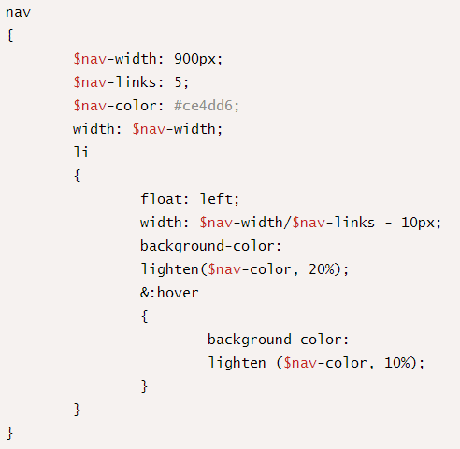
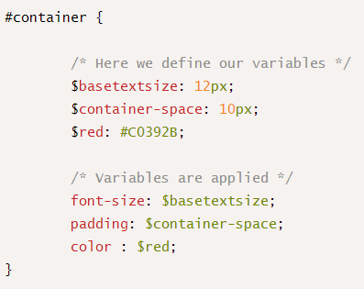

Slide 23
Compass
Compass is a Sass framework
Compass is a collection of helpful tools and battle-tested best practices for Sass.
@import 'compass/css3';
.shadow {
@include box-shadow(#000 5px 5px 5px);
}

Slide 24
Grunt
Grunt is a task runner that can dramatically improve your front-end development workflow
With the use of a number of grunt plugins you can automate tasks such as compiling Sass, optimizing images and validating your JavaScript code with JSHint.

Slide 25
Installing the Grunt Command Line Interface
This is responsible for locating the grunt library in your project and loading the Gruntfile.js configuration
Install Node.js package manager
Once you have Node.js and npm installed you
can install the grunt-cli package.
npm install -g grunt-cli
-g flag will install grunt-cli globally

Slide 26
Creating a package.json File
Use to manage the dependencies for your project
The package.json file should be placed in the root of your project
{
"name": "project-name",
"version": "0.1.0",
"author": "Your Name",
"devDependencies": {
"grunt": "~0.4.1",
"grunt-contrib-jshint": "~0.6.3",
"grunt-contrib-watch": "~0.5.3",
"grunt-contrib-compass": "~0.6.0"
}
}

Slide 27
Once you have created your package.json file you can install all of the dependencies you specified using a single command:
npm install
npm install <module> --save-dev
Using the --save-dev flag will cause npm to automatically add this package to the dependencies in your package.json file

Slide 28
Defining Tasks in the Gruntfile
Next you need to create a file called Gruntfile.js
THE WRAPPER FUNCTION
All of code for your Gruntfile must be placed within the ‘wrapper’ function. This convention is needed so that Grunt can understand the file.
module.exports = function(grunt) {
// Configuration, Tasks and Plugins.
};

Slide 29
CONFIGURING TASKS
grunt-contrib-watch
watch: {
css: {
files: [
'**/*.sass',
'**/*.scss'
],
tasks: ['compass']
},
js: {
files: [
'assets/js/*.js',
'Gruntfile.js' ],
tasks: ['jshint']
}
},
grunt-contrib-compass
compass: {
dist: {
options: {
sassDir: 'assets/sass',
cssDir: 'assets/css',
outputStyle: 'compressed'
}
}
},

Slide 30
REGISTERING THE DEFAULT TASKS
The grunt.registerTask method is used specify a default set of tasks that should run when the grunt command is executed.
// Register the default tasks.
grunt.registerTask('default', ['watch']);

Slide 31
Bibliography, Important Links
http://www.webdesignerdepot.com/2013/11/the-beginners-guide-to-sass/
http://www.gayadesign.com/diy/how-to-start-using-sass-and-compass-in-10-minutes/
http://blog.teamtreehouse.com/getting-started-with-grunt

Slide 32
Any Questions?

Slide 33
Thank you!

