Slide 1
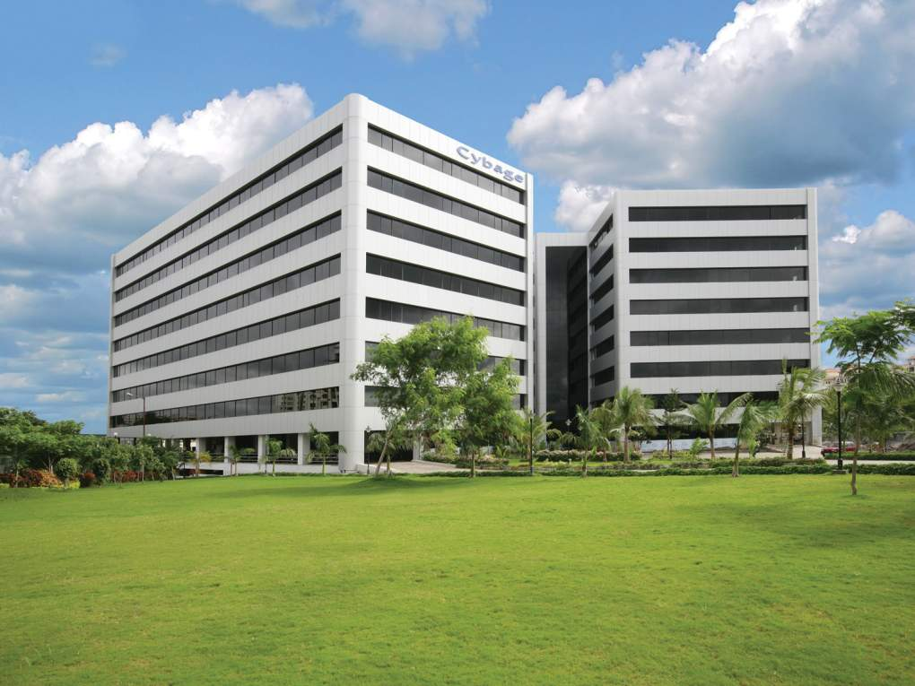

Welcome to Cybage
This document and all its contents contain information from Cybage Software Private Limited which may be privileged, confidential, or otherwise protected from disclosure. The information is intended to be for the addressee(s) only. Any unauthorized disclosure, copy, distribution, or use of the contents of this message is strictly prohibited.

Slide 2
RESPONSIVE WEB DESIGN
KRUNAL VACHHETA

Slide 3
Course Structure
Target audience | Fresher's
Level | Beginner
Pre-requisites | HTML, CSS
Training methods
Evaluation

Slide 4

FRONT END TECHNOLOGY
RESPONSIVE WEB DESIGN

Slide 5
INDEX
Responsive Web Design
Predate Methodology
Layouts
Progressive Enhancement
Graceful Degradation
Mobile First Approach
Media Queries
Grid View & Frameworks
Images
Videos

Slide 6
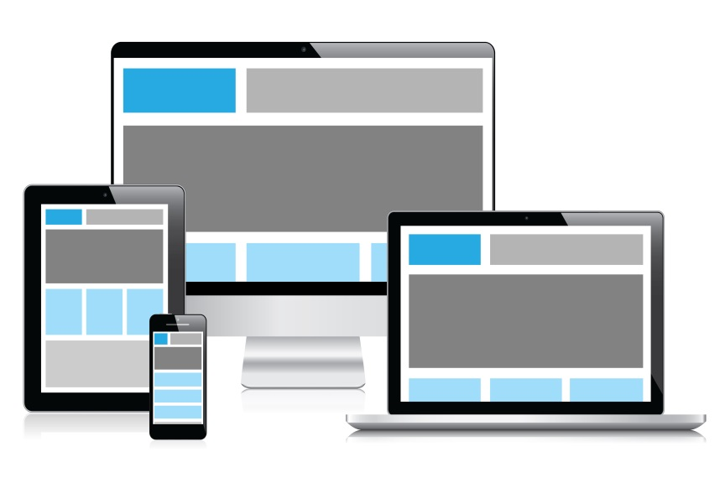
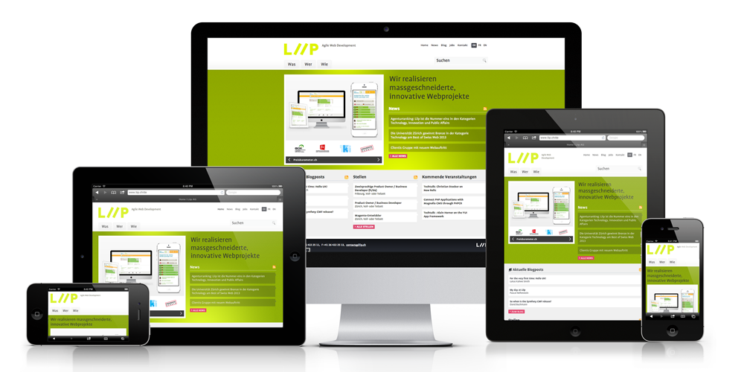
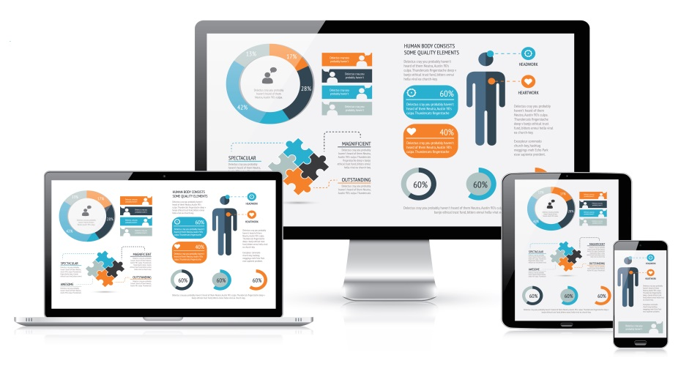
RWD What is it ?

Slide 7
RWD
Responsive Web Design is the methodology that recommends the design and implementation of a website that responds to user behavior and environment based on the screen size, orientation and operating system of their device.
From a technology standpoint, the framework consists of a combination of flexible grids, flexible layouts, images and intelligent use of CSS media queries.
As the user switches from one device to another (for example, desktop to iPhone), the website automatically adapts to accommodate for resolution, image size and scripting abilities. This eliminates the need for resizing, panning and scrolling by the user in order to view the website on the new device.

Slide 8
Pros and Cons
Pros :
A single website
A single URL
Easy SEO
Easy marketing
Low cost
Future proofing
Better, faster, smarter user experience
Cost Effective
SEO optimized

Slide 9
Pros and Cons
Cons:
A single website
User Experience
Technical Difficulty
Performance
Implementation
Limited Resources

Slide 10
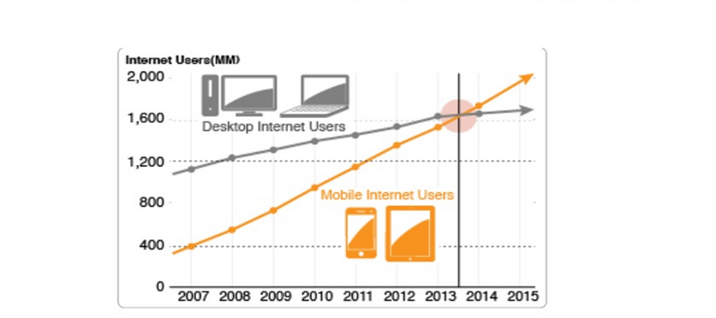
Why RWD

Slide 11
Mobile Website
A mobile website is similar to a regular website and can be accessed with the help of different browsers, the only difference being it is created for small-screen devices.
Mobile sites are optimized for on-the-go users, contain limited (or rather, necessary) content and are lighter and faster than responsive websites.
m.yahoo.com For example, is nearly 3 times lighter (Webpage Size Checker) and 4 times faster (GoMoMeter) than bostonglobe.com.
http://developers.google.com/speed/pagespeed/insights/

Slide 12
Predate Methodology
Layouts
Progressive Enhancement
Graceful Degradation
Mobile First Approach

Slide 13
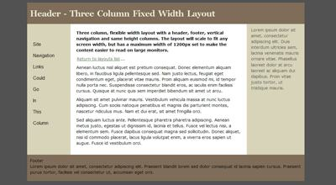
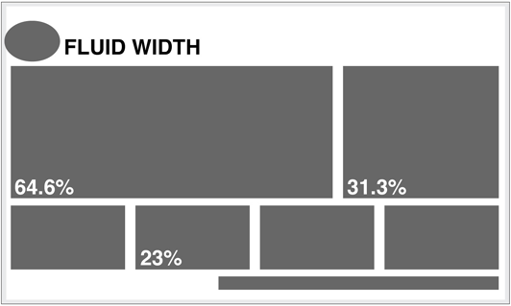

Types of Layout
Fixed
Fluid/Liquid
Elastic
Hybrid

Slide 14
Progressive Enhancement
The three layers of Progressive Enhancement:
Content layer = rich semantic HTML markup
Presentation layer = CSS and styling
Client-side scripting layer = JavaScript or jQuery behaviors

Slide 15
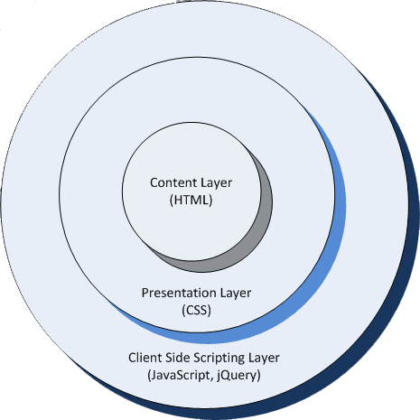
Layers of Progressive Enhancement
Benefits of progressive enhancement:
Improved accessibility
Expand transferability
Performance boost
Ease of modular web design

Slide 16
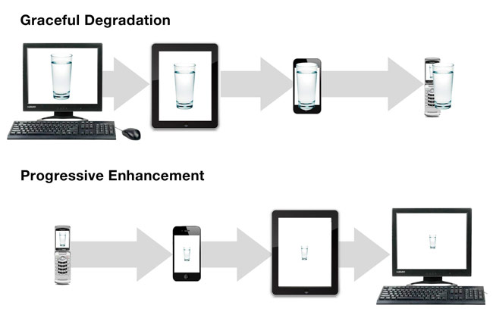
Graceful Degradation
Is the practice of building your web functionality so that it provides a certain level of user experience in more modern browsers, but it will also degrade gracefully to a lower level of user in experience in older browsers.
This lower level is not as nice to use for your site visitors, but it does still provide them with the basic functionality that they came to your site to use; things do not break for them.

Slide 17
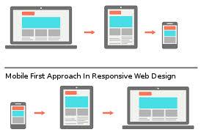
Mobile First Approach
It can be challenging to clone a multi-column layout into smaller screen space, instead it’s much better to start simple & then work upwards to more complex designs.
Here comes the Mobile First approach wherein the idea of designing the Smartphone experience comes first & then developing the design for tablets, desktops & possibly beyond.

Slide 18
What is The Viewport?
The viewport is the user's visible area of a web page.
The viewport varies with the device, and will be smaller on a mobile phone than on a computer screen.
HTML5 introduced a method to let web designers take control over the viewport, through the <meta> tag.
You should include the following <meta> tag in all your web pages:
<meta name="viewport" content="width=device-width, initial-scale=1.0">
The width=device-width- sets the width of the page to follow the screen-width of the device (which will vary depending on the device).
The initial-scale=1.0 - sets the initial zoom level when the page is first loaded by the browser.
Example:

Slide 19
CSS3 box-sizing
Without the CSS3 box-sizing Property
By default, the width and height of an element is calculated like this:
width + padding + border = actual width of an element height + padding + border = actual height of an element
This means: When you set the width/height of an element, the element often appear bigger than you have set (because the element's border and padding are added to the element's specified width/height).
Example One:
So, for a long time web developers have specified a smaller width value than they wanted, because they had to subtract out the padding and borders.
With CSS3, the box-sizing property solves this problem.
Example Two:
The CSS3 box-sizing property allows us to include the padding and border in an element's total width and height.
If you set box-sizing: border-box; on an element padding and border are included in the width and height:

Slide 20
CSS3 box-sizing
Since the result of using the box-sizing: border-box; is so much better, many developers want all elements on their pages to work this way.
The code below ensures that all elements are sized in this more intuitive way. Many browsers already use box-sizing: border-box; for many form elements (but not all - which is why inputs and textareas look different at width: 100%;).

Slide 21
Responsive Web Design - Grid-View
Many web pages are based on a grid-view, which means that the page is divided into columns:
A responsive grid-view often has 12 columns, and has a total width of 100%, and will shrink and expand as you resize the browser window.
Building a Responsive Grid-View
Lets start building a responsive grid-view.
First ensure that all HTML elements have the box-sizing property set to border-box. This makes sure that the padding and border are included in the total width and height of the elements.
Add the following code in your CSS:
* { box-sizing: border-box; }

Slide 22
Building a Responsive Grid-View
However, we want to use a responsive grid-view with 12 columns, to have more control over the web page.
First we must calculate the percentage for one column: 100% / 12 columns = 8.33%.
Then we make one class for each of the 12 columns, class="col-" and a number defining how many columns the section should span:
All these columns should be floating to the left, and have a padding of 15px:
Each row should be wrapped in a <div>. The number of columns inside a row should always add up to 12:
The columns inside a row are all floating to the left, and are therefore taken out of the flow of the page, and other elements will be placed as if the columns does not exist. To prevent this, we will add a style that clears the flow:
Notice that the webpage in the example does not look good when you resize the browser window to a very small width. In the next chapter you will learn how to fix that.

Slide 23
CSS3 Media Queries
Definition and Usage:
The @media rule is used to define different style rules for different media types/devices.
In CSS2 this was called media types, while in CSS3 it is called media queries.
Media queries look at the capability of the device, and can be used to check many things, such as: width and height of the browser window, width and height of the device, orientation (is the tablet/phone in landscape or portrait mode?), resolution.

Slide 24
What is a Media Query?
Media query is a CSS technique introduced in CSS3.
It uses the @media rule to include a block of CSS properties only if a certain condition is true.
Syntax & Logical Operators
@media (min-width: 700px) { ... }
@media (min-width: 700px) and (orientation: landscape) { ... }
@media tv and (min-width: 700px) and (orientation: landscape) { ... }

Slide 25
Comma-separated lists
@media (min-width: 700px), handheld and (orientation: landscape) { ... }
@media not all and (monochrome) { ... }
this means that the query is evaluated like this:
@media not (all and (monochrome)) { ... }... rather than like this:
@media (not all) and (monochrome) { ... }

Slide 26
Comma-separated lists
As another example, look at the following media query:
@media not screen and (color), print and (color)
It is evaluated like this:
@media (not (screen and (color))), print and (color)
only
The only keyword prevents older browsers that do not support media queries with media features from applying the given styles:
<link rel="stylesheet" media="only screen and (color)" href="example.css" />

Slide 27
CSS Syntax
@media not|only mediatype and (media feature) { CSS-Code; }
You can also have different stylesheets for different media:
<link rel="stylesheet" media="mediatype and|not|only (media feature)" href="mystylesheet.css">

Slide 28
Add a Breakpoint
Earlier in this tutorial we made a web page with rows and columns, and it was responsive, but it did not look good on a small screen.
Media queries can help with that. We can add a breakpoint where certain parts of the design will behave differently on each side of the breakpoint.
Mobile First means designing for mobile before designing for desktop or any other device (This will make the page display faster on smaller devices).
Another Breakpoint
We will also insert a breakpoint between tablets and mobile phones.
We do this by adding one more media query (at 600px), and a set of new classes for devices larger than 600px (but smaller than 768px):

Slide 29
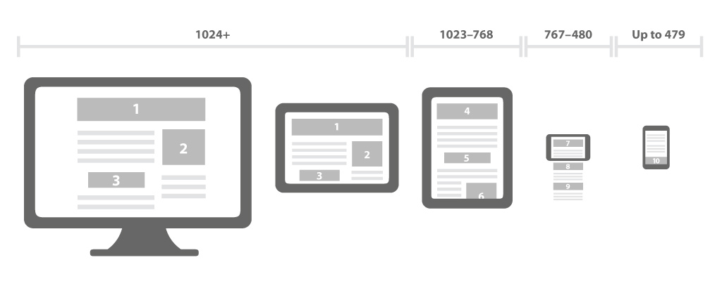
RWD Break Points

Slide 30
Orientation: Portrait / Landscape
Media queries can also be used to change layout of a page depending on the orientation of the browser.
You can have a set of CSS properties that will only apply when the browser window is wider than its height, a so called "Landscape" orientation:

Slide 31
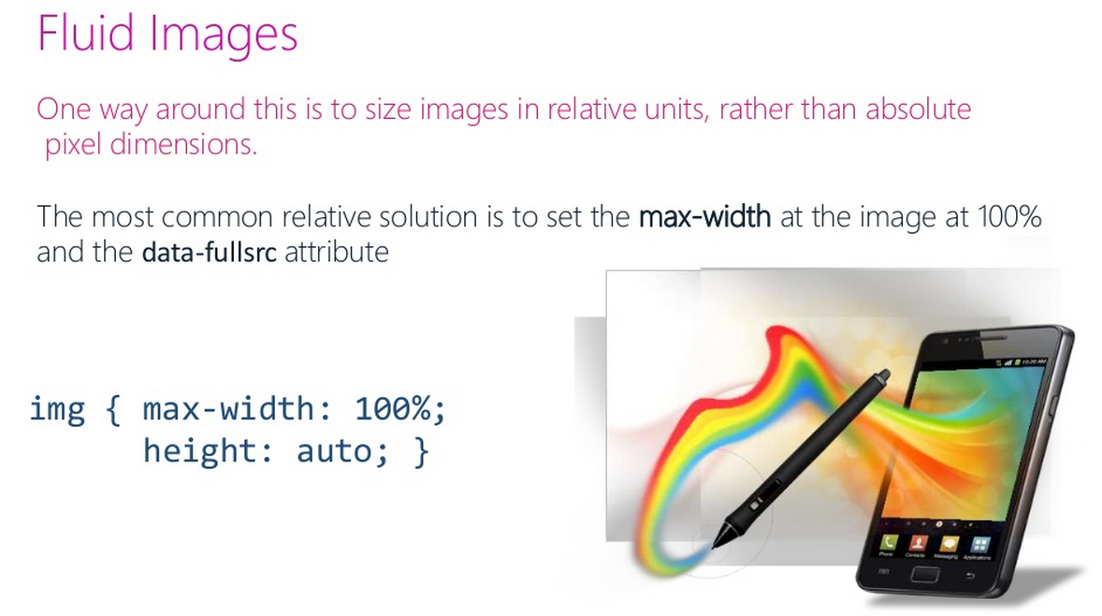
Responsive Images
If the max-width property is set to 100%, the image will scale down if it has to, but never scale up to be larger than its original size:

Slide 32
Background Images
Background images can also respond to resizing and scaling.
Here we will show three different methods:
If the background-size property is set to "contain", the background image will scale, and try to fit the content area. However, the image will keep its aspect ratio (the proportional relationship between the image's width and height):
If the background-size property is set to "100% 100%", the background image will stretch to cover the entire content area:
If the background-size property is set to "cover", the background image will scale to cover the entire content area. Notice that the "cover" value keeps the aspect ratio, and some part of the background image may be clipped:

Slide 33
Different Images for Different Devices
A large image can be perfect on a big computer screen, but useless on a small device. Why load a large image when you have to scale it down anyway? To reduce the load, or for any other reasons, you can use media queries to display different images on different devices.
Example: Here is one large image and one smaller image that will be displayed on different devices:
You can use the media query min-device-width, instead of min-width, which checks the device width, instead of the browser width. Then the image will not change when you resize the browser window:

Slide 34
RWD Frameworks
A framework is a standardized set of concepts, practices and criteria for dealing with a common type of problem, which can be used as a reference to help us approach and resolve new problems of a similar nature.
In the world of web design, to give a more straightforward definition, a framework is defined as a package made up of a structure of files and folders of standardized code (HTML, CSS, JS documents etc.) which can be used to support the development of websites, as a basis to start building a site.

Slide 35
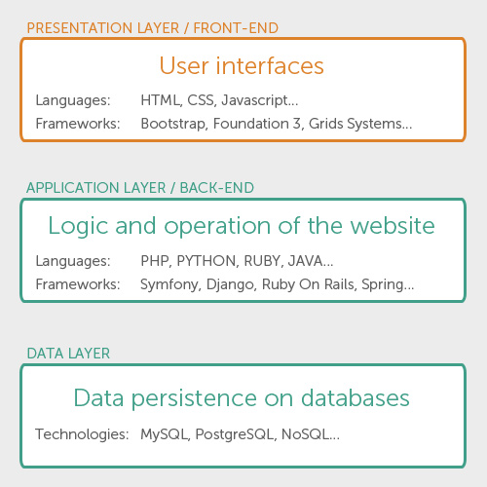
Types of Framework
How many types of framework are there?
There are basically 2 types to differentiate: backend and frontend.
This distinction is drawn depending on whether the framework is for the presentation layer or the application/ logical layer.

Slide 36
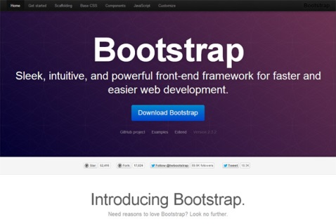
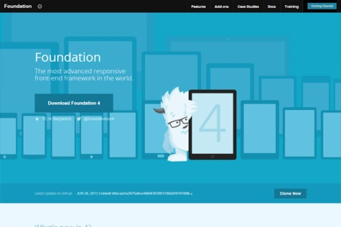
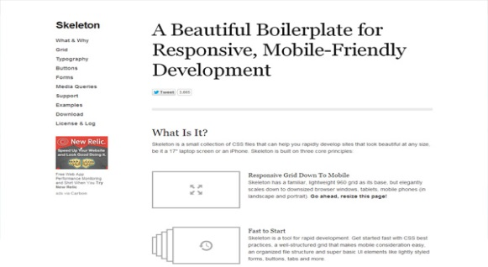
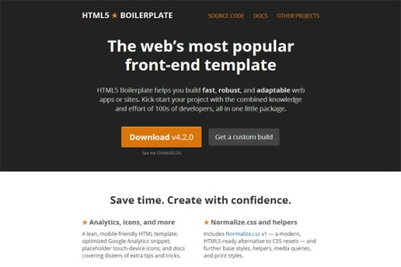
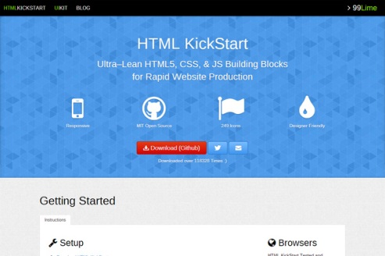
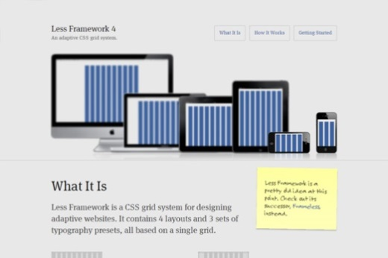
Some of Best RWD Frameworks

Slide 37
How to test responsive websites?
Developers:
They can do unit testing with debugger tools available in browser default or different plugins.
Emulators.
Actual devices.
QA:
Emulators.
Browser and Actual devices mobile lab.

Slide 38
Thank You!

