Slide 1
AN INTRO TO CSS REPROCESSING
Authored by : Presented by : Harshal Sawant

Slide 2
Course Structure
Target audience
Level
Pre-requisites | Basic Knowledge of CSS
Training methods
Evaluation

Slide 3
Agenda
    What is CSS preprocessing
    Tools
    SCSS
      Installation
      Use

Slide 4
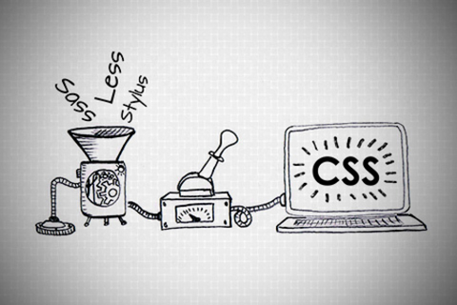
AN INTRO TO CSS PREPROCESSING

Slide 5
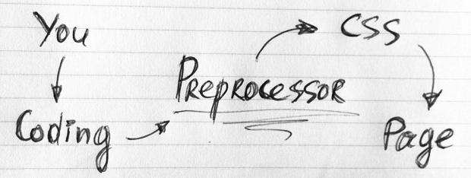
What is CSS Preprocessor
Primarily intended to make authoring CSS more dynamic, organized and productive

Slide 6
WHY WHY WHY??
First, they don’t break browser compatibility
Another advantage is preprocessors make our CSS DRY

Slide 7
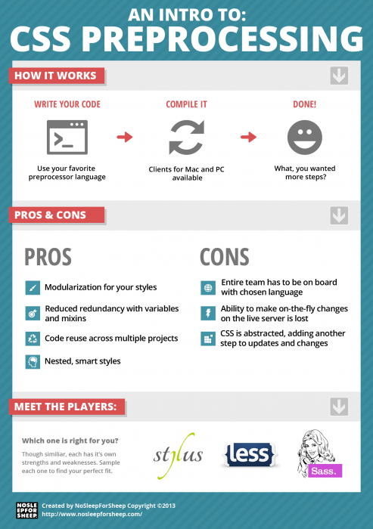

Slide 8

There are a number of CSS Preprocessor.
The question is, which of them does the Job best?

Slide 9
Installation
Sass is running on Ruby while LESS is a JavaScript library (which it was actually also built on Ruby at first).
Sass: Sass needs Ruby in order to work
LESS: LESS is built upon JavaScript, so intalling LESS is as easy as linking JavaScript library to your HTML document.
Comparison Score so far: Sass (0) – LESS (1)

Slide 10
Extensions
Sass - Compass the current and popular Sass-based extension. Compass has a number of Mixins to write CSS3 syntax in less time.
Compass is beyond just CSS3 Mixins, it has added other very useful features such as Helpers, Layout, Typography, Grid Layout and even Sprite Images.
Compass is an all-in-one package to do web development with Sass
LESS: LESS also has several extensions, but unlike Compass that has all we need in one place
need to take some time to choose the right extensions that suit workflow
  CSS3 Mixins: LESS Elements, Preboot, LESS Mixins.
  Grid: 960.gs, Frameless, Semantic.gs
  Layout: Even.less
  Misc: Twitter Bootstrap
Score so far: Sass (1) – LESS (1)

Slide 11
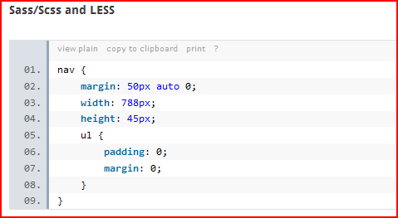
Nesting
But Sass/Scss takes this method a step further by allowing us to also nest individual properties
Score so far: Sass (2) – LESS (1)

Slide 12
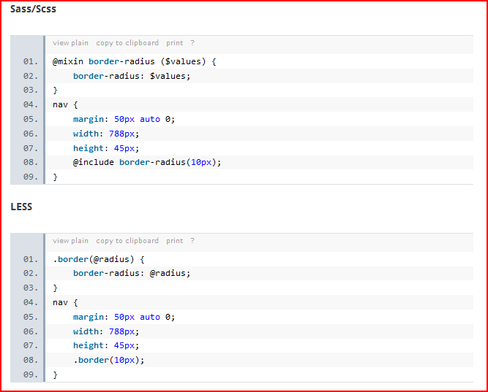
Mixins and Selector Inheritance

Slide 13
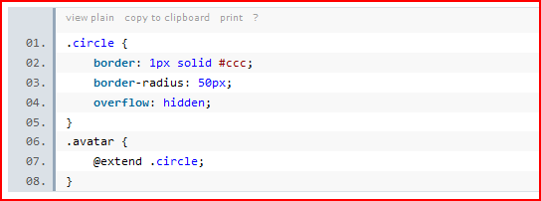
In Sass, this method is taken further with Selector Inheritance
Score so far: Sass (3) – LESS (1)

Slide 14
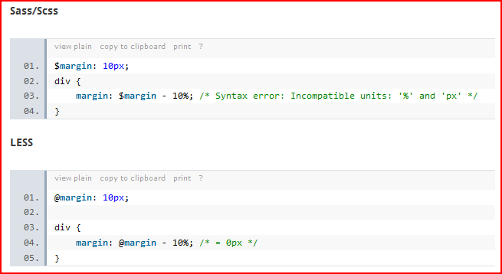
Operations
% and px is not equivalent, it should return an error
Score so far: Sass (4) – LESS (1)

Slide 15
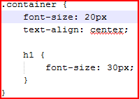

Error Notifications
SASS: In this case we will remove one semicolon on line 2, and this should turn to an error.
LESS: With the same error scenario, LESS notification is more well-presented and it also appears to be more accurate
Score: Sass (4) – LESS (2)

Slide 16
Documentation
The LESS documentation presentation is better, although Sass has more comprehensive documentation, so I think we can call this one a tie.
Score so far: Sass (5) – LESS (3).

Slide 17
Final Thought
Sass is better with a total score of 5 versus 3 for LESS; However, it doesn’t mean that LESS is bad.
Be it Sass or LESS, as long as they are comfortable and more productive, then that is the winner in their list

Slide 18
SCSS
Sass stands for Syntactically Awesome Stylesheets.
SASS & SCSS - two ways of writing the code which produce the same output.
SASS provides some new functionality: variables, nesting, mixins as well as a number of convenience features.
It's worth pointing out that though SASS is written in ruby, ruby doesn't need to be running on your server, only on your local machine

Slide 19
Installation
Install Ruby
  Set Environment Variables ( Only for windows OS user )
  In the System variables section, press New. For variable name enter RYBUOPT and for variable value rubygems
gem install sass
gem install compass
Create config.rb file in root directory
To check if SASS and Compass are working, type in
sass –v
compass –v
compass watch

Slide 20
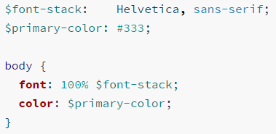

Calculations
Variables
Sass uses the $ symbol to make something a variable.
You can use all standard operators (*, /, +, -) for example:

Slide 21
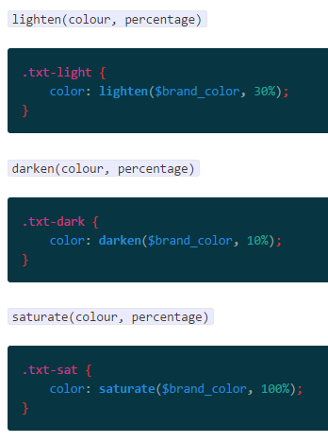
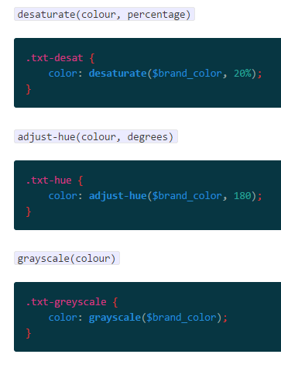
Color functions

Slide 22

Importing
You can import other Sass files into your main stylesheet using @import.

Slide 23
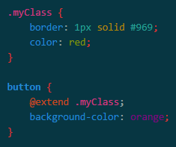
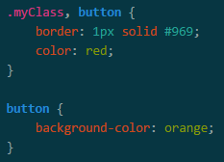
Extend
All this does is repeat properties in the compiled CSS.
Output

Slide 24
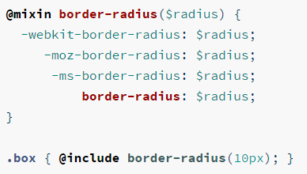
Mixin
A mixin lets you make groups of CSS declarations that you want to reuse throughout your site. You can even pass in values to make your mixin more flexible.

Slide 25
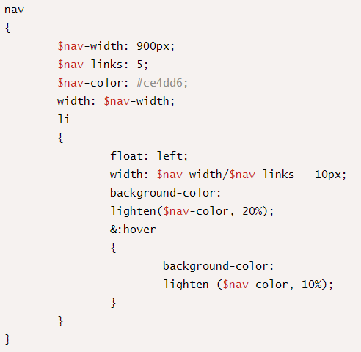
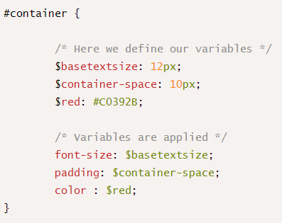
Examples of Import, Variable and Nesting

Slide 26
Compass
Compass is a Sass framework
Compass is a collection of helpful tools and battle-tested best practices for Sass.
@import 'compass/css3';
.shadow {
@include box-shadow(#000 5px 5px 5px);
}

Slide 27
Spriting
The simplest way to use these icon sprites is to let compass give you a class for each sprite:
@import "compass/utilities/sprites";
@import "my-icons/*.png";
@include all-my-icons-sprites;
**Note: The use of my-icons is only for this example, "my-icons" represents the folder name that contains your sprites.

Slide 28
Bibliography, Important Links
http://www.webdesignerdepot.com/2013/11/the-beginners-guide-to-sass/
http://www.gayadesign.com/diy/how-to-start-using-sass-and-compass-in-10-minutes/
http://awordpress.net/blog/ruby-is-not-recognized-as-an-internal-or-external-command-operable-or-batch-file-error/

Slide 29
Assignments
Convert simple css to scss
Create a sprite image of 5 icons
Learn more about config.rb

Slide 30
Thank you!

