Slide 1


SASS – Future of Stylesheet
Authored & Presented by: Yogesh Gaikwad
This document and all its contents contain information from Cybage Software Private Limited which may be privileged, confidential, or otherwise protected from disclosure. The information is intended to be for the addressee(s) only. Any unauthorized disclosure, copy, distribution, or use of the contents of this message is strictly prohibited.

Slide 2
A Quick Question – Why are you here?
I don’t know and I think you don’t know either
May be to understand the FET part
May be your bosses has nominated you
Understand the complexity faced by engineers on FET
Who has heard of SASS?
Who has used SASS?

Slide 3
Agenda
Pizza & Beer
CSS Today
Introduction to SASS
Features of SASS
How to use SASS
Small and lovely demo

Slide 4
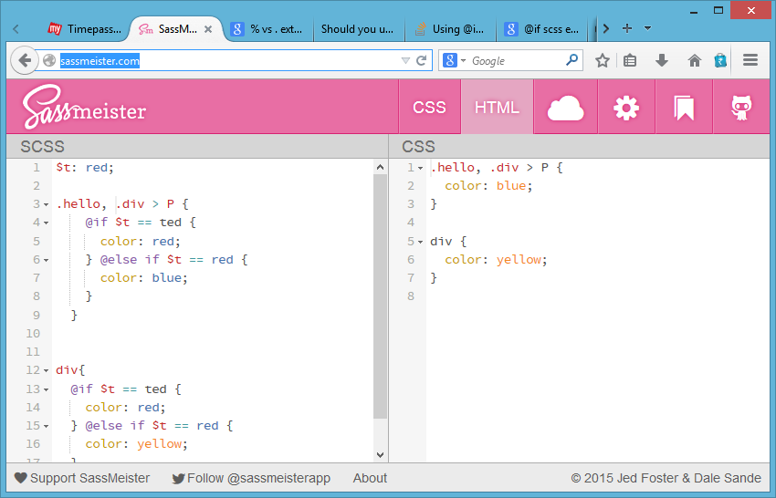
Live Testing
You can test out SASS during this presentation!
Use: http://sassmeister.com/
Notes:
https://www.youtube.com/watch?v=_XI0ODNPqk4
https://speakerdeck.com/imathis/sass-compass-the-future-of-stylesheets-now

Slide 5
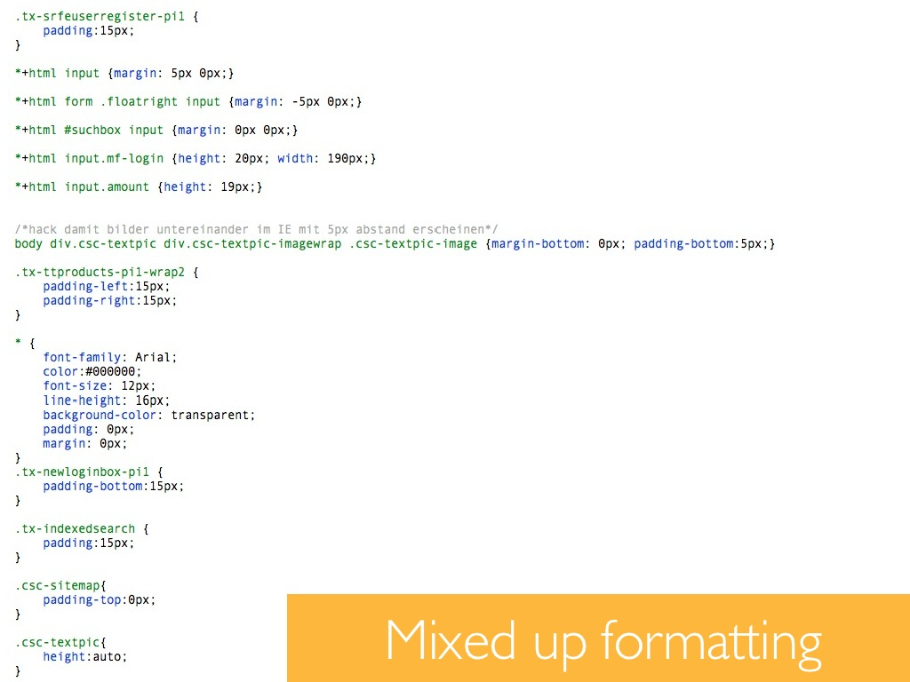
CSS Today
Notes:
https://www.youtube.com/watch?v=_XI0ODNPqk4

Slide 6
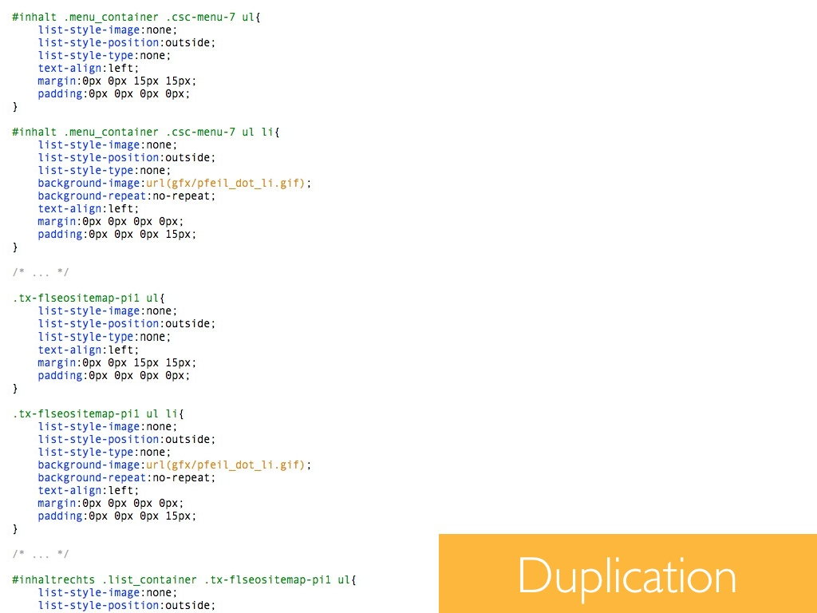
CSS Today
Notes:
https://www.youtube.com/watch?v=_XI0ODNPqk4

Slide 7
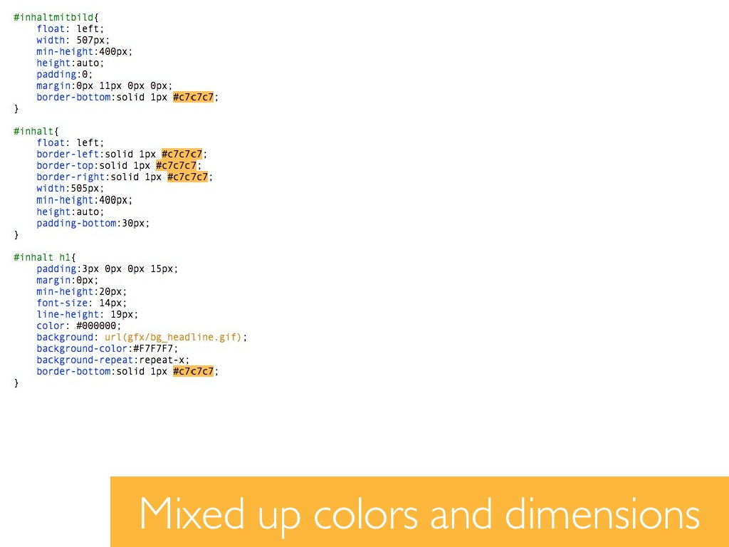
CSS Today
Notes:
https://www.youtube.com/watch?v=_XI0ODNPqk4

Slide 8
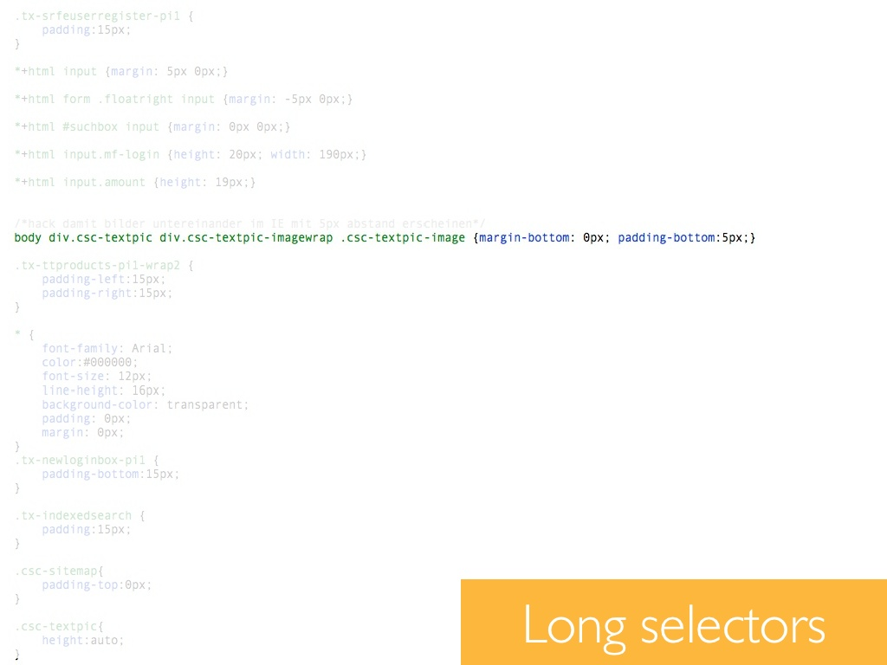
CSS Today
Notes:
https://www.youtube.com/watch?v=_XI0ODNPqk4

Slide 9
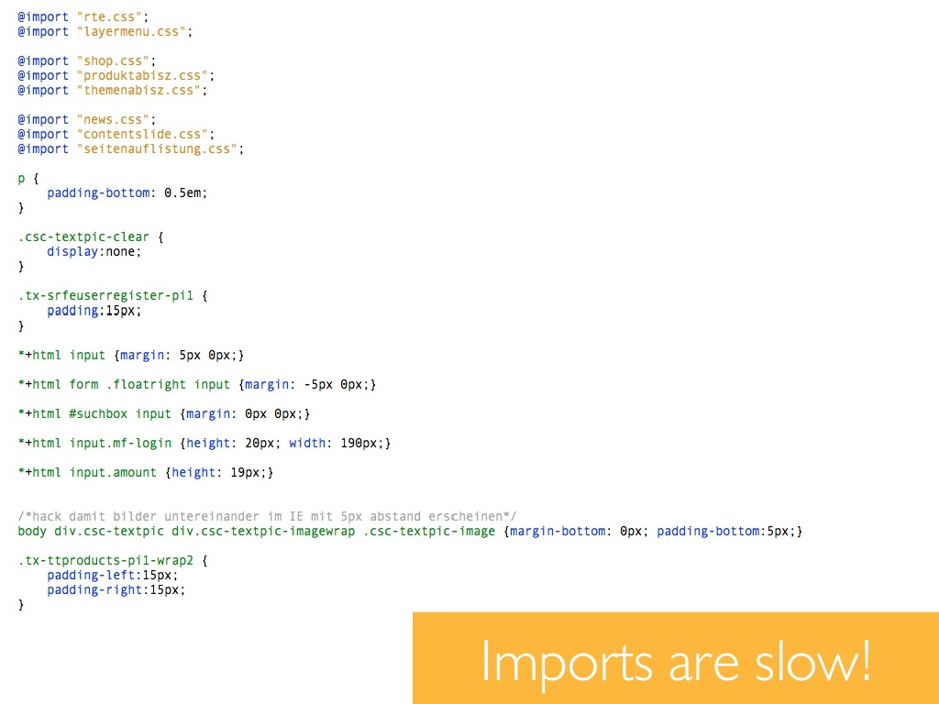
CSS Today
Notes:
https://www.youtube.com/watch?v=_XI0ODNPqk4

Slide 10
CSS Today
The Good, The Bad & The Cry for Help…!!!
Frustration
Vendor specific prefixes
Replacing color values in a project
Copying and pasting style again and again
Media queries
3D Animations
Actually features are now becoming nightmare of developers life!
Notes:
https://www.youtube.com/watch?v=_XI0ODNPqk4

Slide 11
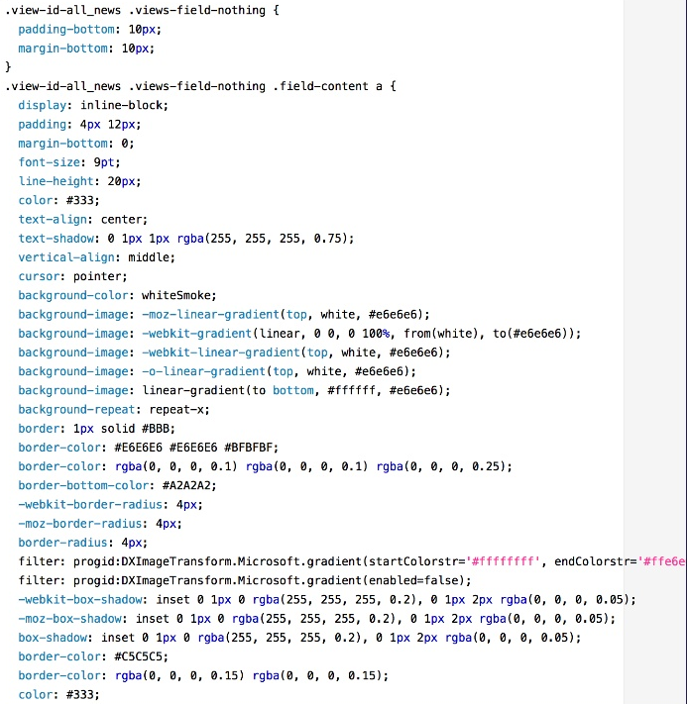
Complex CSS

Slide 12
What you could have done to improve it?
Make it intelligent
Make it scalable
Make it re-usable
So how to do it?

Slide 13
Intro to SASS (Style with attitude)

Slide 14
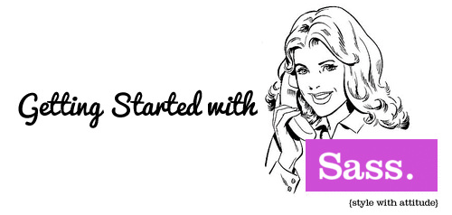
History
Syntactically Awesome Stylesheets
Firstly developed in 2007
Born in the Ruby and Rails Community
SASS has two main parts
Scripting language
Preprocessor for CSS
SASS is a system that extends CSS and can make your CSS more eﬃcient and organized.

Slide 15
How it works
Scripting language: SassScript is a scripting language that extends the CSS syntax, adding nested rules, variables, mixins, selector inheritance and more.
Preprocessor for CSS: The preprocessor interprets your SassScript and produces well formatted standard CSS.
SASS compiles in to CSS
Two Syntax and Formatting Conventions
.SASS
.SCSS

Slide 16
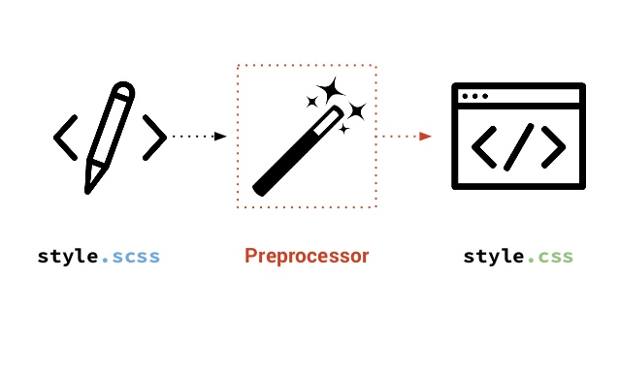
How does it works?

Slide 17
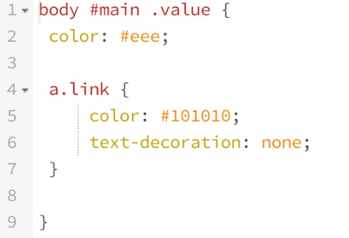
.SCSS (SassyCSS)
SCSS follows conventions of CSS
Superset of CSS syntax and uses brackets and semicolons.
SCSS Stylesheets get an .scss extension.
Most commonly used.

Slide 18
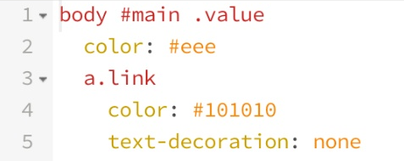
.SASS (The Indented Syntax)
SASS focuses on indentation and short-hand.
Instead of brackets and semicolons, it uses indentation of lines to specify blocks of code.
SassScript stylesheets get a .sass extension.
Older syntax.
A project would normally only use one of the two syntaxes.

Slide 19
Tools Used – (sass-lang.com)
Compilation tools
SASS, Compass – Requires Ruby
SASS/Compass GUI tools
Scout (open source)
Koala (open source)
Compass.app (USD 10)

Slide 20
Features / Enhancements
SASS has 5 primary features
Variables
Nesting
Mixins
Partials
Inheritance

Slide 21
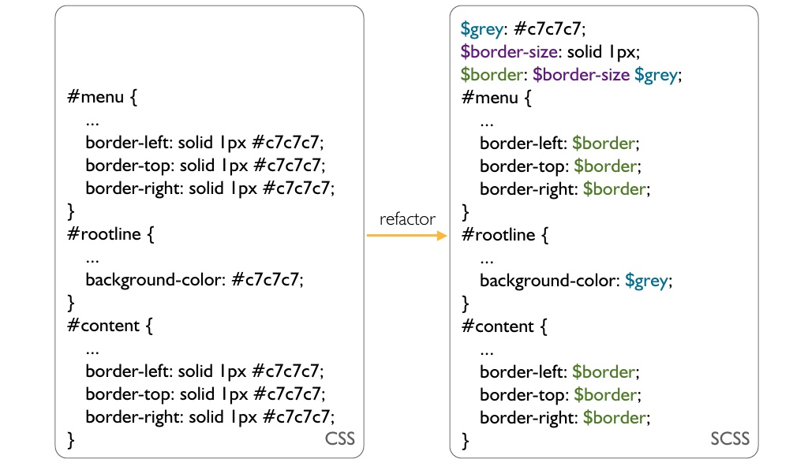
Variables

Slide 22
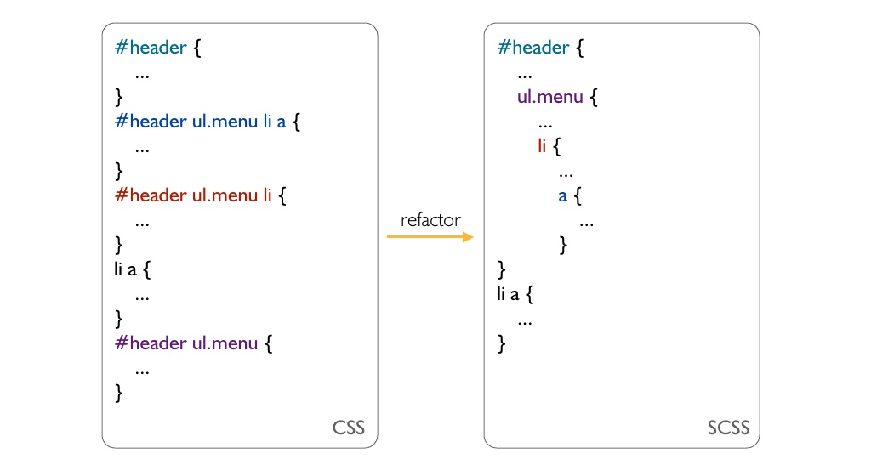
Nesting

Slide 23
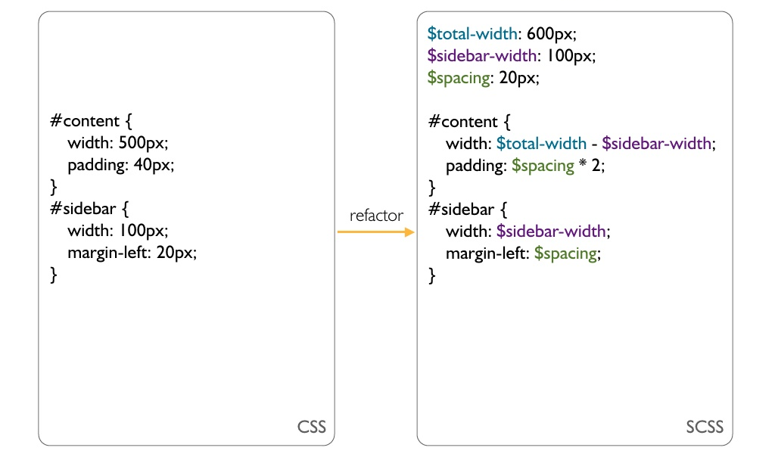
Calculations

Slide 24
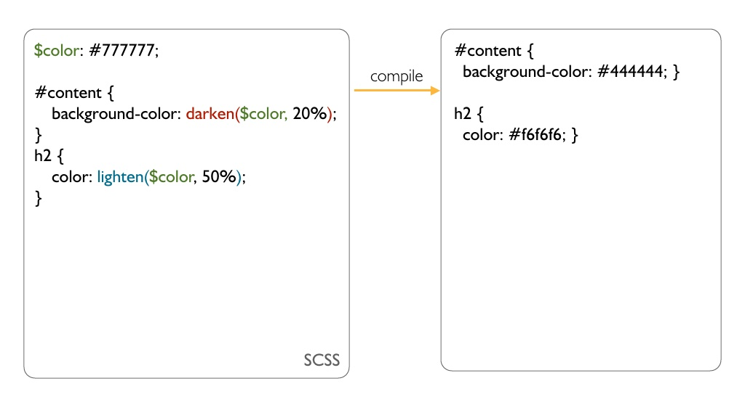
Predefined Functions

Slide 25
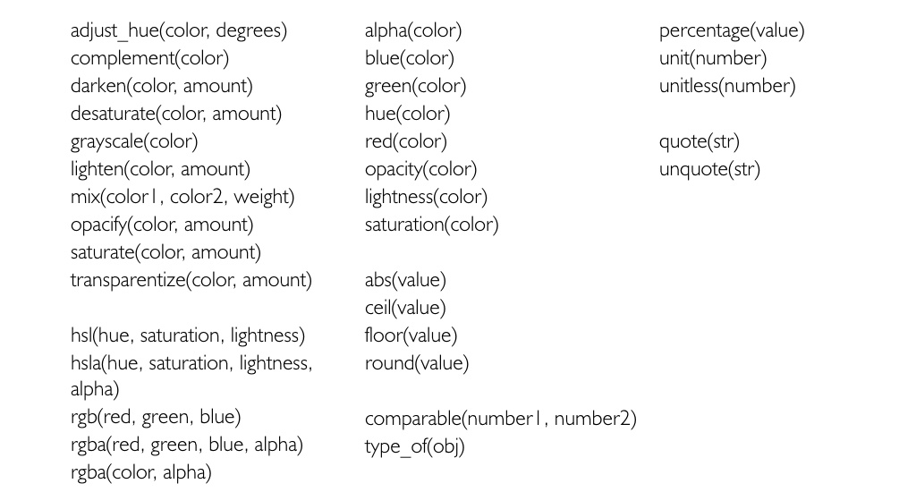
Predefined Functions
http://sass-lang.com/documentation/Sass/Script/Functions.html

Slide 26
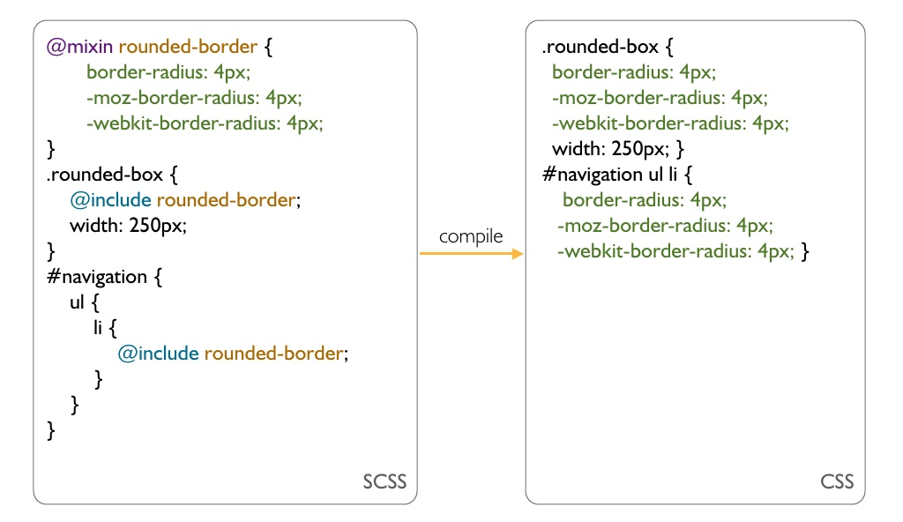
Mixins

Slide 27
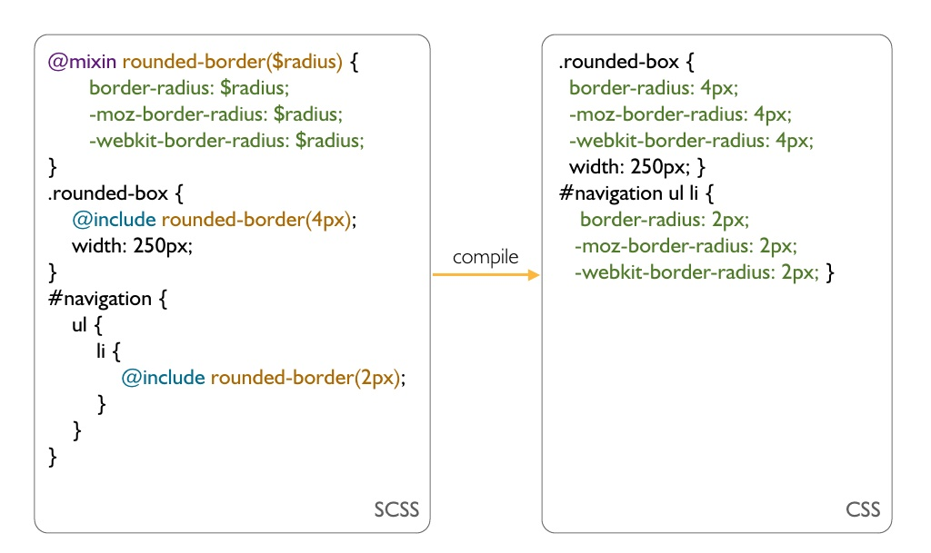
Mixins with Arguments

Slide 28
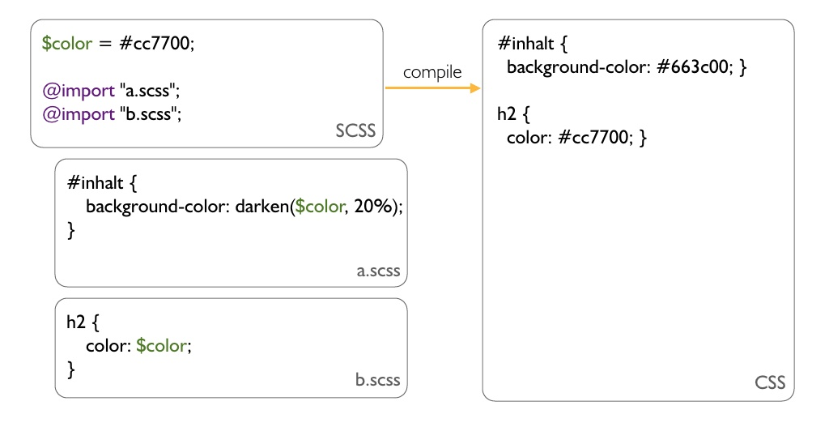
Partials

Slide 29
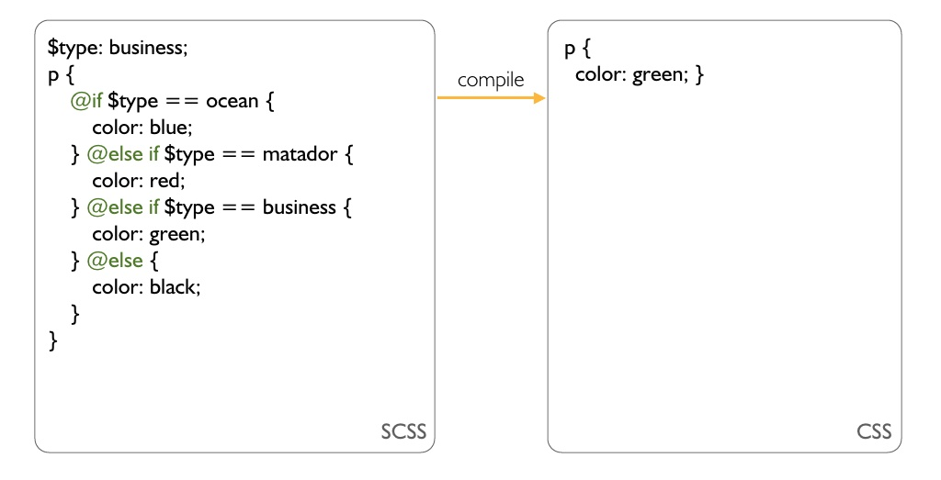
Control Structures - if

Slide 30
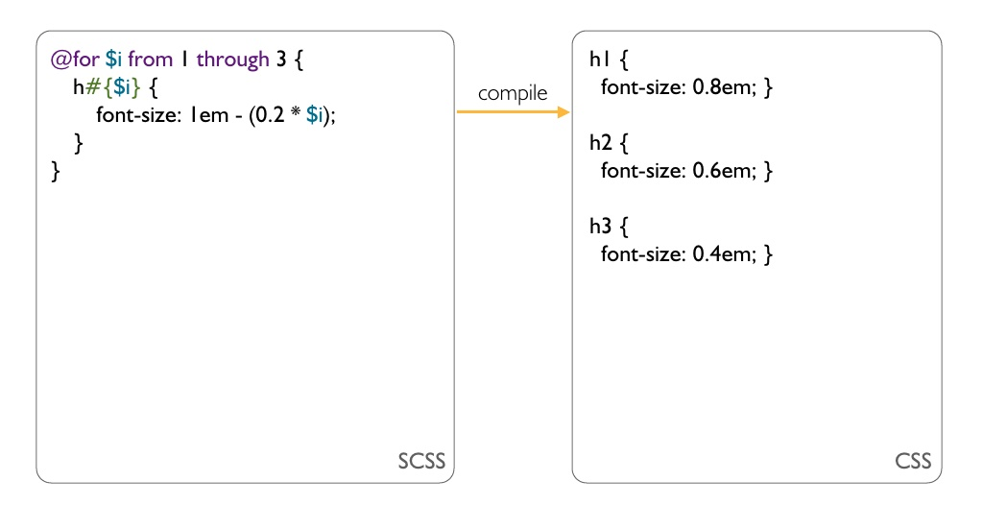
Control Structures - for

Slide 31
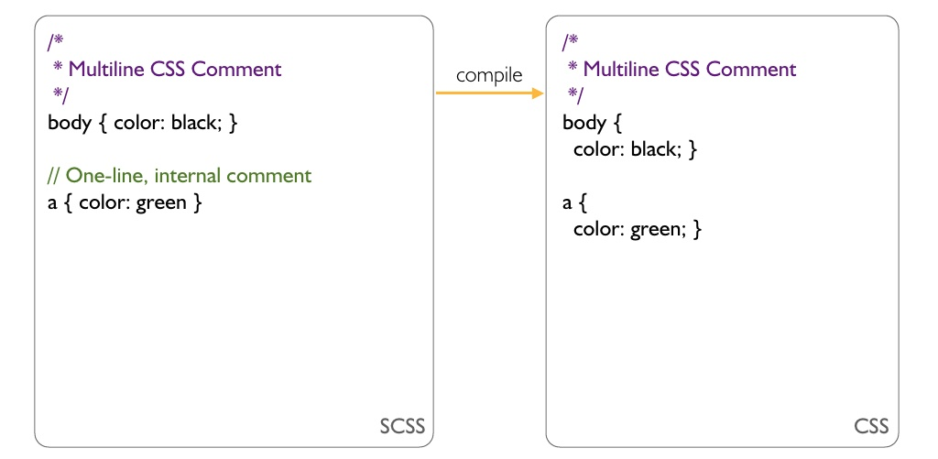
Comments

Slide 32


Slide 33
Thank You!

