Slide 1

www.cybage.com
JQUERY
Presented By:
Vinay Mishra
Copyright © 2009. Cybage Software Pvt. Ltd. All Rights Reserved. Cybage Confidential.

Slide 2
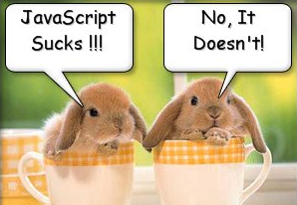
www.cybage.com
What’s the problem with JavaScript?
Copyright © 2009. Cybage Software Pvt. Ltd. All Rights Reserved. Cybage Confidential.

Slide 3
www.cybage.com
Javascript
JavaScript was a initially introduced in Netscape in Dec 1995, it’s official name is ECMAScript
JavaScript is a C-family, extremely powerful language (not a script), totally unrelated to Java
JavaScript is a weakly typed, classless, prototype based OO language.
Copyright © 2009. Cybage Software Pvt. Ltd. All Rights Reserved. Cybage Confidential.

Slide 4
www.cybage.com
What is JavaScript?
JavaScript was designed to add interactivity to HTML pages
JavaScript is a scripting language
A scripting language is a lightweight programming language
JavaScript is usually embedded directly into HTML pages
JavaScript is an interpreted language (means that scripts execute without preliminary compilation)
Everyone can use JavaScript without purchasing a license
Copyright © 2009. Cybage Software Pvt. Ltd. All Rights Reserved. Cybage Confidential.

Slide 5

www.cybage.com
This session is about improving your Quality of Life !
Copyright © 2009. Cybage Software Pvt. Ltd. All Rights Reserved. Cybage Confidential.

Slide 6

www.cybage.com
Introduction to jQuery
Copyright © 2009. Cybage Software Pvt. Ltd. All Rights Reserved. Cybage Confidential.

Slide 7
www.cybage.com
A Quality of Life by jQuery:
$(“#firstName”).text(“Joe Black”);
$(“button”).click(function() {alert “Clicked”;});
$(“.content”).hide();
$(“#main”).load(“content.htm”);
$(“<div/>”).html(“Loading…”).appendTo(“#content”);
Very compact and fluent programming model
Copyright © 2009. Cybage Software Pvt. Ltd. All Rights Reserved. Cybage Confidential.

Slide 8

www.cybage.com
What is jQuery?
Copyright © 2009. Cybage Software Pvt. Ltd. All Rights Reserved. Cybage Confidential.

Slide 9
www.cybage.com
jQuery is a lightweight, open-source JavaScript library that simplifies interaction between HTML and JavaScript
Copyright © 2009. Cybage Software Pvt. Ltd. All Rights Reserved. Cybage Confidential.

Slide 10
www.cybage.com
jQuery is a framework built with JavaScript to help JavaScript programmers who are doing common web tasks.
jQuery is a library written in JavaScript.
It's something you can use to reduce the amount of work when creating web-based applications.
Copyright © 2009. Cybage Software Pvt. Ltd. All Rights Reserved. Cybage Confidential.

Slide 11

www.cybage.com
It was and still being developed
by John Resig from Mozilla and was first announced in January 2006
It has a great community, great documentation, tons of plugins, and it was recently adopted by Microsoft
Copyright © 2009. Cybage Software Pvt. Ltd. All Rights Reserved. Cybage Confidential.

Slide 12

www.cybage.com
The current version is 1.8.2
(as of Sep 2012)
Copyright © 2009. Cybage Software Pvt. Ltd. All Rights Reserved. Cybage Confidential.

Slide 13
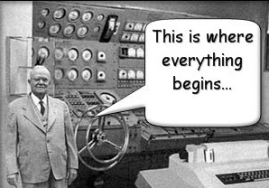
www.cybage.com
Getting Started
Copyright © 2009. Cybage Software Pvt. Ltd. All Rights Reserved. Cybage Confidential.

Slide 14
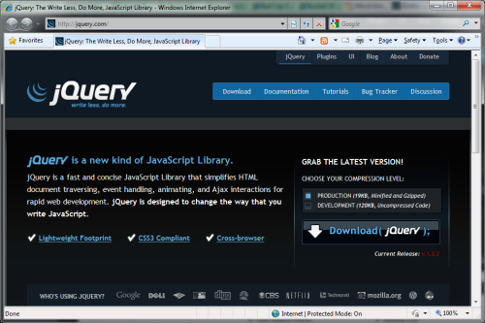
www.cybage.com
Download the latest version from
http://jquery.com
Copyright © 2009. Cybage Software Pvt. Ltd. All Rights Reserved. Cybage Confidential.

Slide 15
www.cybage.com
Reference it in your markup
  <script src=“jquery.js”/>
You can also reference it from Google
  <script src="https://ajax.googleapis.com/ajax/libs/jquery/1.7.2/jquery.min.js">
  </script>
Copyright © 2009. Cybage Software Pvt. Ltd. All Rights Reserved. Cybage Confidential.

Slide 16
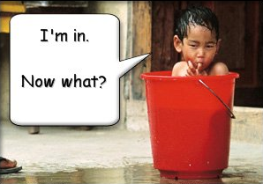
www.cybage.com
jQuery Core Concepts
Copyright © 2009. Cybage Software Pvt. Ltd. All Rights Reserved. Cybage Confidential.

Slide 17
www.cybage.com
The Magic $() function
  var el = $(“<div/>”)
Create HTML elements on the fly
Copyright © 2009. Cybage Software Pvt. Ltd. All Rights Reserved. Cybage Confidential.

Slide 18
www.cybage.com
The Magic $() function
  $(window).width()
Manipulate existing DOM elements
Copyright © 2009. Cybage Software Pvt. Ltd. All Rights Reserved. Cybage Confidential.

Slide 19
www.cybage.com
The Magic $() function
  $(“div”).hide();
  $(“div”, $(“p”)).hide();
Selects document elements
(more in a moment…)
Copyright © 2009. Cybage Software Pvt. Ltd. All Rights Reserved. Cybage Confidential.

Slide 20
www.cybage.com
  $(function(){…});
Fired when the document is ready for programming.
Better use the full syntax:
  $(document).ready(function(){…});
Copyright © 2009. Cybage Software Pvt. Ltd. All Rights Reserved. Cybage Confidential.

Slide 21
www.cybage.com
The full name of $() function is
  jQuery(“div”);
It may be used in case of conflict with other frameworks.
Copyright © 2009. Cybage Software Pvt. Ltd. All Rights Reserved. Cybage Confidential.

Slide 22
www.cybage.com
jQuery’s programming philosophy is:
GET >> ACT
  $(“div”).hide()
  $(“<span/>”).appendTo(“body”)
  $(“:button”).click()
Copyright © 2009. Cybage Software Pvt. Ltd. All Rights Reserved. Cybage Confidential.

Slide 23
www.cybage.com
Almost every function returns jQuery, which provides a fluent programming interface and chainability:
  $(“div”).show()
  .addClass(“main”)
  .html(“Hello jQuery”);
Copyright © 2009. Cybage Software Pvt. Ltd. All Rights Reserved. Cybage Confidential.

Slide 24
www.cybage.com
DAY 2
Copyright © 2009. Cybage Software Pvt. Ltd. All Rights Reserved. Cybage Confidential.

Slide 25


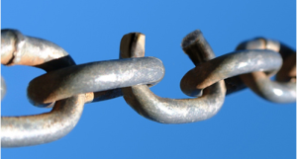
www.cybage.com
Three Major Concepts of jQuery
The $() function
Get > Act
Chainability
Copyright © 2009. Cybage Software Pvt. Ltd. All Rights Reserved. Cybage Confidential.

Slide 26

www.cybage.com
jQuery Selectors
Copyright © 2009. Cybage Software Pvt. Ltd. All Rights Reserved. Cybage Confidential.

Slide 27
www.cybage.com
All Selector
  $(“*”) // find everything
Selectors return a pseudo-array of jQuery elements
Copyright © 2009. Cybage Software Pvt. Ltd. All Rights Reserved. Cybage Confidential.

Slide 28
www.cybage.com
Basic Selectors
By Tag:
  $(“div”)
  // <div>Hello jQuery</div>
By ID:
  $(“#usr”)
  // <span id=“usr”>John</span>
By Class:
  $(“.menu”)
  // <ul class=“menu”>Home</ul>
Yes, jQuery implements CSS Selectors!
Copyright © 2009. Cybage Software Pvt. Ltd. All Rights Reserved. Cybage Confidential.

Slide 29
www.cybage.com
More Precise Selectors
  $(“div.main”) // tag and class
  $(“table#data”) // tag and id
Copyright © 2009. Cybage Software Pvt. Ltd. All Rights Reserved. Cybage Confidential.

Slide 30
www.cybage.com
Combination of Selectors
  // find by id + by class
  $(“#content, .menu”)
  // multiple combination
  $(“h1, h2, h3, div.content”)
Copyright © 2009. Cybage Software Pvt. Ltd. All Rights Reserved. Cybage Confidential.

Slide 31
www.cybage.com
Hierarchy Selectors
  $(“table td”) // descendants
  $(“tr > td”) // children
  $(“label + input”) // next
  $(“#content ~ div”) // siblings
Copyright © 2009. Cybage Software Pvt. Ltd. All Rights Reserved. Cybage Confidential.

Slide 32
www.cybage.com
Selection Index Filters
  $(“tr:first”) // first element
  $(“tr:last”) // last element
  $(“tr:lt(2)”) // index less than
  $(“tr:gt(2)”) // index gr. than
  $(“tr:eq(2)”) // index equals
Copyright © 2009. Cybage Software Pvt. Ltd. All Rights Reserved. Cybage Confidential.

Slide 33
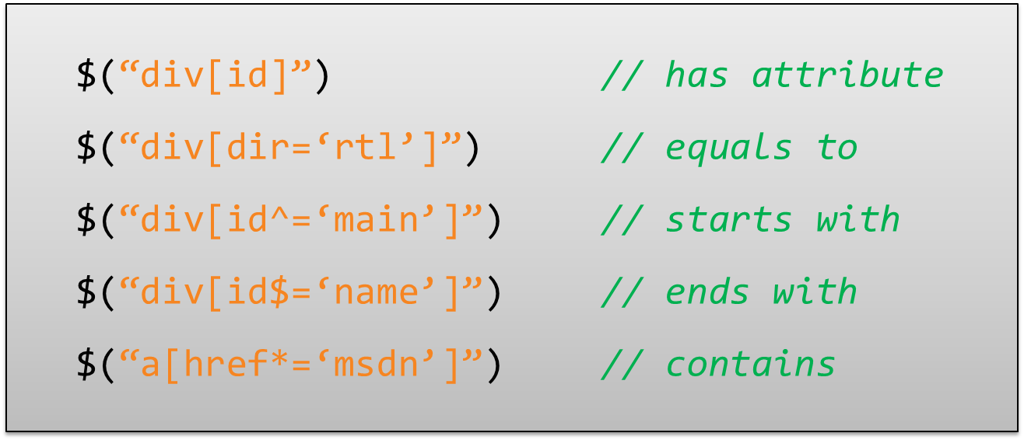
www.cybage.com
Attribute Filters
Copyright © 2009. Cybage Software Pvt. Ltd. All Rights Reserved. Cybage Confidential.

Slide 34
www.cybage.com
Forms Selectors
  $(“input:checkbox”) // checkboxes
  $(“input:radio”) // radio buttons
  $(“:button”) // buttons
  $(“:text”) // text inputs
Copyright © 2009. Cybage Software Pvt. Ltd. All Rights Reserved. Cybage Confidential.

Slide 35
www.cybage.com
Forms Filters
  $(“input:checked”) // checked
  $(“input:selected”) // selected
  $(“input:enabled”) // enabled
  $(“input:disabled”) // disabled
Copyright © 2009. Cybage Software Pvt. Ltd. All Rights Reserved. Cybage Confidential.

Slide 36
www.cybage.com
Find Dropdown Selected Item
  <select name=“cities”>
    <option value=“1”>Tel-Aviv</option>
    <option value=“2” selected=“selected”>Yavne</option>
    <option value=“3”>Raanana</option>
  </select>
  $(“select[name=‘ddl’] option:selected”).val()
Copyright © 2009. Cybage Software Pvt. Ltd. All Rights Reserved. Cybage Confidential.

Slide 37
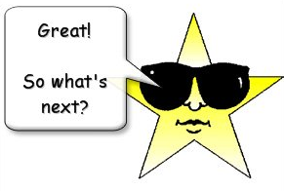
www.cybage.com
SELECTORS DEMO
Copyright © 2009. Cybage Software Pvt. Ltd. All Rights Reserved. Cybage Confidential.

Slide 38
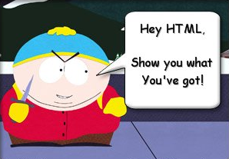
www.cybage.com
Document Traversal
Copyright © 2009. Cybage Software Pvt. Ltd. All Rights Reserved. Cybage Confidential.

Slide 39
www.cybage.com
A Selector returns a pseudo array of jQuery objects
  $(“div”).length
Returns number of selected elements.
It is the best way to check selector.
Copyright © 2009. Cybage Software Pvt. Ltd. All Rights Reserved. Cybage Confidential.

Slide 40
www.cybage.com
each(fn) traverses every selected element calling fn()
  var sum = 0;
  $(“div.number”).each(
  function(){
  sum += (+this.innerHTML);
  });
this – is a current DOM element
Copyright © 2009. Cybage Software Pvt. Ltd. All Rights Reserved. Cybage Confidential.

Slide 41
www.cybage.com
each(fn) also passes an indexer
  $(“table tr”).each(
  function(i){
  if (i % 2)
  $(this).addClass(“odd”);
  });
$(this) – convert DOM to jQuery
i - index of the current element
Copyright © 2009. Cybage Software Pvt. Ltd. All Rights Reserved. Cybage Confidential.

Slide 42
www.cybage.com
Traversing HTML
  .next(expr) // next sibling
  .prev(expr) // previous sibling
  .siblings(expr) // siblings
  .children(expr) // children
  .parent(expr) // parent
Copyright © 2009. Cybage Software Pvt. Ltd. All Rights Reserved. Cybage Confidential.

Slide 43
www.cybage.com
DAY 3
Copyright © 2009. Cybage Software Pvt. Ltd. All Rights Reserved. Cybage Confidential.

Slide 44
www.cybage.com
DAY1 : Three Major Concepts of jQuery
The $() function
Get > Act
Chainability
Copyright © 2009. Cybage Software Pvt. Ltd. All Rights Reserved. Cybage Confidential.

Slide 45
www.cybage.com
DAY 2 :
Selectors
Document Traversal
Copyright © 2009. Cybage Software Pvt. Ltd. All Rights Reserved. Cybage Confidential.

Slide 46
www.cybage.com
Check for expression
  $(“table td”).each(function() {
  if ($(this).is(“:first-child”)) {
  $(this).addClass(“firstCol”);
  }
  });
Copyright © 2009. Cybage Software Pvt. Ltd. All Rights Reserved. Cybage Confidential.

Slide 47
www.cybage.com
Find in selected
  // select paragraph and then find
  // elements with class ‘header’ inside
  $(“p”).find(“.header”).show();
  // equivalent to:
  $(“.header”, $(“p”)).show();
Copyright © 2009. Cybage Software Pvt. Ltd. All Rights Reserved. Cybage Confidential.

Slide 48
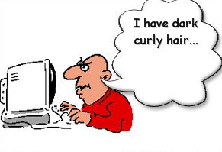
www.cybage.com
HTML Manipulation
Copyright © 2009. Cybage Software Pvt. Ltd. All Rights Reserved. Cybage Confidential.

Slide 49
www.cybage.com
Getting and Setting Values
  // get the value of the checked checkbox
  $(“input:checkbox:checked”).val();
  // set the value of the textbox
  $(“:text[name=‘txt’]”).val(“Hello”);
  // select or check lists or checkboxes
  $(“#lst”).val([“NY”,”IL”,”NS”]);
Copyright © 2009. Cybage Software Pvt. Ltd. All Rights Reserved. Cybage Confidential.

Slide 50
www.cybage.com
Handling CSS Classes
  // add and remove class
  $(“p”).removeClass(“blue”).addClass(“red”);
  // add if absent, remove otherwise
  $(“div”).toggleClass(“main”);
  // test for class existance
  if ($(“div”).hasClass(“main”)) { //… }
Copyright © 2009. Cybage Software Pvt. Ltd. All Rights Reserved. Cybage Confidential.

Slide 51
www.cybage.com
Inserting new Elements
  // select > append to the end
  $(“h1”).append(“<li>Hello $!</li>”);
  // select > append to the beginning
  $(“ul”).prepend(“<li>Hello $!</li>”);
  // create > append/prepend to selector
  $(“<li/>”).html(“9”).appendTo(“ul”);
  $(“<li/>”).html(“1”).prependTo(“ul”);
Copyright © 2009. Cybage Software Pvt. Ltd. All Rights Reserved. Cybage Confidential.

Slide 52
www.cybage.com
Replacing Elements
  // select > replace
  $(“h1”).replaceWith(“<div>Hello</div>”);
  // create > replace selection
  $(“<div>Hello</div>”).replaceAll(“h1”);
Copyright © 2009. Cybage Software Pvt. Ltd. All Rights Reserved. Cybage Confidential.

Slide 53
www.cybage.com
Handling attributes
  $(“a”).attr(“href”,”home.htm”);
  // <a href=“home.htm”>…</a>
  // remove attribute - enable
  $(“button”).removeAttr(“disabled”)
Copyright © 2009. Cybage Software Pvt. Ltd. All Rights Reserved. Cybage Confidential.

Slide 54
www.cybage.com
Setting multiple attributes
  $(“img”).attr({
  “src” : “/images/smile.jpg”,
  “alt” : “Smile”,
  “width” : 10,
  “height” : 10
  });
Copyright © 2009. Cybage Software Pvt. Ltd. All Rights Reserved. Cybage Confidential.

Slide 55
www.cybage.com
CSS Manipulations
  // get style
  $(“div”).css(“background-color”);
  // set style
  $(“div”).css(“float”, “left”);
  // set multiple style properties
  $(“div”).css({“color”:”blue”,
  “padding”: “1em”
  “margin-right”: “0”,
  marginLeft: “10px”});
Copyright © 2009. Cybage Software Pvt. Ltd. All Rights Reserved. Cybage Confidential.

Slide 56
www.cybage.com
DAY 4
Copyright © 2009. Cybage Software Pvt. Ltd. All Rights Reserved. Cybage Confidential.

Slide 57

www.cybage.com
Events
Copyright © 2009. Cybage Software Pvt. Ltd. All Rights Reserved. Cybage Confidential.

Slide 58
www.cybage.com
When the DOM is ready…
  $(document).ready(function(){
  //…
  });
Fires when the document is ready for programming.
Uses advanced listeners for detecting.
window.onload() is a fallback.
Copyright © 2009. Cybage Software Pvt. Ltd. All Rights Reserved. Cybage Confidential.

Slide 59
www.cybage.com
Attach Event
  // execute always
  $(“div”).bind(“click”, fn);
  // execute only once
  $(“div”).one(“click”, fn);
Possible event values:
blur, focus, load, resize, scroll, unload, beforeunload, click, dblclick, mousedown, mouseup, mousemove, mouseover, mouseout, mouseenter, mouseleave, change, select, submit, keydown, keypress, keyup, error
(or any custom event)
Copyright © 2009. Cybage Software Pvt. Ltd. All Rights Reserved. Cybage Confidential.

Slide 60
www.cybage.com
Detaching Events
  $(“div”).unbind(“click”, fn);
Copyright © 2009. Cybage Software Pvt. Ltd. All Rights Reserved. Cybage Confidential.

Slide 61
www.cybage.com
Events Triggering
  $(“div”).trigger(“click”);
Triggers browser’s event action as well.
Can trigger custom events.
Triggered events bubble up.
Copyright © 2009. Cybage Software Pvt. Ltd. All Rights Reserved. Cybage Confidential.

Slide 62
www.cybage.com
Events Helpers
  // attach / trigger
  elem.blur(fn) / elem.blur()
  elem.focus(fn) / elem.focus()
  elem.click(fn) / elem.click()
  elem.change(fn) / elem.change()
And many others…
Copyright © 2009. Cybage Software Pvt. Ltd. All Rights Reserved. Cybage Confidential.

Slide 63
www.cybage.com
Live Events
  // attach live event
  (“div”).live(“click”, fn);
  // detach live event
  (“div”).die(“click”, fn);
Currently supported events:
click, dblclick, mousedown, mouseup, mousemove, mouseover, mouseout, keydown, keypress, keyup
Copyright © 2009. Cybage Software Pvt. Ltd. All Rights Reserved. Cybage Confidential.

Slide 64

www.cybage.com
Effects
Copyright © 2009. Cybage Software Pvt. Ltd. All Rights Reserved. Cybage Confidential.

Slide 65
www.cybage.com
Showing or Hiding Element
  // just show
  $(“div”).show();
  // reveal slowly, slow=600ms
  $(“div”).show(“slow”);
  // hide fast, fast=200ms
  $(“div”).hide(“fast”);
  // hide or show in 100ms $(“div”).toggle(100);
Copyright © 2009. Cybage Software Pvt. Ltd. All Rights Reserved. Cybage Confidential.

Slide 66
www.cybage.com
Sliding Elements
  $(“div”).slideUp();
  $(“div”).slideDown(“fast”);
  $(“div”).slideToggle(1000);
Copyright © 2009. Cybage Software Pvt. Ltd. All Rights Reserved. Cybage Confidential.

Slide 67
www.cybage.com
Fading Elements
  $(“div”).fadeIn(“fast”);
  $(“div”).fadeOut(“normal”);
  // fade to a custom opacity
  $(“div”).fadeTo (“fast”, 0.5);
Fading === changing opacity
Copyright © 2009. Cybage Software Pvt. Ltd. All Rights Reserved. Cybage Confidential.

Slide 68
www.cybage.com
Detecting animation completion
  $(“div”).hide(“slow”, function() {
  alert(“The DIV is hidden”);
  });
  $(“div”).show(“fast”, function() {
  $(this).html(“Hello jQuery”);
  }); // this is a current DOM element
Every effect function has a (speed, callback) overload
Copyright © 2009. Cybage Software Pvt. Ltd. All Rights Reserved. Cybage Confidential.

Slide 69
www.cybage.com
Custom Animation
  // .animate(options, duration)
  $(“div”).animate({
  width: “90%”,
  opacity: 0.5,
  borderWidth: “5px”
  }, 1000);
Copyright © 2009. Cybage Software Pvt. Ltd. All Rights Reserved. Cybage Confidential.

Slide 70
www.cybage.com
Chaining Animation
  $(“div”).animate({width: “90%”},100)
  .animate({opacity: 0.5},200)
  .animate({borderWidth: “5px”});
By default animations are queued and than performed one by one
Copyright © 2009. Cybage Software Pvt. Ltd. All Rights Reserved. Cybage Confidential.

Slide 71
www.cybage.com
http://www.alfajango.com/blog/the-difference-between-jquerys-bind-live-and-delegate/
http://www.no-margin-for-errors.com/projects/prettyphoto-jquery-lightbox-clone/documentation/
Copyright © 2009. Cybage Software Pvt. Ltd. All Rights Reserved. Cybage Confidential.

Slide 72

www.cybage.com
Where to go next
jQuery web-site: http://jquery.com
jQuery API: http://api.jquery.com
Many many blogs
jQuery in Action book:
Copyright © 2009. Cybage Software Pvt. Ltd. All Rights Reserved. Cybage Confidential.

Slide 73
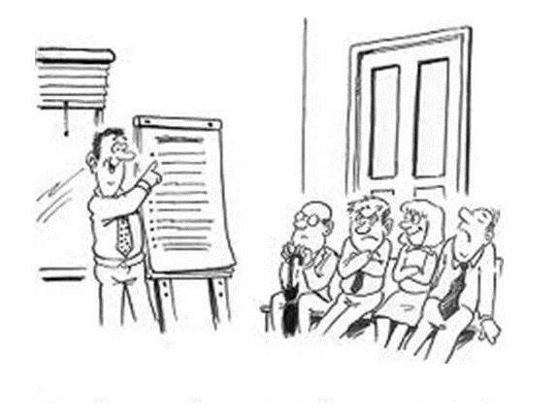

www.cybage.com
DAY 5
Copyright © 2009. Cybage Software Pvt. Ltd. All Rights Reserved. Cybage Confidential.

Slide 74
www.cybage.com
Copyright © 2009. Cybage Software Pvt. Ltd. All Rights Reserved. Cybage Confidential.

Slide 75
www.cybage.com
Copyright © 2009. Cybage Software Pvt. Ltd. All Rights Reserved. Cybage Confidential.

Slide 76
www.cybage.com
Copyright © 2009. Cybage Software Pvt. Ltd. All Rights Reserved. Cybage Confidential.

Slide 77
www.cybage.com
Copyright © 2009. Cybage Software Pvt. Ltd. All Rights Reserved. Cybage Confidential.

Slide 78
www.cybage.com
Copyright © 2009. Cybage Software Pvt. Ltd. All Rights Reserved. Cybage Confidential.

Slide 79
www.cybage.com
Copyright © 2009. Cybage Software Pvt. Ltd. All Rights Reserved. Cybage Confidential.

Slide 80
www.cybage.com
Copyright © 2009. Cybage Software Pvt. Ltd. All Rights Reserved. Cybage Confidential.

Slide 81
www.cybage.com
Copyright © 2009. Cybage Software Pvt. Ltd. All Rights Reserved. Cybage Confidential.

Slide 82
www.cybage.com
Copyright © 2009. Cybage Software Pvt. Ltd. All Rights Reserved. Cybage Confidential.

Slide 83

www.cybage.com
Copyright © 2009. Cybage Software Pvt. Ltd. All Rights Reserved. Cybage Confidential.

