Slide 1


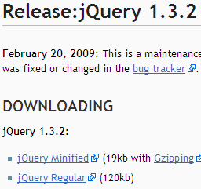
As a JavaScript library
  Shorthand & Utilities functions
  Document Object Model
    Elements, Attributes, Styles, Events
  Effects / Animation
  Asynchronous JavaScript And XML
As an UI development framework
  Community Plugins
  Widgets & Themes
  Extending jQuery object

Slide 2

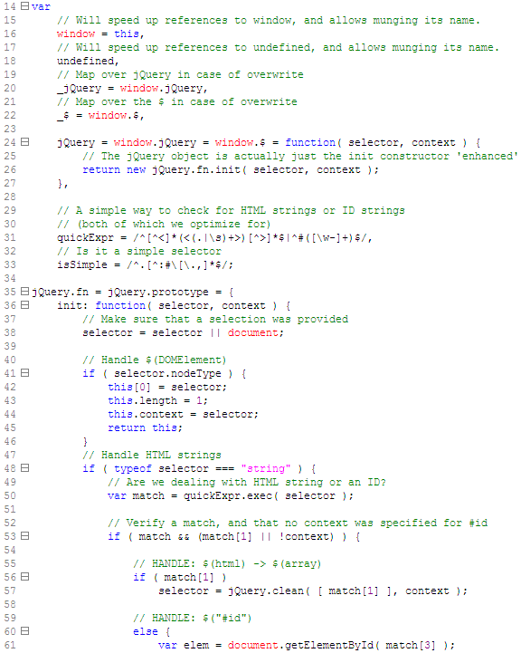
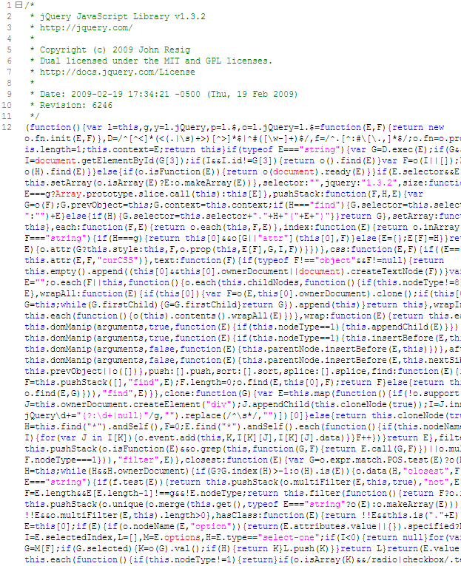



Slide 3
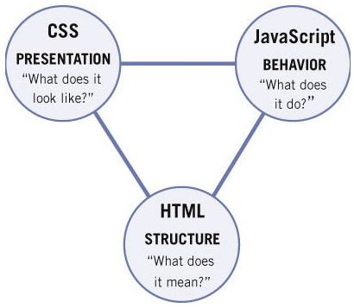
View in browser (frontend / user interface) jQuery JavaScript (HTML + CSS)
Document Object Model
A Re-introduction to JavaScript
$/jQuery at first sight
CSS Selectors
jQuery Selectors
Traversing DOM
DOM Attributes
Event handling
AJAX / Firebug
Effects / jQuery UI
Plugins / jqGrid
Plugin: jQuery.fn.x

Slide 4
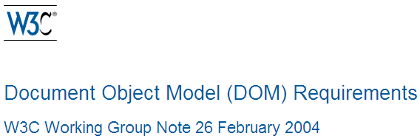
Basic requirement
  Language neutral & platform independent
Document & content manipulation
  Can programmatically access & manipulate elements, attributes & content
Event model
  All elements can generate events
  Interface for binding events
Stylesheet object model
  Selectors, rules and properties of individual style sheets can be added, removed and changed

Slide 5
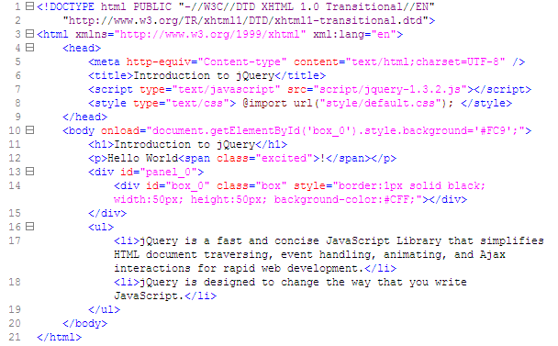
Document Object Model

Slide 6
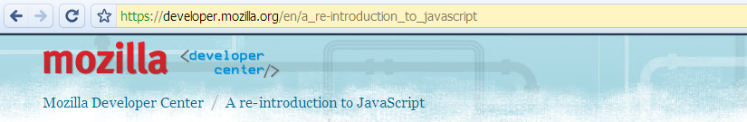
The world’s most misunderstood programming language - Douglas Crockford 2001
LiveScript / JavaScript / JScript / ECMAScript
Name, Design Errors, Bad Books, Substandard
No concept of input or output
Host environment scripting
Can be Object-Oriented: prototype new delete
Can have private variables & private methods
Can use classical inheritance & other code reuse patterns

Slide 7
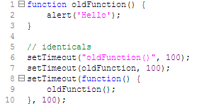

Slide 8
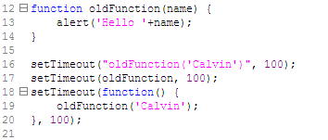

Slide 9
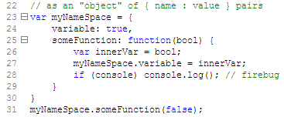
{ // JavaScript Object Notation
name: value, key: obj,
array: [true,1,'string',"str",[],{a:null}]
}

Slide 10
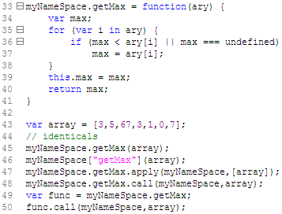

Slide 11
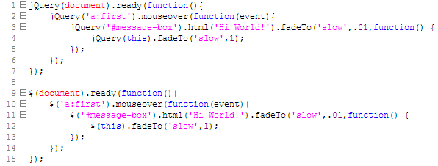
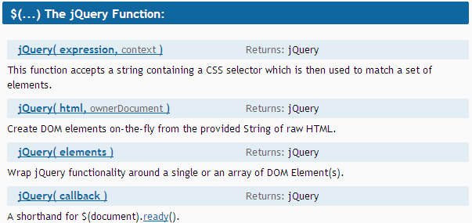
$/jQuery at first sight

Slide 12
jQuery as (an object-based) library
document.getElementById(‘id’)
  $(‘#id’)
document.getElementsByTagName(‘tag’)
  $(‘tag’)
document.getElementsByClassName(‘cls’)
  $(‘.cls’)
elm.style.display = ‘none’
  $(elm).css(‘display’, ‘none’)
  $(elm).hide() // .show()
elm.className = ‘cls’
  $(elm).addClass(‘cls’)
  $(elm).removeClass(‘cls’)
  $(elm).hasClass(‘cls’)
  $(elm).toggleClass(‘cls’)

Slide 13
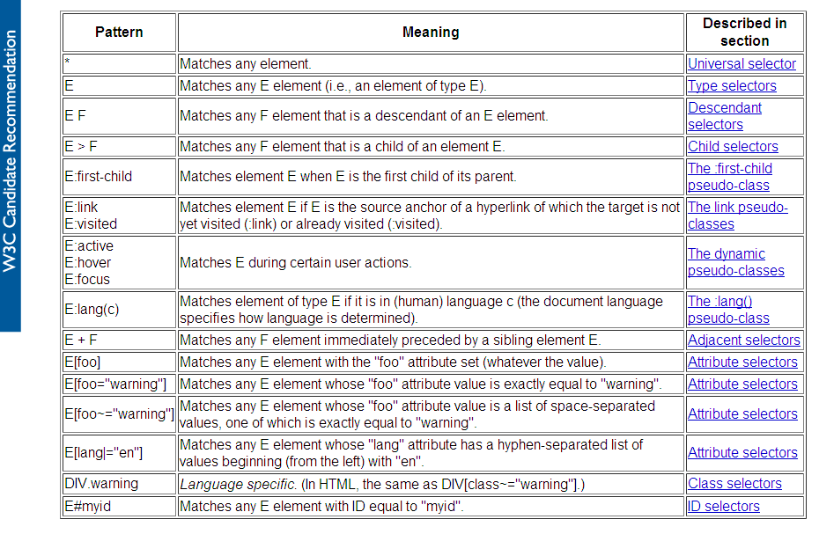
CSS Selectors

Slide 14
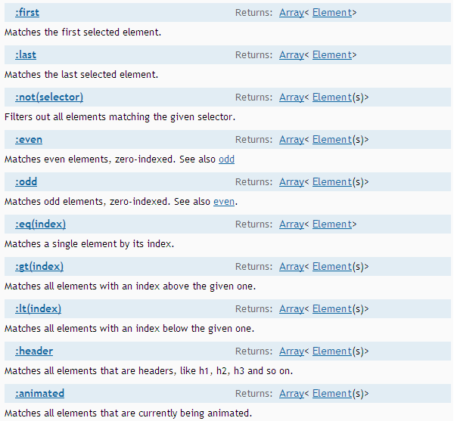
jQuery Selectors

Slide 15
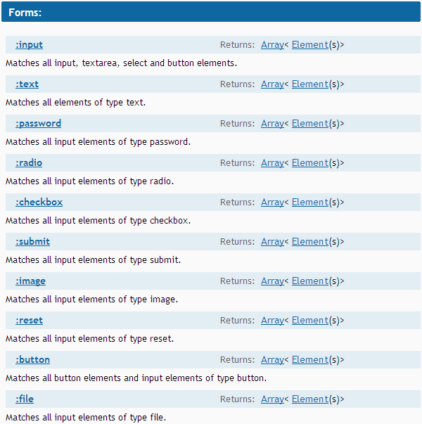
jQuery Selectors - Forms

Slide 16
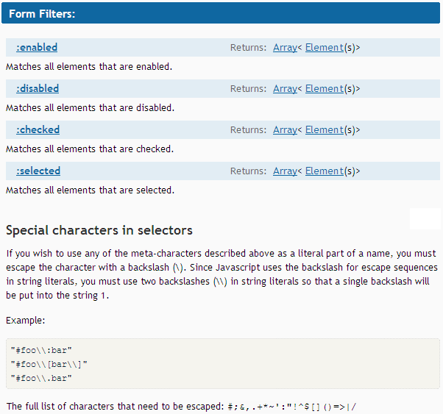

Slide 17
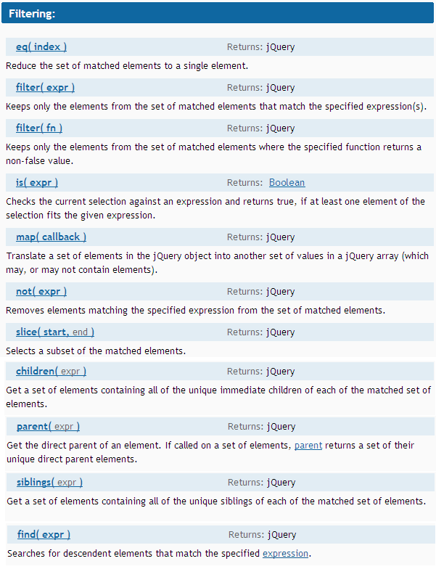

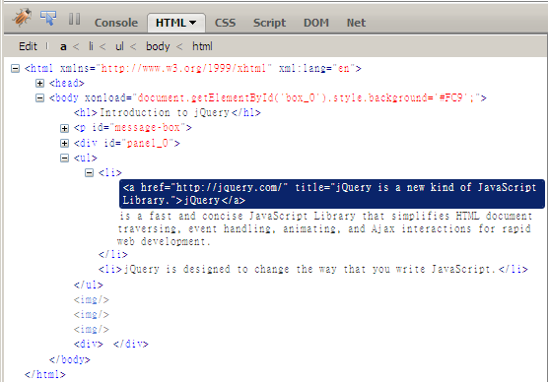
Traversing DOM (with firebug)

Slide 18
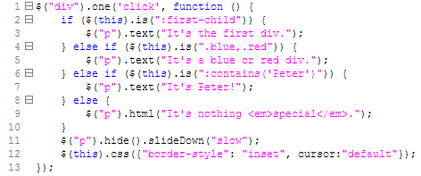

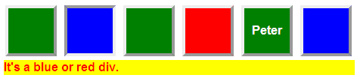
Traversing DOM

Slide 19
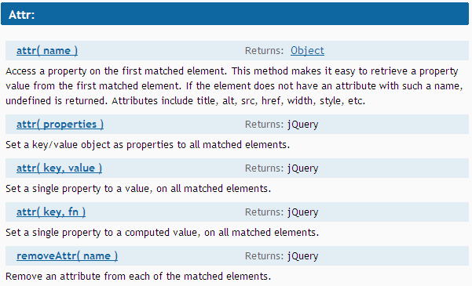
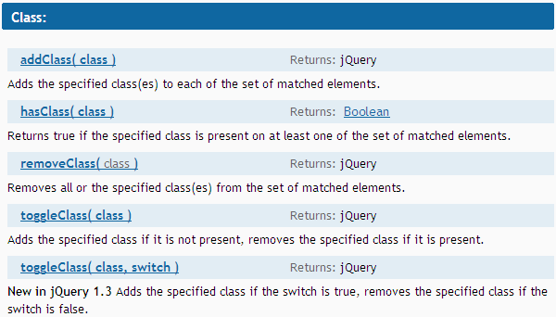
DOM Attributes

Slide 20
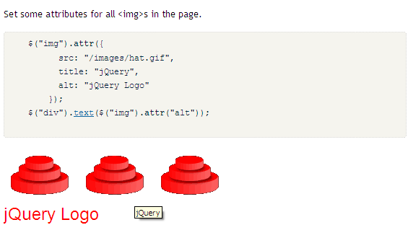
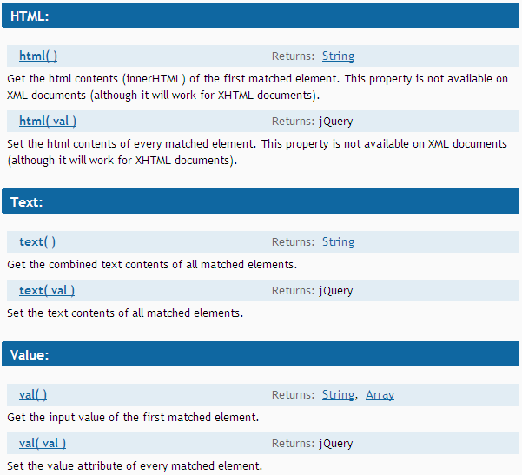


Slide 21
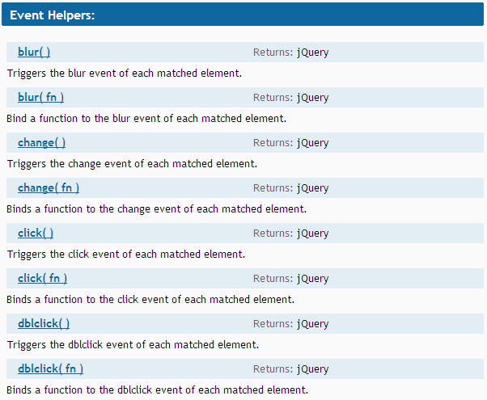

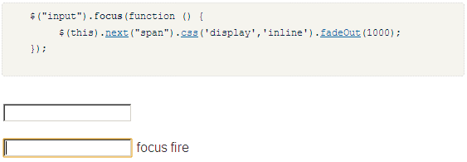
Event handling

Slide 22
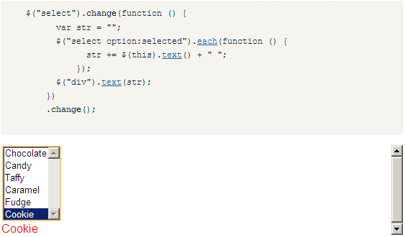
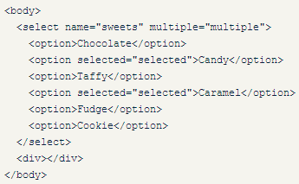
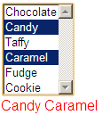
Event handling

Slide 23
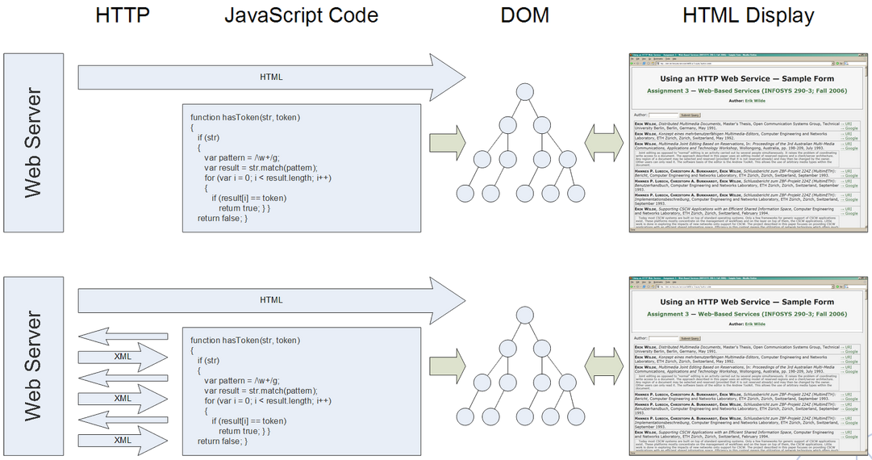
Asynchronous JavaScript And XML

Slide 24
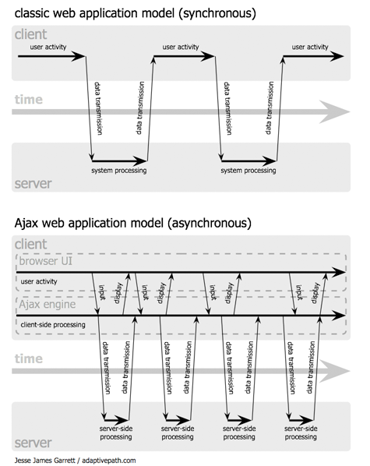
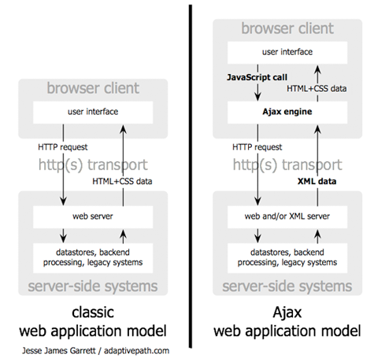
Asynchronous JavaScript And XML

Slide 25
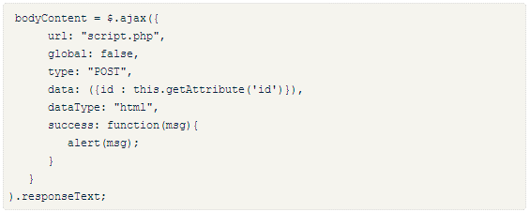
Asynchronous JavaScript And XML

Slide 26
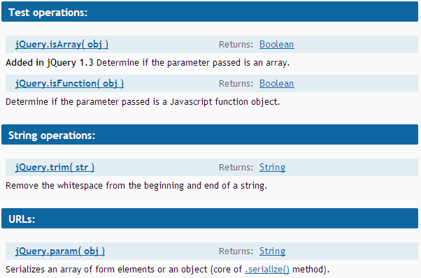
Utilities
$.trim(' some text ');

Slide 27
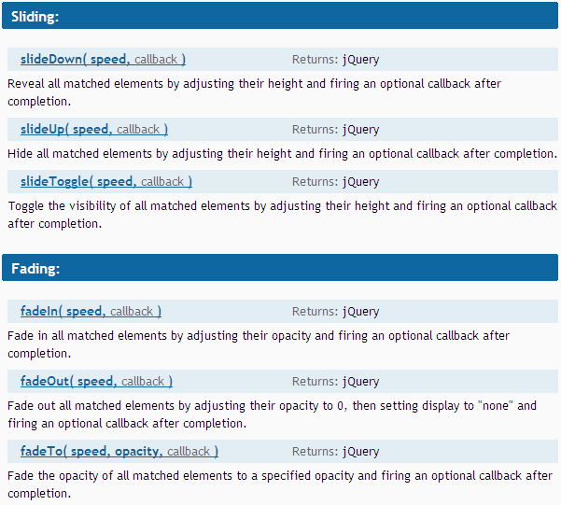
Effects

Slide 28
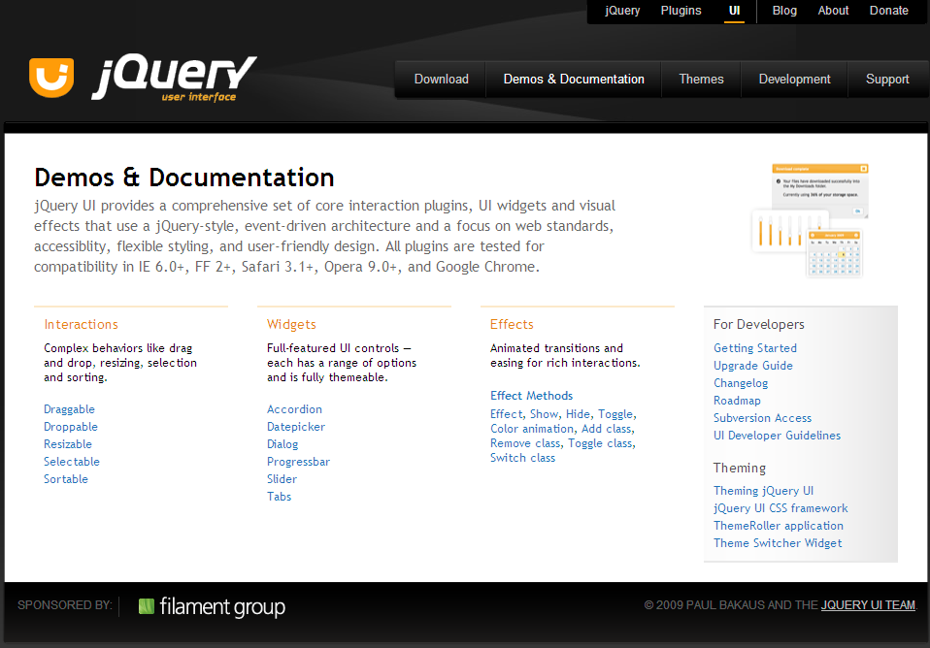

Slide 29
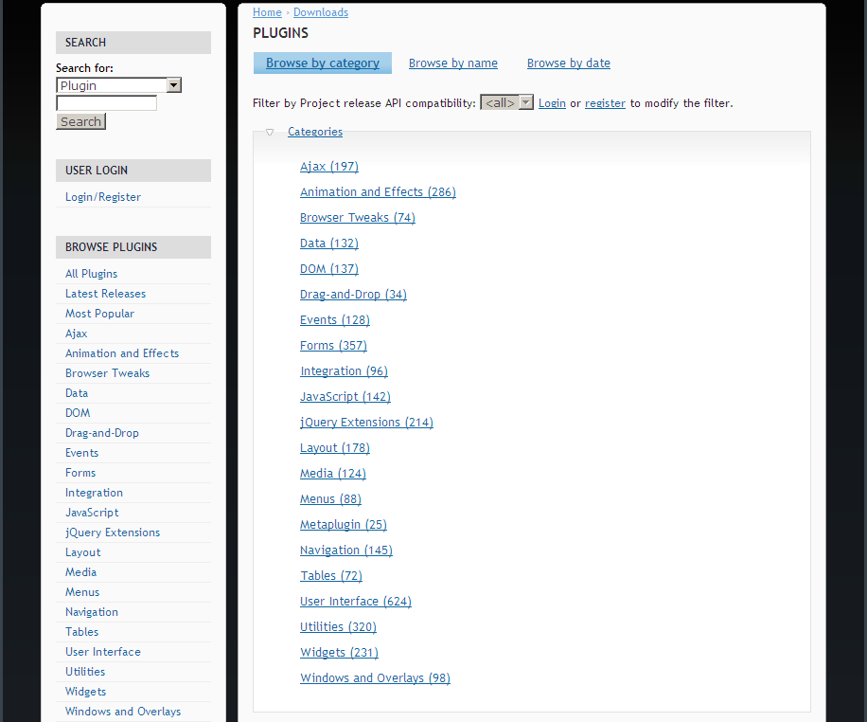

Slide 30

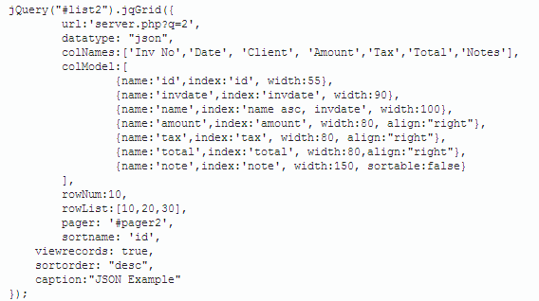

Slide 31
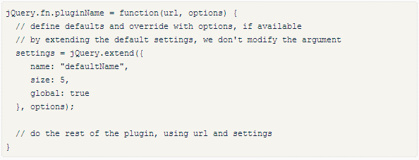
Plugin: jQuery.fn.x

Slide 32
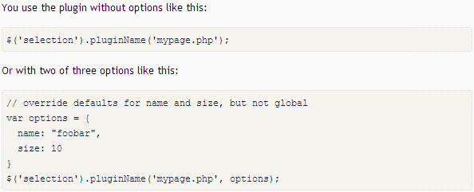
Plugin: jQuery.fn.x

Slide 33
As a JavaScript library
  Shorthand & Utilities functions
  Document Object Model
    Elements, Attributes, Styles, Events
  Effects / Animation
  Asynchronous JavaScript And XML
As an UI development framework
  Community Plugins
  Widgets & Themes
  Extending jQuery object

Slide 34
