Slide 1
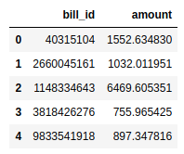
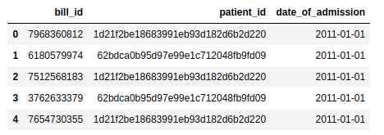
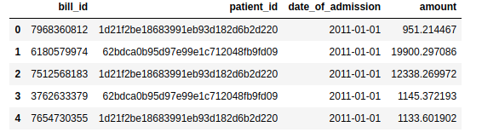
Insights for Bill_id and Bill_amount dataset
Bill ID
Bill Amount
Both the tables were having same number of rows (13600)
Joined the two tables using common column bill_id

Slide 2
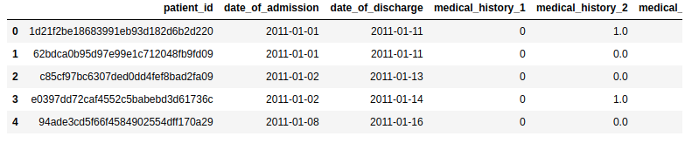
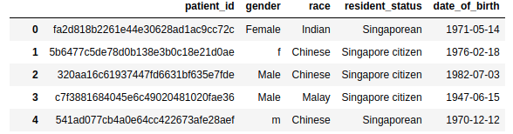
Clinical_data
Shape: (3400,26)
Demographic Data
Shape: (3000,5)

Slide 3
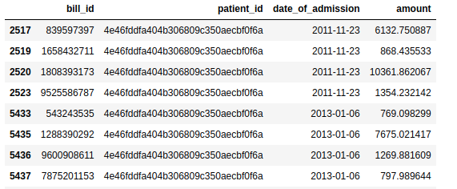

As there were 13600 with common patients over time
Created Group of patients according to their date_of admission
Different bills were created during the patien treatment ( Added the amount as total for full procedure
data1 =total.groupby(['patient_id','date_of_admission']).sum('amount').reset_index()
Resultant dataframe was having the shape of (3400,4)
Notes:
Here we can see patient has 4 bills for same date

Slide 4
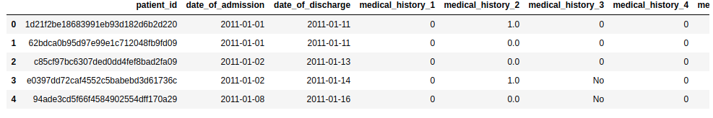
Merged all datasets together with common column patient_id
Final DataFrame
Shape : ( 3400, 33)

Slide 5
Data Preprocessing and Cleaning
Column : medical_history_3 was string column with values
['0', '1', 'No', 'Yes']
Replaced and Converted all values to numeric
{'0':0, '1':1, 'No':0, 'Yes':1}
There were null values in 2 columns filled with 0 as it was categorical col
test.fillna(value=0,inplace=True)
Creating one hot encoding for categorical columns in demographic dataframe

Slide 6
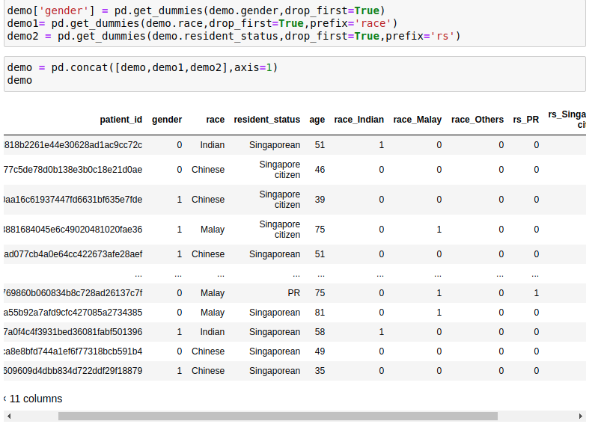
Creating one hot encoding for categorical columns in demographic dataframe

Slide 7
Creating Dependent and Independent Features for model
Partitioning the data for Training and Testing with Sklearn

Slide 8
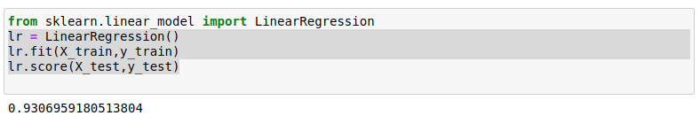
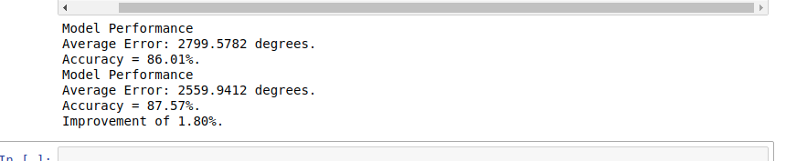
Applying linear Regression
Random Forest scores

Slide 9
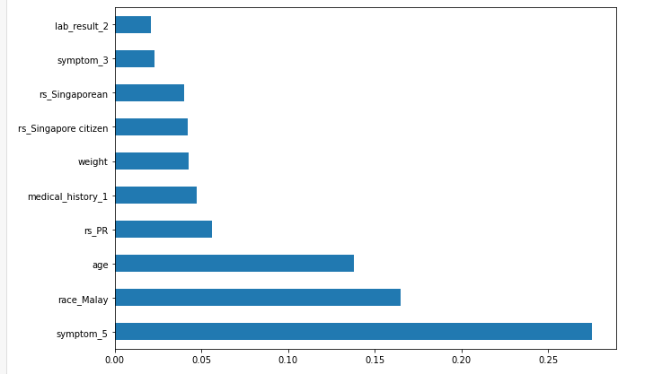
Important features which are dependent on cost

