Slide 1

Cookies vs Sessions – Critical Analysis
Presented By:
Chanda Jignesh_192411154

Slide 2


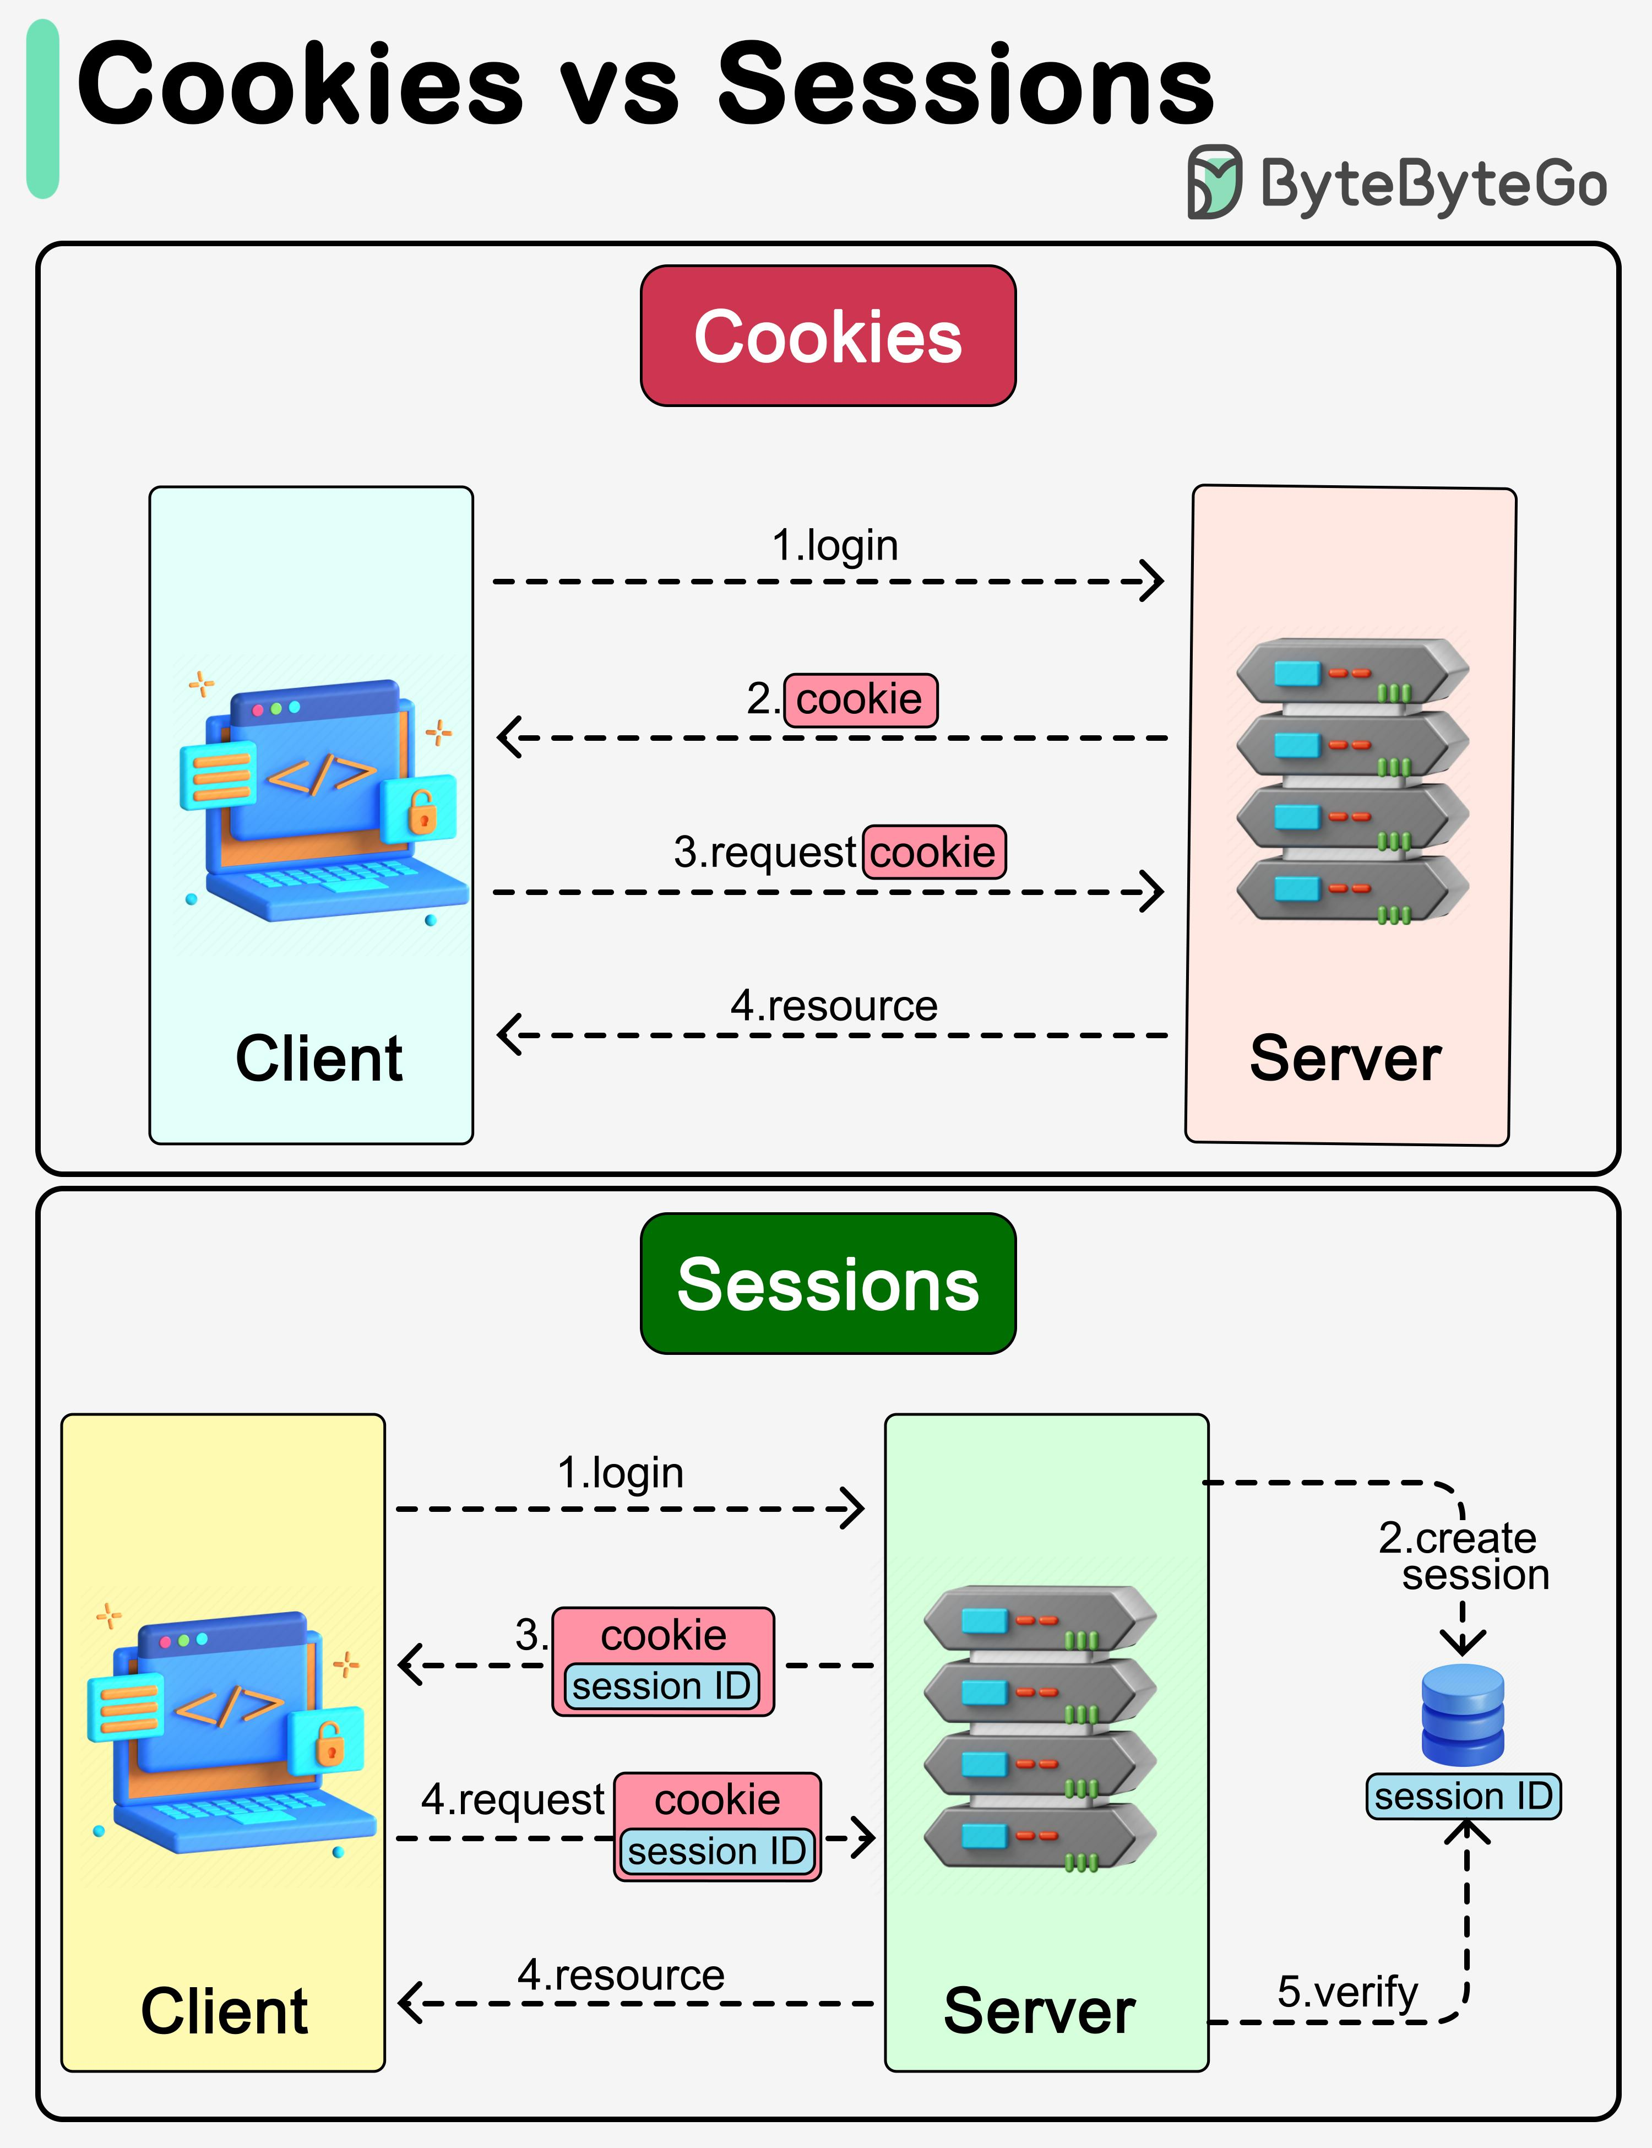
Introduction
What are Cookies and Sessions?
Cookies and Sessions are techniques used to maintain user information in web applications because HTTP is a stateless protocol.
Cookies store data on the client side (browser), while Sessions store data on the server side.
They help websites remember user details such as login status, preferences, and shopping cart items.
Cookies are faster and suitable for user preferences, whereas Sessions are more secure and used for authentication and sensitive data.

Slide 3
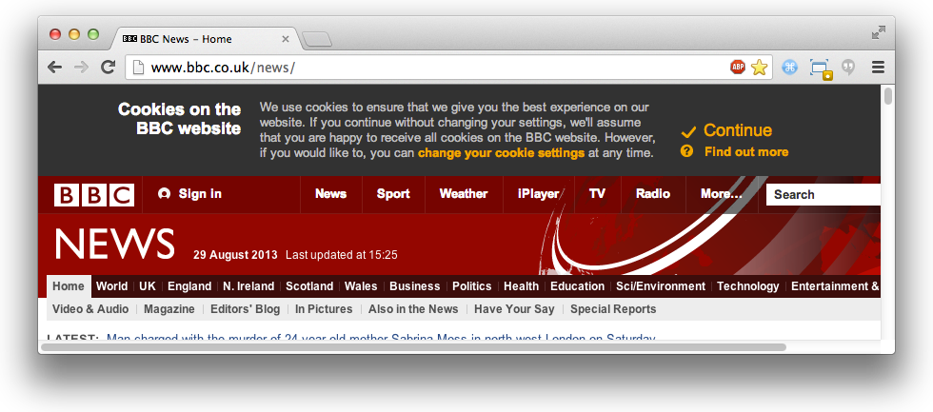
Cookies
A Cookie is a small text file stored in the user's web browser by a website. It helps the website remember information about the user between different visits or requests.
Features:
Stored on the client side (browser).
Contains small amounts of data such as username, preferences, or session information.
Automatically sent to the server with every request.
Can remain stored even after the browser is closed.
Example:
When you select "Remember Me" while logging into Gmail or Facebook, a cookie is stored in your browser. The next time you visit the site, the browser sends that cookie to the server, allowing the website to recognize you.

Slide 4
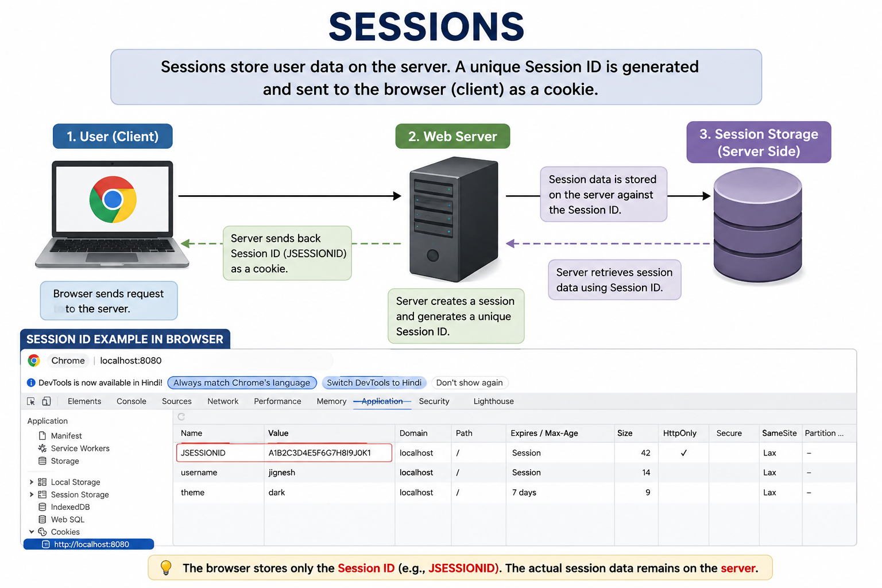
Sessions
A Session is a server-side mechanism used to store user information during interactions with a website. Instead of storing data in the browser, the data is stored on the server.
Features:
Stored on the server side.
Each session has a unique identifier called a Session ID.
More secure than cookies.
Automatically expires after a period of inactivity.
Example:
When you log in to an online banking website, the server creates a session to store your login information. As long as the session is active, you can access different pages without logging in again.

Slide 5
Cookies vs Sessions
Feature | Cookies | Sessions
Storage | Browser | Server
Security | Less | More
Speed | Fast | Moderate
Capacity | Small | Large
Lifetime | Long | Temporary

Slide 6

Security Comparison
Cookies
Can be stolen
Less secure
Sessions
More secure
Better for authentication
Conclusion
Sessions are safer than Cookies.

Slide 7
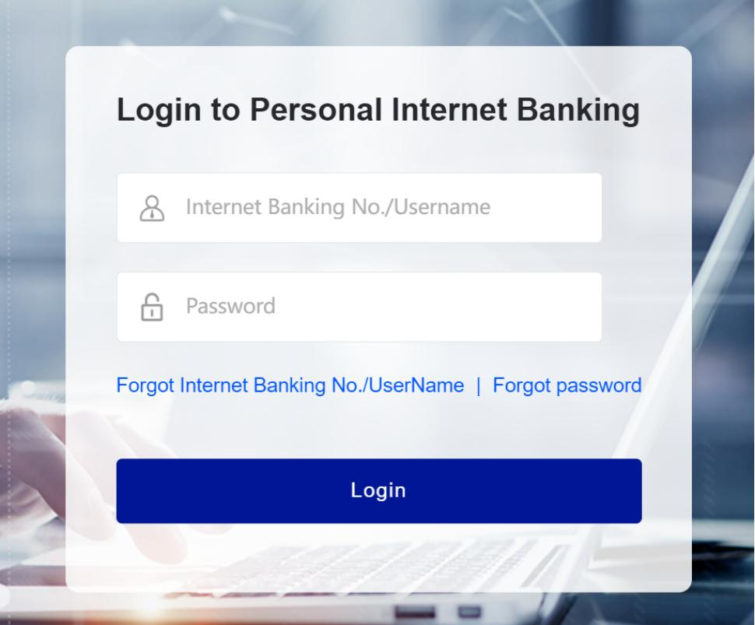
Real-Time Applications
Cookies
Language settings
Theme settings
Remember username
Sessions
Banking websites
Shopping carts
Online examinations

Slide 8
Advantages and Limitations
Cookies
Advantages:
Fast
Less server load
Limitations:
Less secure
Size limit
Sessions
Advantages:
Secure
Large storage
Limitations:
Uses server memory

Slide 9
Conclusion
Cookies store data on client side.
Sessions store data on server side.
Cookies are faster.
Sessions are more secure.
Both are important in web applications.

Slide 10

Thank You

