Slide 1
Music Genre Classification
Dataset : GTZAN, which contains 10 genres, each with 100 songs of 30 seconds each.
Input : Spectrogram images scaled to a ‘mel-scale’(MFCC)
Name : Botla Jignesh
Supervisor : Dr.Abhik Jana

Slide 2
Genre classification using supervised learning
Firstly, there are implemented supervised learning genre classification models (DNN, CNN) with different sub-categories of their implementations.
This paper mentions more supervised learning models (chapter-7) that can give better results than the existing implemented ones.
Fully Convolutional Networks (FCN) :
FCN is a deep learning strategy that consists of 4 convolution layers that helps in music tagging, in our case it is genre classification.
Hyper-parameters like epochs and learning rate set to (250, 0.0001) for the fare comparison between existing implemented models.
Based on data preparation methods, there are sub categories in FCN (without data slicing, with data slicing, with data augmentation)

Slide 3
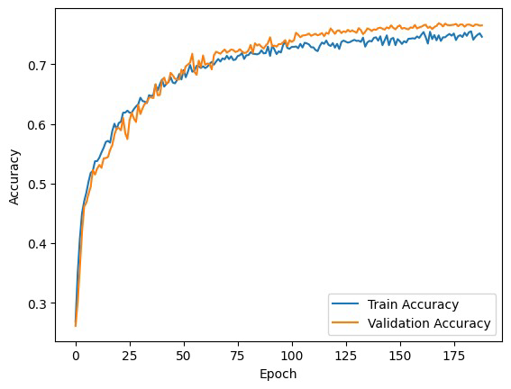
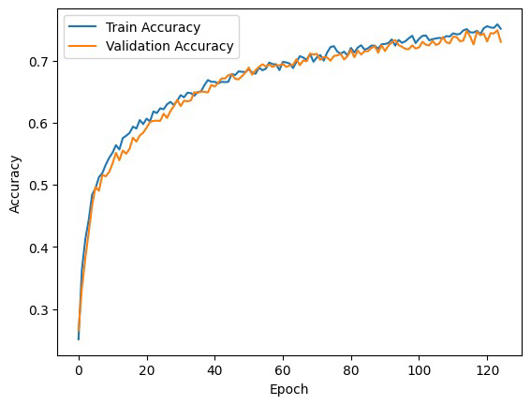
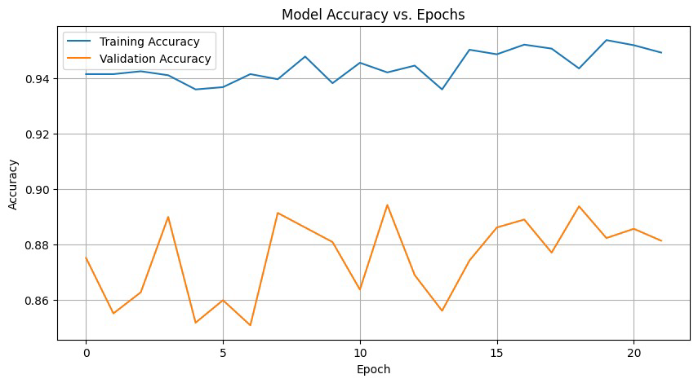
FCN with data augmentation:
To expose the model to new data we use augmentation techniques, here i have fed the reversed data(basically a reversed song) to the model to feed on new data.
The accuracy achieved here is 75 % which is more than few of the existing models.
FCN with data slicing:
As deep learning models require large data to be trained on we try to divide the each song in the dataset into 10 slices of 3 second each.
The accuracy achieved here is 75 % which is more than few of the existing models.
FCN without data slicing:
Dataset contains song of each 30 seconds is directly fed into the model by converting them into spectrograms.
The accuracy achieved here is 92.12 % which is more than all the existing models.

Slide 4
Short chunk CNN:
According to the definition mentioned in the paper i have introduced 7 convolution layers, with dense maxpooling (2,2).
Now we divide data into 3.69 second chunks each and train the model on it.
The accuracy achieved here is 81.40 % which is more than most of the existing models.
MusiCNN:
Till now we have used kernel/filter dimension as (2,2) or (3,3) but in this model we tune with different values manually and measure the model’s performance.
The accuracy achieved here is 83 % which is more than few of the existing models.
Convolutional Recurrent Neural Network(CRNN):
Combined both convolution layers, LSTM for spatial feature extraction(MFCC) and temporal dependencies(combination of CNN and RNN).
The accuracy achieved here is 83 % for 400 epochs and with learning rate of 0.0001 which is more than few of the existing models.

Slide 5
Genre classification using Semi-supervised learning
Since it is semi-supervised learning we generate pseudo-unlabeled data by augmentation process.
There are 2 models that were mentioned in the chapter-12, they are ‘Noisy student training’ and ‘knowledge expansion and distillation’.
Noisy student training(NST):
Here there will be 2 models “Teacher model” that trains on pseudo-unlabeled data and predicts the labels.
I’ve used CRNN as the “Teacher model,” which has performed decently, allowing it to predict the labels.
After the label predictions of “Teacher model” we then do training on the labeled data using “Student model”.
This brought down an accuracy of “83.38 %” for 250 epochs and with a learning rate of 0.0001 for the student model.

Slide 6
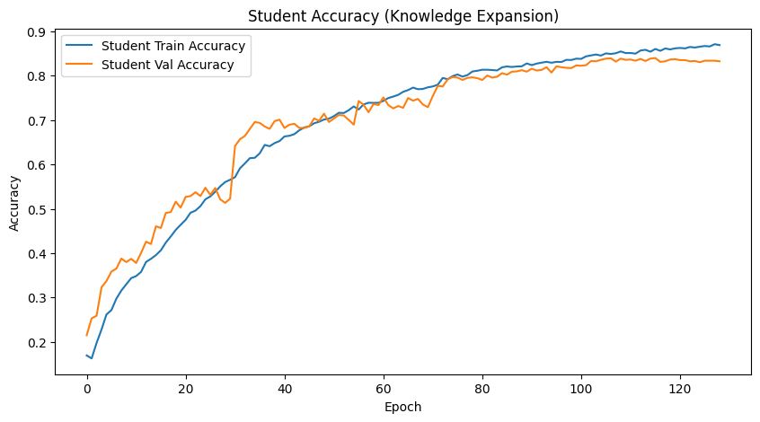
Knowledge expansion and distillation(KED):
As a continuation to the previous model we will try to expose the student model to large data(Knowledge expansion) so that it can learn more than teacher model and in more difficult environment(more noise).
Achieved an accuracy of 81.64 % for 250 epochs and with a learning rate of 0.0001.

Slide 7
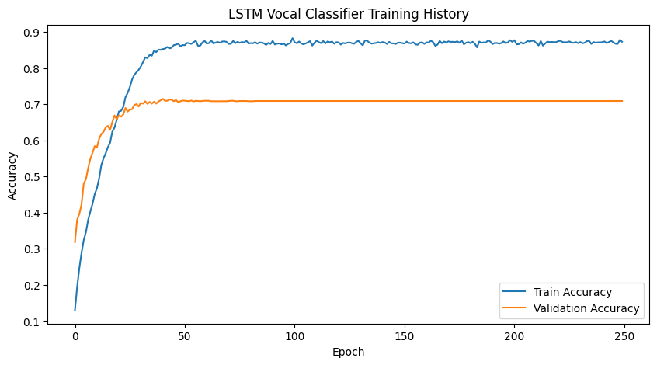
Genre classification using Ensemble learning
According to the paper for the Music information retrieval(MIR) first we need to do music feature classification.
In this case of Music genre classification, we find ‘vocal’ and ‘accompaniment’ features in each song.
LSTM model is used for vocal extraction and CNN is used for accompaniment.
LSTM model for vocal extraction:
I have introduced 2 Bidirectional LSTM layers and 4 dense layers(including output layer).
Also incremented the number of epochs to 250 and removed the Earlystopping, so that model gets trained for all epochs.

Slide 8
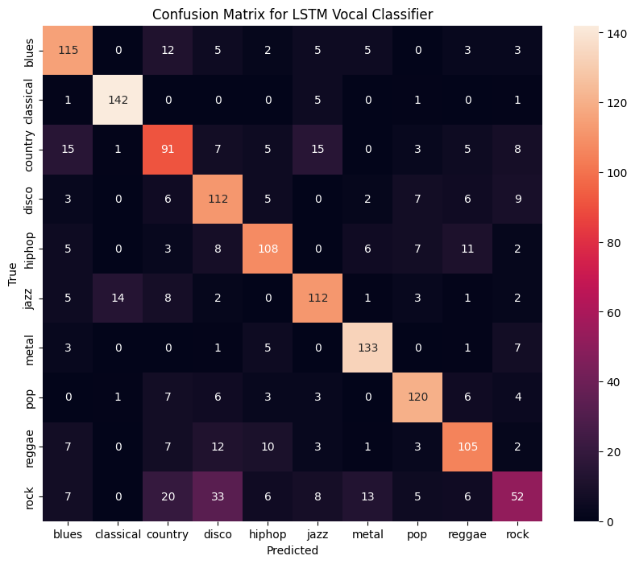
From the following confusion matrix we can get the accuracy as “72.76 %”.
$$\text{Accuracy}=\frac{\text{Sum of diagonal elements}}{\text{Sum of all elements}}$$
= ~ 72.76%
The accuracy achieved is higher than the one they achieved in the predefined model in the paper.
As of now we tried to achieve good performance in one model(LSTM) used in Ensemble learning(for vocal extraction).

Slide 9
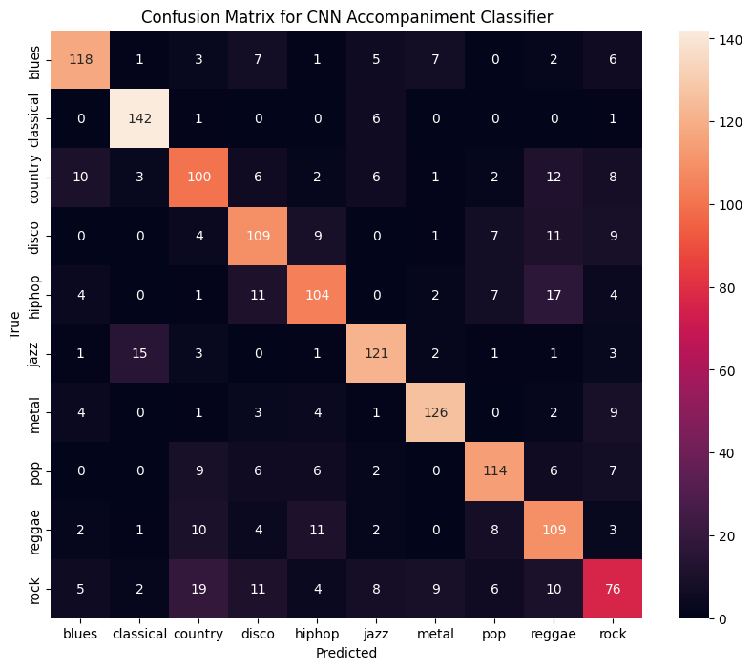
Accompaniment(CNN):
Now we need to separate instruments from music using CNN model for using it in ensemble learning.
Added 6 convolution layers and 2 dense layers to the CNN model for better learning.
From the following confusion matrix we can get the accuracy as “74.7%” which is reasonably higher performance.
Now we use both of the models for music genre classification.

Slide 10

Ensemble learning:
Here we use 2 models to improve the performance of the final classification model.
We use two methods in this learning strategy, they are bagging and Stacking.
Bagging is further divided into soft voting and mean value.
Here i have tried with different weights and used [0.33, 0.67] as weights for accompaniment and vocal.
Used 6 dense layers(including output layer) for DNN and achieved an accuracy of “80.84%” for 400 epochs

Slide 11

References
Minz Won, Janne Spijkervet, Keunwoo Choi "Music Classification: Beyond Supervised Learning, Towards Real-world Application"
Yichen Liu, Abhijit Dasgupta, Qiwei He “Music Genre Classification: Ensemble Learning with Subcomponents-level Attention”
https://github.com/crlandsc/Music-Genre-Classification-Using-Convolutional-Neural-Networks/tree/main
NOTE :
Since all the trained models are saved, let’s utilize them to deploy a web application. This application will take a song as input and prompt the user to select a specific learning strategy. Once the song is uploaded, it will be processed, and MFCC features will be extracted. These features will then be the input to the models, and the output will be the genre name.
Here’s the link to the web application: https://jigneshbotla-music-genre-classification-app-i0kjjk.streamlit.app/

