Slide 1
DOCKER IMAGE CONTAINER FOR ML MODEL

Slide 2
STEPS:
First we need to download the docker from below link
https://docs.docker.com/desktop/windows/install/
And also download the Linux kernel update package
https://wslstorestorage.blob.core.windows.net/wslblob/wsl_update_x64.msi

Slide 3
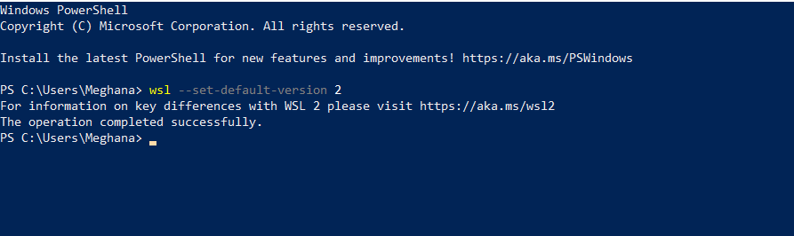
Open the windows PowerShell and run the following command
wsl --set-default-version 2

Slide 4
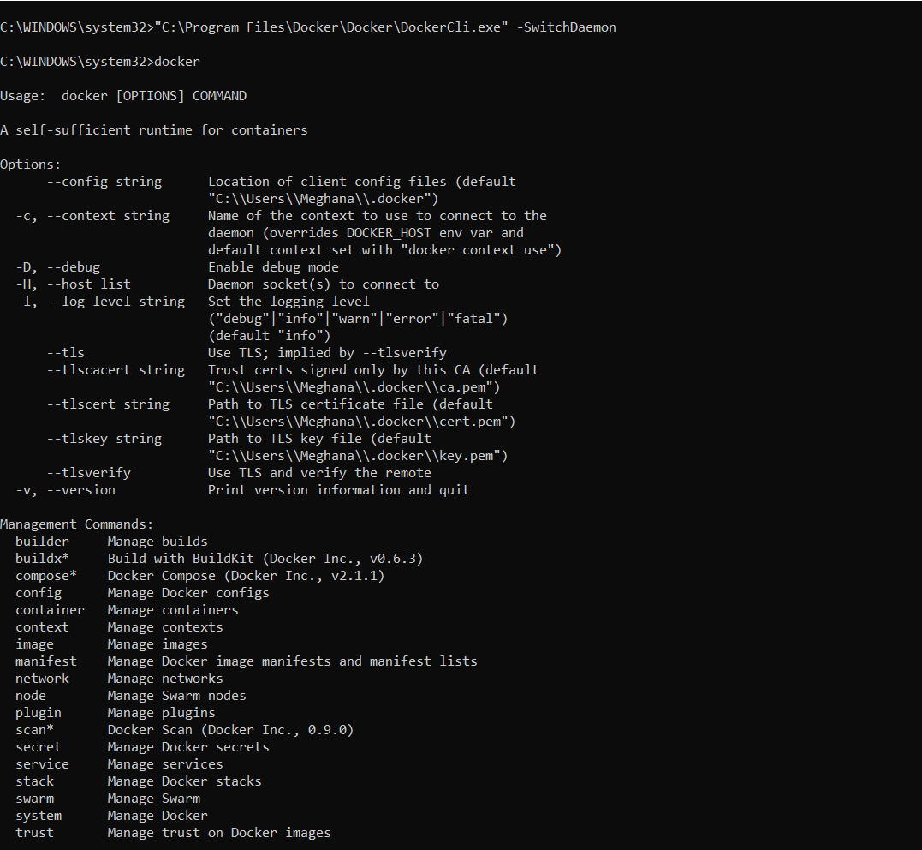
To switch to the docker
Open command prompt as administrator
Launch command: "C:\Program Files\Docker\Docker\DockerCli.exe" -SwitchDaemon
(Mention the DockerCli.exe path

Slide 5
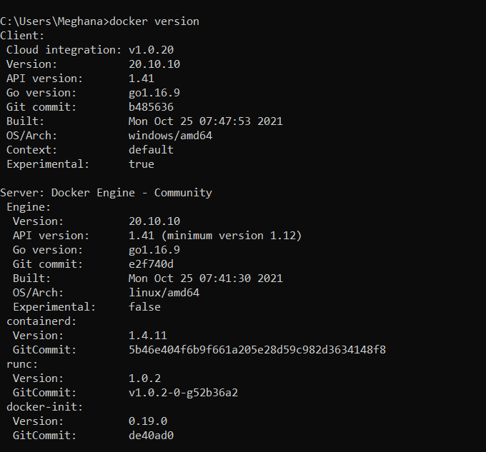
check the docker version in command prompt as: docker version

Slide 6
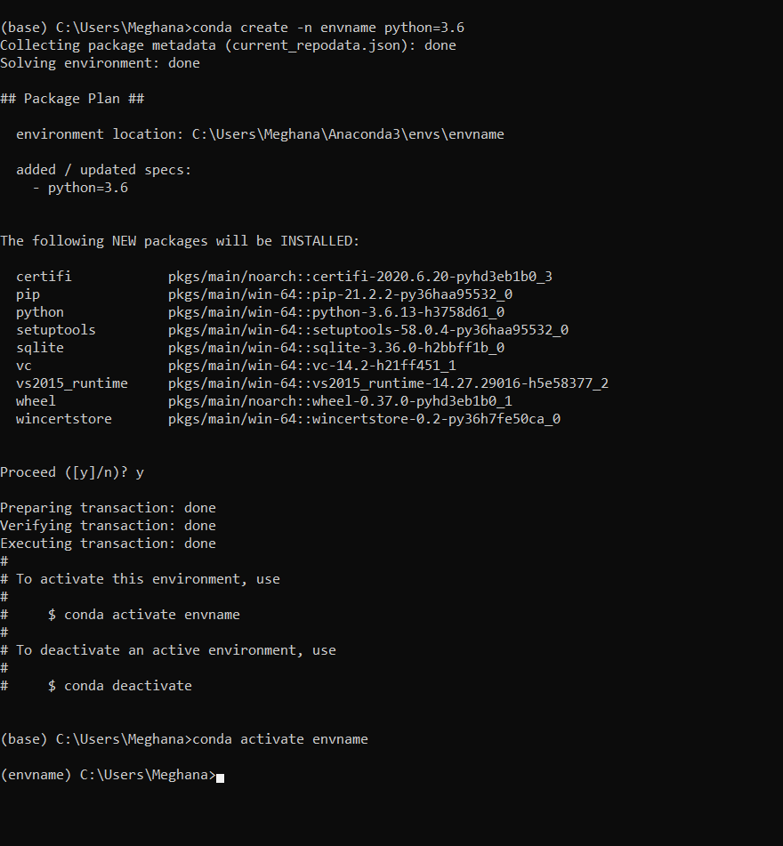
Next, open anaconda prompt and create a new environment
conda create –n envname python=3.6
After creating the new environment we need to activate it.
conda activate envname

Slide 7
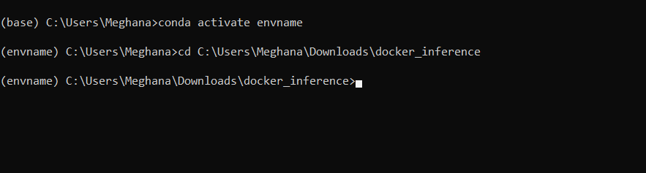
And change the path where the folder we need run.
cd C:\Users\Meghana\Downloads\docker_inference
Install the required installments using
pip install –r requirements.txt

Slide 8
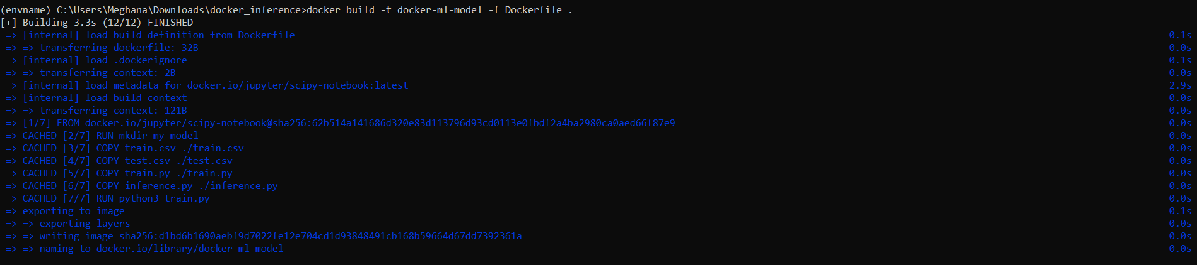
After installing the required packages, in order to build the image, we run the following command
docker build -t docker-ml-model -f Dockerfile .
The output is as following:

Slide 9
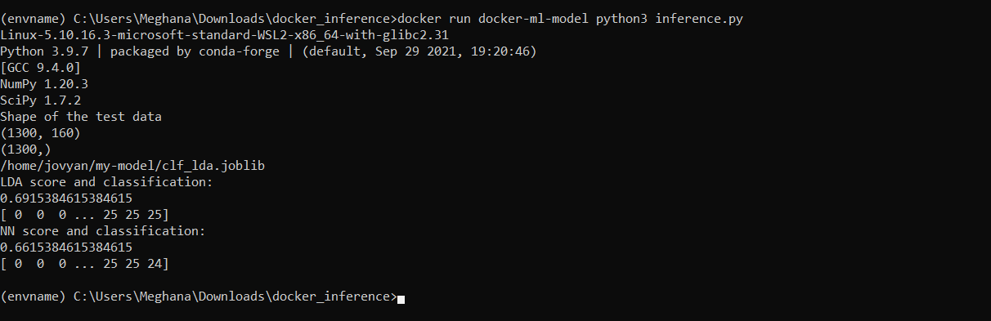
To perform the inference on new data (test.csv), we need to run the following command:
docker run docker-ml-model python3 inference.py
When we make any changes in the .py files, we need to build the dockerfile again.

Slide 10
References:
https://link.medium.com/YiO306LNwlb
https://github.com/xaviervasques/Online_Inference
https://github.com/xaviervasques/EEG-letters

